Slide 1

Axial Spa for Physiotherapists Webinar
Hosted by CSP West Midlands RN
@WestMidlandsCSP

Slide 2
Housekeeping
Please put mics to mute
Presentations from this session are being recorded and will be shared afterwards via the email you used to register for this event as well as on the CSP West Midlands web page - www.csp.org.uk/networks/nations-regions/west-midlands
https://www.csp.org.uk/networks/associates-support-workers
Please use the chat box to ask questions of the presenters, which we will then answer at the Q&A session at the end. Please note that we will stop the recording once the Q&A starts.

Slide 3
Agenda
7:05pm “What is Axial SpA?” – Karen Morley-Williams
7:10 “NASS: Achieving the gold standard to reduce diagnostic delay to 1 year” – Dale Webb
7:30 “Recognition of Axial SpA and diagnostic delay in primary care” – William Gregory
7:50 “Management of Axial SpA” – Steph Cliffe, Karen Morley-Williams and Lucy McCann
8:15 Questions to the presenter panel
8:30 Thank you and Close

Slide 4


What is Axial SpA?
Karen Morley-Williams – Spinal and Rheumatology Advanced Practice Physiotherapist

Slide 5


Slide 6
Axial SpA
Chronic Inflammatory condition which predominantly affects the axial skeleton characterised by pain and stiffness of the spine, fatigue and enthesitis. Can also experience peripheral symptoms.
Typically presents under the age of 45 (more suspicious if under 35)
1:1 male:female ratio
Its cause is unknown although, thought to be triggered by an autoimmune response and there is a strong family link.
It is closely associated with other inflammatory conditions
Notes:
This is a repeated process of inflammation occurring at the site the ligaments or tendons attach to the bone causing erosion. As the inflammation reduces the healing produces bone. In the spine this eventually produces syndesmophytes.

Slide 7
Axial SpA features
Inflammatory back pain – morning stiffness either severe or > 30 mins, night waking (usually 2nd half), worse with rest and better with activity
Arthritis
Enthesitis (heel)
Uveitis
Dactylitis – sausage digits
Psoriasis
IBD
Positive NSAID response
Family history of SpA
HLA-B27 link (but not always)
Raised CRP (but not always)

Slide 8
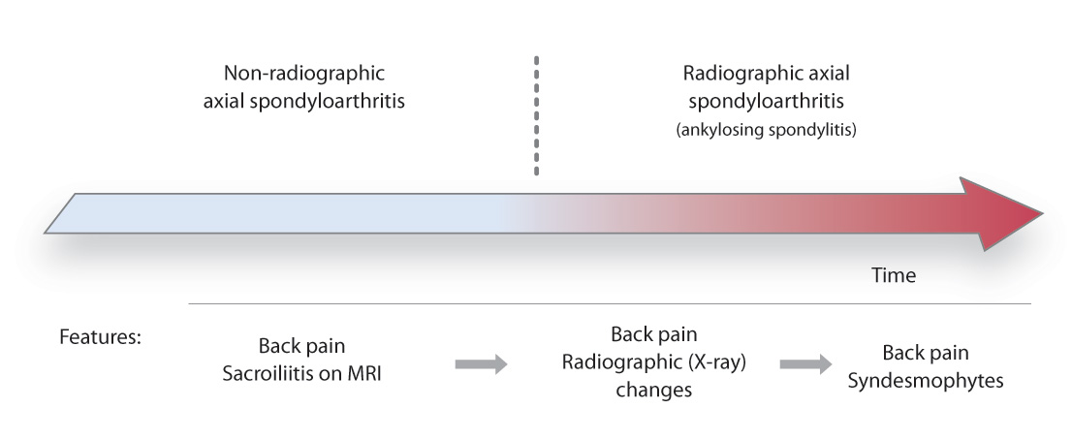

Slide 9
Patterns of joint involvement
Axial SpA
Axial involvement -
Sacroiliac joint
Asymmetric peripheral joint involvement:
Hip 40%
Shoulder 40%
Peripheral joints 25%
Small hand joints rarely
Relative sparing of small hand joints
Enthesitis – insertion tendon/ligt/joint capsule into bone:
Plantar fasciitis
Achilles tendonitis
Trochanteric bursitis
Medial/lateral epicondylitis

Slide 10
Dale Webb
CEO NASS

Slide 11





Recognition of Axial SpA and diagnostic delay in primary care
Will GREGORY, Consultant Physiotherapist
Salford Royal Hospital, Northern Care Alliance NHS Foundation Trust
CSP West Midands RN Monday 8 July @PhysioWillGreg @RheumPhysioUK

Slide 12
Agenda
Screening
The relevance of screening for Axial Spondyloarthritis in musculoskeletal assessment.
Delay to Δ
The global issue of delayed diagnosis and the importance of early recognition of axial spondyloarthritis.
Patient story
A framework
Perspectives on the impact of axial spondyloarthritis and of delayed diagnosis.
The PT role in management of Axial Spondylitis from pre-diagnosis to long-term management.
A pathway
An overview of the Rheumatology Physiotherapy Specialist Capabilities Framework: Screening in Musculoskeletal Settings

Slide 13

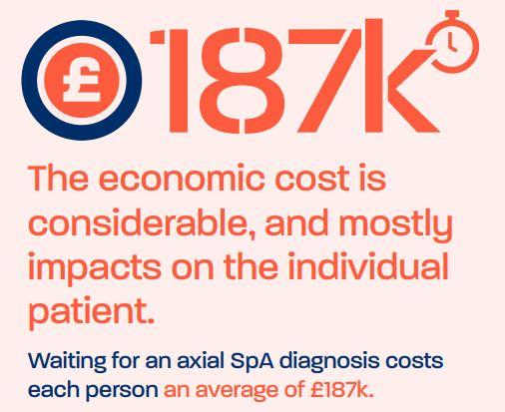
Why screen for Axial SpA?
Young age of onset for most
->impact on career, family, productivity.
Hidden within broader chronic LBP.
Costs to the individual & the economy.
Once diagnosed:
medications can be lifechanging
exercise is anti-inflammatory

Slide 14
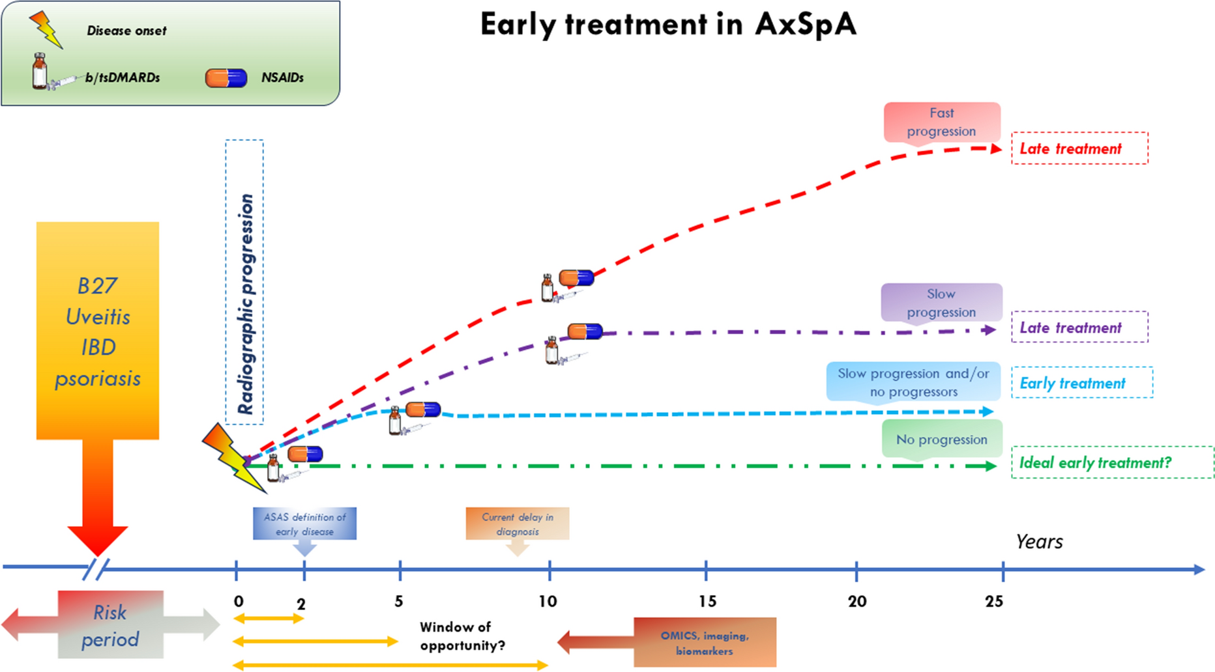
Mauro, D., Forte, G., Poddubnyy, D. et al. The Role of Early Treatment in the Management of Axial Spondyloarthritis: Challenges and Opportunities. Rheumatol Ther 11, 19–34 (2024). https://doi.org/10.1007/s40744-023-00627-0

Slide 15
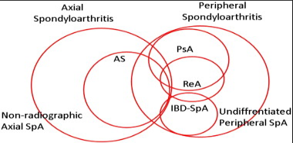
CSP West Midands RN Monday 8 July @PhysioWillGreg

Slide 16
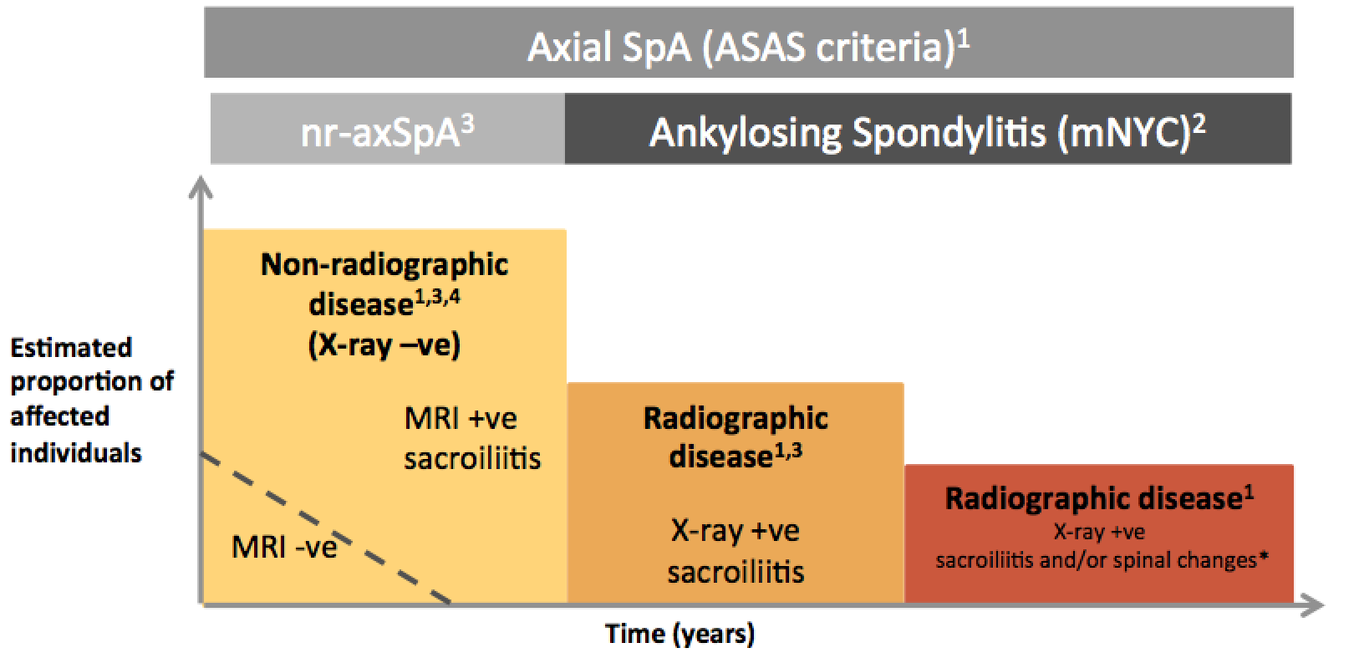
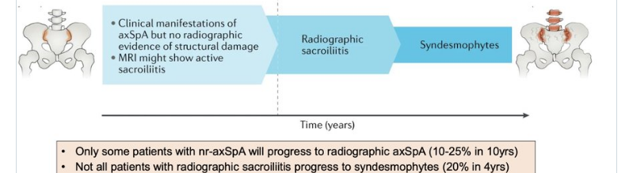

Slide 17
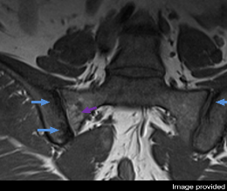
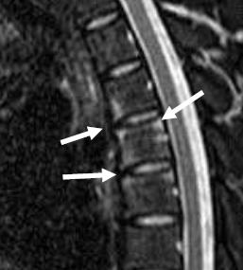
Progression of nr-axSpA to AS
Non-radiographic axial spondyloarthritis
Progress to
Not all patients progress to AS¹
ankylosing spondylitis
 | 0–2 years^{1,2} | 2–9 years^{1,3–7} | ≥10 years^{1,5}
% progression | 8–12% | 20–52% | 36–59%
Duration of disease
1Sampaio-Barros P et al. J Rheumatol. 2010; 37:1195–1199; 2Poddubnyy D et al. Ann Rheum Dis. 2011;70:1369–1374; 3Schattenkirchner M et al. Clin Rheumatol. 1987;6(Suppl 2):83–86; 4Sany J et al. Arthritis Rheum. 1980;23(2):258–259; 5Mau W et al. J Rheumatol. 1988;15:1109–1114; 6Oostveen J et al. J Rheumatol. 1999;26:1953–1958; 7Bennett A et al. Arthritis Rheum. 2008;58(11):3413–3418. 8Haibel H et al. Arthritis Rheum. 2008;58:1981–1991.
Notes:
It is important to remember that the rate of disease progression from nr to r (or AS) is variable whereby 10 years after diagnosis less than 50% will have progressed to develop structural changes evident on xray. This therefore emphasises the importance of undertaking MRI when attempting to establish a diagnosis of AxSpA especially in early disease.
¹Sampaio-Barros P et al. J Rheumatol. 2010; 37:1195–1199; ²Poddubnyy D et al. Ann Rheum Dis. 2011;70:1369–1374; ³Schattenkirchner M et al. Clin Rheumatol. 1987;6(Suppl 2):83–86; ⁴Sany J et al. Arthritis Rheum. 1980;23(2):258–259; ⁵Mau W et al. J Rheumatol. 1988;15:1109–1114; ⁶Oostveen J et al. J Rheumatol. 1999;26:1953–1958; ⁷Bennett A et al. Arthritis Rheum. 2008;58(11):3413–3418. ⁸Haibel H et al. Arthritis Rheum. 2008;58:1981–1991.

Slide 18
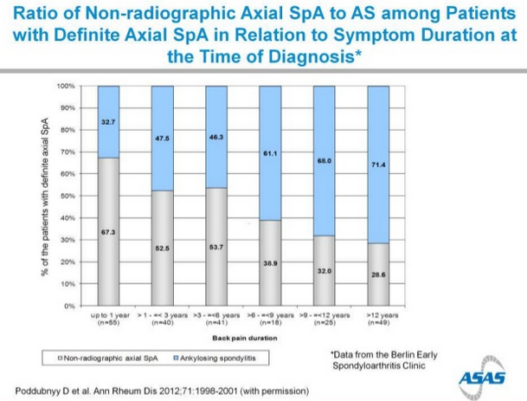
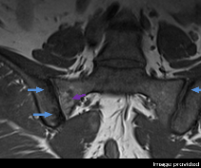
Ank Spond
Non-radiographic axial SpA
<1yr
1-3yrs
3-6yrs
6-9yrs
9-12yrs
>12yrs
CSP West Midands RN Monday 8 July @PhysioWillGreg

Slide 19
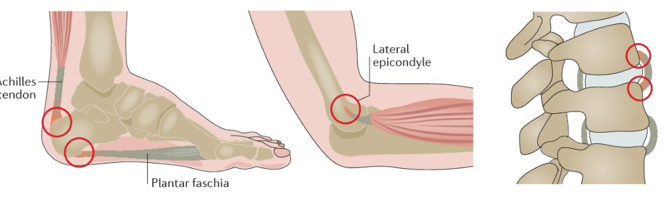
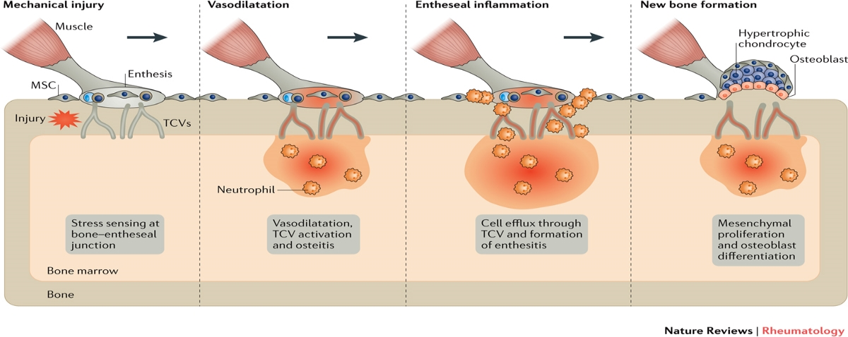
Axial SpA - pathophysiology: Enthesitis
Images: Schett, G. et al. (2017) Enthesitis: from pathophysiology to treatment Nat. Rev. Rheumatol. doi:10.1038/nrrheum.2017.188

Slide 20
DELAY TO DIAGNOSIS

Slide 21
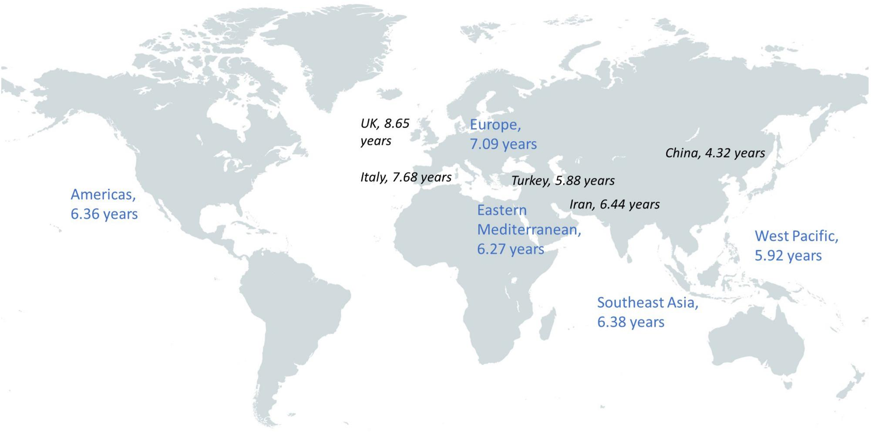
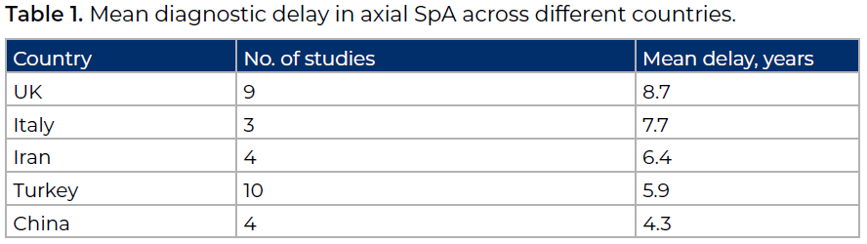
Barnett, Gaffney & Sengupta 2023 Diagnostic delay in axial spondylarthritis: A lost battle? Best Practice & Research Clinical Rheumatology37(3) https://doi.org/10.1016/j.berh.2023.101870
CSP West Midands RN Monday 8 July @PhysioWillGreg

Slide 22
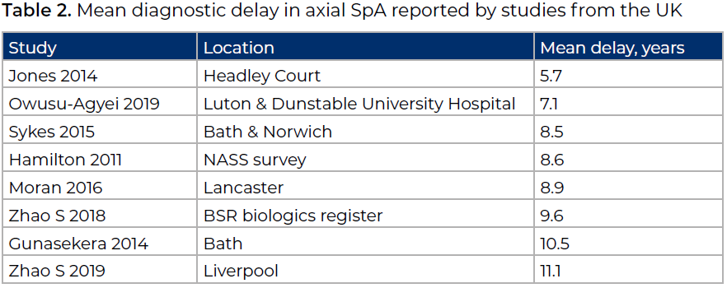
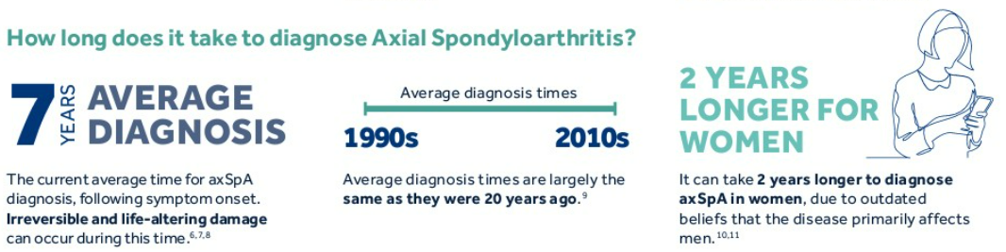
https://asif.info/delay-to-diagnosis-report/

Slide 23
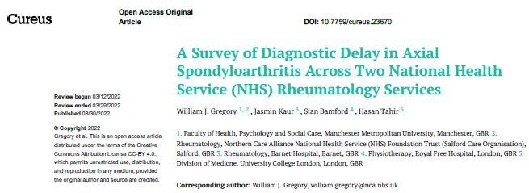
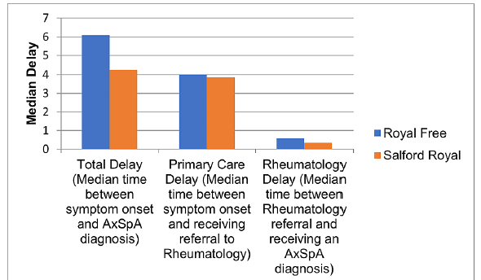

Slide 24
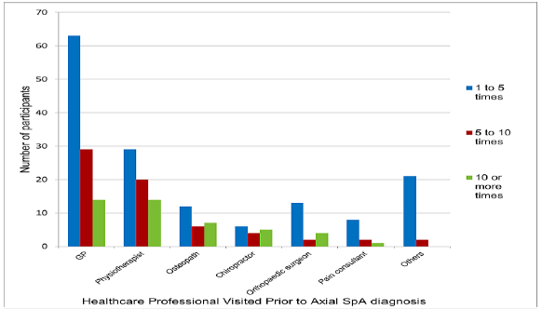


Slide 25
62 out of 102 saw a physiotherapist pre-diagnosis (61%)

Slide 26


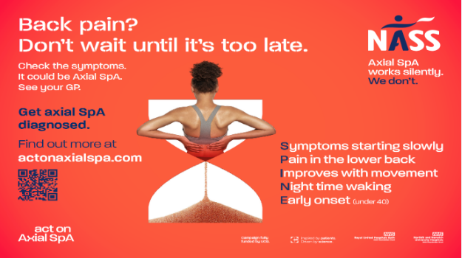

Slide 28

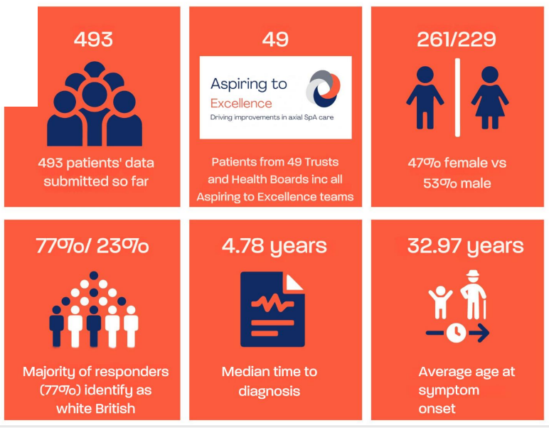

Slide 29
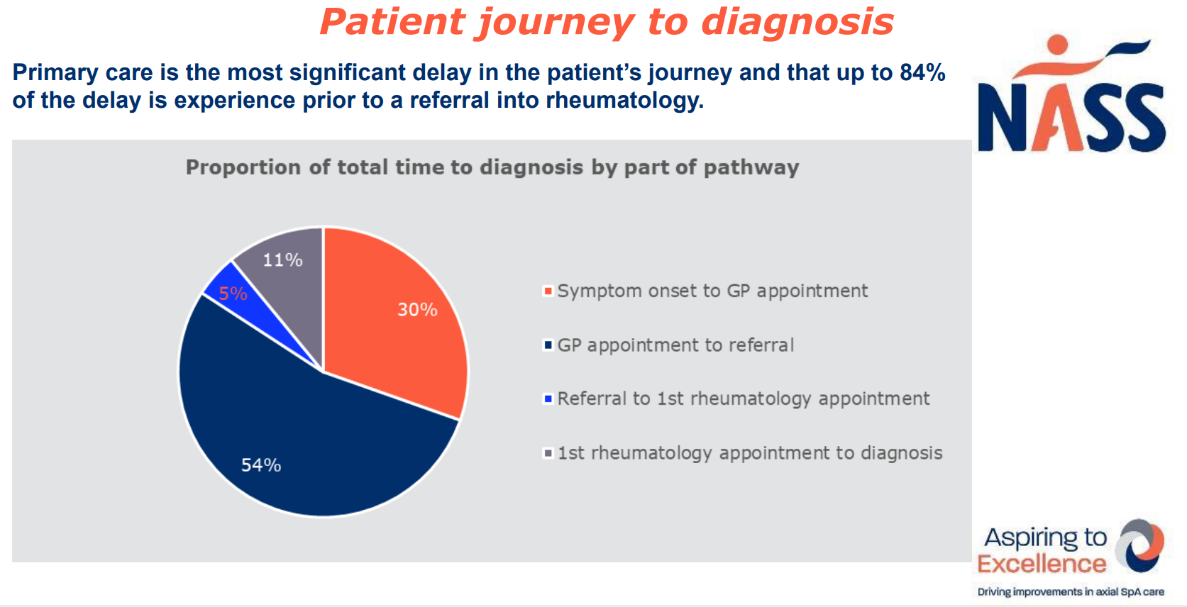

Slide 30
SOLUTIONS?

Slide 31
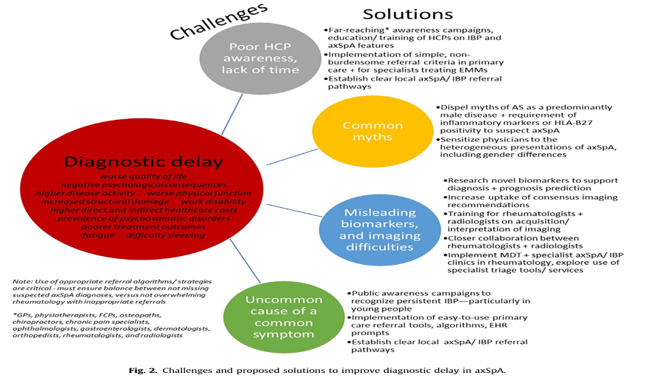
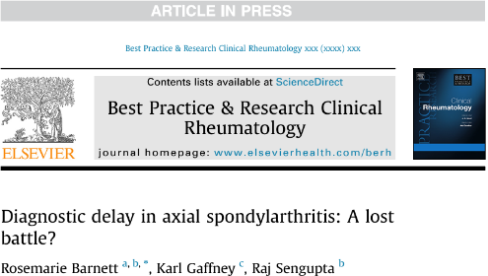
Barnett, Gaffney & Sengupta 2023 Diagnostic delay in axial spondylarthritis: A lost battle? Best Practice & Research Clinical Rheumatology37(3) https://doi.org/10.1016/j.berh.2023.101870

Slide 32



Fostering national change: frameworks

Slide 33
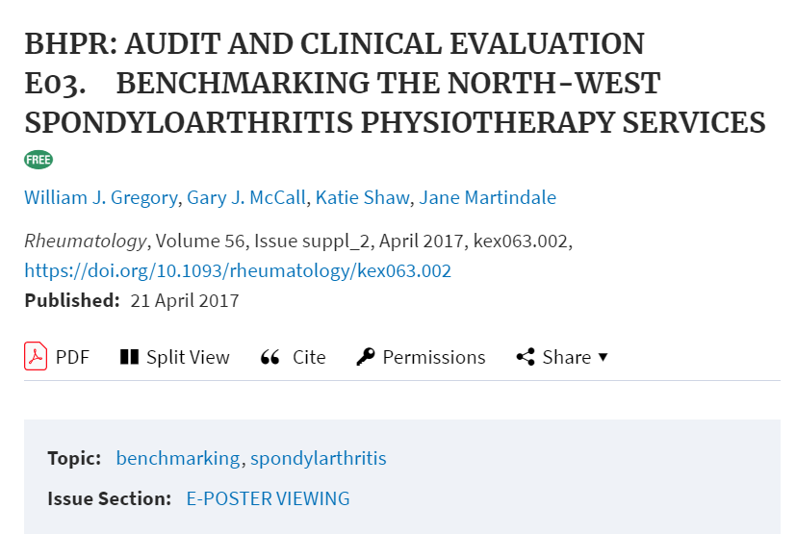
Background
ASSIGNw Benchmarking project ¹ inconsistency in Rheumatology Physiotherapy provision, settings, experience.
1.Gregory et al. 2016 ASSIGN Group; 2. Ndosi, et al (2017). National variation in the composition of rheumatology multidisciplinary teams Rheum int, 37(9), 1453-14595. 3 NEIAA (2019) Annual Report 4. Recommendations | Rheumatoid | Guidance | NICE 5. Overview | Spondyloarthritis in over 16s: | Guidance | NICE 6. 2019 EULAR ard.bmj.com/content/79/1/53 7. Gregory et al. (2021), National survey of the current clinical practices Musc Care, https://doi.org/10.1002/msc.1516
CSP West Midands RN Monday 8 July @PhysioWillGreg

Slide 34
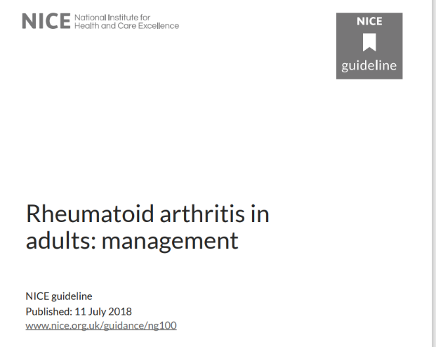
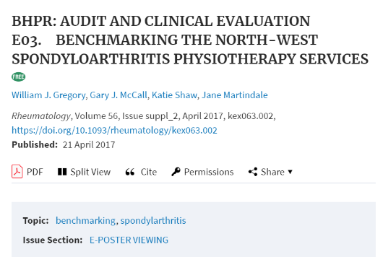
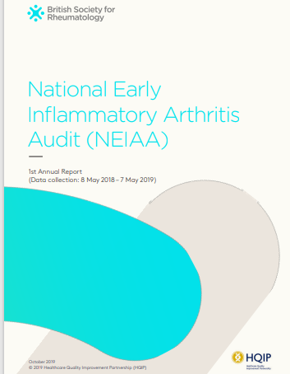
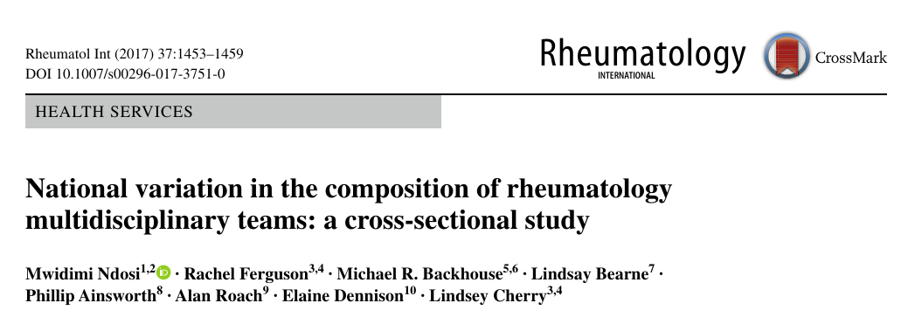
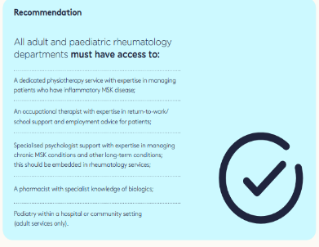
Background
ASSIGNw Benchmarking project ¹ inconsistency in Rheumatology Physiotherapy provision, settings, experience.
NICE Guidance and QS ^{4,5} recommendations for 'specialist physiotherapist’ - but with no definition/description.
National variation in compositions of rheumatology MDTs ^{2,3}
NEIAA (2019)³ - only 50% of centres had access to specialist rheumatology physio, and 7% declare no access to any physiotherapy.
1.Gregory et al. 2016 ASSIGN Group; 2. Ndosi, et al (2017). National variation in the composition of rheumatology multidisciplinary teams Rheum int, 37(9), 1453-14595. 3 NEIAA (2019) Annual Report 4. Recommendations | Rheumatoid | Guidance | NICE 5. Overview | Spondyloarthritis in over 16s: | Guidance | NICE 6. 2019 EULAR ard.bmj.com/content/79/1/53 7. Gregory et al. (2021), National survey of the current clinical practices Musc Care, https://doi.org/10.1002/msc.1516
CSP West Midands RN Monday 8 July @PhysioWillGreg

Slide 35
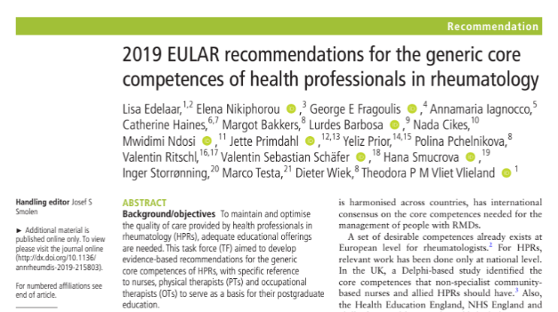
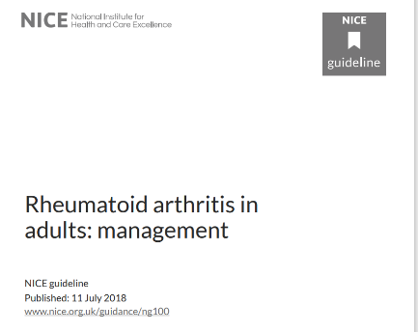

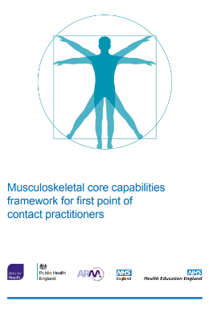
Background
ASSIGNw Benchmarking project ¹ inconsistency in Rheumatology Physiotherapy provision, settings, experience.
NICE Guidance and QS ^{4,5} recommendations for 'specialist physiotherapist’ - but with no definition/description.
National variation in compositions of rheumatology MDTs ^{2,3}
NEIAA (2019)³ - only 50% of centres had access to specialist rheumatology physio, and 7% declare no access to any physiotherapy.
EULAR generic core competencies of HPs in Rheum⁵
No competency guidance found defining rheumatology specialist practice, standards, evaluation, training and career progression
Lack of support for Rheumatology physiotherapy workforce.
Essential role of screening– core Rheum capabilities in MSK & First Contact Practitioner fields
1.Gregory et al. 2016 ASSIGN Group; 2. Ndosi, et al (2017). National variation in the composition of rheumatology multidisciplinary teams Rheum int, 37(9), 1453-14595. 3 NEIAA (2019) Annual Report 4. Recommendations | Rheumatoid | Guidance | NICE 5. Overview | Spondyloarthritis in over 16s: | Guidance | NICE 6. 2019 EULAR ard.bmj.com/content/79/1/53 7. Gregory et al. (2021), National survey of the current clinical practices Musc Care, https://doi.org/10.1002/msc.1516
CSP West Midands RN Monday 8 July @PhysioWillGreg

Slide 36
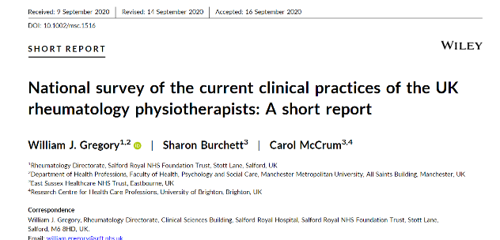
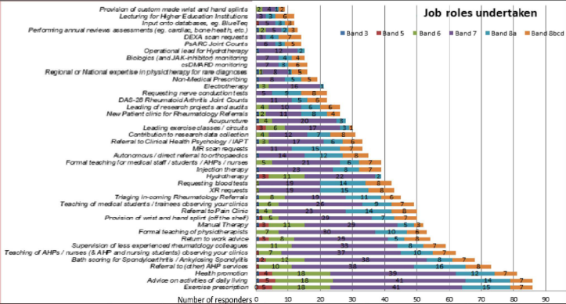



Development of the Framework
Stage 1: INVITATION (i) three lead authors (ii) those who completed the Oct ’19 UK Survey of Rheum PT clinical practice¹
- V1 drafted from survey results + Lit Rv + shared local competency docs – 465 capability statements
1 Gregory, W.J., Burchett, S. and McCrum, C. (2021), National survey of the current clinical practices of the UK rheumatology physiotherapists: A short report. Musculoskeletal Care, 19: 136-141. https://doi.org/10.1002/msc.1516
CSP West Midands RN Monday 8 July @PhysioWillGreg

Slide 37
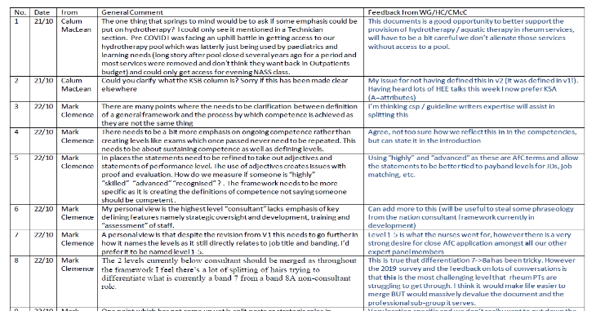
Development of the Framework
Stage 1: INVITATION (i) three lead authors (ii) those who completed the Oct ’19 UK Survey of Rheum PT clinical practice¹
- V1 drafted from survey results + Lit Rv + shared local competency docs – 465 capability statements
Stage 2: V1 - shared 25 Rh physios (B6-B8, 4 nations) > 1000 comments
Stage 3: V2 -Comments amalgamated into V2 & informed supporting narrative
1 Gregory, W.J., Burchett, S. and McCrum, C. (2021), National survey of the current clinical practices of the UK rheumatology physiotherapists: A short report. Musculoskeletal Care, 19: 136-141. https://doi.org/10.1002/msc.1516
CSP West Midands RN Monday 8 July @PhysioWillGreg

Slide 38

Development of the Framework
Stage 1: INVITATION (i) three lead authors (ii) those who completed the Oct ’19 UK Survey of Rheum PT clinical practice¹
- V1 drafted from survey results + Lit Rv + shared local competency docs – 465 capability statements
Stage 2: V1 - shared 25 Rh physios (B6-B8, 4 nations) > 1000 comments
Stage 3: V2 -Comments amalgamated into V2 & informed supporting narrative
Stage 4: V3 - Invited expert Rh Physio group provided comment & ratification- Likert-lite agreement rating on each capability.
Stakeholders, external review group, HEI, BSR, CSP & MDT group comments informed final document
Launched: 30 Sept 2021
1 Gregory, W.J., Burchett, S. and McCrum, C. (2021), National survey of the current clinical practices of the UK rheumatology physiotherapists: A short report. Musculoskeletal Care, 19: 136-141. https://doi.org/10.1002/msc.1516
CSP West Midands RN Monday 8 July @PhysioWillGreg

Slide 39

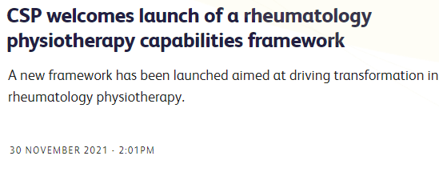

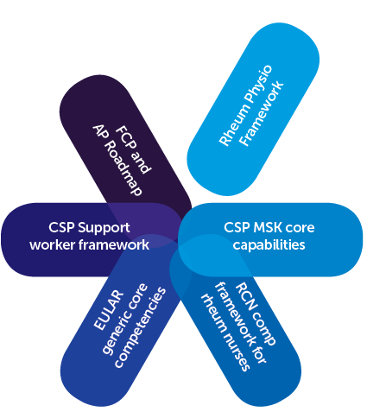
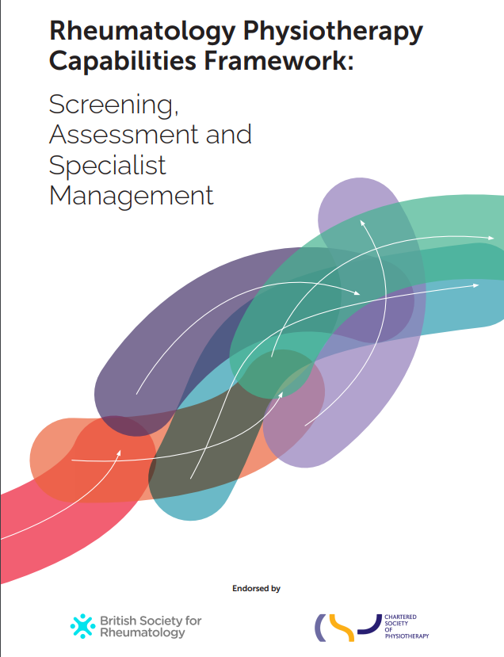
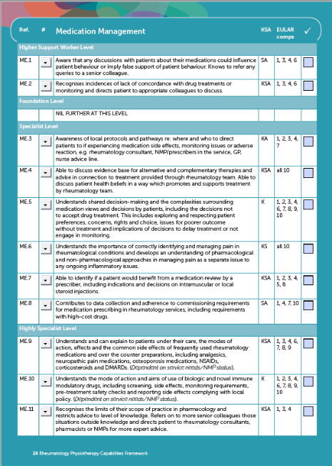
CSP West Midands RN Monday 8 July @PhysioWillGreg

Slide 40
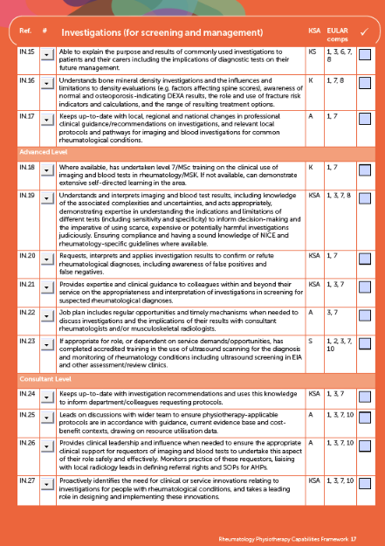
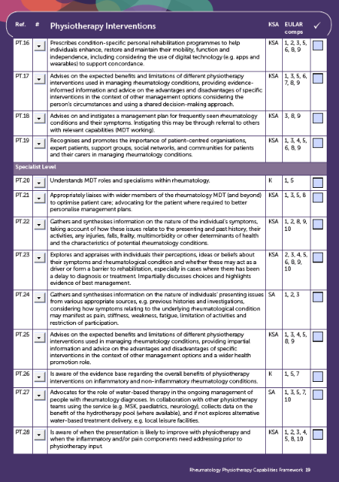
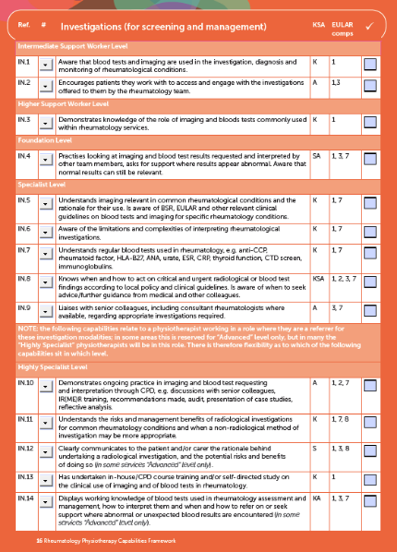
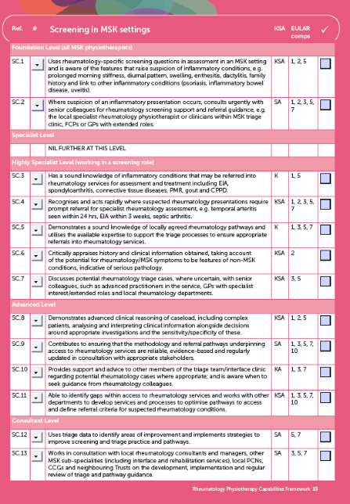
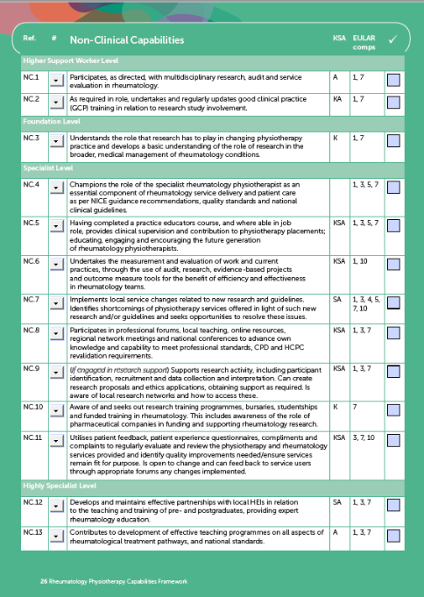
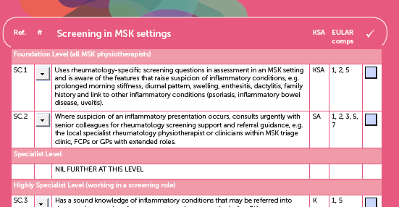
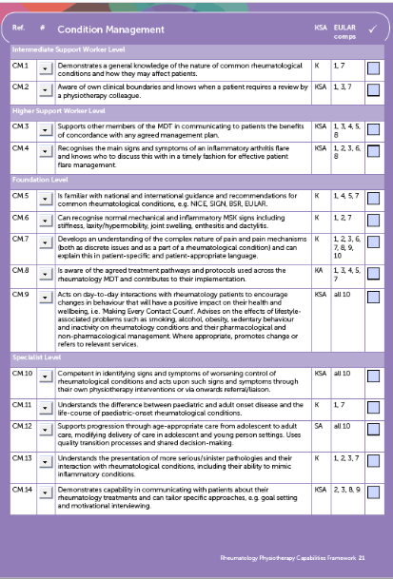
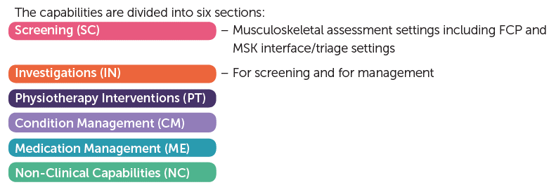
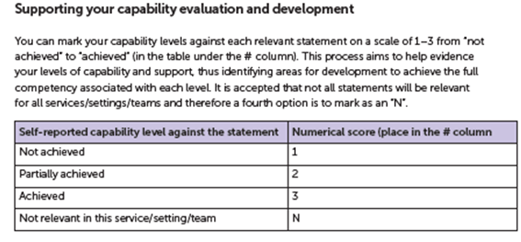

CSP West Midands RN Monday 8 July @PhysioWillGreg

Slide 41

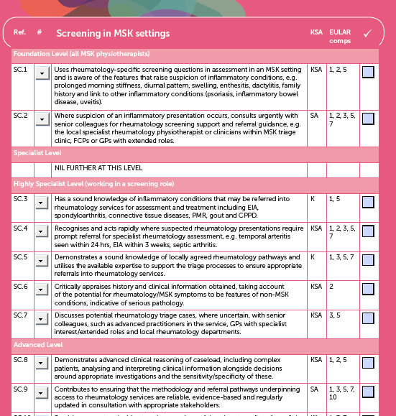

SpA relevance
https://www.rheumatology.org.uk/news/details/new-framework-launched-drive-transformation-rheumatology-physiotherapy

Slide 42
PATHWAYS TO PROGRESS

Slide 43

CSP West Midands RN Monday 8 July @PhysioWillGreg

Slide 44

CSP West Midands RN Monday 8 July @PhysioWillGreg

Slide 45
CSP West Midands RN Monday 8 July @PhysioWillGreg

Slide 46
CSP West Midands RN Monday 8 July @PhysioWillGreg

Slide 47


Slide 48
TOMORROWS CLINIC

Slide 49

Suspecting Axial SpA - Physical Assessment
Guidance on Spondyloarthritis – recognition and referral
CSP West Midands RN Monday 8 July @PhysioWillGreg

Slide 50

When to Suspect Axial SpA
- cluster of features for Inflammatory Back Pain^{1 ,2}
Insidious onset
Onset before 45 yrs – onset < 35 yrs ↑ suspicion
Buttock pain - alternating buttock pain ↑ suspicious
Woken second half of night because of back pain
  Improvement with movement and activity /No improvement with rest
      Responsive to NSAIDs (usually within 48 hrs)
      Prolonged morning stiffness - >30 min- 1-2 hrs
  - more features -> ↑ suspicion
1. Assessment in SpondyloArthritis international Society
2. Poddubnyy, The Journal of rheumatology, 38(11), 2452-2460.
CSP West Midands RN Monday 8 July @PhysioWillGreg

Slide 51
Agenda
Screening
The relevance of screening for Axial Spondyloarthritis in musculoskeletal assessment.
Delay to Δ
The global issue of delayed diagnosis and the importance of early recognition of axial spondyloarthritis.
Patient story
A framework
Perspectives on the impact of axial spondyloarthritis and of delayed diagnosis.
The PT role in management of Axial Spondylitis from pre-diagnosis to long-term management.
A pathway
An overview of the Rheumatology Physiotherapy Specialist Capabilities Framework: Screening in Musculoskeletal Settings
CSP West Midands RN Monday 8 July @PhysioWillGreg

Slide 52
Recognition of Axial SpA and diagnostic delay in primary care
Will GREGORY, Consultant Physiotherapist
Salford Royal Hospital, Northern Care Alliance NHS Foundation Trust
CSP West Midands RN Monday 8 July @PhysioWillGreg @RheumPhysioUK

Slide 53

Management of Axial SpA
July 2024
Steph Cliffe – MSK and Rheumatology APP
Karen Morley-Williams – MSK and Rheumatology APP
Lucy McCann – MSK APP and FCP

Slide 54

Recommendations | Spondyloarthritis in over 16s: diagnosis and management | Guidance | NICE

Slide 55

Rheumatology-Axial-Spondyloarthritis-Pathway.pdf (gettingitrightfirsttime.co.uk)

Slide 56


Slide 57
Rheumatology appointments
Check disease activity – BASDAI and pain score
Annual check of BASMI – movement measurements
Changes to medication, escalation of management as needed
Advice for specific problems, signposting to relevant resources
Injections if needed
Blood tests if on regular NSAIDs
Not all parts of the country have a dedicated Axial SpA service or specialist Rheumatologist physiotherapists – bit of a postcode lottery!

Slide 58
Axial SpA management
Exercise
Flare management
Fatigue management
Medication
Self-management
Patient support groups

Slide 59
Medications
NSAIDs
Analgesia
DMARDs for peripheral disease
Biologics
Injections – joint/soft tissue/IM

Slide 60

NSAIDs
Usually first line treatment for most
Should be with regular PPI cover (eg. Omeprazole or something similar)
Needs regular blood monitoring – renal function
Recommendations | Spondyloarthritis in over 16s: diagnosis and management | Guidance | NICE
Painkillers and NSAIDs | Side-effects, uses, time to work (versusarthritis.org)

Slide 61
DMARDs
Only helpful in peripheral disease in Axial SpA
Prescribed by Rheumatologist
Usually tablet or injection
Consideration of lifestyle and circumstances (alcohol, pregnancy), co-morbidities (uveitis, psoriasis, IBD), disease characteristics and possible side effects
Regular blood test monitoring

Slide 62
Biologics/biosimilars
Helpful for both axial and peripheral disease
Prescribed by Rheumatologist if certain criteria reached (in AxSpA, BASDAI >4 and spinal pain score >4, exhausted NSAIDs or contraindicated)
Significant screening before starting – TB, hepatitis, HIV, chest XR
Usually injection or infusion
Different types target different parts of the immune system – immunosuppressive response
Efficacy checked between 3-6/12 (drug dependent) to see if can continue or need to change
Choice depends on diagnosis, co-morbidities, extra-articular manifestations
Blood tests regularly
Approved list on NICE guideline for Axial SpA
Consider secondary non-response if disease activity increasing

Slide 63
Injections
Intra-articular or soft tissue steroid injections
  if one or two areas are inflamed for period of time then may be appropriate
  if more than this may need review of management overall
  if symptoms return after steroid injection, may need change of medication management
IM depomedrone:
  can help with axial and peripheral disease
  Considered with more widespread inflammatory activity
  can be useful to assess response to see if active inflammation or other causes of pain
  sometimes is enough to dampen inflammatory drive to allow other medications to kick in

Slide 64
Exercise
Stretching
Strengthening
Posture/spinal extension
Hydrotherapy
CV exercise
Balance

Slide 65
Exercise considerations…
Time of day
Ideally get a mix of exercise
Fatigue levels
Graded increase if not use to exercising regularly or coming out of flare
Embed into daily life
Do something enjoyable!
Deep breathing exercises
Addressing fears/worries

Slide 66
Exercise
Online resources:
  Back-to-Action for editing.pdf (nass.co.uk)
  Stretches for your daily life | National Axial Spondyloarthritis Society (nass.co.uk)
  Exercises for axial spondyloarthritis (axial SpA), including ankylosing spondylitis (AS) – YouTube – advice about HIIT, weight training, pilates, yoga, tai-chi

Slide 67


87 articles, 25 different countries, 2779 participants
Conlusion: inflammation-related markers such as C-reactive protein, interleukin 6, and tumor necrosis factor α were reduced by regular exercise interventions.
Regular exercise interventions combined with multiple exercise modes were associated with greater benefits.
The anti-inflammatory effects of exercise on autoimmune diseases: A 20-year systematic review - PubMed (nih.gov)
20 RCTs, including 1,670 patients
Compared with control group, exercise therapy improved BASFI, BASMI, BASDAI, ASDAS, VO2 peak, 6MWT, pain and fatigue
No significant benefit found in chest expansion, CRP or ESR
Conclusions: Exercise therapy is an effective strategy for improving disease control and symptom relief in axSpA.
Effects of exercise therapy in axial spondyloarthritis: A systematic review, meta-analysis and meta-regression of randomized trials - PubMed (nih.gov)

Slide 68


Notes:
Investigated the effect of 12 weeks of walking on symptom severity, cardiometabolic health, inflammatory biomarkers and immune cell populations.
20 people with AxSpA (60%) male on stable dose NSAIDs
Randomly assigned to control or exercise group – exercise 30 mins walking x 5/week
Walking group – lowered proportion pro-inflammatory monocytes, lowered IL-6 and CRP concentrations, lower spinal pain. Control group – markers increased.
Exercise as an anti-inflammatory Therapy in Axial Spondyloarthritis Therapeutic Intervention (EXTASI) study: a randomized controlled trial - PMC (nih.gov)
Assessor blinded multi-centre RCT
100 patients randomly assigned to exercise (high intensity cardiorespiratory and muscular strengthening 3/12) or control group (usual care)
97 out of 100 completed – significant treatment effect ASDAS and BASDAI. Inflammation funciont and CV health.
Conclusion – HIIT reduces diseases symptoms and inflammation, improves function and CV health
High intensity exercise for 3 months reduces disease activity in axial spondyloarthritis (axSpA): a multicentre randomised trial of 100 patients | British Journal of Sports Medicine (bmj.com)

Slide 69

Hydrotherapy
Recommendations | Spondyloarthritis in over 16s: diagnosis and management | Guidance | NICE
Effectiveness of aquatic exercise in the treatment of inflammatory arthritis: systematic review
Larissa Nakahata Medrado ¹, Maria Lua Marques Mendonça ¹, Mariana Bogoni Budib ¹, Silvio Assis Oliveira-Junior ¹, Paula Felippe Martinez ²
Rheumatol Int
2022 Oct;42(10):1681-1691.
oi: 10.1007/s00296-022-05145-w. Epub 2022 May 28.
The effect of a six-week Aqua Pilates and Aqua Stretch intervention on pain, function, and quality of life in patients affected by ankylosing spondylitis: A rater-blind randomized controlled trial.
Journal of Back and Musculoskeletal Rehabilitation. 37. 1-12. 10.3233/BMR-230077.
Soufivand, Parviz & Gandomi, Farzaneh & Assar, Shirin & Abbasi, Homayoun & Salimi, Mehran & Ezati, Mozhgan & Pournazari, Mehran & Shahsavari, Soodeh. (2023).
Effects of water therapy on disease activity, functional capacity, spinal mobility and severity of pain in patients with ankylosing spondylitis: a systematic review and meta-analysis.
Liang, Z., Fu, C., Zhang, Q., Xiong, F., Peng, L., Chen, L., … Wei, Q. (2019). Disability and Rehabilitation, 43(7), 895–902. https://doi.org/10.1080/09638288.2019.1645218

Slide 70

Hydrotherapy useful resources
https://nass.co.uk/managing-my-as/exercise/swimming/
https://nass.co.uk/managing-my-as/exercise/hydrotherapy/
https://www.solent.nhs.uk/media/4865/axial-spa-6-week-programme-exercises-and-patient-sheet.pdf

Slide 71




Hydrotherapy self-management
Good Boost: https://www.goodboost.ai/
Aqua Move App: https://aquamove.app/about-us/
Swim England: https://www.swimming.org/poolfinder/

Slide 72

Hydrotherapy considerations for Axial SpA
Usual contraindications/precautions
Care if reduced spinal extension range and consider restricted chest expansion
Psoriasis – barrier creams
Stoma – not a contraindication
Immunosuppression – individual risk assessment
Consider water depth, temperature, humidity, access
https://atacp.csp.org.uk/system/files/documents/2021-10/Purchase%20complete%20downloaded%20document.pdf

Slide 73




Good Boost https://goodboost.webflow.io/about-us
NASS groups https://nass.co.uk/managing-my-as/in-your-area/
Example online search
Warwick
Poolfinder https://www.swimming.org/poolfinder/search
Nuffield https://www.nuffieldhealth.com/about-us/our-impact/healthy-life/joint-pain-programme

Slide 74
Alternative/adjunctive therapies
Manual therapy – controversial area, advice from Rheumatologist or MDT discussion, may depend on degree of fusion and consider bone health
Massage
TENS
Acupuncture

Slide 75
Other sources of pain
Not all pain in Axial SpA is inflammatory
  Degenerative changes in joints
  Radicular symptoms
  Biomechanical stress from deformities
  Osteoporosis
  Fibromyalgia is more prevalent in patients with chronic inflammatory diseases

Slide 76
Link with fibromyalgia/chronic widespread pain
Can happen to anyone with severe pain or chronic widespread pain > 3/12
Recognising and differentiating in clinical practice is a challenge due to overlapping symptoms with inflammatory fatigue, enthesitis points
Presence of fibromyalgia/chronic widespread pain can impact drug response
If concerns re: active disease – medical review
Link with higher disease activity and burden at baseline
  natural history of chronic widespread pain in patients with axial spondyloarthritis: a cohort study with clinical and self-tracking data | Rheumatology | Oxford Academic (oup.com)
Address psychosocial issues
Highlights importance of early recognition and treatment!

Slide 77
Fatigue
Overwhelming mental or physical exhaustion
Impacts significantly on mental health
It is invisible, variable and multifactorial:
  Poor/unrefreshed sleep
  Inflammatory driven (cytokines)
  Chronic pain
  Low mood
  Co-exsisting anaemia
  Medication side effects
Utilise 4 P’s:
Planning, Prioritising, Pacing, Positioning
  Activity diaries
  Balanced exercise regimes
  Pacing and prioritisation, both social and work
  Relaxation techniques – can be active to avoid stiffness

Slide 78


Slide 79

Recommendations | Spondyloarthritis in over 16s: diagnosis and management | Guidance | NICE

Slide 80
Flare management
No two flares are the same and everybody’s different
Sometimes gradually worsen, other times sudden worsening
Tend to come out of nowhere
Associated with worsening fatigue levels
Modifying activities and exercise - Gentle exercise/hydro/swimming – keep moving
Medications – increasing NSAID use to safest maximum level, check what other medications you can safely add in

Slide 81
Flare management
Warm shower or bath
Let work/family/friends know how you’re doing – NASS mood bands
Flare toolkit – find out what works for you!
Prioritise sleep
Rheumatology review/helpline – if flare not settling, flares becoming more frequent or more severe

Slide 82
Advice
Dispel unhelpful beliefs
Contact sports – MDT discussion (dependent on degree of fusion)
Diet – keeping weight within healthy limits, link between obesity and inflammation
Smoking cessation – apart from usual reasons, stopping smoking can reduce disease progression and activity

Slide 83
Advice
Work/employers
  AS-Managing-at-work-02.22v3-FINAL.pdf (nass.co.uk)
  AS-Employers-Guide-02.22v2-FINAL.pdf (nass.co.uk)
Injuries – fused patients especially (falls, RTA, bang on the head) - want to get at least x-ray to rule out bony injury/pseudarthrosis. If ongoing concern consider specialist opinion, may need CT/MRI
Osteoporosis – higher risk of developing osteoporosis than general population
Vaccinations – consideration of timings re: steroid injections + biologics

Slide 84
NASS support and resources for patients and health care professionals

Slide 85
Free confidential Helpline open Mon-Fri, 10.00-16.00: 020 8741 1515 and select option 1
Email: asknass@nass.co.uk
NASS Membership
Benefits of membership:
Access to online members forum
Yearly magazine
Annual Members Day
Members-only webinars

Slide 86

Your SpAce – bitesize information on managing your axial SpA and the impact it has on your life:
Pain
Flares
Fatigue
Making medication decisions
Getting the most out of appointments
Free online meetups every month to meet other people with axial SpA and share advice and experiences

Slide 87

Healthcare professionals can order free materials to signpost patients to Your SpAce:
Postcards
Posters for clinics
The programme is particularly aimed at:
People recently diagnosed
Those who are struggling with symptoms
Those who have previously not engaged with managing their condition

Slide 88
My AS, My Life – regular live-streamed webinars with the videos saved in a library to watch back afterwards:
Axial SpA in-depth
Managing pain
Life hacks
Emotional wellbeing
Exercise
Axial SpA in a nutshell – a great introductory video to axial SpA. Useful for patients to share with friends and family

Slide 89

Guides
Patients can download or request a free copy to be posted:
Living well with axial SpA
Managing my axial SpA flares
Living with axial SpA fatigue
Managing my uveitis
Biologic therapy for axial SpA
Managing your axial SpA at work
Working with axial SpA (guide for employers)
Healthcare professionals can order free guides to hand out in clinic

Slide 90
Network of local branches – for physio-led exercises, hydrotherapy, and peer support. Find your local branch with our postcode checker.
Online branch is open to anyone with axial SpA in the UK. Online sessions include:
Physio-led exercises
Pilates
Yoga
Chair dance or low impact dance
Relaxation and meditation sessions
Social sessions

Slide 91






Visit our toolkit on Act on Axial SpA which gives you the resources for diagnosis and care
www.actonaxialspa.com
Posters
Symptom checker
Videos
Podcasts
National guidelines and protocols
Clinically validated tools e.g. SPADE
View and download our resources to use in your care

Slide 92

Rheum for Improvement
6 episodes available
Reflecting on projects from teams to improve diagnosis and care in axial SpA
Free to stream on platforms including Apple, Spotify and Castbox
CPD accredited

Slide 93

Peer to Peer network
152 members
Monthly online meet ups
  presentation on axSpA topic
  discussion around implementing into practice
Content shared within the network
Local Peer to Peer online meet ups
  In specific localities on axSpA pathways
Scan here to join
Notes:
As part of the Act on Axial SpA (AoAS) campaign the Peer to Peer network aims to bring together healthcare professionals (HCPs) working in Axial SpA either within the NHS or Private Practice. The multi-professional network is a structured but informal group which provides the opportunity to share information, knowledge, skills, prospectives and ideas on how to approach issues.
Each month there is an hour long webinar which alternates between lunchtime (12.30 – 1.30pm) and evening meetings (6 – 7pm) to provide opportunities for people to attend around their clinical commitments. Invites are sent out to all on the sign up list.
It is an informal but structured group with meetings consisting of a 20 min presentation from a HCP working in axial SpA. There is time for questions relating to the presentation as well as discussion and network time to explore other collective issues around axial SpA, particularly education and delay to diagnosis. The webinar provides a safe space for discussions enabling people to feel free to discuss barriers as well as things that are going well.
Following the meeting an email is sent out to the network with a copy of the presentation, any accompanying links and discussion points raised so that people who were not able to attend are kept informed.
In addition to the webinars, HCP’s are able to email for advice and input. Individual Teams meetings are set up and HCP’s working on similar projects or in neighbouring areas are linked as appropriate

Slide 94
Other resources for health care professionals
Recommendations | Spondyloarthritis in over 16s: diagnosis and management | Guidance | NICE
Versus Arthritis | A future free from arthritis
Act on axial SpA - reducing time to diagnosis
Welcome To ASTRETCH : ASTRETCH – physiotherapy management of Axial SpA course
BRITSpA – The British Society for Spondyloarthritis
News - ASAS (asas-group.org)
Homepage | EULAR
British Society for Rheumatology – AHP courses
RheumPhysioUK – special interest group, x@RheumPhysioUK
Rheumatology Physiotherapy Capabilities Framework Rheumatology-physiotherapy-capabilities-framework.pdf

Slide 95


Slide 96


Slide 97

SPADE tool – www.spadetool.co.uk
Inflammatory type of back pain
Heel pain (enthesitis)
Peripheral arthritis
Dactylitis
Iritis or anterior uveitis
Psoriasis
IBD (Crohn’s or Ulcerative Colitis)
Positive family history of Axial SpA, reactive arthritis, psoriasis, IBD or anterior uveitis
Good response to NSAIDs
Raised acute-phase reactants (CRP/ESR)
HLA-B27
Sacroiliitis on MRI

Slide 98

SPINE acronym for AxSpA - NASS

Slide 99

Screend'em (thekneeresource.com)

Slide 100


Slide 101

Stay in touch

