Slide 1

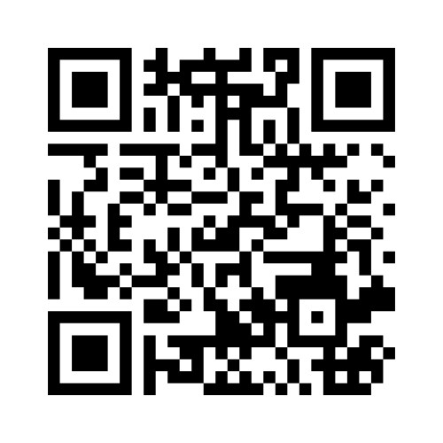
Welcome!
CSP South Central Regional Network:
Health Inequalities – what can I do?
@CSPSouthCentral
Please join in this quick welcome poll by scanning this QR code or visit menti.com and enter
6869 6102

Slide 2

Housekeeping
We will be taking pictures and filming aspects of today – if you do not want to be in the picture please let a member of CSP staff know
Feel free to tweet your observations and pictures of the day using @CSPsouthcentral
Powerpoint slide decks from today will be made available after the event online on the CSP South Central web page: https://www.csp.org.uk/networks/nations-regions/south-central

Slide 3
Agenda
9:35 CSP CEO John Cowman
10:25 Steven Goldensmith, Head of Prevention & Health Inequalities, Buckinghamshire, Oxfordshire and Berkshire West Integrated Care Board
11:00 Break
11:15 Mark Hinchcliffe, Strategic Head of Quality Improvement, Berkshire Healthcare NHS Foundation Trust
11:45 Katrina Kennedy, Demystifying health inequalities for Physiotherapists
12:15 Lunch
13:00 Coaching skills for physiotherapists workshop with Sudhir Daya
16:00 Finish

Slide 4
Connect with us
@CSPSouthCentral
https://www.facebook.com/
groups/590057697797178

Slide 5

CSP CEO John Cowman
cowmanj@csp.org.uk
@theCSP
@CSPSouthCentral

Slide 6
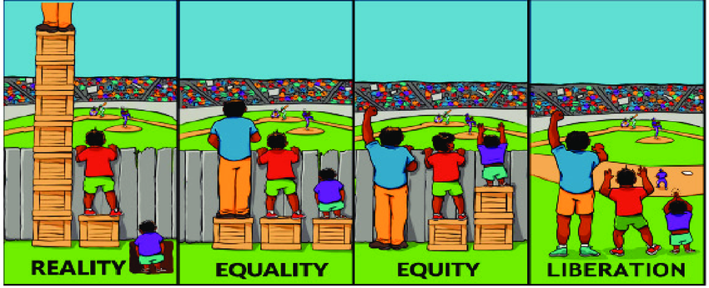
Equality vs Equity
Reality
Equality
Equity
Liberation

Slide 7
Terminology
Health inequalities: ‘Unfair and avoidable differences in health across the population, and between different groups within society. These include how long people are likely to live, the health conditions they may experience and the care that is available to them.’

Slide 8
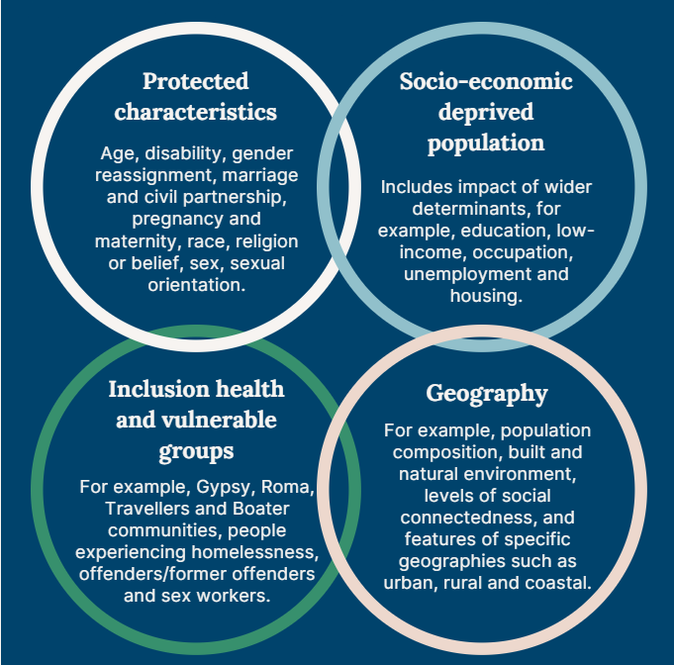
Wider determinants of health
Source: King’s Fund
Notes:
Who is a higher risk of experiencing health inequalities?
Health inequalities are caused by complex interactions between many factors which creates barriers to access to and successful participation in services.
Some groups and communities are more likely to experience health inequalities and therefore experience poorer health outcomes and greater challenges in accessing care than others.
The conditions in which we are born, grow, live, work and age can impact our health and wellbeing, and are sometimes referred to as wider determinants of health.
This Venn diagram helps us gain a clearer picture of who is at greater risk from the impacts of health inequalities.
Wider determinants of health can be divided into 4 categories:
•socioeconomic status and deprivation
•sharing certain protected characteristics
•belonging to vulnerable or excluded groups of society
•geography.
These factors often overlap, meaning people can fall into combinations of these categories. This can compound and multiply the impact and severity of health inequalities experienced.
For example, someone who is unemployed may be more likely to live in poorer quality housing with less access to green space and less access to fresh, healthy food. This means some groups and communities are more likely to experience poorer health than the general population. These groups are also more likely to experience challenges in accessing care.

Slide 9
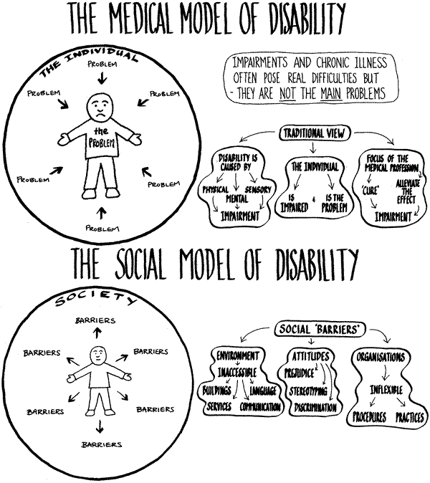
Medical versus Social

Slide 10
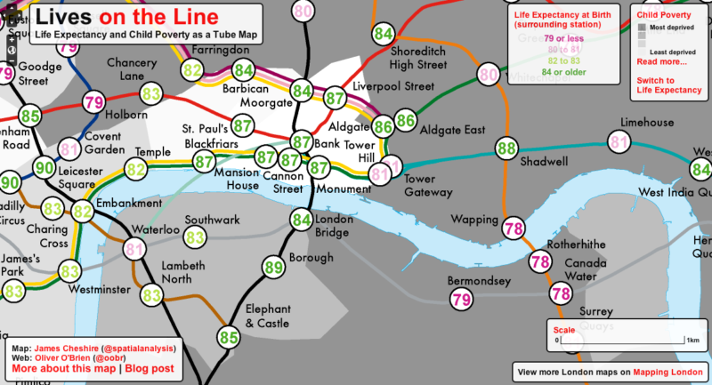
Health Inequalities

Slide 11


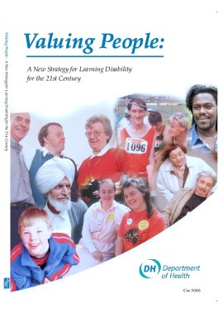

Health Inequalities
On average, men die 23 years younger than women in the general population.
On average, women with die 19 years younger than women in the general population
39% of people died an avoidable death
32% of people died an avoidable death
26% of people with an avoidable death
(LeDeR, 2023; ONS, 2022).

Slide 12

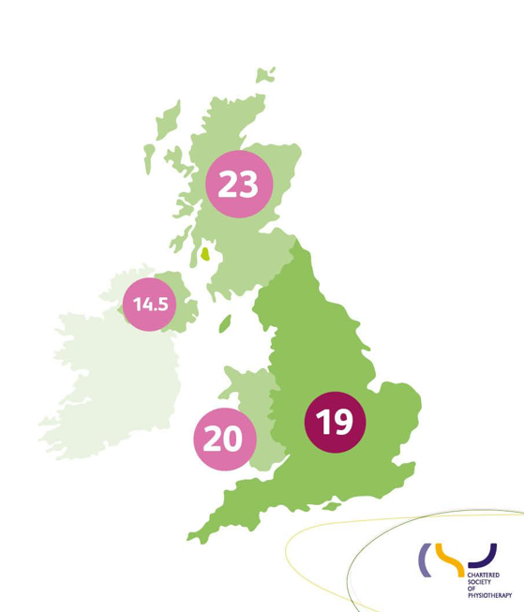
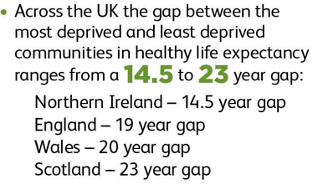
(CSP Easing the Pain Report 2022)
The health inequity gap
Notes:
National examples of the impact of health inequalities:
The number of years that a person can expect to live in good health varies across the UK.
This stark inequality is played out in communities around the country, showing that the circumstances in which we live (the wider determinants of health) shape our health.
The UK map shows the difference in health life expectancy in years between those living in the areas of highest deprivation verses those living in the least deprived areas. With Scotland showing a 23 year difference in health life expectancy between the most deprived and the least deprived.
Examples from across the UK quoted by The Health Foundation:
A woman born in Wokingham can expect to live 15 more years in good health than a woman born in Blackpool. A man born in Richmond upon Thames can expect to live 17 more years in good health than a man born in Belfast.
In the Orkney Islands female healthy life expectancy at birth is 75.0 years, while in Blackpool it is just 55.3 years.
The impact of deprivation, further pertinent statistics
People in the poorest communities are 60% more likely to be diagnosed with a LTC. They also have a 30% higher chance that their condition will be more severe.
People in the bottom fifth of deprivation levels (so in the highest areas of deprivation) are nearly twice as likely to have MSK or respiratory conditions and 4 times as likely to have mental health issues than those living in areas of lowest deprivation.

Slide 13
Health Inequalities
The Impact more Locally
Looking at life expectancy across the UK by postcode taking info tracked from Portsmouth City Council:
Stark poverty divide in Portsmouth laid bare as data shows people can live eight years longer in different postcodes
Fratton West and Portsea, the average life expectancy for men in 2019 was 74.41 years of age, and 77.59 for women.
But only a stones throw away in the Southsea Haslemere Road area, the average for men is 79.41, and 84.22 for women.
Difference of 5 years for men and almost 7 years for women.
Source: Oct 2021 The News - info from the Lancet

Slide 14
Barriers to Health Equality
a lack of accessible transport links
patients not being identified as having a learning disability
staff having little understanding about learning disability
failure to recognise that a person with a learning disability is unwell
failure to make a correct diagnosis
anxiety or a lack of confidence for people with a learning disability
lack of joint working from different care providers
not enough involvement allowed from carers
inadequate aftercare or follow-up care.
(Heslop et al. 2013; Tuffrey-Wijnes et al. 2013; Allerton and Emerson 2012).

Slide 15





How the Profession is responding
Key work the CSP is doing nationally:
Easing the pain report
Contributed and influenced the ARMA national inquiry into musculoskeletal (MSK) health inequalities and deprivation
Response to Women’s health strategy
Inequalities
Inequalities Health Alliance member
10 year cancer plan consultation
Notes:
Key health inequality work the CSP is doing nationally :
Easing the pain report, infographics and presentation slides https://www.csp.org.uk/publications/rehabilitation-recovery-reducing-health-inequity-easing-pain
· Contributed and influenced the ARMA national inquiry into musculoskeletal (MSK) health inequalities and deprivation https://www.csp.org.uk/news/2024-03-19-physiotherapists-are-tackling-musculoskeletal-health-inequalities https://www.csp.org.uk/system/files/documents/2023-08/ARMA%20Health%20inequalities%20inquiry%20response%20FINAL.pdf · CSP response to Women’s health strategy https://www.csp.org.uk/news/2021-06-15-csp-urges-government-reform-healthcare-women https://www.csp.org.uk/system/files/documents/2021-06/Women%27s%20health%20strategy_140621_pdf.pdf · Lobbying CSP professional network Pelvic, Obstetric and Gynaecological Physiotherapy (POGP) and the Community Rehabilitation Alliance (CRA) has resulted in invitations from NHS England to support the implementation of women's health hubs https://www.csp.org.uk/news/2024-03-13-nhs-england-invites-physios-help-implement-womens-health-hubs-improve-pelvic-health
· Inequalities Health Alliance member – We are members of the IHA. 250 members campaigning for a cross-government strategy to reduce health inequalities. Made contact with Asha Intensive Care Society Tasha following a positive IHA meeting, at which Tasha presented the Easing the Pain report These follow on meetings led to ICS joining the CRA. Inputted into joint letters, statements and campaigns.
· 10 year cancer plan consultation – calling for Health Equality to be made mandatory for all cancer service planning and delivery. The mandate should include: a minimum dataset, inequalities measures, and a health equity audit as part of routine monitoring and reporting of actions taken to address inequalities. https://www.csp.org.uk/news/2022-04-28-physiotherapy-influences-future-cancer-care-england https://www.csp.org.uk/system/files/documents/2022-04/10_year_cancer_plan_call_for_evidence_response.pdf -

Slide 16
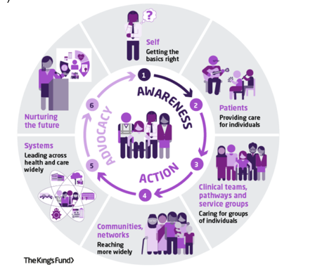
My role in tackling health inequalities: a framework for allied health professionals The King's Fund (2021)
Notes:
In this complex and intersectional picture of multiple factors that impact health inequalities how can CSP members work to tackle health inequalities?
It can feel like a big mountain to climb and sometimes there is a perception that it is not our job or it can be difficult to know where to get started
Physiotherapists, alongside other AHPs, are the third largest clinical workforce, with physios being the largest AHP profession. Therefore, there is huge potential for physio team members contributions to tackling health inequalities to be impactful.
Physio services support patients across pathways and through all stages of life and are therefore really well placed to identify and understand the key characteristics and the needs of the populations they serve.
Small changes to services can improve access to underserved and vulnerable communities, helping to tackle health inequalities.
The King’s Fund has created a framework to support AHPs to get started with seeing their place and take action in tackling health inequalities.

Slide 17
The Individual
The Patient
Clinical Teams and
Communities and Networks
System
The Future
Notes:
The Framework encourages all AHPs throughout their career to contribute towards improving health inequalities via three approaches: raising awareness, taking action and optimising advocacy through six routes to change:
1 Self: everyone’s individual contribution counts – such as increasing your own awareness of health inequalities and considering what unconscious bias you have which could impact your practice. There are excellent resources available such as the King’s Fund’s Health Inequalities in a Nutshell paper.
2 Patients: is your patient at risk of experiencing barriers to healthcare such as learning difficulties, poverty and deprivation or low health literacy? What can you do to improve their equity of access? Could these steps benefit other patients?
3 Clinical teams, pathway and service groups: does your service collect and effectively utilise demographic data about patients?
Are there any gaps in the information you collect? Does the data tell a story about an underserved community in your patient population?
Practical example: You want to make your MSK clinic hours more accessible. You survey existing patients about convenient clinic opening hours–the outcome is that the existing hours are fine.
Consider: With this approach you are not reaching those who struggle to access the clinic.
Look for ways to include opinions from a much wider population that may be struggling to access the service - such as asking via local GP practices or local orthopaedic teams.
4 Communities and networks: Working together across services is essential to ensure the needs of your population are fully understood.
Consider how health inequality may impact at different junctures in patient’s health journey. Is there anything you could do to advocate for patients as they transition from your service into another service? Do groups of patients get lost along the way?
Are the referrals/ self-referrals received by your team reflective of the population in that local area – if not, why not? Can awareness be more widely raised in different ways and to different audiences (for example faith groups, online social groups, local cafes and libraries).
5 Systems: If there are known populations not accessing certain services it is the duty of the system to reach out to where those communities gather.
However, everyone can be proactive in building relationships within the system to promote engagement - for example building relationships with relevant community groups.
6 Nurturing the future: How can we plan for the changing needs of our population? Population health changes do not provide swift outcomes. NHS England suggests that population health changes may be felt 15-20 years down the line but the decisions we make today are crucial for the healthy lives of the future population

Slide 18

The CSP Health Inequalities project team professional network discussion
How we can help you make a difference?
Notes:
Alongside this national influencing work, the CSP is developing resources and support opportunities to help members tackle health inequalities through their practice.
The CSP Health Inequalities project team undertook broad ranging insight across 2023 with the aim of understanding member baseline knowledge, capability and ask them what resources and support they need to transform services and reduce health inequalities.

Slide 19

We need to talk about data
Data is the real currency of healthcare
It’s generated at ALL points of the physiotherapy service user journey but do we …
  Collect it systematically?
  Truly understand what it means?
  Consume it as much/well as we create it?
  Use it to drive improvement?
  Use it to demonstrate impact?
Notes:
we know that physios aren’t utilising data to its best advantage, services ask us for support if they have challenges and one of the first thing we ask is ‘what data do you have’ …more often than you would think the answer is none
We’re encouraging services to think about what data you want to collect and why, numbers of patients referred into a service doesn’t tell us a lot, patient numbers plus number of treatments tells us more, add in re-referral rates and you’re starting to build a picture of what a service achieves
We also need to think about who our data impacts, for example if you work in an early supported stroke service and you expand your service allowing you to take patients out of hospital on average three days earlier, your best evidence for your impact along the pathway may be to collect this data and use it to show the savings you have made for the acute hospital. Using this alongside patient outcomes and satisfaction can show how you have a wide impact and value over more than one area.
Think about the data you collect, how you are using it, and whether it supports you with your work around health inequity
In an ideal world what would you want to collect to show your effect on health inequalities? Can you start to think of ways to achieve this?

Slide 20

Are you sitting comfortably?
The importance of telling stories
with data
Notes:
One of the most powerful ways to present your data is to use it to tell a story – you can weave in multiple aspects of your service, and tailor your content to fit the audience you’re talking to – think about what they might want to hear, and what the hooks will be to engage them. Think about where they may be at now, and the place you want your story to take them to. You can use your data to provide the context for your story, and illustrate how you are or can address problems or gaps in services, or reduce health inequities. Have characters in your story. Introduce your team, and its make-up and why this works, or how you may want to shape the team. A patient or carer quote or video can show the real-life impact of what you do, and qualitative data alongside quantitative data strengthens your value. Having the right data is key to developing your health inequities strategies and services.

Slide 21
Data resources
The Physiotherapy Health Informatics Strategy | The Chartered Society of Physiotherapy (csp.org.uk)
‘Getting started with data collection’ and ‘Getting started with technology’ webinars: Member webinars | The Chartered Society of Physiotherapy (csp.org.uk)
Using meaningful data (csp.org.uk)

Slide 22
Fundamental issues, members need:
knowledge about health inequality and quality improvement
More
confidence in applying knowledge into practice​
More
opportunities to engage; demonstrating benefit​
More
research and evidence
More
Notes:
The project team heard from over 4500 members who told us that they needed more……

Slide 23
What are the CSP’s health inequalities project team’s plans to support members?
Building the evidence base
Building a supporting community
Learning resources
Service transformation
Notes:
Guided by the member insight, work is getting started which includes:
Networking opportunities: the start of which is the Health Inequalities iCSP which launched on 1st May 24 (linked in the next slide)
Further development of the existing CSP online health inequalities resources into a hub with the aim of getting pertinent health inequalities information at members fingertips (this is developing over 2024 with the aim of it being fully available to members in the 1st quarter 2025)
Building the evidence base with the development of a database of service improvement examples, illustrating how physio team members can tackle health inequalities in practice. The team would love to hear about any work you are doing in your practice to tackle health inequalities.
A repository of education and training resources.
The project team would welcome speaking to anyone who would like to find out more about their work or who have any questions about health inequalities in their practice.

Slide 24
How we can help you make a difference
Access the CSP Health Inequalities webpages to find out more about how health inequalities can impact on your clinical practice, service and community:
https://www.csp.org.uk/professional-clinical/improvement-innovation/health-inequalities
CSP Getting started webinar https://www.youtube.com/watch?v=q7jNzeakuwo
Connect with CSP representatives locally including CSP Stewards and CSP Equality Reps who can help with influencing change (use the online ‘find your rep’ facility: https://www.csp.org.uk/people-directory/reps
Join the iCSP Health Inequalities online network:
https://www.csp.org.uk/icsp/health-inequalities
Join the iCSP Influencers network: https://www.csp.org.uk/icsp/influencers
Notes:
Pertinent CSP resources and networking opportunities

Slide 25
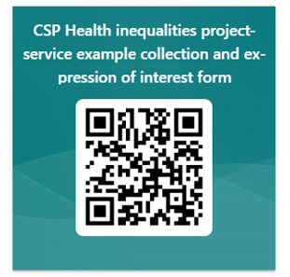
How we can help you make a difference
Share your health inequalities work to inform and inspire other members by completing the linked service improvement MS Form and connecting with the CSP Health Inequalities project team: https://forms.office.com/e/DXwYyUBuFh
Notes:
The CSP Health Inequalities project team are really keen to find out more about what work teams are undertaking to tackle health inequalities to both increase the evidence base and find illustrative examples that can be shared to inspire other members to undertake work to address health inequalities. The QR and link above will take you to a quick form to share some key information about the work/ project with the team

Slide 26
Thank you!
cowmanj@csp.org.uk

Slide 27
Steve GoldenSmith
Head Of Prevention & Health Inequalities

Slide 28
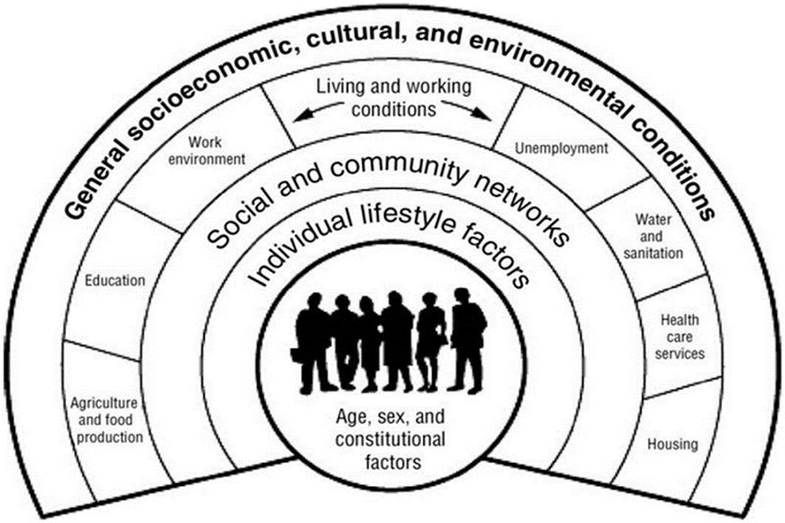

Slide 29
What Drives Inequalities
Opportunities / Outcomes
Opportunity
- When people aren’t given equal opportunities and rights.
- When they are treated unfairly and experience discrimination.
Outcomes
- Income/ Educational Attainment / Health Status
- Social / Financial/ Political/ Legal/ Housing/ Education/ Employment
Health Influencing Behaviours

Slide 30
Geography
Social & Economic Deprivation
Characteristics
Opportunity
Health Service Inequalities
Inclusion Health Groups
Behavioural; Lifestyle
Not Simple
Quite Complex

Slide 31


Slide 32
The People We Support
Long Term Conditions –
People in lower socio-economic groups are more likely to have long-term health conditions, and these conditions tend to be more severe.
Deprivation increases the likelihood of having more multiple LTCs
On average people in the most deprived fifth of the population develop multiple long-term conditions 10 years earlier than those in the least deprived fifth.
People from ethnic minority groups are more likely than white British people to report limiting long-term illness and poor health
Inclusion Health Groups experience worse Health

Slide 33
Health Inequalities are ultimately about differences in the status of people’s health.
Life Expectancy -
Healthy Life Expectancy – LTCs
Avoidable Mortality – Preventable/ Treatable
Ill Health Prevalence -
Health Service Inequalities – Access/ Experience / Outcomes
Health Inequalities are often analysed and addressed across four types of factors:
Socio-economic, e.g. income / educ/ housing/ employment
Geography, e.g. urban or rural / areas of defined deprivation
Specific Characteristics including those protected in law, e.g. sex, ethnicity or disability
Socially excluded groups, e.g. the homeless / asylum seekers/ sex workers/ people with drug & alcohol dependency .

Slide 34














Behavioural Risks are often used to identify & predict Health Inequalities
  Smoking
  Weight
  Drug & Alcohol
  Physical Activity
  Social Isolation

Slide 35
Geography
Social & Economic Deprivation
Characteristics
Opportunity
Health Service Inequalities
Inclusion Health Groups
Behavioural; Lifestyle
Not Simple
Quite Complex
What Can Health do?

Slide 36

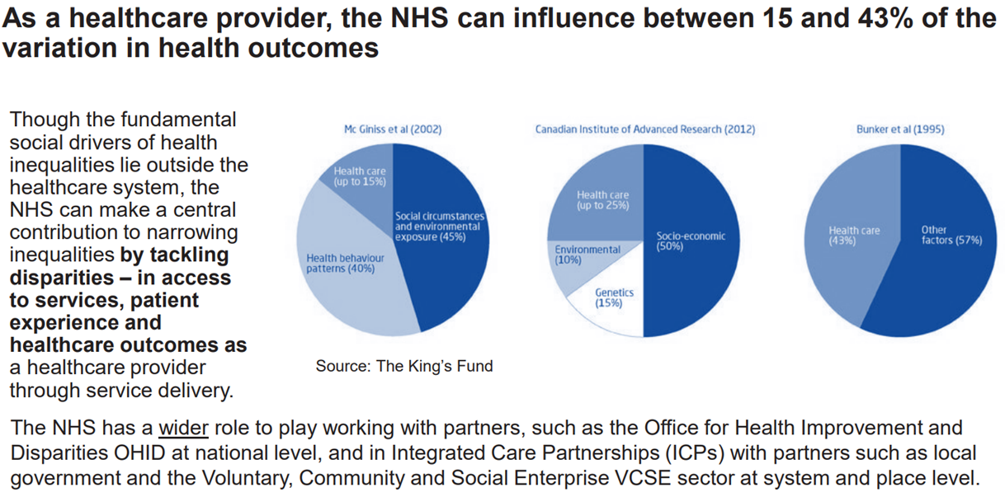
What Can Health Do?

Slide 37





3 Step Plan ​
Get Own House In Order​
Work As Anchor​
Partnerships To Reduce Wider Determinants

Slide 38
Addressing Health Service Inequalities
Access, Experience, Outcomes
Access : time/ digital / costs / beliefs / candidacy/ fear / previous experiences/ self-organisational
Experience : Language – Discrimination – Waiting Times – Service Level – Sign Post & Referral – Digital
Outcome : Diagnosis Rates – Sub Optimal Care & Treatment Variations – Clinical Variation

Slide 39
Where
Target Worse Off​
Reduce Inequitable Gaps within Services ​
Reduce Inequalities across whole population​
​
Focus on​
Prevention & Harm Reduction ​
Evidence Based High Impact Interventions​
Inclusive Recovery ​
​
Maximise Enablers ​
Skilled and motivated workforce ​
Person Centred, Community engagement and coproduction approaches
Effective delivery of prioritised resourced actions and interventions​
Data, Information, Insight and Expertise​
Governance & Assurance Macro- Micro​

Slide 40
Know the population you serve
Share & Learn Best Practice
Personalisation / Culturally Responsive / Trauma Informed
Adapt interventions to target your populations
Access Training
Sign Post & Refer
Engage your communities
Co-produce
Advocate
Engage your more diverse communities
Gather Evidence
Evaluation

Slide 41
Anchor Institution
1) Workforce – Staff & extended families – recruitment - employment
2) Procurement – social value – local – workforce
3) Land & Buildings – vacant land use – design with communities – access - Greenery
4) Sustainability – climate change – de-carbon - sustainable design – transport
5) Partnership & Leadership – community engagement – wider partnerships – greater good

Slide 42
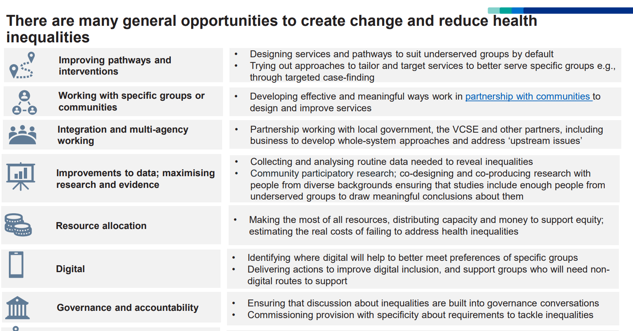

Slide 43
BREAK – please network

Slide 44
Health Inequalities
Quality Improvement Programme
Mark Hinchcliffe
Strategic Head of Quality Improvement
May 2024

Slide 45





Quality definition
Six Characteristics of Quality (as defined by the Institute of Medicine)
Safe, avoiding harm
Timely, at the right time
Effective, evidence based and appropriate
Efficient, avoid waste
Equitable, an equal chance of the same outcome regardless of geography, socioeconomic status etc.
Person-centred, respectful and responsive to individual needs and wishes.
=

Slide 46
Health inequalities definition
“Health inequalities are the
unjust and avoidable differences
in people's health across the population and between specific population groups.”
Health Scotland, 2021

Slide 47
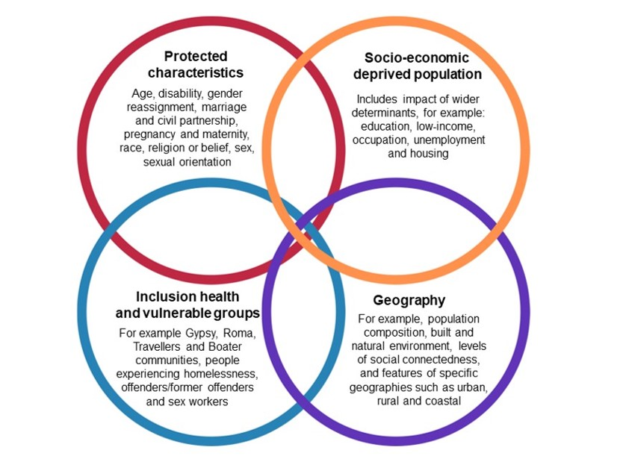
Health Inequalities domains
Health disparities and health inequalities: applying All Our Health - GOV.UK (www.gov.uk)

Slide 48
Health Inequalities causes
Access to services
Economic inequalities
Social determinants
Experience of services
Physical and mental health outcomes
Personal health behaviours
Relationships with others (parents, carers, etc)

Slide 49
Health inequality what can we do?
“Action on health inequalities requires improving the lives of those with the worst health, fastest”
https://www.england.nhs.uk/wp-content/uploads/2019/11/EDC03-Place-Based-Approach-Health-Inequalities.pdf

Slide 50
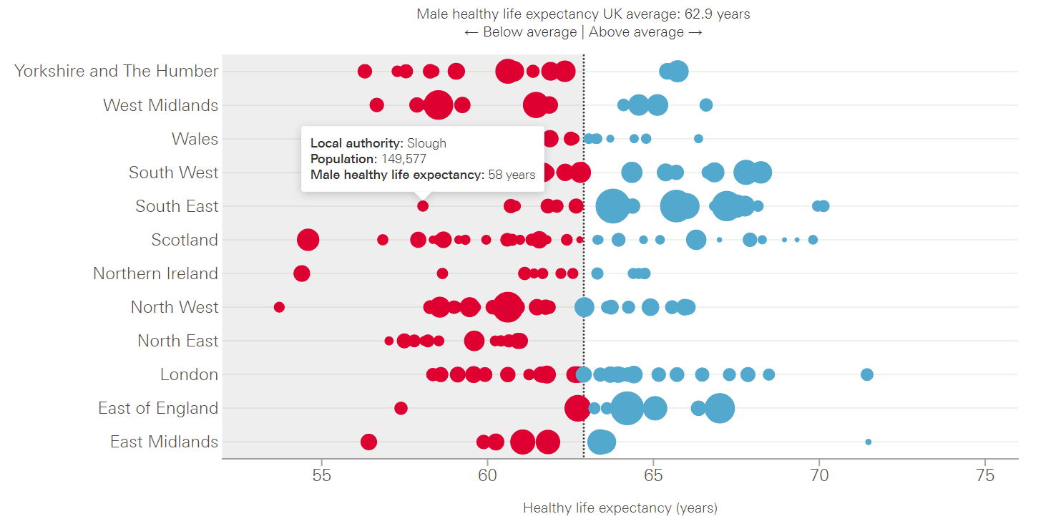
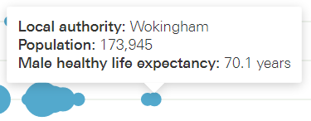
Berkshire healthy life expectancy
Local healthy life expectancy at birth by region and sex - The Health Foundation

Slide 51
Berkshire Healthcare strategy
‘Develop a corporate level
quality improvement programme
to scope, engage and address
(on our own and with partners)
key identified health inequalities and drivers for our patients and communities.’
Berkshire Healthcare NHS Foundation Trust Strategy 2023 - 2025

Slide 52
Quality improvement the problem
‘QI offers an opportunity to improve equity and aspects of health inequality but standard approaches to QI
and pursuit of uniformity
may be problematic’.
Equity, health inequality and quality improvement; Healthcare Improvement Scotland 2020

Slide 53
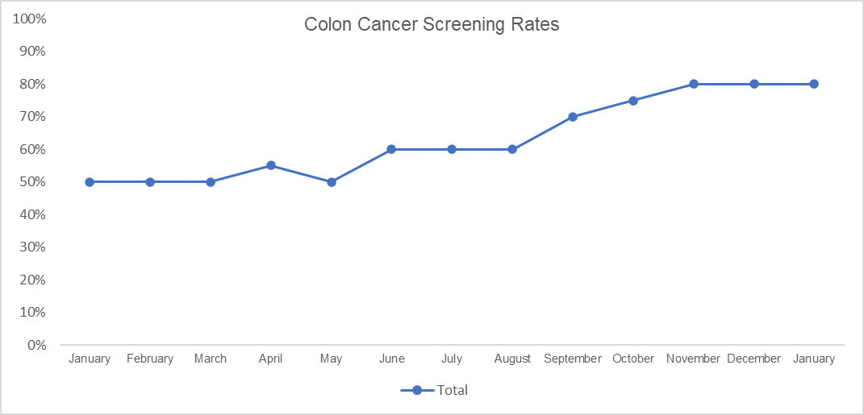
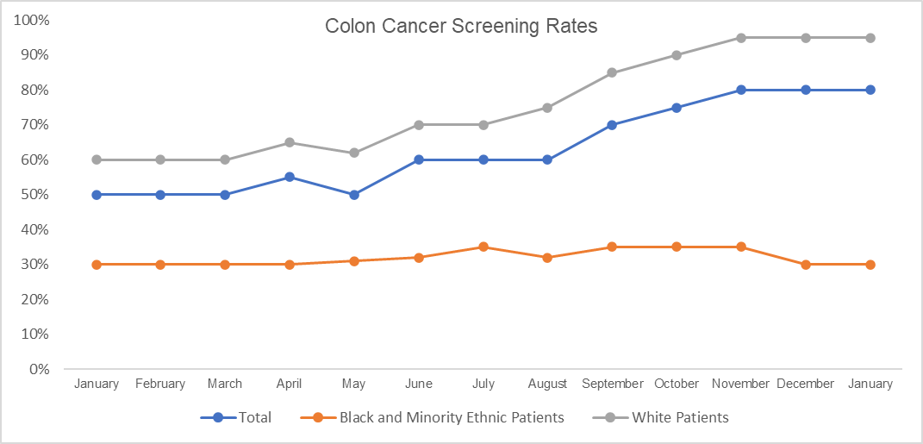
Quality improvement the problem
Improvement?

Slide 54
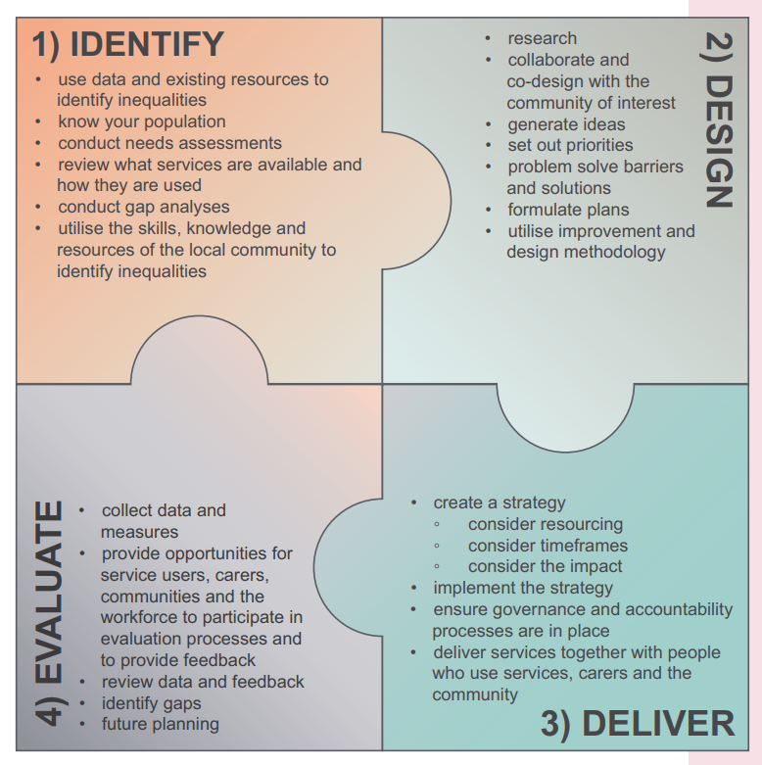
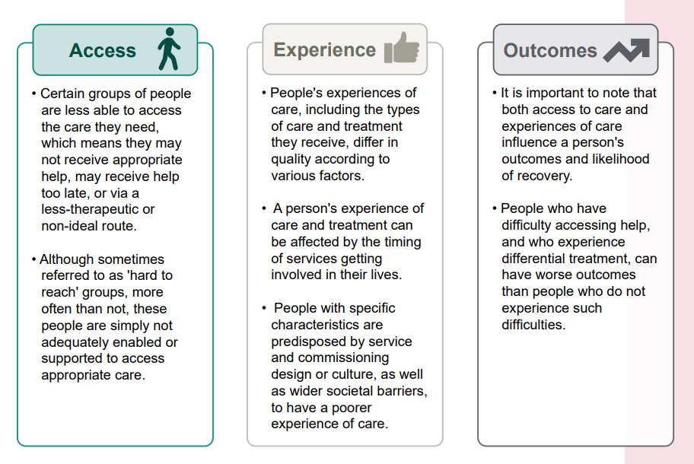
Health inequality what can we do?
https://www.rcpsych.ac.uk/docs/default-source/improving-care/nccmh/amhe/amhe-resource.pdf?sfvrsn=91062ea2_6

Slide 55



Health inequality what can we do?
1) Demonstrate how health inequalities link to organisational strategy and to personal, intrinsic motivation of colleagues.
2) Develop and communicate a simple conceptual framework for health inequalities.
3) Make key health inequality data available and accessible to all.
4) Embed health inequalities-thinking into the processes for change management and service redesign at all levels.
Build will
Accelerate BHFT contribution to reducing health inequalities for our patients and communities through a QI programme.
Prioritise improvements
5) Engage with service users and communities and learn from them what matters most to them.
6) Share insight and bring clinicians together to learn and prioritise key access, experience and outcome inequalities to improve.
7) Identify priority groups of service users to understand root causes of inequalities identified.
Execute specific QI interventions
8) Commission and support a small number of QI projects to address our priority health inequalities
9) Leverage A3 methodology and skills to make improvements.
10) Rigorously measure and share progress made and learning throughout the system.

Slide 56
Prioritising considerations
BHFT has little influence on this
BHFT has control of this
Control / influence 1 2 3 4 5
Impacting very few people <50
Impacting very many people 1,000+
Impact 1 2 3 4 5
Low risk of harm or death
High risk to life
Risk 1 2 3 4 5
Some alignment to True North
Aligned to True North and system goals
Strategy alignment 1 2 3 4 5

Slide 57
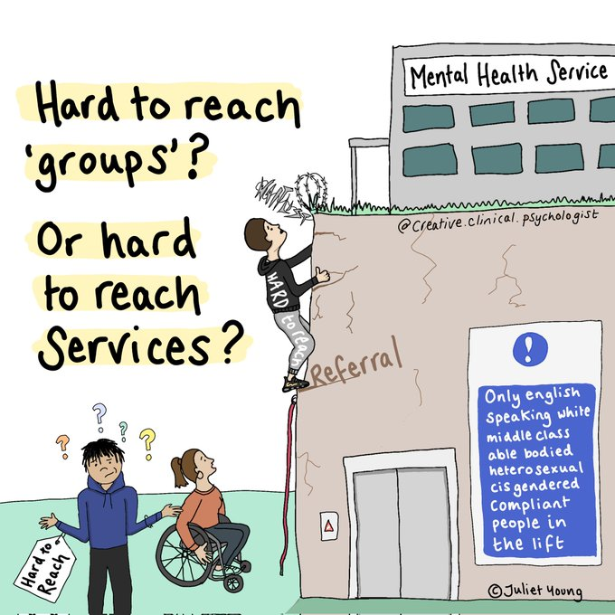
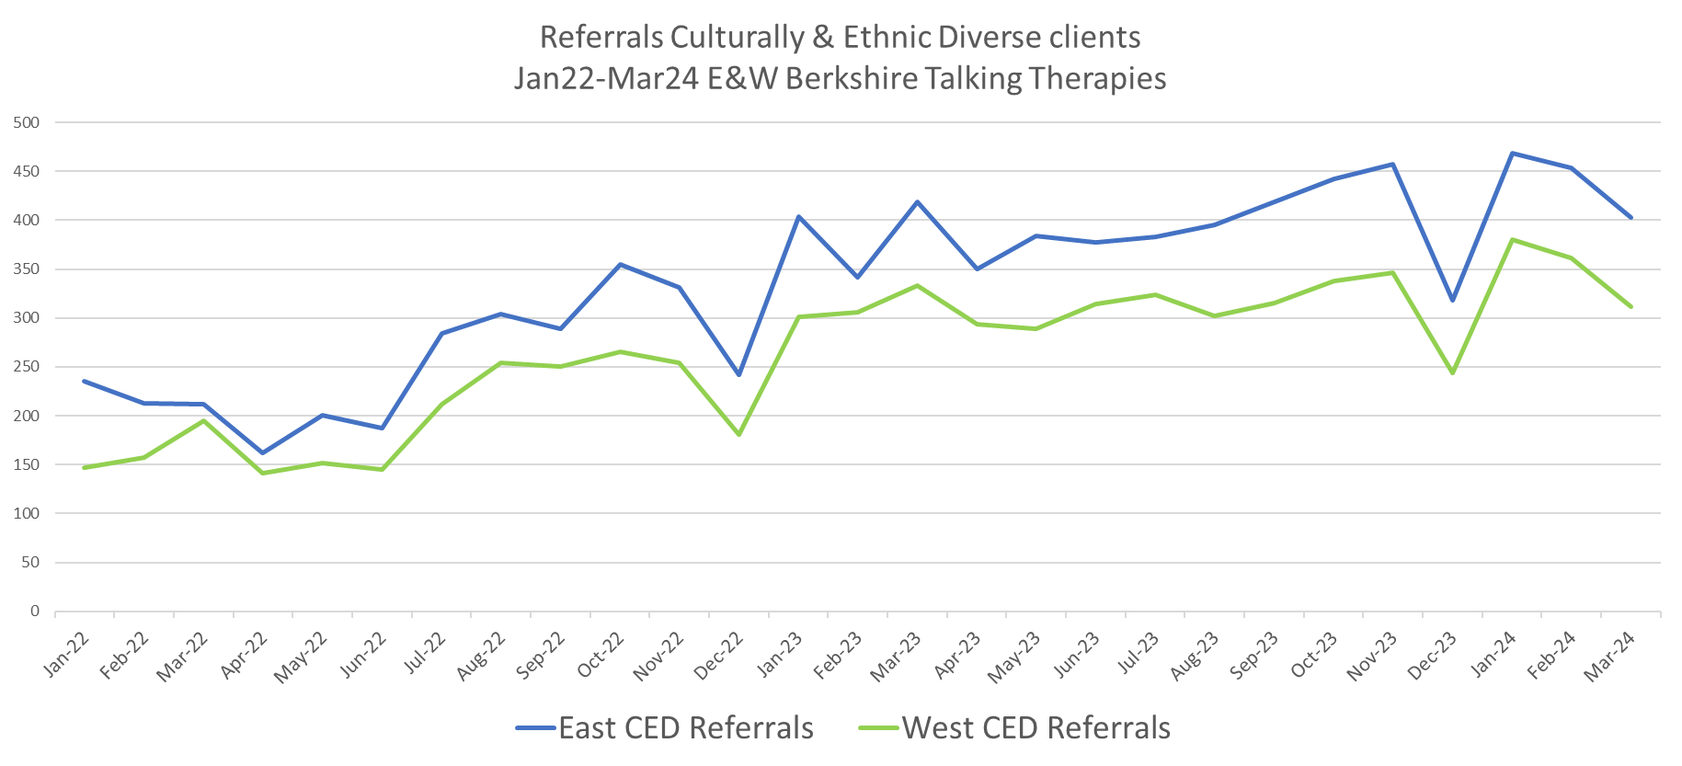
Talking Therapies
Improving data and reporting
Outreach work
Reflection space and CPD for colleagues
Patient voice and representation

Slide 58
Inch wide mile deep
LEARNING

Slide 59
Health inequality what can we do?
Four things you can do starting today:
1 – Participate
2 – Look at your data
3 – Speak with your teams about health inequalities
4 – Take an ‘equity pause’

Slide 60
Demystifying Health Inequalities for physiotherapists
Katrina kennedy
May 15th

Slide 61
Why do health inequalities matter?
Health inequalities are everyone's business. Failing to address health inequalities results in avoidable, unfair differences in people's ability to lead healthy lives across the UK. This could impact on you as an individual, your community, team or service, or the wider healthcare and social care system.
As the Health and Care Professions Council (HCPC) standards about promoting public health and preventing ill health state, HCPC registrants must:
15.1: understand the role of their profession in health promotion, health education and preventing ill-health
15.2: understand how social, economic and environmental factors (wider determinants of health) can influence a person’s health and wellbeing
Notes:
There might be issues with access to services due to location, appointment time, accessibility, literacy (whether written or digital) or cultural differences. We should all take an active interest in trying to improve our services to ensure the best outcomes for our population.

Slide 62
Definition
Health inequalities are unfair and avoidable differences in health across the population, and between different groups within society. These include how long people are likely to live, the health conditions they may experience and the care that is available to them.
The conditions in which we are born, grow, live, work and age can impact our health and wellbeing. These are sometimes referred to as wider determinants of health.

Slide 63
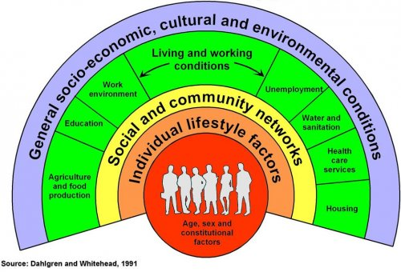
Wider Determinants
- also known as social determinants, are a diverse range of social, economic and environmental factors which impact on people’s health and wellbeing.
Addressing the wider determinants of health and wellbeing has a key role to play in reducing health inequalities.
Notes:
Wider determinants of health are often interlinked. For example, someone who is unemployed may be more likely to live in poorer quality housing with less access to green space and less access to fresh, healthy food. This means some groups and communities are more likely to experience poorer health than the general population. These groups are also more likely to experience challenges in accessing care.
The reasons for this are complex and may include:
the availability of services in their local area
service opening times
access to transport
access to childcare
language (spoken and written)
literacy
poor experiences in the past
misinformation
fear
People living in areas of high deprivation, those from Black, Asian and minority ethnic communities and those from inclusion health group, for example the homeless, are most at risk of experiencing these inequalities.

Slide 64

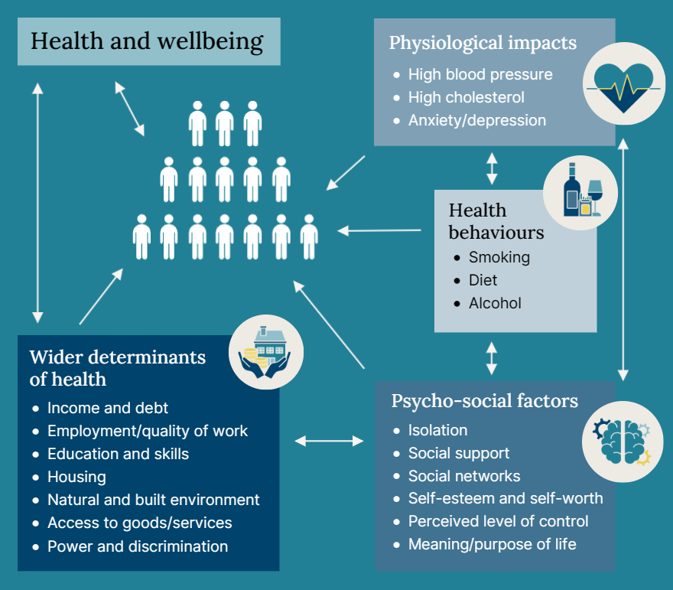
Inequalities of what?
Health status, e.g. life expectancy
Access to care, e.g., availability of given services
Quality and experience of care, for example, levels of patient satisfaction
Behavioural risks to health, e.g., smoking rates
Wider determinants of health, for example, quality of housing.

Slide 65
What is deprivation health?
The index of multiple deprivation ranks each small area in England from most to least deprived based on a combination of seven different factors including: income, employment, education, health, crime, barriers to housing and services, living environment
Evidence shows that those living in the most deprived areas of England face the worst healthcare inequalities in relation to healthcare access, experience and outcomes.
Inclusion health groups include people experiencing homelessness, drug and alcohol dependence, vulnerable migrants, Gypsy, Roma and Traveller communities, sex workers, people in contact with the justice system, victims of modern slavery and other socially excluded groups.

Slide 66
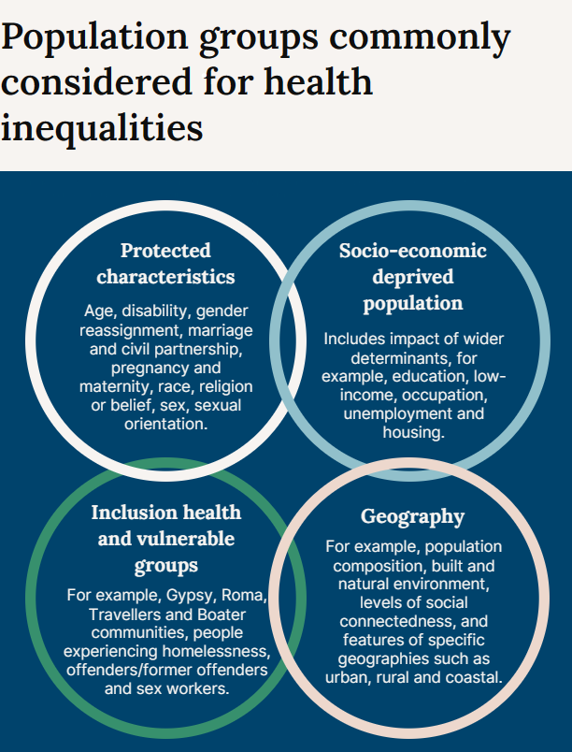

Slide 67
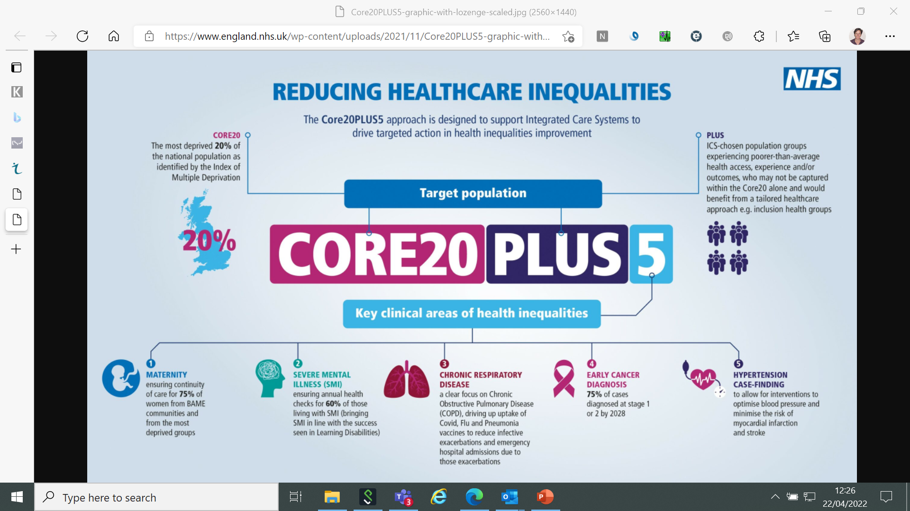

Slide 68
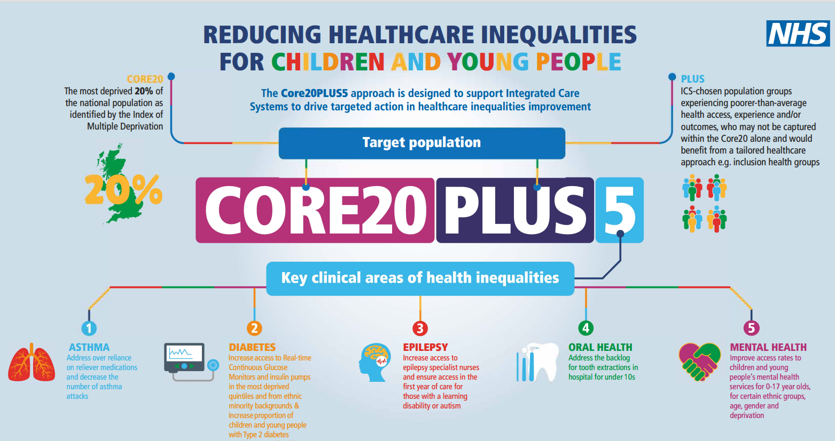

Slide 69
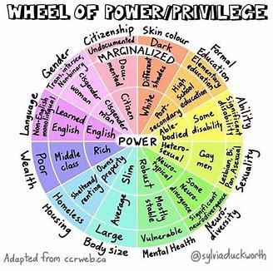

Slide 70

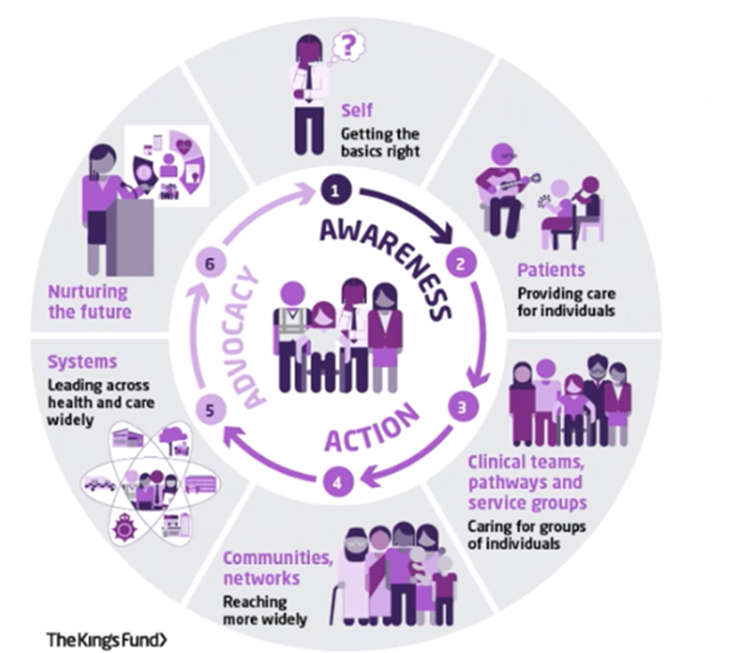
https://www.kingsfund.org.uk/publications/tackling-health-inequalities-framework-allied-health-professionals

Slide 71
1. AWARENESS – Your story world view, bias.
2. ACTION – How can you ensure equality? What processes do you have in place? DNA patients??
3. ADVOCACY – Where can you influence and what are you going to do differently?

Slide 72
Discussion
  What might you identify in a patient’s consultation that suggest to you that health inequalities are impacting this patient’s overall health. How would broach this with them?

Slide 73
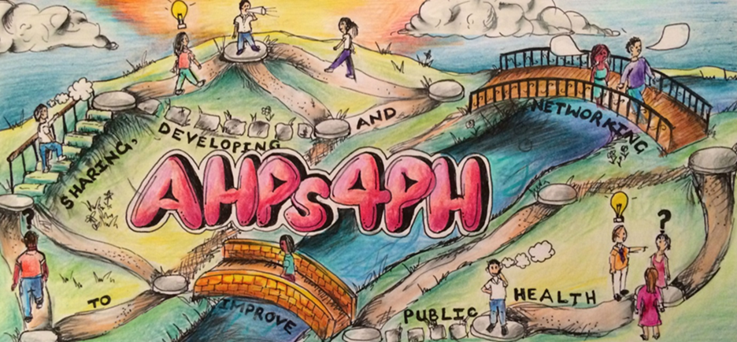

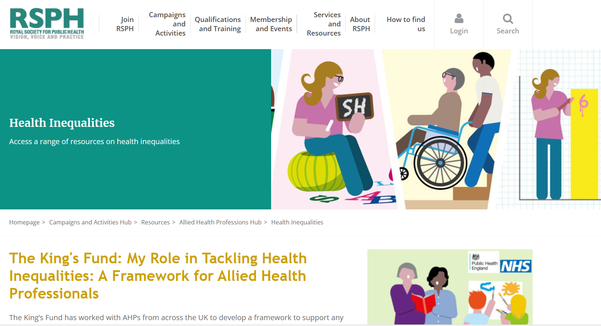

Slide 74
References;
Health inequalities: reducing inequalities in local areas - GOV.UK (www.gov.uk)
All Our Health - elearning for healthcare (e-lfh.org.uk)
https://portal.e-lfh.org.uk/Component/Details/778744 -health disparities and health inequalities module
https://www.rsph.org.uk/our-work/resources/allied-health-professionals-hub/health-inequalities.html
RSPH | Allied Health Professions hub

Slide 75

Thank you

Slide 76
LUNCH and more chance to Network

Slide 77
Sudhir Daya
Coaching skills for physiotherapists workshop

Slide 78
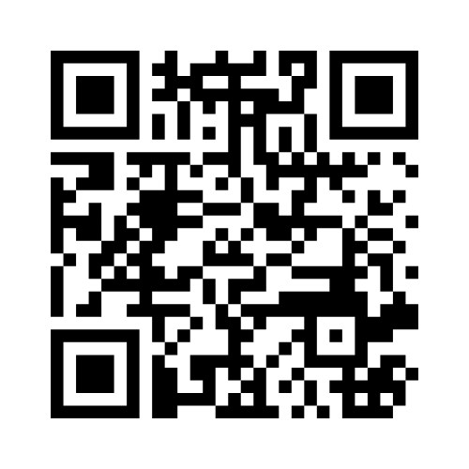
Please give us your feedback on today visit the QR code above or www.menti.com and enter code 3931 5911
Thank you to all our speakers
Thank you for attending - Safe journey home

