Slide 1
Notes:
Hi, my name is Kirsty Semple – I am the Head of Governance at CSP and it is the Governance Team who are responsible for working with CSP Council and the ARC Agenda Committee to deliver the annual representative conference... So today I am going to be giving you a brief overview of the Annual Representatives Conference.

Slide 2
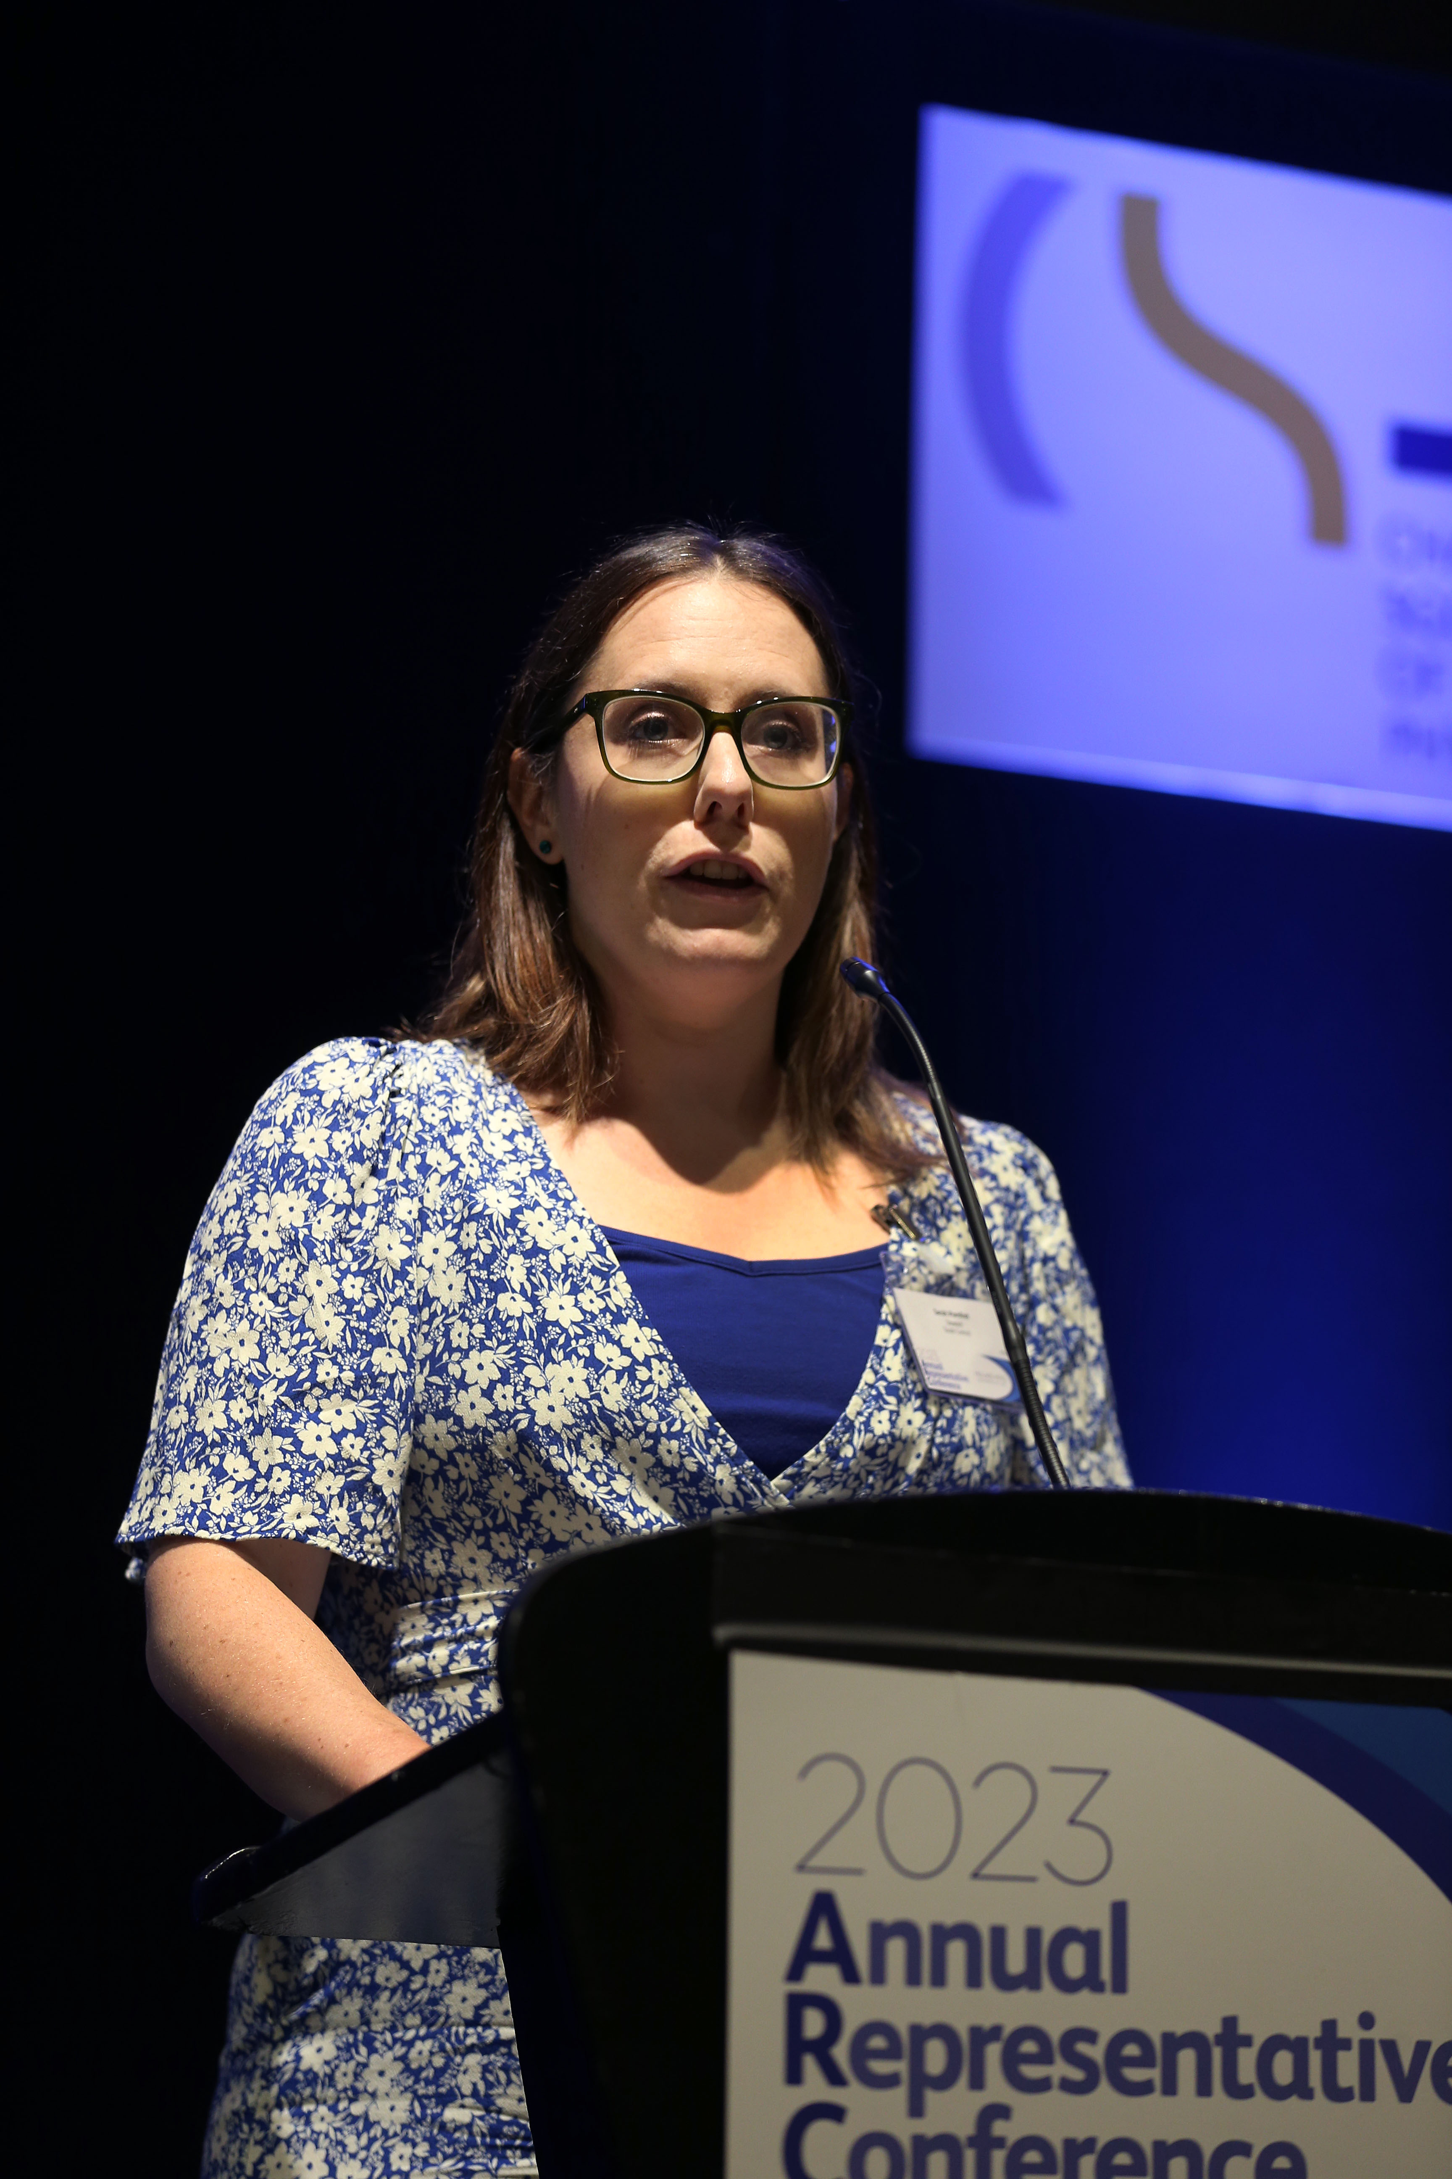
Learning Outcomes
Understanding of ARC and its history
How to write a motion/discussion item
Request a fringe meeting
Overview of ARC timetable
Notes:
The aim of this session is to give you an understanding of ARC and the benefits this has provided to members
how to write a motion or discussion item
An overview of a fringe meeting that your group/network could facilitate
And the ARC timeline

Slide 3
What is ARC?
The Annual Representative Conference (‘ARC’) is an advisory body of the CSP Council
a. debates and discusses matters of importance to the CSP membership;
b. informs CSP strategy and policy through debate and discussion;
c. informs and advises the development and progress of CSP work plans; and
d. promotes engagement and sharing knowledge and views across the CSP.
ARC Agenda Committee
Considers which submitted Motions are debated on and voted on at ARC (within criteria)
Sets the overall agenda
Notes:
So what is ARC
As you can see on the screen ARC is an advisory body of the CSP Council and its main role is to debate and discuss matters of importance to the CSP membership, help inform strategy through these debate, informs and advises the development and progress of CSP work plans; and promotes engagement and sharing knowledge and views across the CSP.
ARC has a constitution that is available on the CSP website and this sets out who can attend and the format of the Conference itself. This is available on the CSP ARC webpage.
to support ARC to work effectively we have an ARC Agenda Committee. these are members nominated from your groups of representatives at ARC and their role it is to determine the business of ARC. There are also a number of CSP staff that support the operational processes so that the conference can achieve its purpose. The committee considers submitted motions and oversee the management of motions as well as looking at the format of the agenda and potential speakers.
As well as considering motions - ARC provides a place for representative to network, attend fringe meetings to find out about the work of other Networks and groups, hear topical information from key note speakers as well as elect members of the ARC Agenda Committee and celebrate the Rep of the Year Awards.

Slide 4
How can regional networks get involved?
Submit a motion
Suggest a discussion item
Attend as a representative, or
Attend as an observer
Notes:
There are plenty ways in which you can become involved in ARC – from suggesting a motion or discussion item to your network to attending as a representative. There is also an option to attend as an observer if all your network or group places have been allocated.
Are you trying to make an impact within the profession and feel you need more support from the CSP?
Try to influence CSP policy, or actions on key issues
Influence and have an opportunity to engage with CSP Council
Opportunity to showcase your Group and attract new members
Just to give you an overview of last year – you had one motion included on the agenda and 28 representatives attended from the regional networks and country board representatives. (there is a total of 39 places available across both the regional networks and Country boards – this works out to approx 3 representatives from each network that can attend.

Slide 5
What is a motion?
A form of words formally proposing an action or policy to the CSP Council. Motions are debated and voted on at ARC.
A motion must meet the criteria to be accepted
Any motion that meets the criteria cannot be rejected
BUT
Not all motions may get considered, and the quality of the motion can impact on how high up the agenda it is placed.
Notes:
The business of ARC mainly comes from the motions that are considered – if a motion is passed at ARC it goes forward to Council – Council does not need to accept them but it does need to consider them and provide a response on them.
Motions are therefore proposing something a group wants council to do – a representative will introduce the motion and there is then the opportunity for representatives to debate for and against the motion before a vote is taken on whether the motion goes forward to Council.
The ARC agenda committee (which is made up of the representative groups) set the criteria for the motions – the criteria is published on the website. If a motion meets the criteria it cannot be rejected. – a key thing to note as there are typically 35 to 45 motions accepted. Last year we had 35 motions on the agenda and ARC voted on all of these - however this does not happen every year. And some – towards the end, have very little discussion.
So as well as meeting the criteria – you want to ensure that your motion is one that the Agenda Committee will think should go higher up the list, or in an allocated time slot. You need to think about the quality of the motion as well as this will likely bring it higher up on the agenda.

Slide 6
Who can submit a motion?
a. Associates;
b. Country Boards;
c. Diversity networks;
d. National Group of Regional Safety Representatives;
e. National Group of Regional Stewards;
f. Professional Networks;
g. Regional Networks;
h. Retirement network;
i. Stewards Regional Groups;
j. Student Reference Group.
Notes:
Up to two motions can be submitted by each group or network,
There is also the opportunity to submit an emergency motion after the 29 February if something occurs after the deadline that you feel is of importance to ARC – the ARC agenda committee will review all emergency motions. Emergency motions are in addition to the 2 motions that each group or network can submit.

Slide 7
The criteria
Must not
address staffing issues relating to the CSP as an employer, which will be dealt with by CSP internal procedures; or
Be drafted in a way that is improperly critical of CSP members and/or staff
Notes:
There are a couple of things that motions should not ask for as these would not meet the criteria and be rejected.
The criteria are published on the website along with the guidance – this also provides examples of motions that have been worded badly and how they can be better written to support a motion to be more likely accepted and likely be higher on the agenda so that the motion will have time for discussion and debate at ARC.

Slide 8
Guidance
Topical
Accurate and concise
Likely to prompt good debate
Clear and logical
Avoid duplicating
Notes:
Its important to make your motion topical – make it interesting, relevant to issues happening with the CSP, nationally or by the government – so do have a look on the CSP website at key things that are happening at the moment.
Remember though – it is not just about getting your motion passed – you will also want Council to act on it. Motions are advisory only – and with the high number that are passed Council cannot act on all of them. It also has a five year strategy that it is working towards. So it is a good idea to frame any motions in accordance with that strategy; and to present your proposals in a way that Council are more likely to accept.
You also want to ensure you motions is accurate and concise – there is a 200 word limit so keep it as simple as possible. The committee will check the information is accurate – so to avoid any ambiguity – check you have the correct information when you are writing a motion. I would also recommend not using acronyms in you motion otherwise the Committee will be coming back to you to amend your motion.
Last year the majority of the motions had little debate and were passed by ARC – therefore if you have a motion that is going to bring different views to ARC and prompt that good debate for people to speak for and against that will generate more debate.
Avoid duplication – for example if you know another group has put in a similar motion – the committee may ask you to composite the motion. This is where groups that have submitted a similar motion will be asked to join their motions together which may involve a slight rewrite - you can choose not to composite your motion but it may be the committee gives this less priority as they may consider other composited motions higher on the agenda.

Slide 9
Guidance – Places to look and people who can help
CSP Strategy - www.csp.org.uk/about-csp/our-strategy
Previous motions and Council responses
Impact Report 2022
Governance team, ARC@CSP.org.uk;
ARC Agenda Committee
Mindy Dalloway dallowm@csp.org.uk
Other CSP staff
Notes:
When you are considering motions that you may want to submit don’t forget there is a further information available on the ARC webpage that include a guidance documents with links to key items such as the CSP strategy and you can also have a look at previous motions that have been discussed during previous years to give you an idea of motions that have been passed at ARC and Council responses to these.
There are also a range of people you can talk to if you are thinking about a motion and maybe want a bit of advise on whether work is already ongoing in this area.

Slide 10
Guidance – submitted motions
Guidance from CSP staff on submitted motions
Incorporating or not accepting the feedback
Motions cannot be withdrawn
Notes:
Following the submission of ARC motions – these will all be reviewed by key CSP staff to provide an update on whether this is work already in progress, or not within the CSP remit, such as requesting a change to a law, or that work is already ongoing. Previoulsy – this review just went to ARC,
This year – prior to motions being discussed at ARC the CSP staff response will be shared with your group and you can decide if you want to revise the motion to be submitted. This is just to provide support for you– we have also made this change so that groups know the comments earlier. There is no intention for staff to be able to re-write your motion or tell you what should be in your motion but may offer guidance on ways in which you may want to amend your motion if work is already ongoing for example. it is up to your group whether you accept the feedback from CSP staff and decide to amend your motion or whether you want to retain your original motion.
To ensure that Agenda Committee will see all of the submitted motions at this stage. You can revise it – but not withdraw it. Agenda Committee want to ensre that ther eis not perceived to be any filtering of motions before they come to Agenda Committee. It is also important to note that any motion that is received by the deadline – cannot be withdrawn – this includes if you have received feedback from CSP staff and want to withdraw your motion. As the motions relate to what your proposing groups feels is important for the wider membership to be aware about therefore it is important that these are all considered by the ARC agenda committee as if they met the criteria they will be included on the agenda.

Slide 11
Discussion items
A discussion item is one where a group wishes to speak on a particular matter, and to hear the contributions of other delegates, but where the group is not requesting that CSP take any new actions, or to change policy.
The approval of discussion items will be at the discretion of the Agenda Committee.
The Agenda Committee will also recommend the format of the discussion item - workshop/item on the main agenda
Notes:
During 2023 discussion items were included for the first time at ARC and enabled groups and networks to submit items that they did not want a vote on but to raise awareness of a particular matter. 7 discussion items were submitted in 2023 and 5 were included on the agenda of which the majority were submitted from the professional networks.
There is no limit on the amount of motions that can be submitted but it is up to the agenda committee if these on the ARC agenda or not. The Committee will also consider the format of the discussion item such as they may feel it needs to be included as a discussion item on the main ARC agenda as is a topical issue that everyone would like to debate or they may decided it would work better as a workshop and representatives can sign up to attend the workshop.
There is a link on the ARC page for submitting these – as well as motions

Slide 12
Fringe Meeting
A meeting held by Groups/ Networks that is not part of the main agenda and used to reach a larger audience using seminars debates, workshops or key note speakers
This is your opportunity to:
raise awareness of challenges/ achievements
share best practice
The ARC Agenda Committee review Fringe meeting requests to consider whether these allocated a room
Notes:
There is also the opportunity to host a fringe meeting.
This is different to a discussion topic as this is you opportunity to raise awareness of key achievements or challenges your group/network may be facing – you may want to talk about how you overcame these.
You may want to share best practice that would support other groups/networks
It is important to note that spaces available for fringe meetings are limited – if you have an idea – do complete the fringe meeting request and the ARC Agenda Committee review this at their meeting to consider its inclusion during a break.

Slide 13
How does it all work? – the timeline!! www.csp.org.uk/arc
Submissions opened 5 January 2024.
Submissions close 12 noon Thursday 29 February 2024
Feedback on motion provided by CSP staff (motion cannot be withdrawn)
Agenda Committee meet 21st March to consider the motions
Proposing groups will be advised of the Committee's initial decision on motions by 31 March 2024 and will have until 15 April 2024 to appeal or amend motions.
Notes:
You can submit at anytime between now and 29 February
We ask staff to provide details on them – eg are they changes to current practices or policy. We also review re clear drafting needs. CSP staff may contact you about your motion and offer advise but it is up to you whether you decide to accept this advise and amend a motion. It also cannot be withdrawn,
Agenda cttee – all of the motions and information from staff go to the committee – the information is anonymised so group names are not submitted. A committee member that has been involved in the development of a motion will also declare this and not take part in the discussion.
The committee then review the motions in detail – there are a number of responses that will be sent to the motion proposers – this will include the motion is accepted; accepted but please amend (its your choice if you do amend this as it will still be accepted); needs to be amended to be accepted; suggested compositing; or rejected.
You can accept the amendments; if you motion was rejected you can appeal – the appeal itself only relates to how you feel the criteria was not applied correctly and not to the motion itself. The committee discuss this at that meeting in May and this is when they will provisionally agree the agenda order

Slide 14
How does it all work? – the timeline!! www.csp.org.uk/arc
Motions approved by the ARC Agenda Committee will be published online by Friday 17 May 2024.
Any amendments to motions should be submitted by 12pm, Monday 3 June 2024.
Emergency motions – between the 29 Feb and 17 June
Notes:
When motions are published groups have the opportunity to propose amendment to each others motions – so please do review the motions when they become available on the website as you cant make any amendments at ARC itself
There are also a couple of opportunities to submit emergency motions.

Slide 15
The process
Annual Representative Conference 2023 | The Chartered Society of Physiotherapy (csp.org.uk)

Slide 16
ARC Training
For a detailed overview of ARC https://www.youtube.com/watch?v=4alCAiOrpf8
ARC in Motion 2023 - https://youtu.be/DdVTGyY9bXc
How to write a motion/ discussion item https://www.youtube.com/watch?v=KTONWm0LTC4
Next training: amending/appealing motions – 27 March 2024 at 6.00pm
Book a place https://www.smartsurvey.co.uk/s/DEF0AF/

Slide 17
The criteria
Must relate to the CSP's remit as a professional body and trade union. – but not necessarily specific to physiotherapy;
Must be expressed in the form of a motion - with an ASK;
Must request something new or a change to existing policy;
Must be unambiguous;
Must ask the CSP to do something which is possible and legally permissible and within realistic financial costs.
Notes:
This provides you with an overview of the criteria – however this is also provided in a much fuller docuemtn and I will provide you with the link for this later in the session.
If the motion meets this criteria the committee can not reject this and it is included on the agenda, ARC agenda committee will consider what priority this is given on the agenda.
The first criteria set out that a motion must relate to the CSPs remit…… however, A motion can also concern matters that relate to the wider political and health care environment as this can impact on CSP members; and or concerning CSP members as moral and ethical agents outside of their professional responsibilities.
Secondly a motion must ask the CSP to do something and would need to be a new or a change to existing policy (for example can be a minor amendment to something that is already ongoing..
When the ARC agenda committee are looking at the motions they would be asking whether the motions is something that would bring about a change if accepted by council. If it does not bring about any change then it would not be a valid motion.
5. It also needs to be something that CSP can do. For example you can put in a motion for CSP to campaign for increases in a living wage but you could not ask CSP to change the law to create a new living wage as this would not be something the CSP could actually do..

