Slide 1





Education Pillar

Slide 2


Education is a reciprocal part of our everyday practice
This Photo by Unknown Author is licensed under CC BY

Slide 3
Education is not an extra-curricular activity!
Formal
Incidental
Informal

Slide 4

4.3 Support others’ learning and development
4.3.1 Contribute to creating and maintaining a learning culture and to meeting the identified learning needs of individuals and groups
4.3.2 Share their own learning with others, including reflections and evidence of its value and impact
4.3.3 Recognise the value of contributing to others’ learning for their own development.
CSP Code of members’ Professional Values and Behaviours

Slide 5

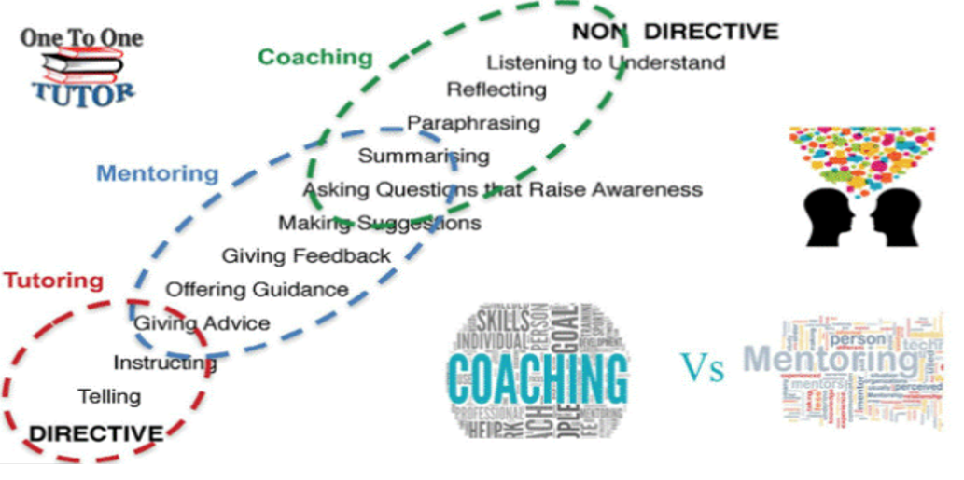
Education is a spectrum

Slide 6
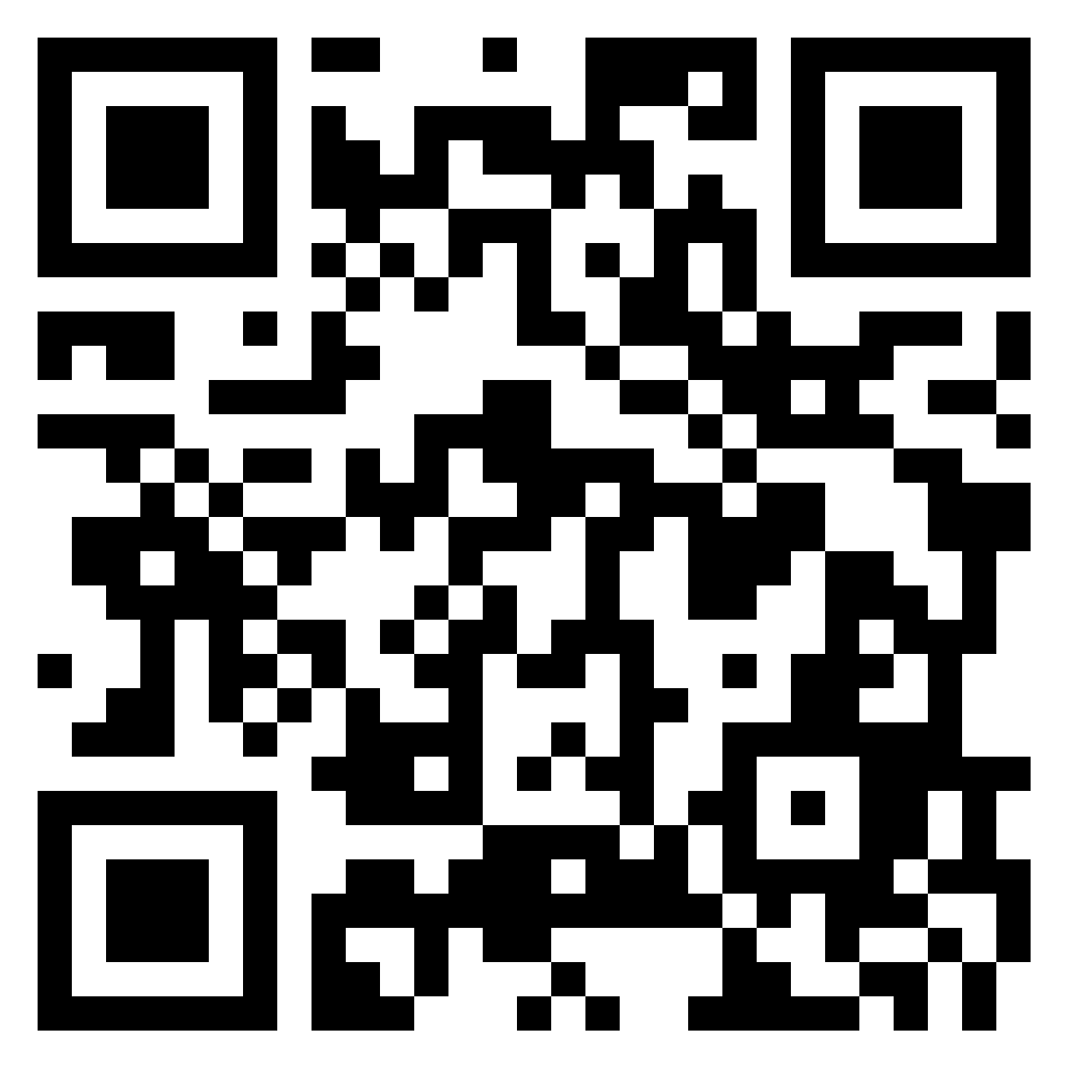
28th March 2023
Education pillar workshop- Padlet
https://padlet.com/sjryan/education-pillar-911zx64y1mtcde5l

Slide 7
Focus 1:
Consider the different educational opportunities you have over a week and over your year.

Slide 8
Focus 2:
How can you practice the education pillar whilst in a busy role?
Consider how you record this?

Slide 9

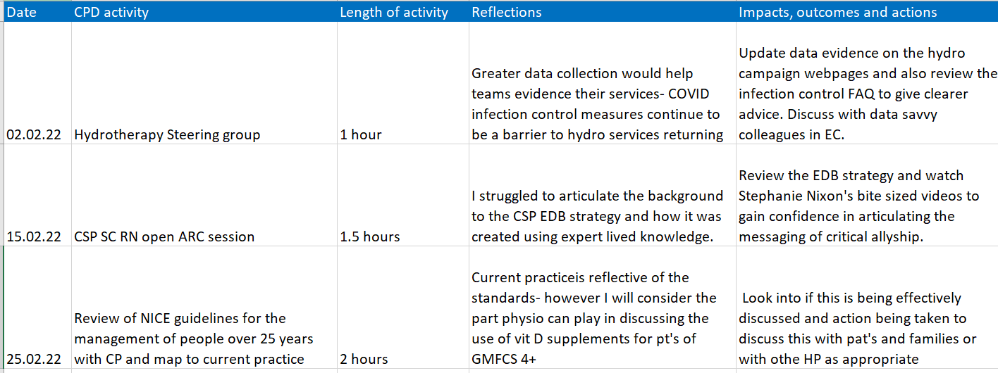





Examples of methods of recording-

Slide 10
Focus 3:
How can I develop as an educator?

