Slide 1



HCPC Standards of Proficiency (SOP) changes 2023
Notes:
HCPC protect the public and by doing so maintain public confidence in the 15 health and care professionals that they regulate
set standards for professionals' education and training and practice and which define the minimum safe working practices of each profession professional practice and conduct.
Approve pre-registration programmes which professionals must complete before being able to join the register
keep a register of professionals, known as 'registrants', who meet our standards; which is open to the public to check.
take action if professionals on our Register do not meet our standards.

Slide 2

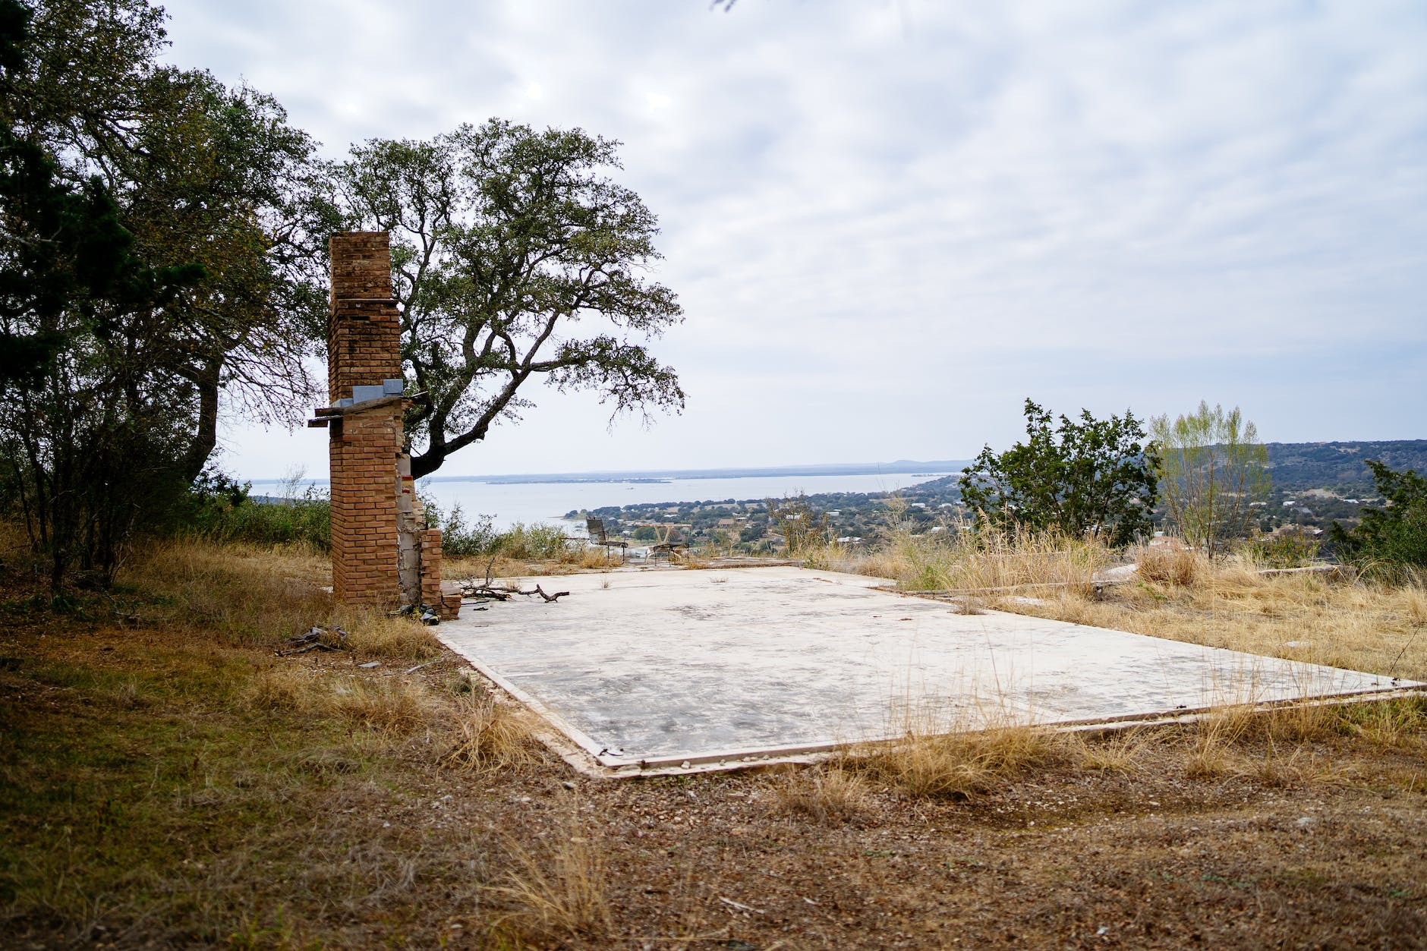
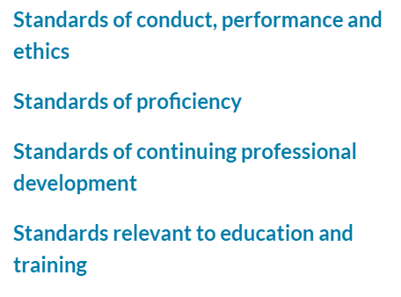

Notes:
HCPC standards form the foundation for how we are regulated as a profession- they are the baseline/ the minimum against we are measured.
3 standards that are cross profession-
-Standards of conduct, performance and ethics- what conduct the public should expect.
-CPD- Sets out what you need to do to keep knowledge and skills up to do to practice safely and effectively and therefore remain on the register.
Education and training- Ax and approves pre-reg courses to ensure they produce HCP who will reach the standards to go on the register,
Standards of proficieny which are profession specific and these are the standards that we are focusing on today.

Slide 3


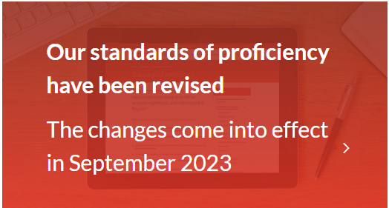
Notes:
HCPC standards of proficiency for physiotherapists have been updated, and these changes will take effect from 1 September 2023.
All registered members must be aware of these changes and be able to demonstrate their practice meets the new standards from this date.

Slide 4

Notes:
What is changing?
Following the HCPC’s consultation process, the changes move away from physios passively understanding the standards to a requirement that they can actively demonstrate the standards in practice.
Focused on being able to DEMONSTARTE rather than understand.
Also, more focus has been put on the following areas:
Equality, diversity, and inclusion
Centralising the role of the service-user
Promoting public health and preventing ill-health
Registrants’ mental health
Digital skills and new technologies
Leadership at all levels of practice

Slide 5
Standard 1 makes clear that registrants must ‘practise safely and effectively’ instead of being able to practise safely and effectively:
“1. Registrant[s] must practise safely and effectively within their scope of practice”
Notes:
Some examples of passive understanding to being able to actively demonstrate the standards is practice

Slide 6
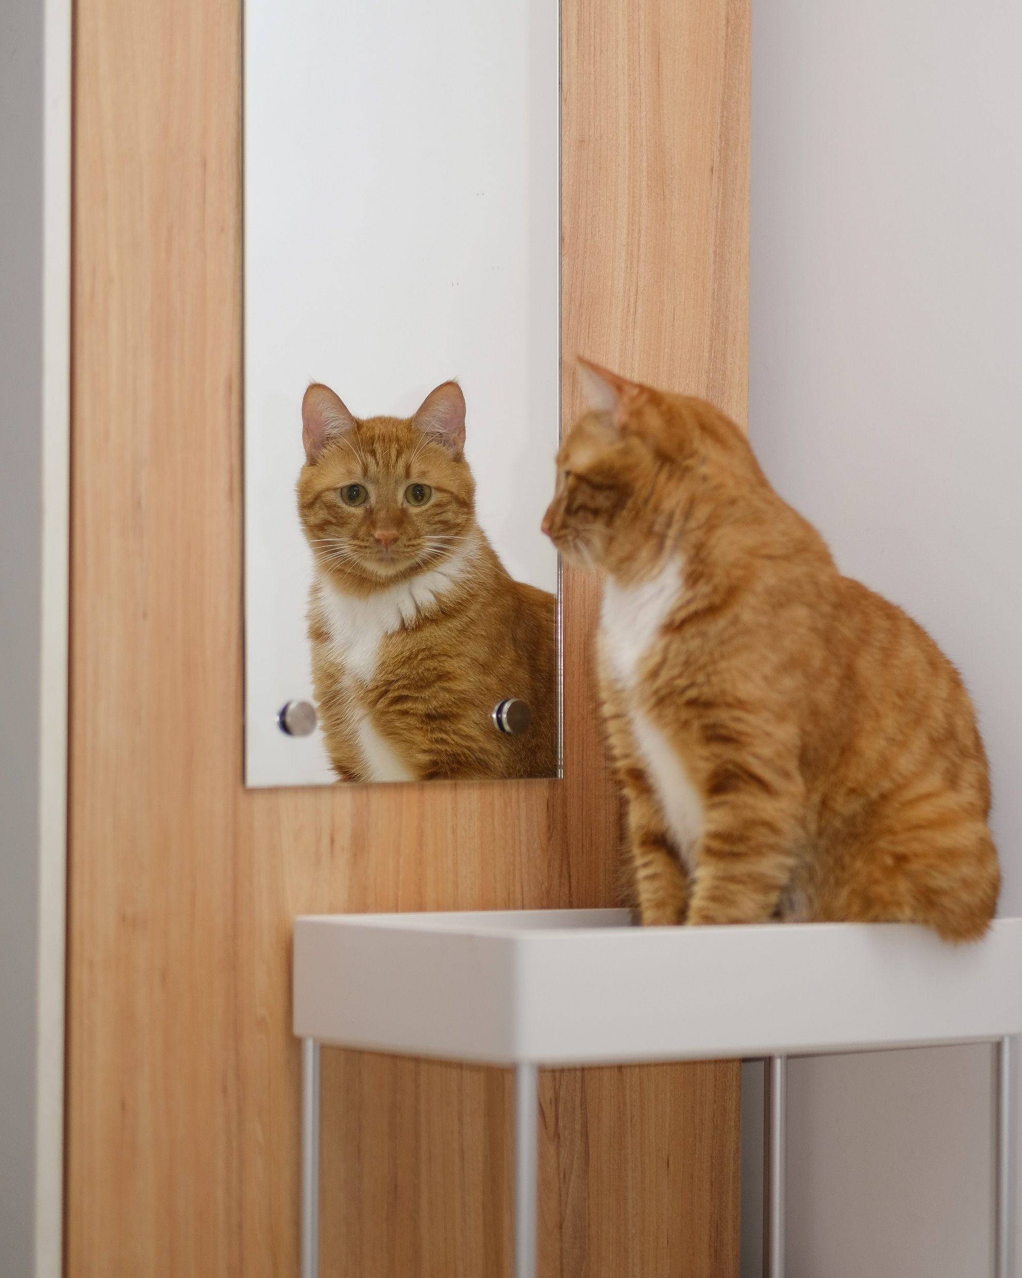





Notes:
Changes are cross cutting which are pertinent to everyone’s practice and they do mirror the CSP strategy
They are congruent with the CSP corporate strategy cross cutting themes of Promoting personalised care
Promoting prevention and public health
Promoting a positive public image of physiotherapy
The CSP EDB strategy
The 4 pillars- ed, clinical, research and leadership
Physiotherapy Health Informatics Strategy (PHIS)

Slide 7
More focus has been put on the following areas:
Equality, diversity, and inclusion
Centralising the role of the service-user
Promoting public health and preventing ill-health
Registrants’ mental health
Digital skills and new technologies
Leadership at all levels of practice
Using research and evidence in practice
Notes:
Scope-

Slide 8
What should registrants be be doing?
Start to familiarise yourself with the forthcoming changes in the standards.
Start to work through the HCPC gap analysis tool.
Top-tip- think about the scope of your role when doing this.
Notes:
What should you be doing?
Everybody is different and may approach this from different angels- but one good way to get started.
Start to familiarise yourself with the forthcoming changes in the standards. Each registrant has a personal responsibility and accountability to be able to demonstrate they are meeting the new standards from 1 September.
What is my employer’s responsibility?
It is your employer’s responsibility to be aware of the changes and create an environment where registrants can meet the new standards – this may include opportunities to discuss these as part of supervision, team meetings and/or CPD opportunities to support registrants to be up and running with the standards by September.
Start to work through the HCPC gap analysis tool, which will help you identify where the gaps are in your practice, and help ensure you are meeting the standards.
Top-tip- Think about the scope of your role when doing this.
The HCPC advises
A registrant’s particular scope of practice may mean that they are unable to continue to demonstrate that they meet all the standards of proficiency that apply for the whole of their profession. As long as they make sure they are practising safely and effectively, within their given scope of practice, and do not practise in the areas where they are not proficient to do so, this will not be a problem.
Standards should be applied within your scope of practice. For example, if you are a physiotherapist working in a non-patient-facing role, you will not be expected to demonstrate standard 14.6 – understand and be able to apply appropriate moving and handling techniques – as this is not part of your role

Slide 9

Questions

Slide 10

This Photo by Unknown Author is licensed under CC BY-NC

Slide 11

Each table has a HCPC change category- inc. a list of the relevant standards.
Individual-
Take 2 mins as an individual to consider if you feel you have any gaps that require attention to ensure that you are meeting that standard change.
As a pair-
Take 2 minutes to list ideas/ actions that could be undertaken to show that you are meeting the standard (think as a individual and/or as part of a team)
Table group activity-
Take 5 mins to share you ideas and select a scribe and write on the A4 piece of paper.

Slide 12
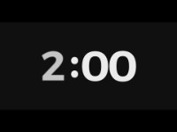
- Do you feel you have any gaps that require attention to ensure that you are meeting that standard change?
https://youtu.be/fJQEOX0-cFQ
Notes:
Take 2 minutes individual consideration if you feel you have any gaps that require attention to be able to show that you are demonstrating the given standard? You don’t have to share this with anyone- it is just to start you on your gap analysis journey.

Slide 13
- Think about ideas/ actions that would be helpful for you or your colleagues to take to prepare for that you are meeting the updated standard.
https://youtu.be/fJQEOX0-cFQ

Slide 14
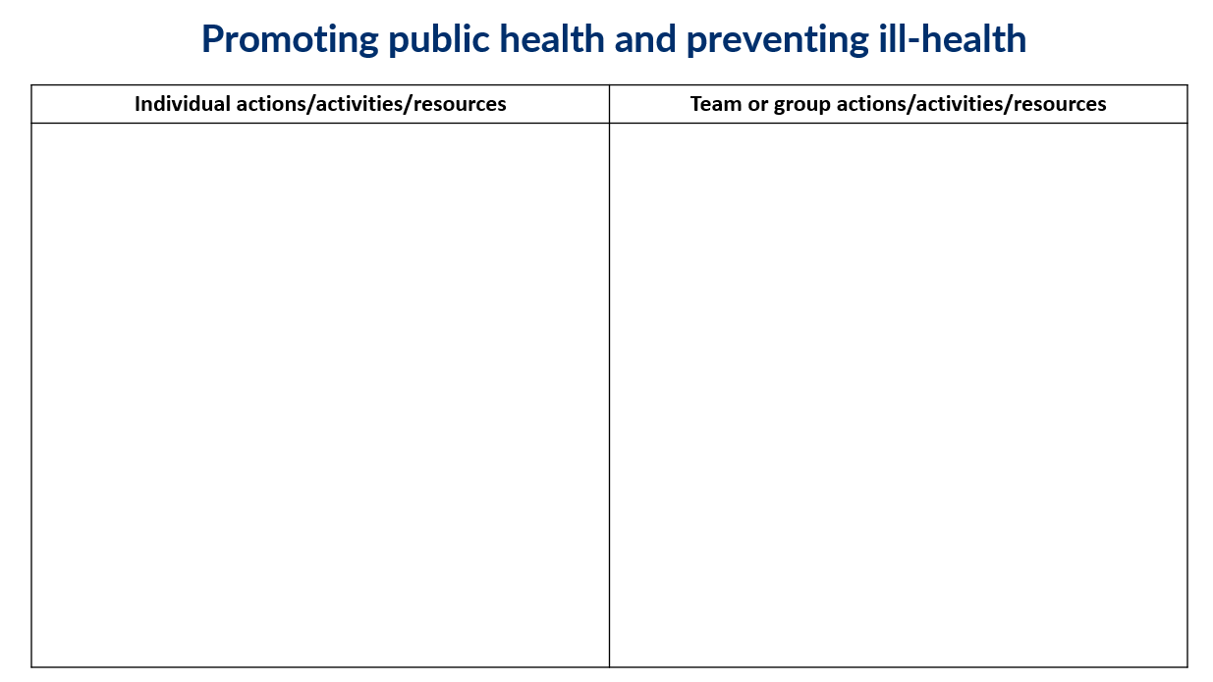

Slide 15

Share you ideas and select a scribe and write on the A4 pieces of paper.
https://youtu.be/KiIHN0FaQPw

Slide 16

Please let me have your A4 sheets!
Notes:
I plan to put together all your ideas into one document and share it back with you later this week so that you have a full set of ideas of actions you can take to prepare for the changes- please share these with your teams and colleagues- along with the links from this presentation which will come out via email with the resource I will put together.

Slide 17
Menti
Rank by priority which areas you would like to develop your knowledge in preparation for 1st September HCPC standards change?
https://www.mentimeter.com/app/presentation/aldmyphscguqv6c2u4o7s8fjtoknewm2/3nzex9656exm/edit
Notes:
Intel to help guide our next steps with regards to resource development- this is anonymous.

