Slide 1
Tales from the Sussex system
Moving from patient to person
Karen Poole
AHP Rehabilitation Consultant
East Sussex Health Care Trust
Karen.poole2@nhs.net
Rehabilitation – East Sussex Healthcare NHS Trust (esht.nhs.uk)
Notes:
Good morning everyone. – Im Karen Poole and I work as an AHP Rehabilitation Consultant in East Sussex.
Its lovely to be here with you all and I’d like to thank the CSP for inviting me to join your session this morning, which is titled Tales from the Sussex system. I hope to share more of our learning and insights from our transformation journey as we reshape our rehabilitation services in order to reframe the focus from patient to person.

Slide 2
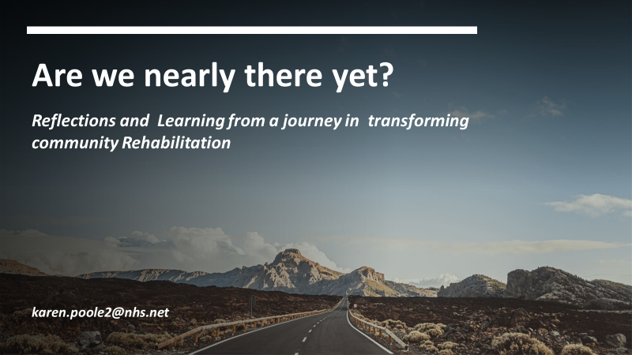
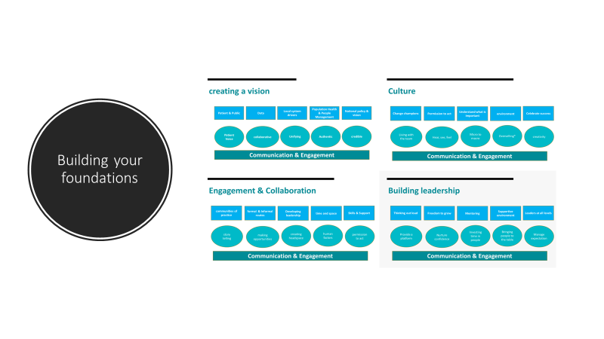
Are we nearly there yet?
Recap from last time
Notes:
Some of you in the audience may remember that I joined you earlier in the year to share our reflections from Sussex on engaging others and how we create the conditions for transformation. In the session titled ‘are we nearly there yet;, I explored with you about how we co-create a vision, how we were establishing opportunities for engagement, provided opportunities to see, hear and feel our culture and the importance of enabling opportunities for leadership at all levels. For each of these foundational steps we also explored how we could influence for different audience: individual, organisational, your local system and regionally.

Slide 3




Our time together today
The Big Picture
Collective Learning
Developing networks
Putting it into Practice
Notes:
We only have a short time together today, so I would like to offer some perspectives from Sussex on four key elements: offering an opportunity to reflect on the bigger picture and share what we are trying to achieve as a rehabilitation community; to share some of the learning we have acquired on the way and how we are developing more robust network for rehabilitation within Sussex and finally share some examples of how we are trying to put all of this into practice.
As I share our reflections I have popped the icons you can see on the screen into the top right hand corner which I hope will be helpful in signposting our session.

Slide 4
The big picture- delivering population health
NHS Personalisation Agenda
NHSE Intermediate Care Programme
ICB Population health & inequalities priorities
CSP Community rehab standards
NHS Long Term Plan
Notes:
There is lots of information that I could have pulled into this slide, so forgive me for a fairly basic approach to such a large topic. However our overarching guiding principle for all elements of health and social care , including rehabilitation , is to deliver population health. So how are we keeping people living well for longer within our communities.?
The long term plan sets out the broad principles for us within rehabilitation including: end to end care, prevention and health inequality, better care outcomes, innovation in workforce and digital enhancement, whilst the personalisation agenda reframes our relationship with those who use our healthcare services.
In September Jenny Keane, National Clinical Director for Intermediate Care & Rehabilitation launched the Intermediate Care Framework which sets out the new blueprint for transforming out of hospital services. This will include testing and evaluation of a single community recovery model to be delivered at place by a single commissioner.
This is a new programme of work and so is still in formation- but in essence it has ambitions to better understand the models of care and the workforce required to best support access to therapeutic intermediate care services. The principles that Jenny keane described are very much aligned with our journey within East Sussex, which is to move towards a single umbrella model for community rehabilitation, enabling us to reduce health inequality through improving access to consistent needs based approach for all who need it.
Also offering guidance and direction on how we collectively tackle health inequality within our regions will be the newly formed integrated care systems. These are partnerships of organisations that come together to plan and deliver joined up health and care services, with the aim of improving the lives of people who live and work in their area.. The partnerships will involve the NHS, local councils, community and voluntary organisations, local residents, people who use services, their carers and representatives and other community partners with a role in supporting the health and wellbeing of the population.
We also have the newly launched CSP community standards that offers quality best practice guidance to support the changes we need to make in how we deliver rehabilitation to reduce health inequalities that have inadvertently developed as a result of historical condition specific models.

Slide 5

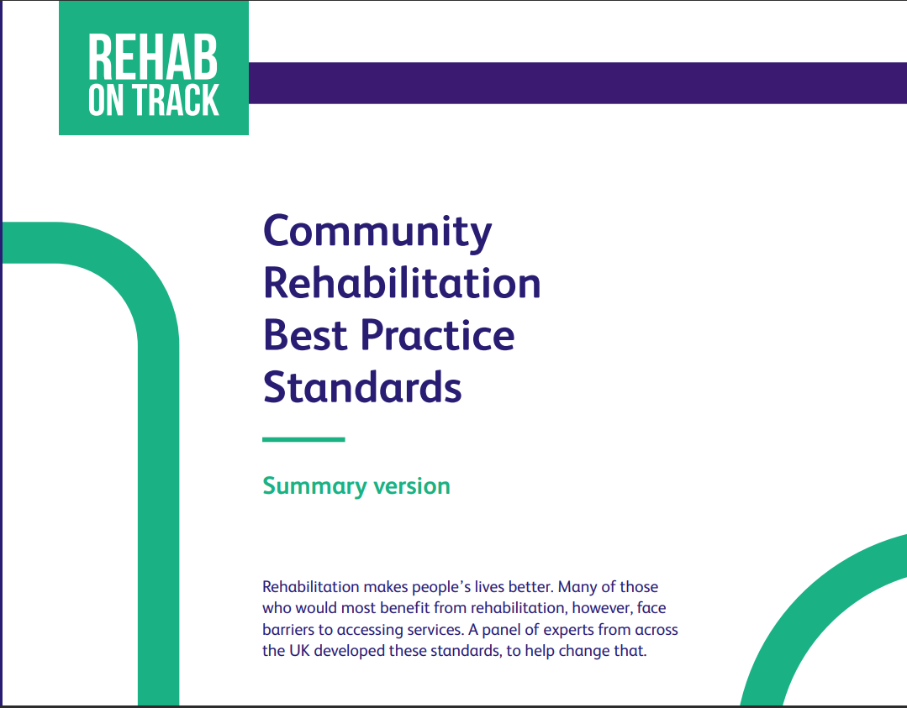
CSP Community rehabilitation Standards
Current issue
Overuse of high cost resource
Aging population
Multi-presentational complexity
Diagnosis specific rehab models
Variation in access & delivery
ICS impact data
Call to Action
Mapping & benchmarking
System rehabilitation programmes
Needs based care
Proportionate delivery models
Single community umbrella
Regional data suite
Notes:
Through the CSP Community rehabilitation Standards, Sarah has already shared with us the current issues and the collective call to action us all. I will pick up a few of these within the next few slides.

Slide 6
What are our guiding principles to enable people to live well?
Single community vision
Person centered system
Adaptable needs based response
Longterm view of rehabilitation
Broader paradigm of rehabilitation
Notes:
So If I was to bring together all of the information, policy and guidance to offer that helicopter view – how would I describe the principles that underpin our approach in supporting our population to live well.
Where are we going ?
We need to offer a single community response that is able to deliver truly person centred care and respond to areas of concern that matter to individuals. This will also include the ability to wrap around care in a flexible away that involves horizontal and vertical integration , so what I mean by this is an ability to scale up and down the level of intensity and recognised that rehabilitation support plans may be delivered by multiple agencies working in a coordinated way around a single patient at the same time. This will also require us to evolve the support we offer people with long term conditions over their life course.
How many of your services offer long term follow up and flexible patient led re-access at a time that feels right for individual? We recognise that we are where we are in relation to our historical rehabilitation models, but i would urge you to look at the person in front of you and ask yourself what do they really need from me to help them live well. We additionally know that the solutions needed to support our ambition to deliver lifelong rehabilitation and move from patient to person will sit within broader partnerships forged with all parts of our community infrastructure. Collectively this will help us to shift our thinking towards a broader paradigm for rehabilitation –so what might now we need to considered within the rehabilitation toolbox.

Slide 7

Making this reality- what does this mean for us?
Uncoupling services & reforming
Developing squiggly pathways
Need to embracing new aspects of health
New rehabilitation cohorts to support
Embracing new roles to deliver rehabilitation
Working in new environments
How does that make you feel?
Notes:
Delivering all this may feel like a tall ask. So how do we make this a reality, and what might this mean for us.
We have invested time and energy in refining and developing our services, ones that we are rightly proud of, however to offer rehabilitation that supports the journey of patient to person, we may need to uncouple elements of our service or practice and reform them in a way that will enables a more person centred perspective to rehabilitation .
I'm sure that for some in the audience this may be evoking different emotions. It may mean that we need to develop squiggly pathway- what do I mean by squiggly pathways? Well I just mean that its not nice and linear. We generally like our patients to come in one way and out at the other end, but patients may coming in and out multiple times or may have a stop and start approach in to their rehabilitation, accessing our services at a time that is right for them and not us. We will need to move away from discreet episodes of care and to a more open access options.
Todays event is around self management and living well, for some of us in the rehab community these may be skills we don’t yet have or feel confident in- for others it may mean we are moving away from hands on approaches built around rehabilitation goals, and moving towards more enabling and coaching skills which harness a what matters to me ethos. So how do we deliver multiple agency needs based care around a person which will feel like a single team is supporting them?
There are also new cohorts- I don’t know about you but in our system we spend lots of time discussing the groups of people who don’t fit within our services- so where do these patients go and who will see them? To be clear this isn’t about health filling all the gaps and it brings me back to my first reflection around uncoupling our services to look at integration and partnerships opportunities across the wider community landscape.
We will also be starting to see new roles and opportunities to better support our population in this changing landscape. This may be new roles for practitioners in non-healthcare settings, innovation in the roles that our non-registered colleagues now occupy or embedding our community voluntary partners within the healthcare setting to build more integrated teams. These all come with new ground for us to tread- shared competency, feeling of blurred boundaries and new skills.
I just want to take a pause and ask you to reflect on how that makes you feel. 10 second Pause
If we have time we may pick this up at the end.

Slide 8
So what might our be our challenges?
Capacity & demand
Workforce
Investment
Measuring our impact
Blurring boundaries
Governance
Notes:
I'm not going to go into this in detail today but I do want to acknowledge that all of the thoughts I shared on the previous slide come with potential challenges as well as opportunities. None of these are new to anyone here today, however as a collective community of practice many of you will already have expertise, insight and practice examples on tackling these challenges. The CSP has a vibrant community of practice and I would urge you to post your learning for others to see and share. This is not a competition folks – we are in this together.

Slide 9

A Shared Rehabilitation Vision for Sussex
Understanding our rehabilitation population
Measuring our performance
Prevention
Service users central to the whole process
Needs based rehabilitation
Transforming our workforce
The 6 Pillar Model
Harnessing innovation and digital technology
Delivering responsive rehabilitation pathways
Reducing health inequalities
Access to life long reablement
Notes:
So I moving into the collective learning section now – check out the icon in the corner
The last time we met I shared with you all our collective vision for rehabilitation in Sussex. To provide context, outside of my clinical role, I also have two clinical advisory roles within our Integrated care system, supporting the delivery of the stroke and long Covid programmes. These programmes sit within the Long Term Conditions programme, and in the absence of a formal rehabilitation network we had used this programme as a lever to develop The Sussex Rehabilitation Mandate or 6 pillar Model .
By way of a recap, this is intended to offer a blue print or framework with which our rehabilitation services can review their current service delivery models and explore the opportunities for transformation. We recognise that our teams operate and have been commissioned differently, however through the principles within the model we are supporting colleagues to move collectively towards a needs based and personalised care ethos that is irrespective of the pathway or geography they may operate within . The delivery of the model is supported through the 6 Pillar transformation journey which I will share in more detail on the next slide.
Our model has been endorsed by the Sussex AHP Council, Aging Well and long term conditions programme within the ICS and our primary and community care collaborative.
The model consists of 6 board pillars with 4 foundations
The Pillars are:
Understanding our rehab population –
Measuring our performance –
Transforming out workforce –
Needs based rehab –
Delivering Responsive rehabilitation pathways –
Access to life long re-ablement –
The core foundations that underpin the model are:
Prevention
Engagement of service users
Harnessing innovation and digital solutions
Reducing health inequalities

Slide 10
Delivering under the 6 pillars
Understanding our rehabilitation Population
Measuring our performance
Responsive Rehabilitation services
Needs Based Rehabilitation
Transforming our workforce
Lifelong
Re-ablement
Embedded approaches to population segmentation and/or stratification based on symptoms, function and need.
Handbook (networks.nhs.uk)
Multi-morbidity rehabilitation models
https://innovations.csp.org.uk/innovation/multimorbidity-rehabilitation-sustainable-way-forward
Utilise personalised care approaches and an understanding of patient activation within rehabilitation
Participate & engage in relevant Rehab Outcome data collection
All Community Stroke services participate in the Post Acute SSNAP audit
Development and delivery of an ISDN Rehabilitation Dashboard and quarterly reporting process
Use of stratification modelling to support capacity and demand thresholds
To ensure contribution to local & regional Situation Reports for rehabilitation pathways.
Rehab Services use an appreciative enquiry approach to enable patient & public feedback, supporting improvements in patient experience and development of our services. Patient_experience_improvement_framework_full_publication.pdf
Access to Rehabilitation & care navigation e.g. rehab co-ordinators
Access to Early Supported Rehabilitation models to support acute discharge for all rehab patients
All ESD patients assessed within 24 hours
Availability of Community Rapid Access beds for rehabilitation (diagnostic , intervention and rehab assessment)
Services to clarify patient pathway for Access, Follow up & Review.
Mid way reflection workshop
Implement & deliver Needs Based rehab model across Sussex
Embed Ambulatory Rehabilitation Models to support flexible care delivery.
Reduce diagnostic silos in rehabilitation
Ensure access to Psychological services for all who need it (>85%)
Improving access to vocational rehabilitation
Delivery of a regional post stroke spasticity model
Provide an opportunity for 6 month reviews for any patient on a rehab pathway
Harness novel and modern workforce solutions – use of community assets across the pathway from admission & beyond Implementation of 7/7 access to stroke rehabilitation
Implementation of stroke rehab training and education programme & e-learning
Increase use of digital and tele-rehabilitation platforms
Access to Multi-professional clinical forums across health, psychological and social care
Implementation of Rehabilitation Pilots
Engaging our stakeholders (e.g. crowd wisdom) to help shape our rehab strategy
Increased survivor, carers and public involvement in co-designing our services to address health inequalities
All patients given a Stroke or Rehabilitation passport.
Access to advice and support at point of need
Harnessing the Third Sector and community assets to support self management
Ensure access to patient peer led/ facilitated forums to support living well in our communities.
Prevention
Service users central to whole process
Harnessing Innovation & Digital solutions
Reducing Health Inequalities
Notes:
So how are we applying the Sussex Rehabilitation Mandate or 6 pillar Model in a pragmatic way.
The 6 pillar journey is a series of half day workshops that uses an embedded learning approach, where the outputs are co-created by colleagues across our system- including community ambassadors, community voluntary partners, commissioners, and health and social care. In this first 6 pillar cohort we have colleagues representing all of our neurorehabilitation or stroke services across Sussex, with a plan to roll out in other areas. This slide illustrates our progress so far – which has seen us host 4 of the pillar workshops with the 5th planned for the 24th November.
There is a purposeful order to the pillars in the programme, which enable our teams to build on their knowledge and insights gained within the previous pillar. Through this approach we are also able to respond to emergent themes in a collaborative way. As our programme for rehabilitation and life long reablement evolves, underpinned by our growing insight, we are additionally introducing a variety of approaches to respond to requests for support from colleagues.
The feedback from the 6 pillar approach has been positive as it offers colleagues much needed headspace to think differently and a collective approach to learning. It may also offer a realistic way to undertake whole system transformation.

Slide 11
What have we learnt so far?
Need common tools to understand community complexity
Shared Rehab Framework or model to ensure right people are getting the right type of rehab and therapy at the right time
Evolving the responsive rehab offer beyond traditional ESD pathways
Embed a common approach to community waiting times to reduce risk of clinical harm
Developing models to support tiering or segmentation of caseloads to maximise workforce and access to rehabilitation
Ensure there is a universal offer of self-management& support across Sussex
Amplify our use of peer support and peer leadership
Optimise use of our use supporting infrastructure
Opportunity to look at shared resource and inter-provider rehabilitation collaboration
How do we make this happen on a larger scale………?
Notes:
The Sussex rehabilitation Model has also been embedded within the Rehabilitation Transformation work happening at East Sussex , where I work as a consultant. What have we learnt so far across our collective journey within Sussex?
We recognised that we needed some common tools and a shared understanding of community complexity. Our community caseloads are vast so how do we begin to make sense of those? We are beginning to explore this in more detail within Sussex and I will share those examples with you shortly. We have developed a framework which enables us to segment our community caseloads and help us to apply a consistent approach in determining the needs of our population, as well as understanding how we can better respond to those needs at a time that is right for them. From this we have been able to look differently at the delivery of a responsive rehabilitation model for people with longer term needs and who traditionally may have experienced longer waits for rehabilitation.
To complement our evolution in delivering responsive rehabilitation we have also recognised the need to embed a universal offer of self management and support across Sussex. Our long Covid services have been progressing this model of supported self management as part of a tiered approach to rehabilitation. Through segmentation of our caseloads we have seen opportunities to , maximise the use of our workforce and improve capacity for access to rehabilitation. We are also embedding a common approach to community waiting times to reduce the risk of clinical harm. In addition we are amplifying the role of peer leaders in supporting our service redesign and identifying more opportunities for access to peer support. We also continue to look at shared resources and inter-provider collaborations to strengthen how we can better deliver rehabilitation across Sussex. So we have some fledgling starts here but how do we make this happen on a larger scale?

Slide 12

Collective ambitions of a Sussex Rehabilitation network
Ensure equitable post-discharge offer available to enable more appropriate healthcare utilisation for those living with LTC
Consistent approaches to the delivery of a rehabilitation offer
Maximising access to self management advice and support for every patient who needs community rehabilitation
To move from a prescriptive diagnostic pathway approach to a needs-based rehabilitation offer
Delivery of a tiered approach to rehabilitation enabling a person-centred offer
Encourage integration of primary care within and across rehabilitation pathways through an MDT approach
Notes:
So this is where we need to start to build our rehabilitation networks, and it feels like a really exciting time in Sussex as we start to develop an integrated care system rehabilitation network and programme
So what is our collective ambition for a network as we start to build it?
Its about ensuring there is an equitable and consistent post-discharge offer of rehabilitation and support for those living with LTC
To Maximising access to self management advice and support for every patient who needs community rehabilitation
We are also signed up as a system to move from a prescriptive diagnostic pathway approach to a needs-based & embrace delivery of a tiered approach to rehabilitation enabling a person-centred offer

Slide 13

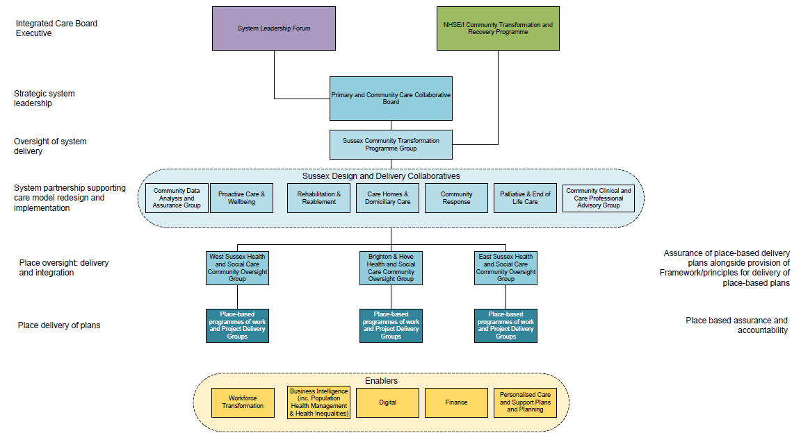
Governance Framework
ICS LTC
programme
ICS Aging Well programme
Sussex Community Transformation Programme
Sussex AHP Council
Provider Transformation
programmes
Notes:
As you all know we need to demonstrate that we have the governance to underpin our rehabilitation programme within the ICS.
This illustrates the governance architecture for rehabilitation within the Sussex Integrated Care system, through the Sussex Community Transformation Programme. There are still details for us to evolve but this feels like a strong starting point.

Slide 14
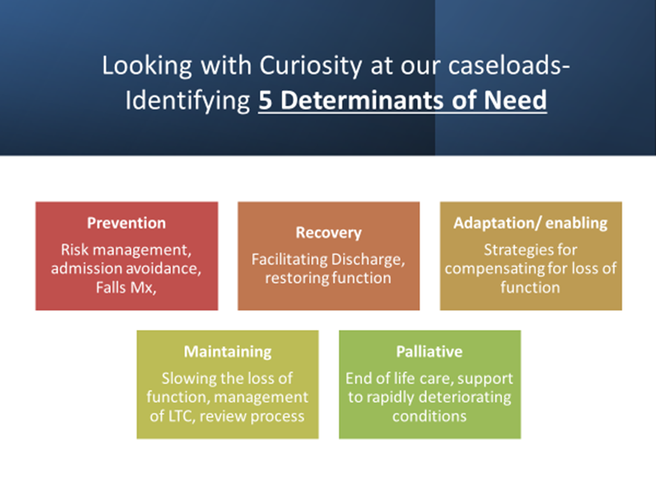
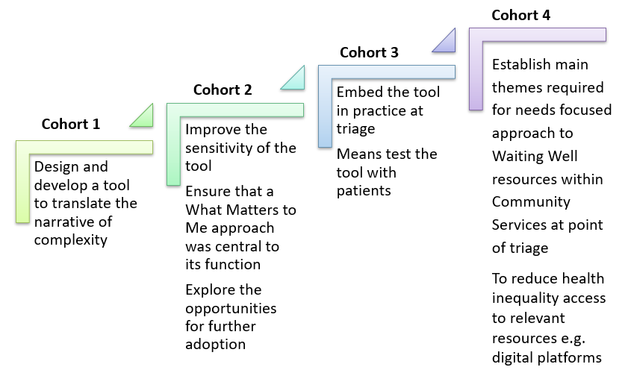
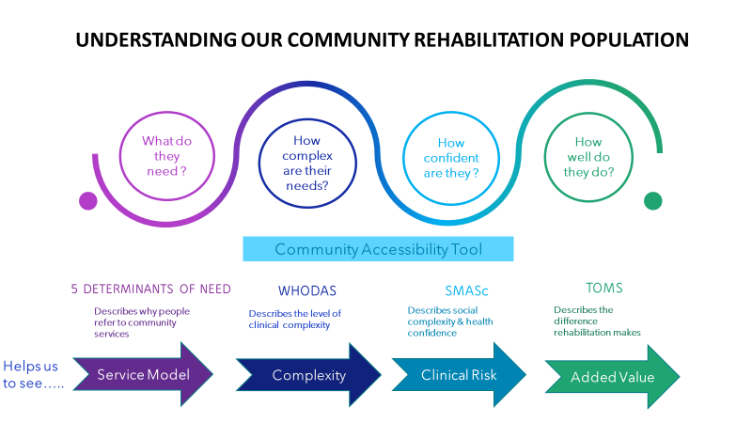
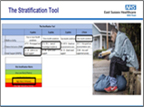
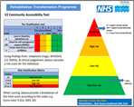
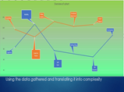

Improving our understanding of our Community Rehab Population and shifting how we respond within East Sussex
Our Challenge
4 Healthcare Student Leadership Placements an action research project to develop, design and test a community accessibility tool measuring three parameters of need, enabling our services to adopt a proportionate, timely and tailored responsive approach to population health, reducing the risk of health inequality through improving access to our services based on need, not diagnosis. Each cohort was supported by designated clinical staff from ESHT and members of the Personalised Care Group.
Due to sustained pressures throughout the pandemic the capacity of our staff to undertake a significant transformative project was limited, so a novel opportunity was identified to work collaboratively with University of Brighton, NHS England and ESHT to offer …
May-Jun 22
Apr-May 22
Jan-Feb 22
May-Jun 21
Next Steps
Recording 5 determinants on S1
Embed Accessibility Tools as part of triage to identify opportunities for waiting well approach
Evolve Waiting Well ( guided self-management approach)
Review capacity & demand
Workforce transformation
REHABILITATION MATTERS
Rehabilitation – East Sussex Healthcare NHS Trust
Notes:
So far I have shared with you how we have started to translate the bigger picture and themes for rehabilitation . I have also described how we have developed and are continuing to build our networks and our architecture for transformation alongside the governance pathways which will support rehabilitation to have a voice within our Sussex system.
So now I want us to move into putting this into practice section
This slide is busy as it is the poster format we use to communicate our rehabilitation transformation journey in East Sussex. To support us in this transformation we embarked on a collaboration between the University of Brighton, the personalised Care group at NHSE and our healthcare trust . Over the last 18 months we have collectively supported 4 cohorts of healthcare students on a leadership placement to explore how we better understand community complexity. I will share in more detail in the next slide.

Slide 15




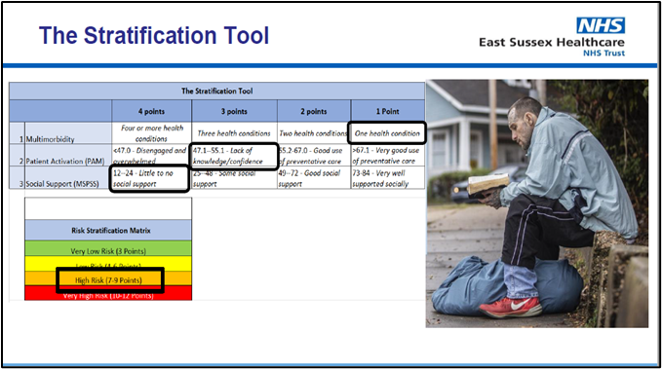
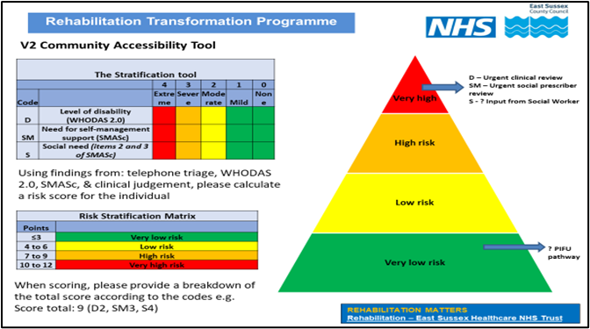

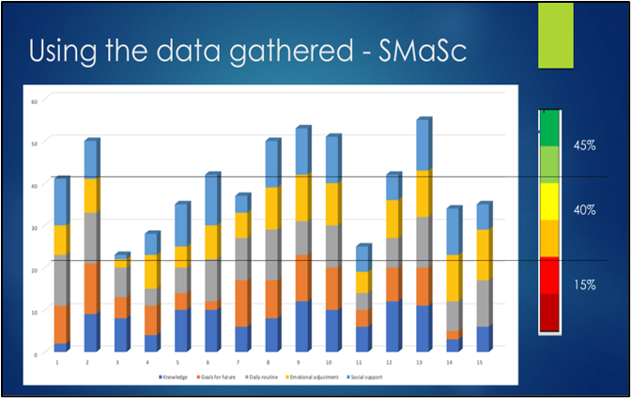
Healthcare Student Leadership Placements – 4 cohorts
COHORT 1
COHORT 2
How do we ‘see’ the opportunities to
do something different?
COHORT 4
COHORT 3
Notes:
Due to sustained pressures throughout the pandemic the capacity of our staff to undertake a significant transformative project was limited. So we took a novel approach and identified an opportunity to work collaboratively with University of Brighton, NHS England and ESHT to offer healthcare students leadership placements to design, test and evaluate a tool to help our staff identify those most at risk from multi-presentational disability .
Our 4 student cohorts were from nursing and physiotherapy undergraduate courses. We are all familiar with the now established narrative around our patients becoming ‘more complex’, so the brief for our students was to work with us to help us better understand our community populations and offer us a unified way of describing what was meant by the term ‘ complex ‘ patient’ and what did that mean for the way we designed and deliver rehabilitation.
Cohorts1-3 helped us to explore the development of a tool that could support us to tier or segment our populating in terms of complexity. They developed a prototype tool, tested its sensitivity, usability and feasibility and then trialled it at clinical triage and explored how the data translated to complexity. We tested out a number of different outcomes or measures to help us stratify and have now reached a consensus on the use of the WHODAs and the SMAsc (Self management Assessment Scale), looking respectively at level of disability and rehab needs alongside health and social confidence . The tool is known as the Community Accessibility Tool as its aim was to improve access to rehabilitation based on a persons level of needs.
With Cohort 4 we were able to move on the next stage of the rehab transformation journey and look at how we could support people in the lower tiers ( the green band in the triangle) and develop a living well approach by using the tool in clinical practice to identify early intervention for those at greater risk of health inequality
In summary, this tool has the capability to offer a systematic and consistent approach to the identification of at risk communities, offering a simple and visual method of quantifying health inequality risk consistent with clinical expertise

Slide 16

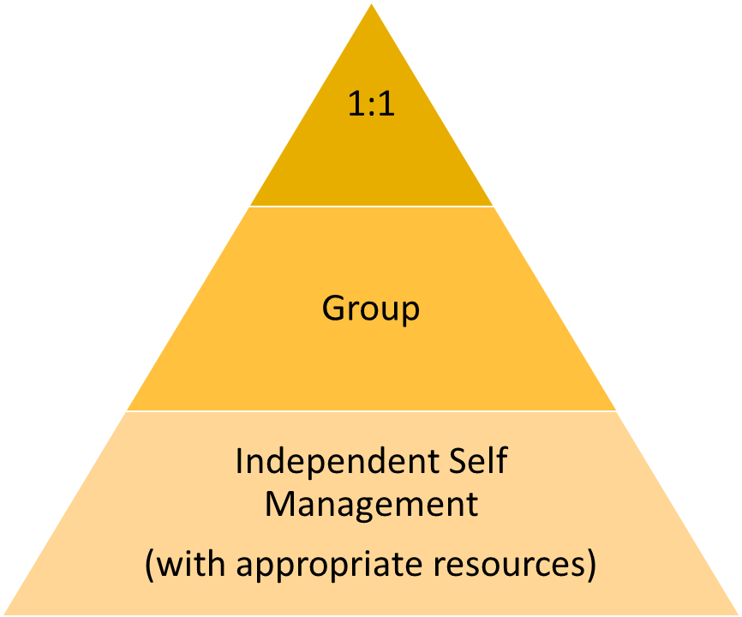




What could be the next steps be?
Understanding our population
Recognition of stratified approach:
30%
50%
Very High
High
Low
Very Low
20%
% of population based on Pilot data using the Community Accessibility Tools (CAT)
Able to describe our population and plan health & social care with confidence alongside our workforce
Notes:
This slide offers a visual representation of how we have used the community Accessibility Tool to stratify our population. You will notice there are percentages and through the pilots that we undertook , we have been able to make provisional estimates of % of patients within each of the low, medium, high and very high risk thresholds according to their scores The thresholds are have been developed through research evidence, clinical consensus and patient feedback, and will continue to be evaluated.
This allows us to identify ways of supporting people within each of those risk categories, and the triangle on the right hand side outline the delivery modelling that we are testing out . The first is the self management category which I will come to later. The next one is our group approach which may be virtual or face to face , and then an individual 1;1 approach again through face to face or virtual methods.

Slide 17
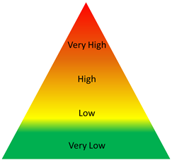

Embedding Living Well in Sussex
Understanding your population
Measuring your performance
Responsive rehabilitation
Needs based rehabilitation
Innovation in workforce
Lifelong reablement
Prevention
Personalisation
Health inequality
Digital innovation
Emerging learning & Practice
Collaborators:
NHS Sussex Long Covid Service
NHSE Personalised care Group
ESHT
SCFT
Care Connectors
Notes:
Now as you can see on the icon in the bottom right hand corner I'm going to talk to you about our lower risk tier and how we have put things in place to support people with their self management journey .
Examples of what we have embedded so far to support our population to live well include:
Embedding the use of the CAT tool at triage within pilot sites to amplify recognition of people who will benefit from a living well or waiting well approach
Embedding Care co-ordinators within our Long Covid & east Sussex community Stroke service
Collaborating with social prescribing colleagues
Using Digital platforms such as Active Lives, Patient Knows best and Trust websites to share self management resourses
Moving to iPREM/iPROM to better understand the impacts of rehabilitation in helping people to live well
Developing personalised care champions across most services

Slide 18
Evolving group offers- supporting rehab intensity
Long Covid virtual pathway programmes
Ambulatory Rehabilitation Model- Hybrid Rehab
Inpatient Activity Co-ordinators
Power Hour- SQuiRe project
NHS Sussex, SCFT & ESHT
ESHT
ESHT, UHSxE
UHSxW
Notes:
Now we are going to move onto those medium risk patients tier- see the icon in the bottom right hand corner. I'm going to give you just a few examples of what we have put in place within Sussex to support this patient group.
Our Sussex Long Covid service have led the way in developing and delivering needs based group rehabilitation through Virtual and face to face methods. The service offers group programmes for fatigue, breathlessness, and well being. They are offer up to 4 groups per week within each of the programmes, with 8-10 participants in each group, and with courses running over 6-8 weeks. The largely virtual approach to care has proven to be welcome for the majority of patients, with less disruption needed to attend appointments. The delivery of group based rehabilitation also speaks to the green agenda, and perhaps more significantly enables the teams to utilise their workforce in a way which optimises their skills, whilst remaining responsive to the needs of the patients.
Our community services have also evolved their use of hybrid rehab approaches within an ambulatory model-enabling access to inpatient environments alongside the persons home, and work collaboratively with our acute colleagues to share access to existing groups or specialist equipment and to optimise opportunities to deliver rehab intensity.
Our inpatient rehabilitation Units have also developed their activity co-ordinator workforce to enhance the delivery of holistic rehabilitation by offering supported practice, socialisation and peer support. Our team at Donald Wilson House in West Sussex have embedded the Power Hour – which is a daily approach to delivering a group based intensity model. This is one of the successful SE Squire initiatives which is exploring how we can deliver quality improvement in stroke rehabilitation. The team are working with the university of Chichester to evaluate the impact of the model.

Slide 19
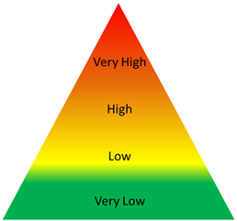
Pan Sussex Responsive Rehab Pilot
12month project Commencing January 2023
Collaborators
ESHT
UHSxE
UHSxW
Innovation in workforce
SQuiRe Funded project
Pathway 3 stroke
Insights & perspectives
Notes:
The last two practice examples address the needs of our population who may be considered in the high complex group.
Through the quality improvement funds for stroke, we have been fortunate to benefit from additional funding to undertake a pan Sussex pilot to explore a responsive model for patients who are aligned to Pathway 3 within the national community stroke model. These are patients with significant disability who may likely require support from long term care facilities or nursing home care. These are not ESD patients or those going home with community rehabilitation, and due to their more limited ability to engage with rehabilitation, have traditionally been subjected to longer waits for rehabilitation and where we may risk losing the opportunity to prevent secondary complications. We anticipate that this will offer us insight and perspectives on developing new way of supporting these patients from an acute setting and improving their access to timely rehabilitation. We also hope this will drive innovation in our workforce such as ACP roles and through new non registered roles.

Slide 20

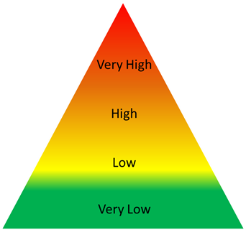
Multiagency vCommunityMDT
What is the vCommunityMDT?
A vCommunityMDT brings together multiple agencies in a simple joined up, virtual way for people with complex needs living within our community.
Collaborators
Patient
Health
Social Care
Housing
Safeguarding
Primary Care
Hospice
Equipment services
Community support partners……….
Benefits
Patient centred care
Plan for those with no plan
Reduced handoffs
Responsive engagement
System accountability
Working together
Boundary blurring
Collective risk sharing
Evidence of rehab and support gaps
Driving change in practice
Cross System
Multi-agency
Governance & Accountability
Population data & Evidence Gathering
Notes:
Finally I would like to share the example of the community multiagency vMDT. This is a process which brings together multiple agencies in a simple but virtual way to support the care planning for people living with complex needs within our community.
This is not a normal run of the mill MDT. This is designed to support the care for individuals where there is no agreed plan. They may be the patients that sit within your caseloads (and you all will have experience of this) where they are handed off from one team to another, where each service declares that the person is not within their scope or remit. It is usually because these are really complex cases where there is no easy pathway to navigate.
So within East Sussex we enacted a QI project to understand how we could better support these people in order to offer a cohesive and timely approach to care. Those who collaborate within the community VMDT can be anyone involved with that individual. To support the community vMDT there is a clear governance and accountability framework which we have developed , shared and tested over the past 2 years. To date over 30 cases have already gone through this process and in all cases an agreed plan has been achieved.
The greatest impact is that once a person is referred to the community vMDT and the process is enacted, everyone engages. We develop an agreed plan and there is a shared endeavour to enable the person to access the support they need. We have also seen improvements in our system engagement and accountability, and it offers us confidence to take shared system risks in the care of individuals within the community. It is also helping us to evidence the gaps in resource for this population group such as postural management, and ultimately drives innovation and change within our system .
Identify the gaps

Slide 21
Reflections & Thoughts
The Big Picture
Collective Learning
Developing networks
Putting it into Practice
Notes:
So this has probably felt like a lot of information today and I hope I have offered a sense of how we can begin to land some of those broader concepts, making them a reality and sharing what this could look like this in practice.
I would like you to spend some time reflecting on what you have heard today and I’d be really grateful to hear your thoughts. I’m also sure that many of you will have examples of practice that you are already doing that could inform our progress in Sussex, so please do reach out and make contact and we can evolve our community of practice within the SE together..
Thank you so much for your time this morning

