Slide 1

Standing Tall
Ruth McEnery-Carter
Julie Butler

Slide 2
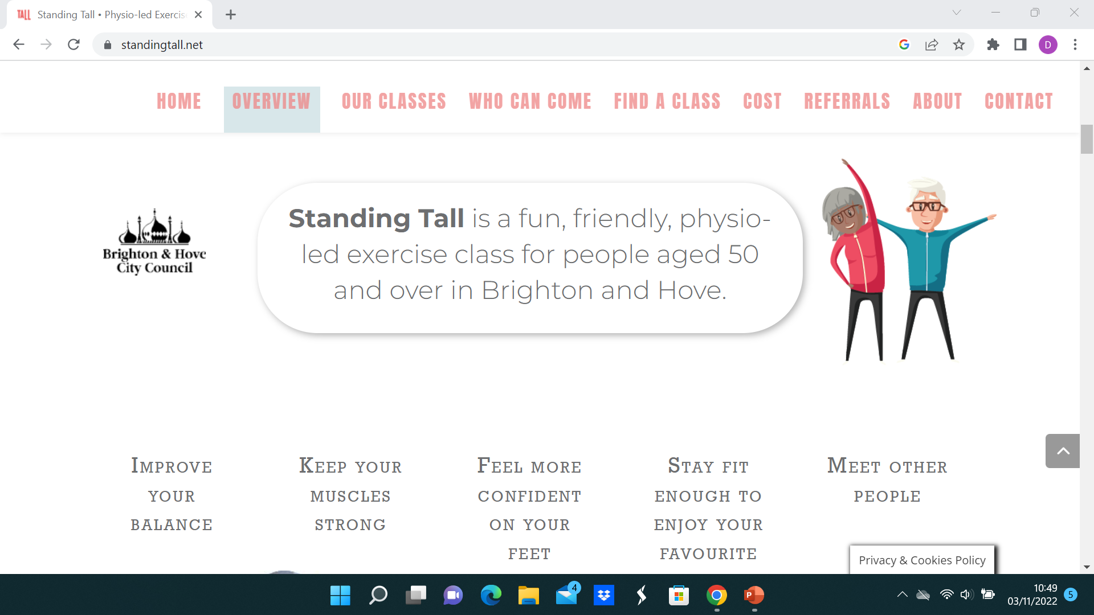

Slide 3

Currently:
11 face to face classes/week
1 zoom class
4 PSIs
133 current participants
Funded, supported and promoted by Public Health BHCC

Slide 4
Who we are
Local physiotherapists, working within NHS
Intermediate Care, Care Homes w Nursing, NRC, Responsive Services
Voluntary sector - befriending charity
Passionate about helping older people move more and do the activities that matter to them, for as long as they can

Slide 5
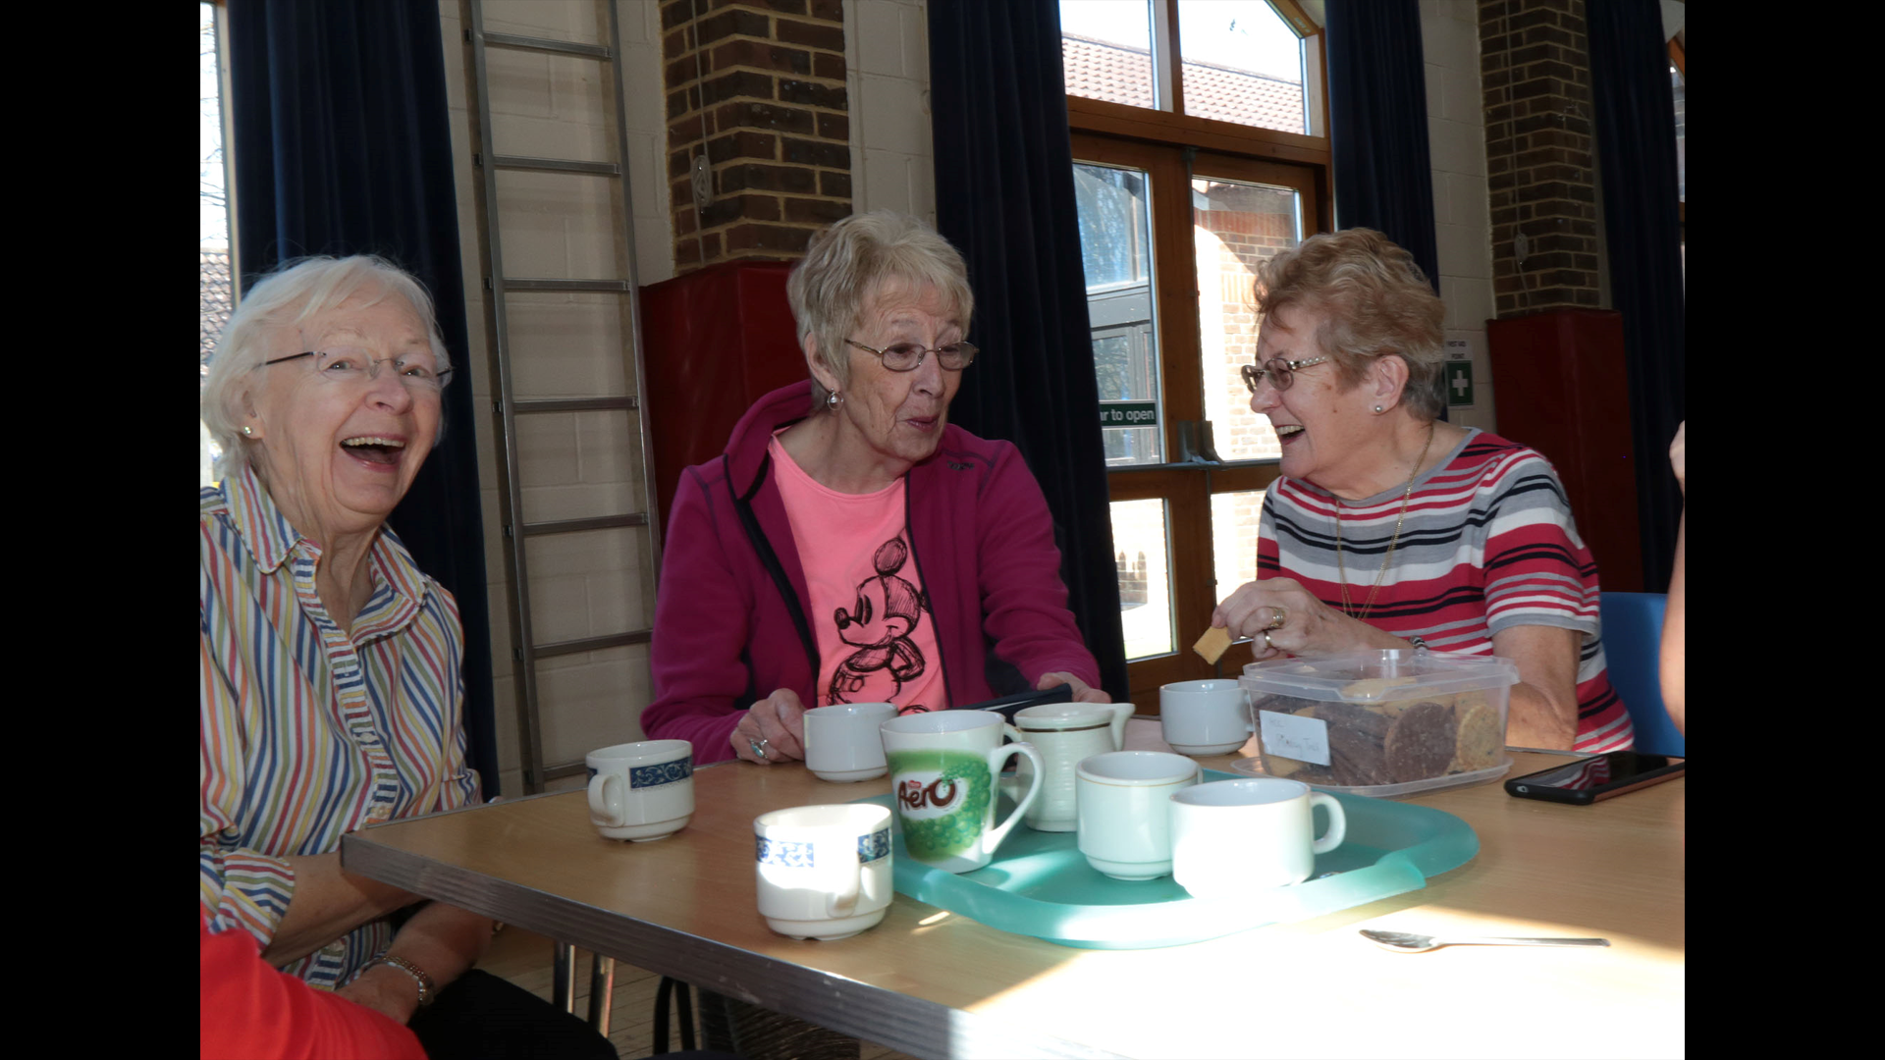
What we do
Community dwelling adults self refer or referred
Community centre/church hall near to them
One hour long class
PSI trained, therapist led
Evidence based strength and balance exercises
Social element after most classes w tea/coffee

Slide 6
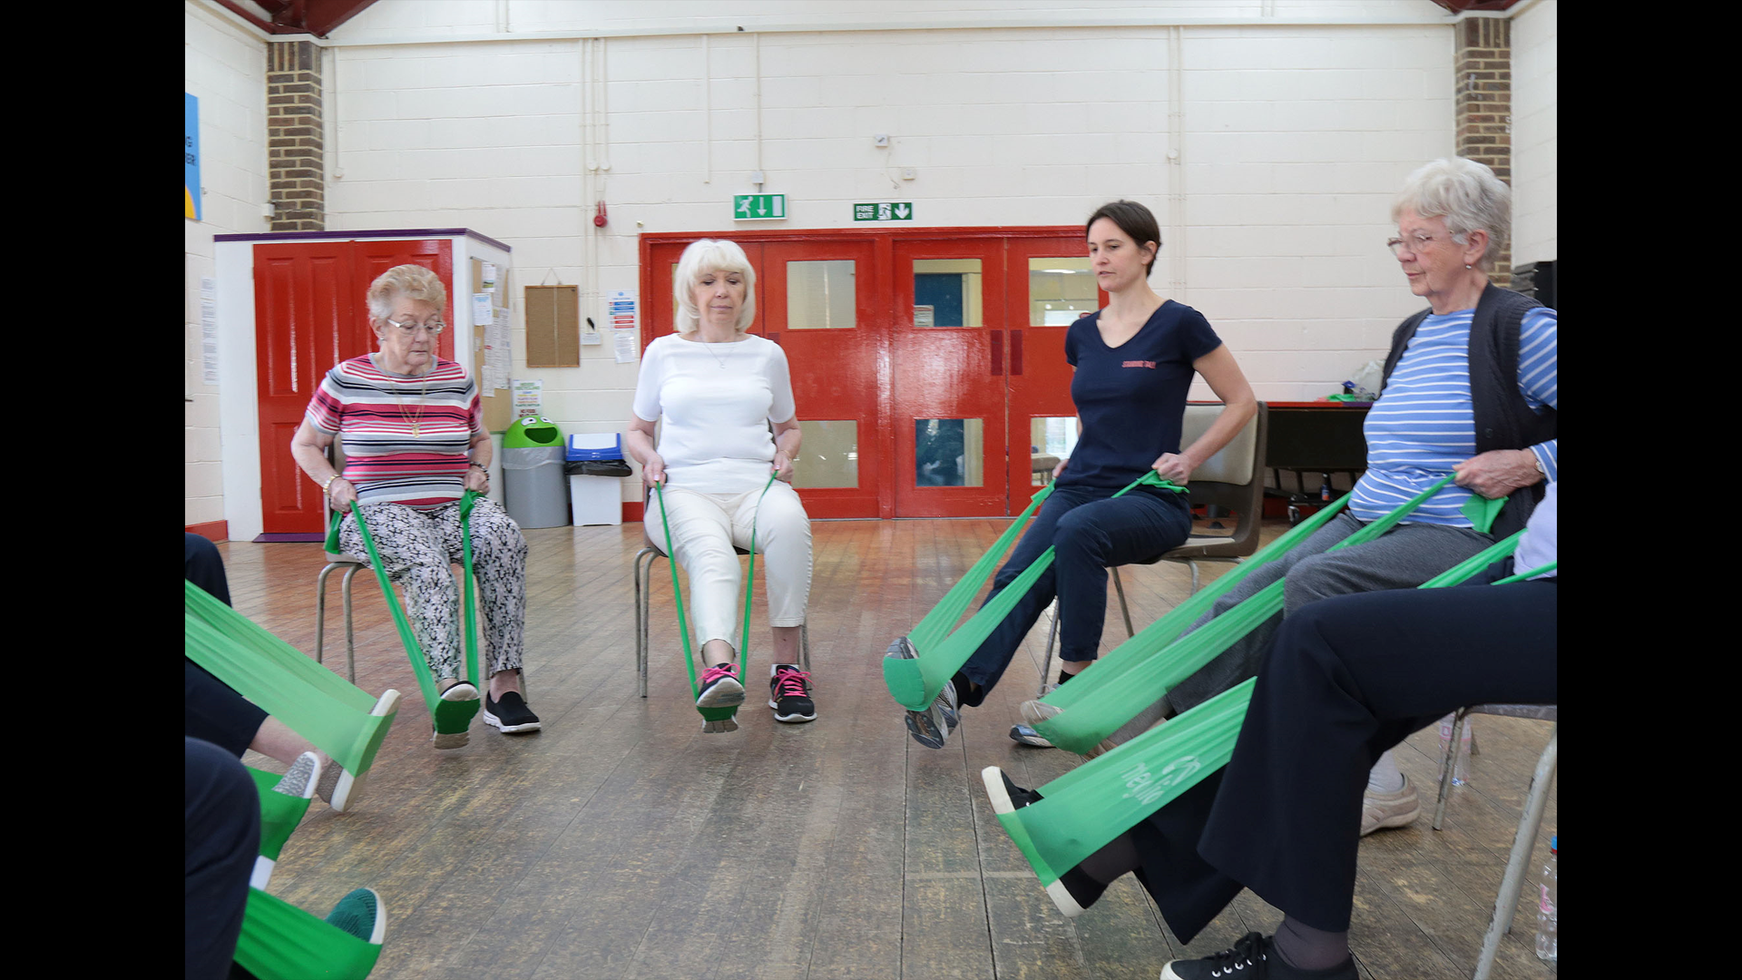

Slide 7
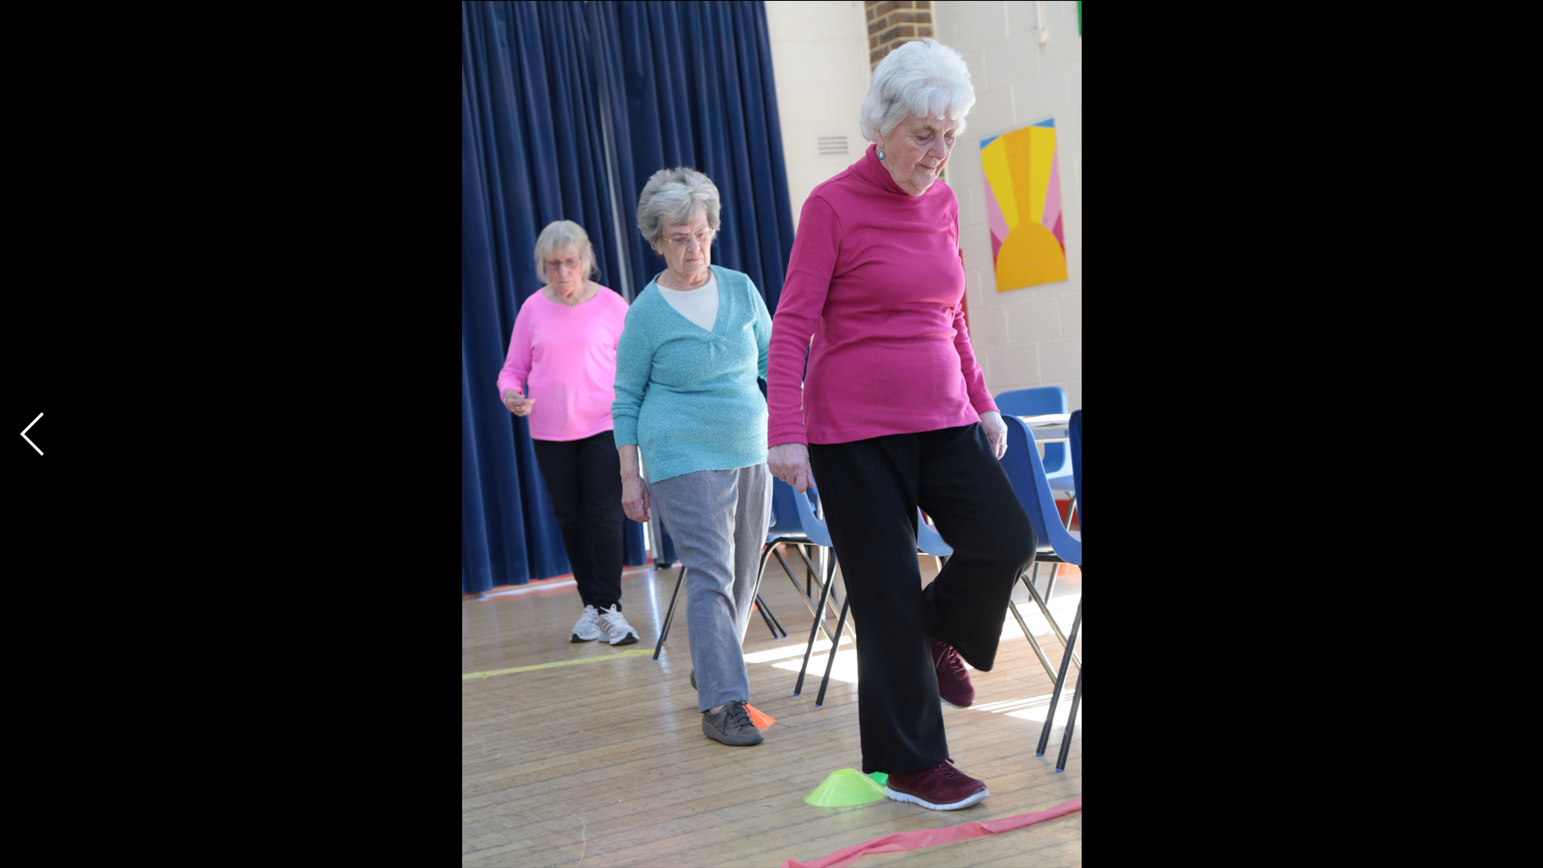

Slide 8
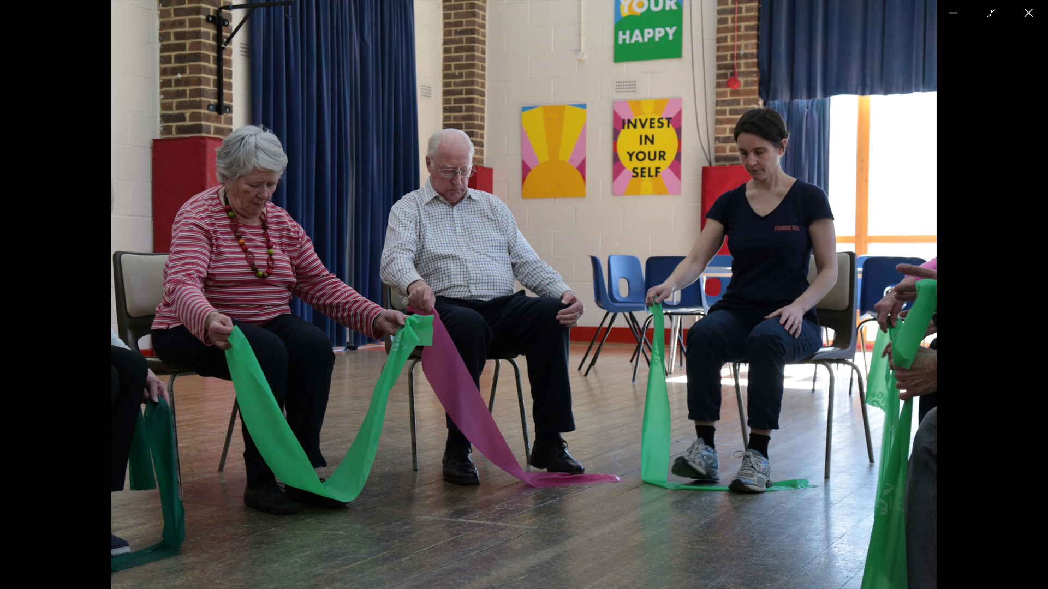

Slide 9
How we grew
2010 x1 class funded for 1 years- Extra Time AITC.
Continued once funding ended – Grant applications, HKOP
Inc number of classes to meet demand
Not time ltd – participants kept coming
Gaps in provision
Links w Falls Co-ord at BHCC
2018 links developed into partnership working
= 2 year contract

Slide 10
SuccessES
Attendance, commitment, ‘compliance’
Reducing social isolation, improving well being, friendships
Education element
Exchanging tips/experiences/encouraging each other
Something is better than nothing
More people moving more!

Slide 11
Moving forwards
Promoting Standing Tall
Social media
Referral pathways
Post covid
Students
Business acuity

