Slide 1

Karen Middleton
CEO, The Chartered Society of Physiotherapy

Slide 2
Why is equity, diversity and belonging so important to the profession?
As a trade union and professional body working in healthcare, it is fundamental to our work that we:
Oppose racism, xenophobia, sexism, homophobia, biphobia, transphobia, anti-Semitism, Islamophobia, ageism, classism and hatred against people with disabilities
Support members facing unfair treatment at work, in education or other aspects of their lives
Seek equal access, treatment and outcomes for all patients
Ensure strategic decisions are informed by the full diversity of our members
Set an example of good practice in equality, diversity and inclusion as an employer

Slide 3
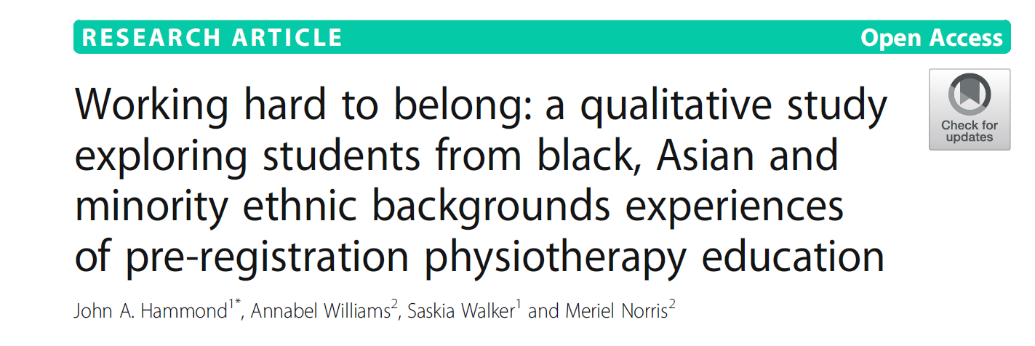

Slide 4
  Consciousness of being an outsider
  Profession defined by white normative views
  General conversations also white middle class
  ‘Ideal’ character subject to cultural stereotypes
Feeling ‘other’ the outsider
  Awkward use of terminology
  Dismissive of presence of racism
  Lack of appropriate acknowledgement / management of racism in practice
  Micro-aggressions
  Be prepared to excel
  Regulate behaviours
  Avoiding conflict
  Absence of role models
  Adapting reflective tools
  Emotional labour
Experience
People’s responses amplifying difference
Personal strategies and burden
Hammond et al 2019

Slide 5

Strategic Aims 2023-2027
A. Improve the health of communities through high quality physiotherapy
B. Enable members to achieve their full potential at work or when learning
C. Establish a confident and influential physiotherapy community
D. Create an agile and sustainable organisation, able to pre-empt changing member needs
Notes:
Council have prioritised some workstreams
Council have included more of a steer on how to deliver workstreams
Strategy does not reflect everything in detail

Slide 6
A: Improve the health of communities through high quality physiotherapy
A1: Lead the transformation of physiotherapy by harnessing evidence based best practice to address health inequities and meet population health needs (EDB)
A2: Promote physiotherapy staffing levels that meet service needs and reflect society across all sectors (EDB)
A3: Promote equity for patients (EDB)
A4: Integrate access to physiotherapy into primary care
B: Enabling members to achieve their full potential
B1: Improve member experiences of education, seeking work and work (EDB)
B2: Champion fair pay, terms and conditions for physios and physio support workers in all sectors and locations
B3: Support chartered and associate members to fulfil their career potential (EDB)
D: Create an agile and sustainable organisation,
able to pre-empt changing member needs
D1: Achieve long term financial sustainability
D2: Enable our Council and committees to thrive (EDB) Enable our staff to thrive (EDB)
D3: Reduce the environmental impact of CSP operations
D4: Enhance member benefit through developing and delivering a strategy to transform our use of data and digital systems
C: Build a confident and influential physiotherapy community
C1: Through the CSP provide physios, physio students and physio support workers with a supportive community (EDB)
C2: Lead the movement for rehabilitation
C3: Create a collaborative community of rehabilitation and exercise professionals.
C4: Enable members to promote physiotherapy as a sustainable healthcare intervention

Slide 7
Strategic Aim A2
Promote physiotherapy staffing levels that meet service needs and reflect society
Where are we now?
Where might we be going?
What are we doing?

Slide 8
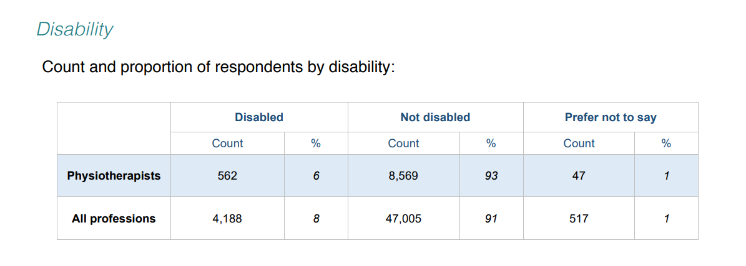
Strategic Aim A2: Promote physiotherapy staffing levels that meet service needs and reflect society
Where are we now?
Notes:
This is HCPC data
6% of registered physiotherapists identify as disabled within this data set which is lower as a proportion than all the other HCPC professions which is at 8% and considerably less than the total UK population which is 18%.
There are regional variations, link between poverty and disabled – wales 22.7% similar NE AND NW

Slide 9
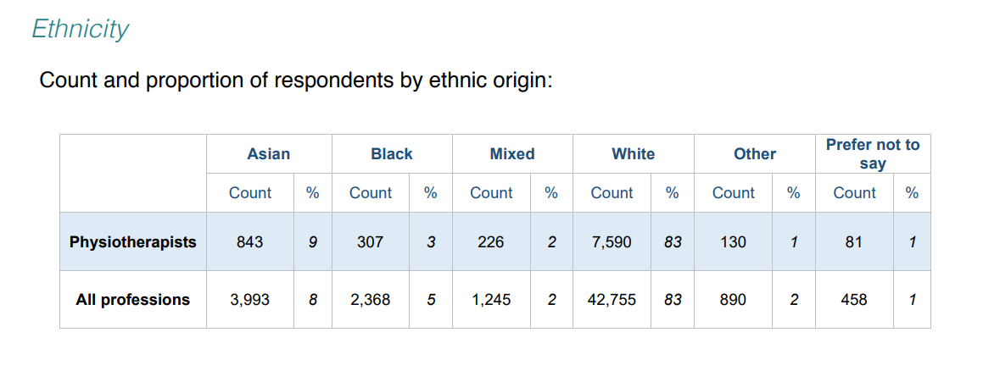
Strategic Aim A2: Promote physiotherapy staffing levels that meet service needs and reflect society
Where are we now?
Notes:
Population data taken from the UK Census (2011)
Physiotherapy data from HCPC
9% of UK physiotherapists are from Asian backgrounds which is higher than the UK Asian population which is 7.5%
3% of UK physiotherapists are from a black background, lower than other HCPC registered professions and the UK Black population which is 3.3%
Whilst this data may appear representative, under representation is evident when comparing regional population data for example, urban population where more physios work
In London 11.2% of the overall population are Black and in the West Midlands 10.8% of the population are from an Asian background, do your services reflect these trends and if so is it proportionate at every career level?

Slide 10
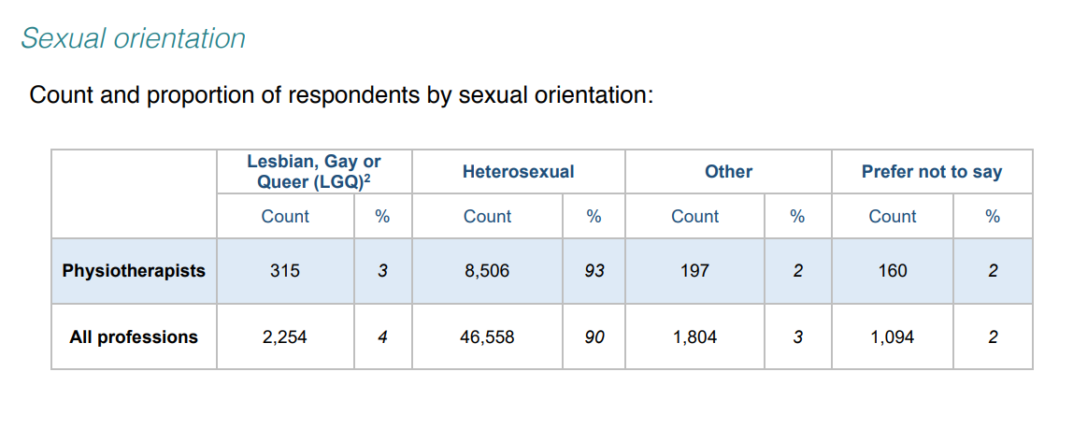
Strategic Aim A2: Promote physiotherapy staffing levels that meet service needs and reflect society
Where are we now?
Notes:
HCPC data set
3% of registered physios identify as Lesbian, gay or Queer which is lower compared to the proportion of LGQ within other AHP professions, 2% of the respondents 'prefer not to say'

Slide 11
Strategic Aim A2: Promote physiotherapy staffing levels that meet service needs and reflect society
Where might we be going?
Notes:
Following data slides are taken from CSP Annual Quality Monitoring of UK physiotherapy pre-reg programmes 2020-2021
This graph illustrates gender profile amongst applicants and 1st year intake
Higher proportion of cis female applicants successful at the recruitment process compared with cis male

Slide 12
Strategic Aim A2: Promote physiotherapy staffing levels that meet service needs and reflect society
Where might we be going?
Notes:
Highest number of applications within 17-20 year olds, from aged 21 years onwards higher proportion of mature applicants were successful with the recruitment process compared with 17-20 year olds.

Slide 13
Strategic Aim A2: Promote physiotherapy staffing levels that meet service needs and reflect society
Where might we be going?
Notes:
2020/21
80.6% of Year 1 UK domicile students identified as white
17.62 were from an ethnic minority background and 1.77% preferred not to say

Slide 14
Strategic Aim A2: Promote physiotherapy staffing levels that meet service needs and reflect society
Where might we be going?
 | 2011 census | UK physio graduates 2020/2021
White | 86% | 84.02%
Black, Asian, Minority Ethnic | 14% | 13.99%
Asian | 8% | 5.18%
Black | 3% | 3.75%
Chinese | inc. in Asian above | 1.19%
Mixed | 2% | 3.19%
Other | 1% | 0.68%
Prefer not to say | 0
Unknown | 0 | 1.99%
Notes:
With the growth in pre-reg provision we are starting to see a positive trend in widening access amongst 2020/2021 graduates.
How welcome will these graduates be made to feel when they start their first roles? – link to belonging. How might these statistics change within the first 5 years of graduating when we have the highest level of attrition from NHS employment/the profession.

Slide 15
Strategic Aim A2: Promote physiotherapy staffing levels that meet service needs and reflect society
Where might we be going?
Notes:
Highest proportion with a learning difficulty - dyslexia

Slide 16
Strategic Aim A2: Promote physiotherapy staffing levels that meet service needs and reflect society
Where might we be going?
Notes:
Again shows highest proportion of first year learners disclosing a learning difficulty
Note upward trend of mental health condition

Slide 17
Strategic Aim A2: Promote physiotherapy staffing levels that meet service needs and reflect society
What are we doing?
Progress:
Ensuring no gaps in datasets
Interrogation of the data
Work with HEE on overseas qualified physios
Policy and influencing
Supporting members in the workforce including support worker development
Increase representation of members with protected characteristics amongst those leading and influencing the profession e.g. mentoring and leadership development
Future:
Web resources to encourage people to feel that physiotherapy is a career for them
Career Development Framework
Preceptorship
Influence HEIs to ensure more representative intake and outflow of students
Student Disability Guidance 2.0
Notes:
Refine data, analyse trends necessary when considering intersectionality
Looks great – dig deeper regional country's sector and speciality variation
Much more complex
Impact of intersectional ethnicity/disability/social class
Disability guidance is a priority area driven by data and lived experiences, compounded by ethnicity and sexuality
Activities just a snap shot
Web resources – inclusive stories background, protected characteristics/socio economic background can’t be ignored with a degree entry profession
Feed into career framework – interactive tools that illustrate they belong
Preceptorship early career attrition
Challenge HEIS re. recruitment, bias
Allies in education – community of practice, what they teach, how they teach
Embedding anti-discriminatory marking criteria in CPAF
Ensure pre-reg curriculum includes health inequities, cultural competence
LDP embedded in both modules

Slide 18

Notes:
Health equality and health equity are not the same thing
Equality is giving people the same opportunities without making adjustments to meet individuals needs.
Equity is taking steps to enable people, by providing what they need, to reach their best health outcome over and above equality of access
The 'U' - what is on 'your/our' gift
We recognise we are not all experts and we should engage in self-directed learning.
Be accountable and take ownership to educate ourselves and seek knowledge to deepen and strengthen our understanding of ways to promote inclusion as part of the teams and systems we work in.
Ask questions, listen with empathy and compassion to, and learn from those with lived experiences they are the experts!
Visibly and actively empower people from minoritised groups, give opportunities, support and offer platforms.

