Slide 1

Student Placements
Juliet Borwell
HEE South East Programme Lead, Practice Learning

Slide 2


The capacity conundrum
Notes:
For me these images capture the current reality of conversations about placement capacity.
For some capacity already feels at maximum occupancy
Others struggle with the possibility of accommodating one – it is hard to see how it can be done.
These views are often subjective, built from perspectives of scale and proportion.
In both of these images the scale of demand is disproportionate to the capacity of the mini. However, the capacity itself has not changed and can be objectively understood.
When function, size and ability align it has a capacity of 4 seats.
In establishing a picture, scale and proportion are essential.

Slide 3





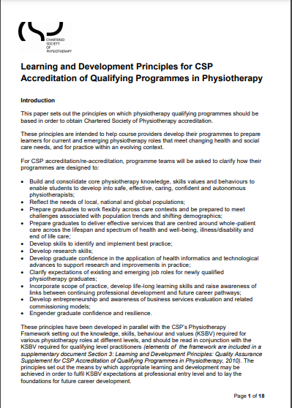
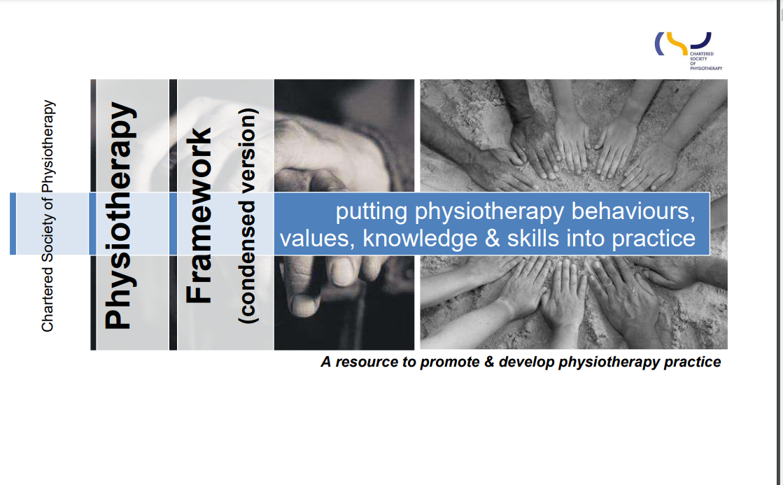
Quality student placements

Slide 4
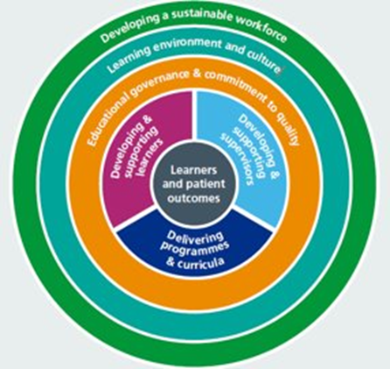
HEE Quality Framework (2021)
Multi-professional
Cross-sector
6 Quality Domains
49 Quality standards

Slide 5
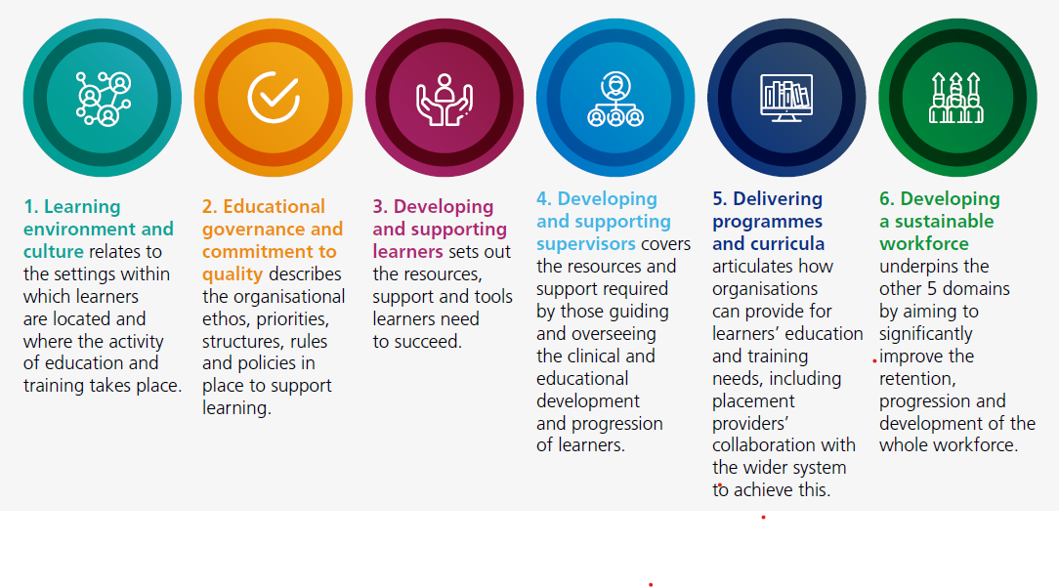
HEE Quality Framework (2021)

Slide 6
HEE SE: Placement Development Structure
HEE South-East Placement Steering Group
BOB
HIoW
Frimley
Surrey
K&M
Sussex
Nursing & Midwifery Team
AHP Workforce Team
AHP Faculties Local Maternity & Neonatal Systems Nursing Workforce Teams
Lorna Mayles
Peggy Mugaha
Kathryn Blair
Rachel Try
Peter Woodford
Catriona Nevard
Cath Grant
Nichola Martin
Sharon Goodchild
Caroline McBride
Jenny Milne
Teresa Buchan
Camille Devaux
Helen Lee Brown
Camilla Ford
Emer Keating
Alison Smith-Robbie
Katy Osbaldeston
Sophia Hicks
Alice Walker

Slide 7
Developing student placements
Practice learning opportunities exist wherever and whenever health and care services are being provided and delivered.
To convert these opportunities into placements three factors need to be present:
  Function - has to be relevant to programme outcomes
  Size - different sizes of department, establishments and skill mix
  Ability - there are other interdependencies that need to be considered

Slide 8
Ability: limiting factors
“ we can only support students from XXX year/university”
“Only certain staff can support students”
“Students need to drive to get here”
“We don’t have the ……..”
“We only have students at certain times of the year”
“I’m/we’re too busy”
“My service/department is too specialised”
“There is nothing for a student to do”
“XXX says students can’t……”
“we make offers that aren’t taken up”

Slide 9
Ability: Factors we can influence
Full/part time
Different sectors, & professions
Non-clinical areas
  Projects
  Leadership/mgt
  Education
  Research
Duration
Hub & spoke
Block/Split/ top & tail/blended
role emerging
TECS, TEL and Sim
Regulatory body requirements
1:1, team, MDT, Multi-student, coaching, long-arm,
Collaborative/peer/buddy
Practice Learning
Model of placement
Model of Supervision
Model of assessment
Hub based, peripatetic, remote, formative, summative, multi-student

Slide 10
Fact or fiction?
Mark is a physiotherapy student in his second year of study.
Mark completed a 6 week leadership and management placement and all outcomes in the CPAF could be assessed.
The placement was with an Arm’s length body
Mark’s practice educator is a nurse
For the entire placement Mark was working remotely, from his home location in Europe.

Slide 11
Mark’s voice: pre-placement
“The reason why I was assigned this placement was that I requested it from the placement coordination team. With us being told that at some point in the degree we will undertake a leadership/management placement, I thought it logical to have done so in Year two of my degree. This was because I am sure that in Year three I will be the most skilled and independent, thus I presume I will be very keen to maximise my time clinically, especially prior to qualifying as a physiotherapist. In addition, it meant that since it was an online placement, I could do it from the comfort of my own home in Czech Republic.
Before I started, I heard a vast amount of negative feedback from my classmates and peers who have done a placement like this before. Words such as ‘boring’ and ‘repetitive’ were thrown around a lot. Thankfully, it did not discourage me. Of course, it is understandable that different people learn in different ways, but I always went into every meeting with an open mind and a desire to learn. I believe things can only be as boring as we make them, and I do not recall ever thinking this placement was boring at any given point.”

Slide 12
Mark’s placement feedback
“I have thoroughly enjoyed this leadership/management placement. I strongly believe it will help me be a better clinician in the future, as I have gained a unique perspective of the work that is being done behind the scenes in terms of placements and ensuring quality.
If I were to use a metaphor, I would say I climbed a tree all the way to the top. Having only done clinical placements prior to this one, I would say I was maybe half-way towards the top of the tree. But after this placement, with all the perspectives, experiences and ideas I gained, I believe I have climbed higher up.
This goes hand in hand with the four pillars of practice: clinical, leadership, research and education. If students only go on clinical placements, they are essentially reducing their experience to only 25% of what their practice should be. That is a limitation, and that is one of the reasons why leadership/management placements should become more common. “

Slide 13
The practice educator voice
This was the first placement that our team (3.8 WTE) has supported.
Having Mark with us was a joy. He brought new ideas and perspectives, boosted our energy with his commitment and seeing him develop his knowledge, skills and confidence was immensely rewarding.
To prepare for Mark’s placement we worked as a team to identify how we could best support Mark to meet his learning outcomes. We used hub and spoke principles blended with a spiral curriculum approach as our model. We set aside time each morning and afternoon to discuss the day’s learning.
Going forward we feel the student experience would be further enhanced by supporting two learners

Slide 14
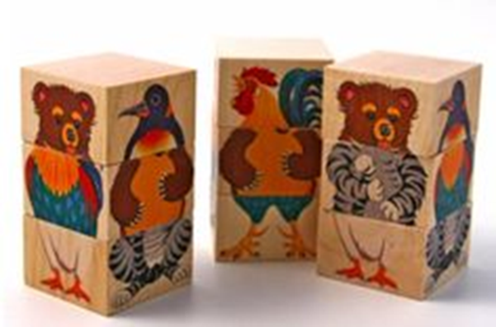
Ability: The art of the possible
There is no one size fits all model
HOWEVER
There is a model for every team.

Slide 15

Thank you for listening
juliet.borwell@hee.nhs.uk
@JulietBorwell
Borwell & Leigh (2021) Addressing the practice learning and placement capacity conundrum. British Journal of Nursing. Vol 30, No 18. P1093

Slide 16
Breakout Groups
If I can’t control or influence it, can I learn to Accept it?
If it’s not in my control can I exert influence?
Is it in my control?
e.g. my behaviours, actions, attitudes, outlook & decisions
Using the 3 spheres of control, map the limiting factors to student placements.

