Slide 1
Practising Physiotherapy in the Digital Age
Information, innovation and implementation
Euan McComiskie
Health Informatics Lead
@EMAHPInfo
Notes:
It’s great to be here. As a Scotsman who lives in Northern Ireland I have to admit to some nerves coming to speak to a room full of folks in the southwest of England. However, to host the event in my second home of a rugby club is a very welcoming touch. So thank you!
And to be surrounded by some familiar faces and new friends from my profession is also very welcoming.
My name is Euan McComiskie and I’ve been a physiotherapist since 2007. I’m now the Health Informatics Lead for the CSP.
Let me take you back to the early 2010s when there was a rotating band 5 physio in a district general hospital somewhere in central Scotland. Outside of work, and before kids stole their time, they were a bit of a computer geek and a gamer. They loved technology and what it could do for them. But when they came in to work the devices and systems that they were using made their work more complicated, clunky and inefficient. They were frustrated at being held back when they thought there must have been ways to do it better. So this precocious and slightly pretentious young physio made their feelings known to their manager and the IT team. What followed, after the initial eyebrow raises, was the opportunity to apply the information they had (and offer to find the information they were lacking!), explore the innovative ideas and support the implementation of an electronic health record system for AHPs across the trust. That physio lucked out with those opportunities and is still counting their blessings in a very different room with a bit more information to share and hopefully ready to inspire some innovation and implementation.

Slide 2

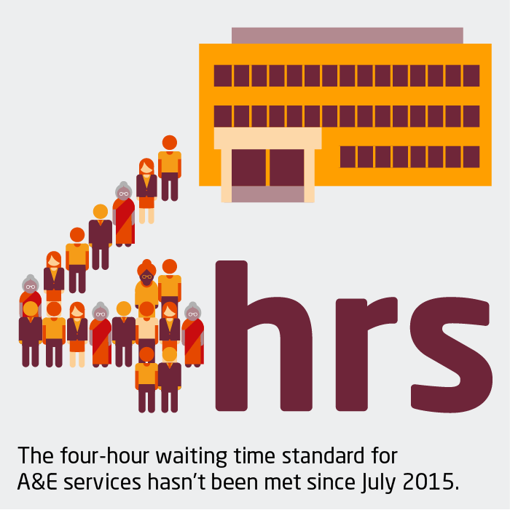
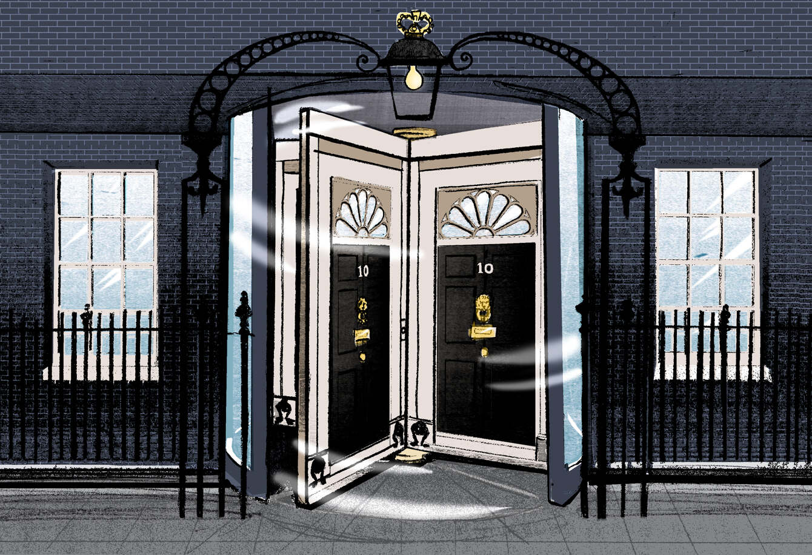

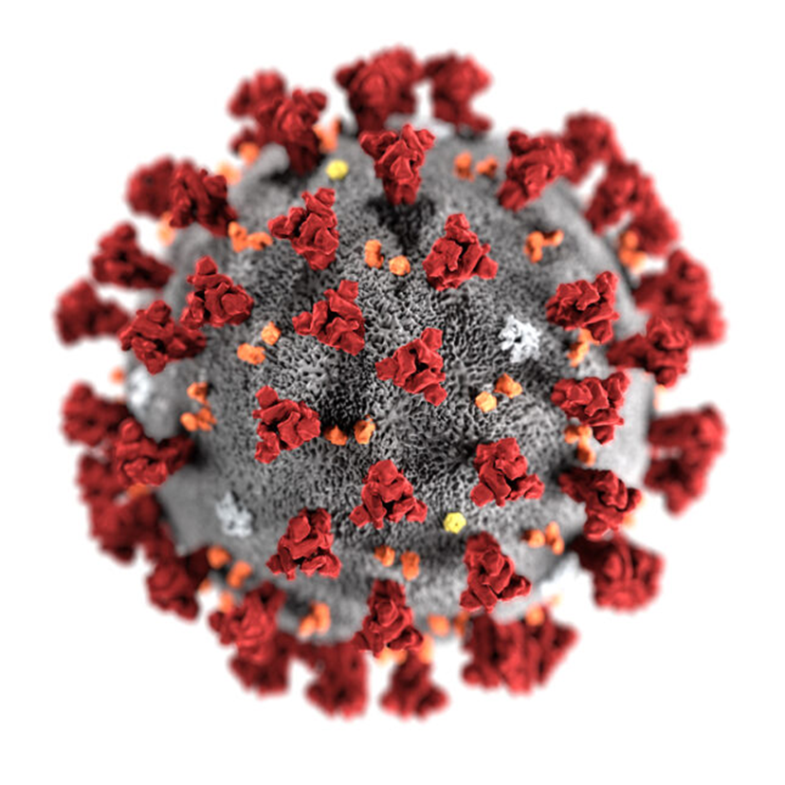
@EMAHPinfo
Notes:
And don’t we need it!
2022 so far has been the next in succession of multiple challenging years.
The cost of living and NHS pay crisis, highest ever and growing pressures on services, political turmoil leading to even more uncertainty for healthcare and of course the lingering shadow of COVID amongst the things making 2022 another in a series of extremely challenging years for those working in healthcare.

Slide 3
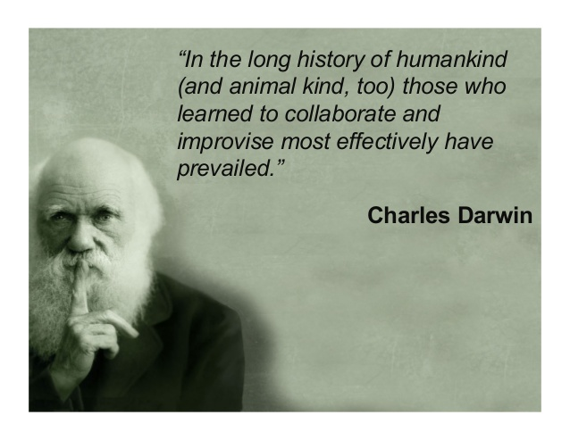
@EMAHPinfo
Notes:
However, physiotherapy has always been a profession of innovators. A profession from the very start that has evolved.
Those who collaborate and improves will prevail. We NEED physiotherapists to be among those who lead innovation in healthcare both in the acute response to current challenges but also to the evolution of future healthcare.

Slide 4

@EMAHPinfo
Notes:
I’m here to talk to you about the role that technology may play as part of that innovation and evolution. NOT as the COMPLETE solution but as PART of the solution.

Slide 5
COVID response …
Rapid implementation of digital solutions
Cultural shift towards acceptance of digital
Barriers → challenges → implementation
Importance of evaluation and sharing
Crisis breeds innovation
@EMAHPinfo
Notes:
In the early stages of lockdown we saw services move to almost entirely digital offerings overnight. Some have retained that offer and some have rightly reverted back but we must explore the potential that it offers
Supported by the cultural acceptance of digital as the only viable option both from clinicians and also public (including those populations previously thought of as hard to reach)
What we used to perceive as unsurmountable barriers are now viewed as simply challenges that can be overcome. Often finding themselves on risk registers for implemented projects
Lack of clinical evidence for use of platforms implemented at pace during a crisis (we’ve never experienced anything like this before so why should there be?!). We need to play our part in filling those gaps
And everybody who has ever worked in the NHS would be familiar with the last sentence. If we take one good thing out of a dreadful episode in world history then it should be the spark to ignite the revolution in health informatics that we’ve needed for years, even decades.

Slide 6
Physiotherapy in 2022 …
Does the provision of physiotherapy in 2022 look as digitally-enabled as other sectors?
Are we as digitally empowered as banking?
Or entertainment?
Or retail?
@EMAHPinfo

Slide 7
Physiotherapy in 2022 …
NO!
Does the provision of physiotherapy in 2022 look as digitally-enabled as other sectors?
Are we as digitally empowered as banking?
Or entertainment?
Or retail?
The technology is here, it’s just not well distributed yet!
@EMAHPinfo

Slide 8
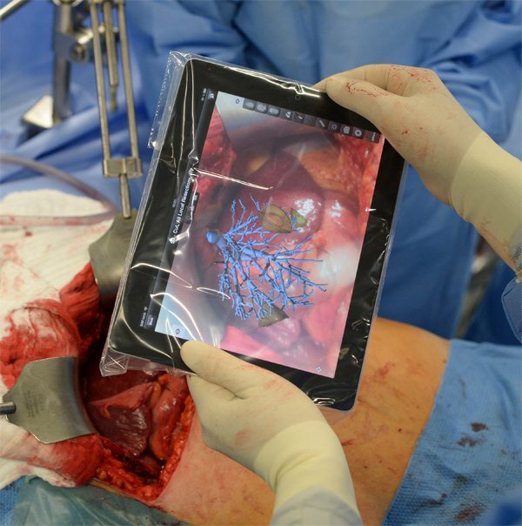
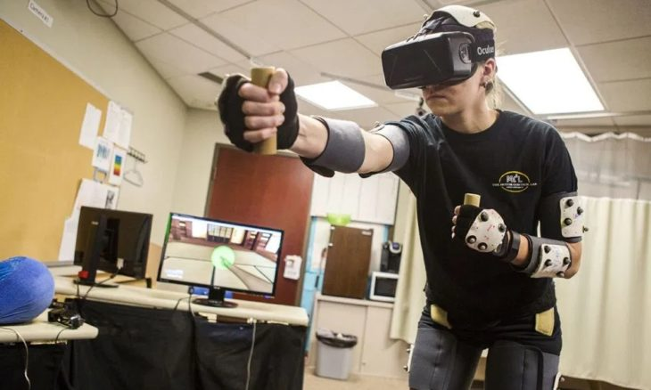
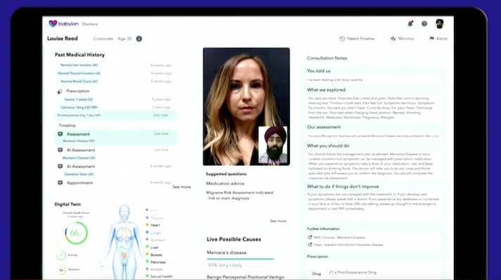

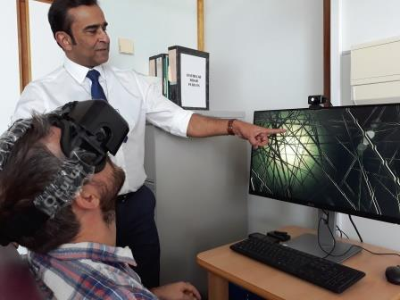
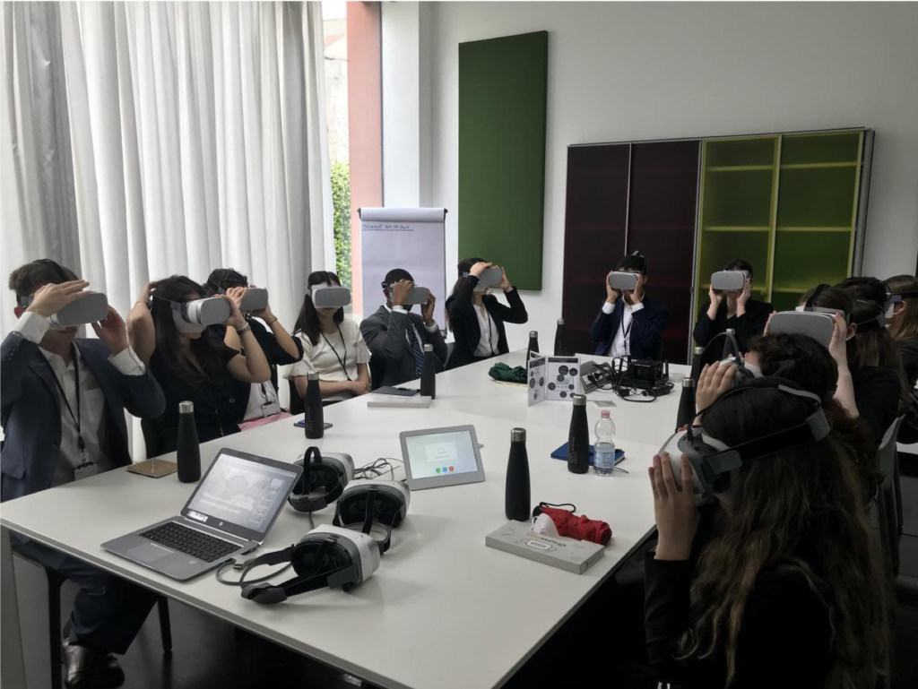
@EMAHPinfo
Notes:
Well yes there are examples where tech is being used at scale in physiotherapy not just in response to COIVD
Screen grab from the clinician view of Babylon powered by AI. The physio lead at Babylon genuinely manages AI bots! On this screen you can see facial recognition, speech recognition, notes creation, automatic coding amongst others.
Attend Anywhere being rolled out all over Scotland and other parts of the UK catching up. Offers virtual consultations on a secure and simple platform.
Study at Warwick Uni about use of VR in physiotherapy. Other uni are exploring similar uses of VR to offer remote and immersive physiotherapy
VR use in immersive learning environments. Vrtuoso platform has gone past 1 million users alone
VR for VR. Sheffield Teaching Hospitals is using VR gaming to treat visual vertigo.

Slide 9
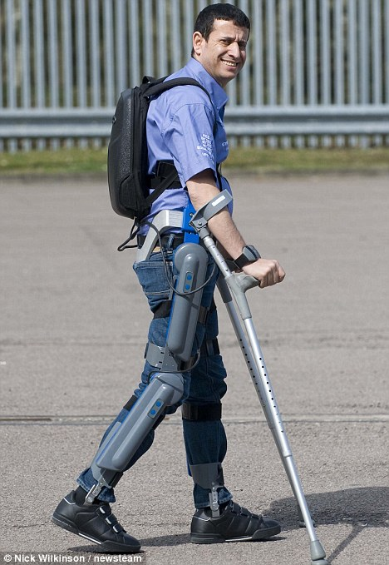
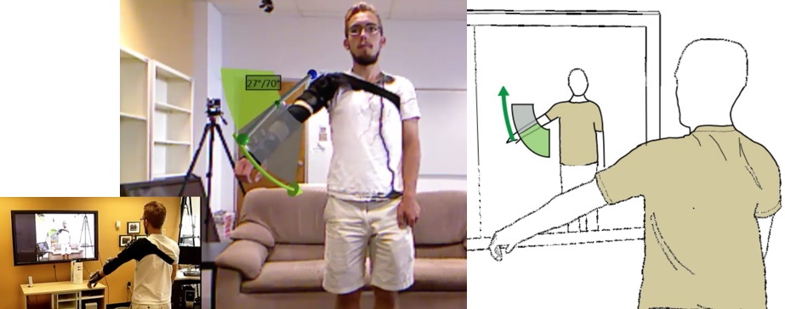
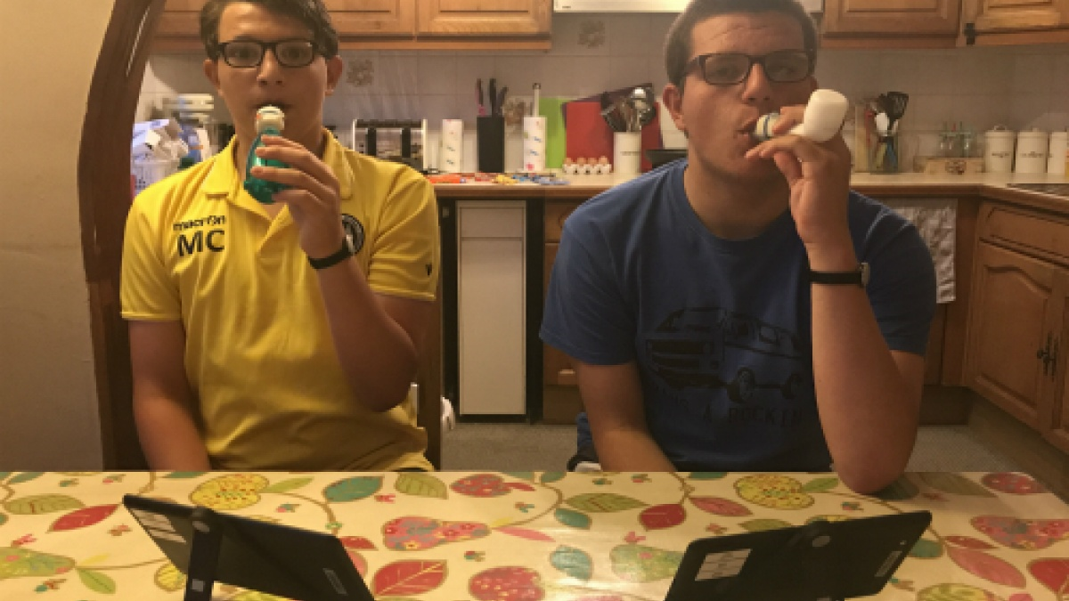
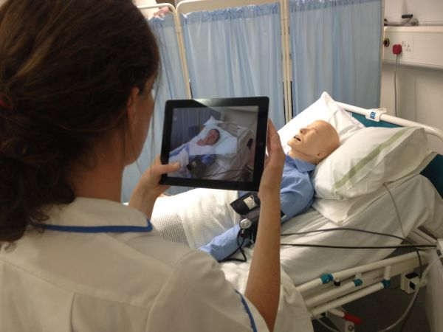
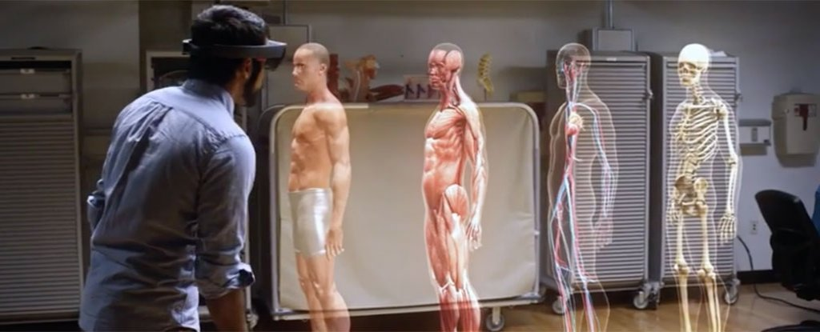
@EMAHPinfo
Notes:
And more …
CF patients in a project called Fizzyo using gamification of breathing exercises shown to improve motivation and exercise compliance
Example of simple augmented reality in UL rehab from Calgary Uni in Canada
Nursing student at Sheffield Hallam Uni using AR wo improve patient simulator engagement
Microsoft’s HoloLens project and the possibility of augmented reality anatomy teaching

Slide 10
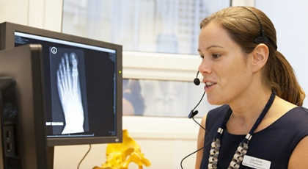
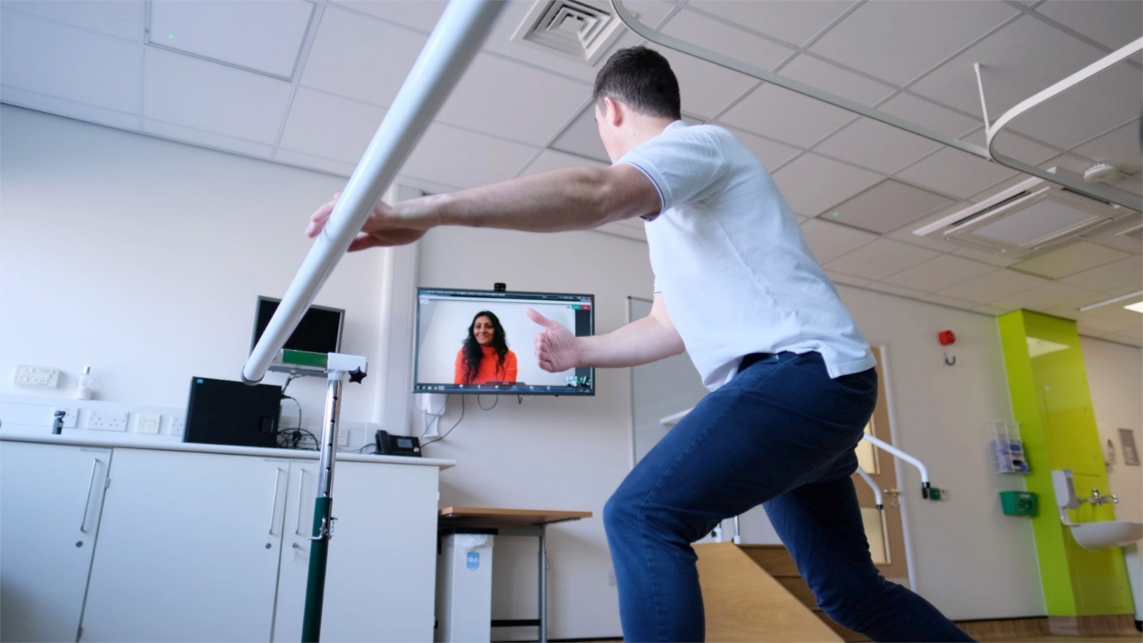
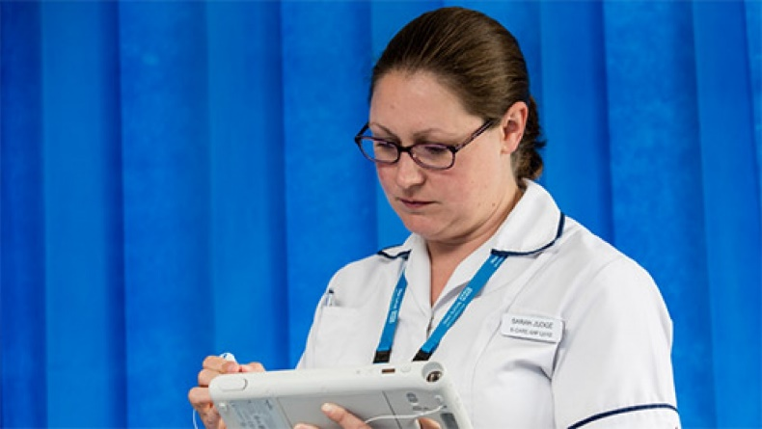
@EMAHPinfo
Notes:
But these are images more familiar to us. A little bit of telephone, may be a bit of video consultancy and possibly some use of a clunky device to access a sub optimal system or 6?! Am I right?!
So what are the CSP doing about it?
We recognise that there are opportunities to use technology to support members of the profession and our patients, to harness better quality data to drive service improvements and so much more. We recognise that there are challenges in delivering this and we really want to support CSP members to overcome these so they can explore the opportunities.

Slide 11
@EMAHPinfo
Notes:
In a couple of weeks we will launch the Physiotherapy Health Informatics Strategy (PHIS) which is the culmination of a significant international literature review exploring best practice and most successful implementation of informatics strategy documentation from the UK and abroad. It has driven the structure and content of the PHIS, and through engagement with groups of our members we have added resources to make sure it is a valuable resource for the whole profession.
It will include the vision for how informatics can be imbedded within the profession. It will provide educational resources to support an upskilling in informatics knowledge of the profession. And crucially it will provide guidance to support the practical application of this knowledge, towards achieving the aspirations set out in the vision.
You will hear much more about the PHIS in the coming few weeks, not just because the SW regional professional advisor Jackie has been so critical to the delivery of the project, but because we will saturate the CSP communication channels with information, resources and opportunities to get involved. So please do keep an eye out and, keep your minds open and see how informatics can impact your part of the physiotherapy world.
Of course, Jackie, me and others at the CSP cannot do this by ourselves. We are reliant on the growing number of CSP members interested and/or involved in health informatics. So why not join us?

Slide 12
Digital and Informatics Physiotherapy Group (DIPG) …
Standing on the shoulders of giants
30 enthusiasts at CSP HQ in February 2019
Core value of linking like-minded physiotherapists together to share learning, challenges, solutions and opportunities
“For the people, by the people”
All 4 home nations and abroad, public sector, private sector, industry, research, education, military, sport, innovation, students, clinicians, managers, directors, government leads and everything in between!
@EMAHPinfo

Slide 13
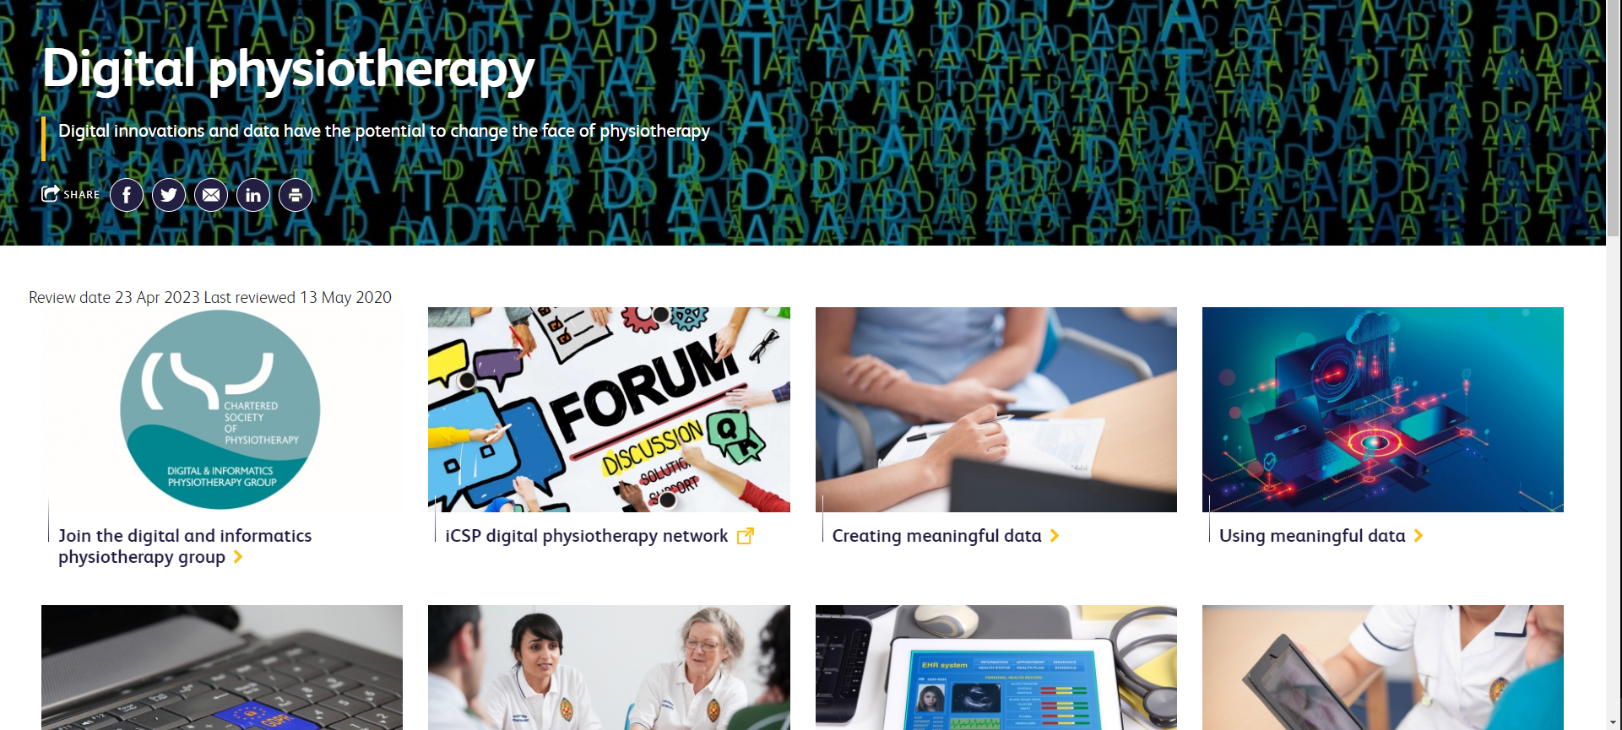
Digital and Informatics Physiotherapy Group (DIPG) …
If you want to join then please contact us at DIPG@csp.org.uk
Find out more about digital physiotherapy at www.csp.org.uk/digitalphysio
Follow the twitter conversations #DigitalPhysio
@EMAHPinfo

Slide 14

@EMAHPinfo
Notes:
Thank you very much for having me. I’d be happy to answer any questions you might have for now. And I’ll be about for the rest of the day so please do catch me at any of the breaks.

