Slide 1
AHP Digital
Katrina Kennedy
Associate Director of AHP

Slide 2
AIMS
National AHPs Deliver
National Digital Framework
Dorset Digital Strategy engagement and ambitions
HIOW AHPs engagement
Workshop

Slide 3
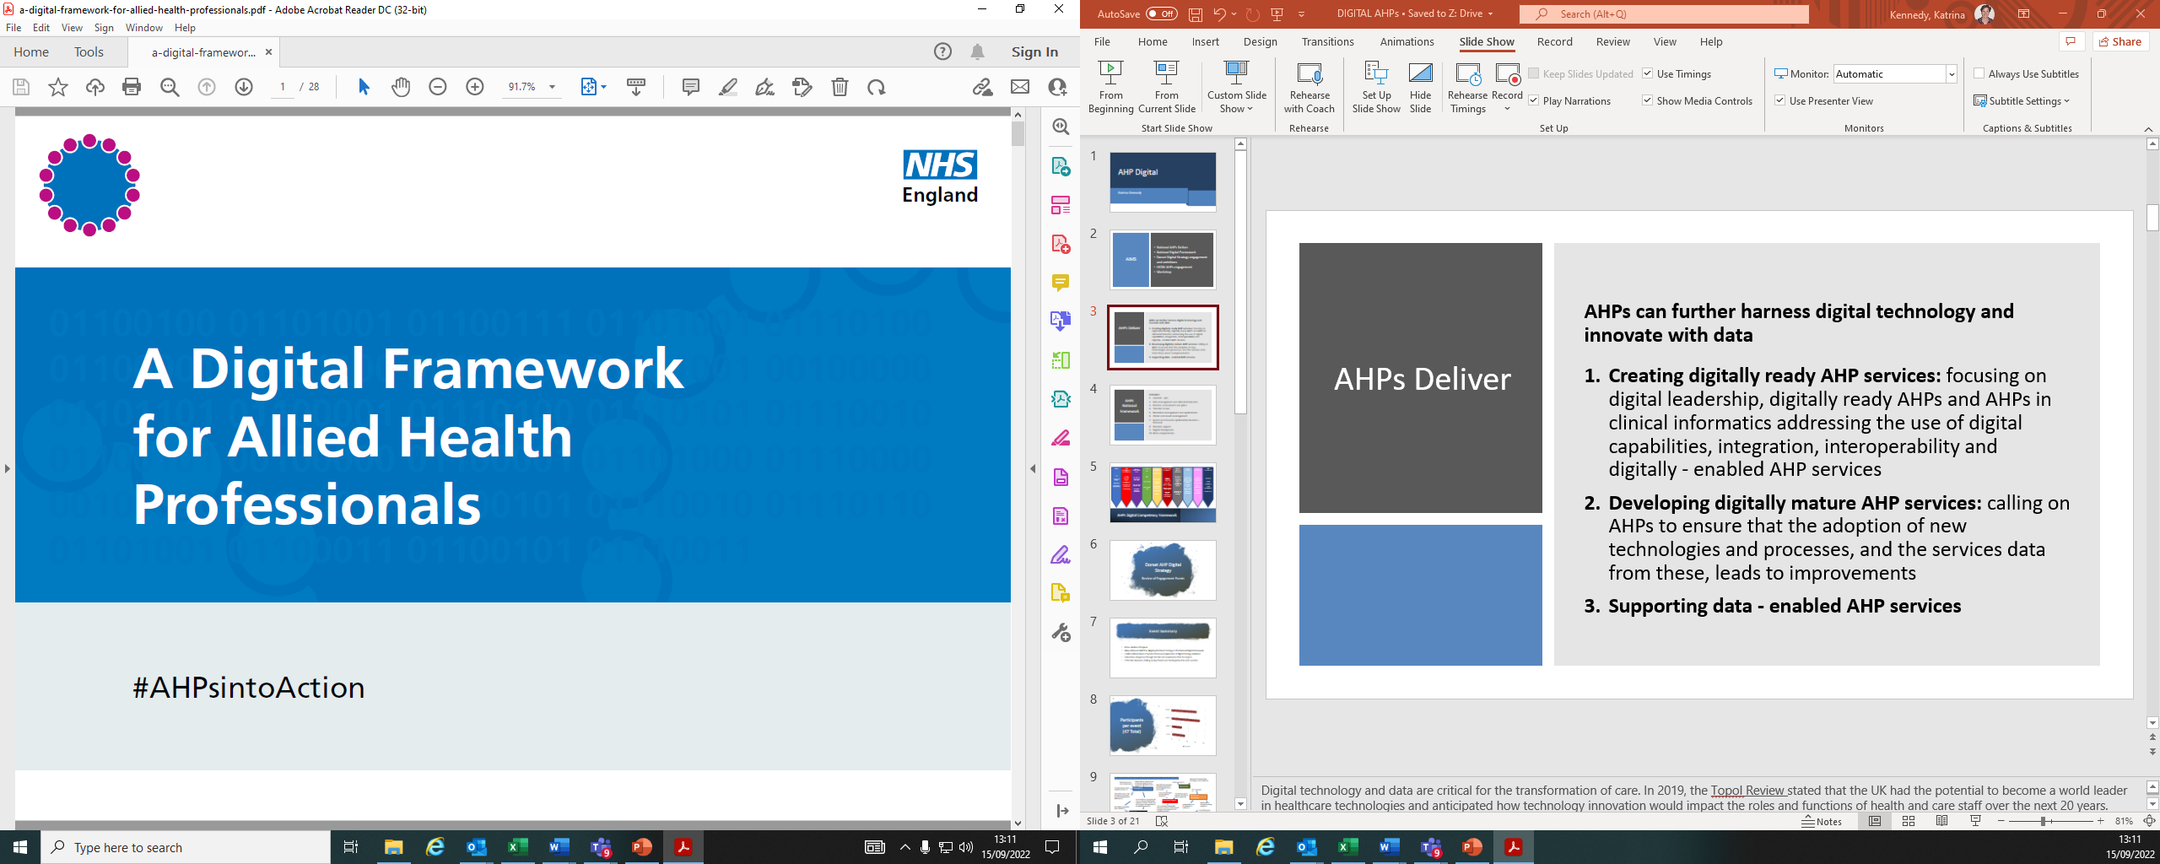
AHPs Deliver
AHPs can further harness digital technology and innovate with data
Creating digitally ready AHP services: focusing on digital leadership, digitally ready AHPs and AHPs in clinical informatics addressing the use of digital capabilities, integration, interoperability and digitally - enabled AHP services
Developing digitally mature AHP services: calling on AHPs to ensure that the adoption of new technologies and processes, and the services data from these, leads to improvements
Supporting data - enabled AHP services
Notes:
Digital technology and data are critical for the transformation of care. In 2019, the Topol Review stated that the UK had the potential to become a world leader in healthcare technologies and anticipated how technology innovation would impact the roles and functions of health and care staff over the next 20 years. Published in the same year, A digital framework for allied health professionals, as well as focusing on the AHP workforce also sought to support local services and AHPs to work towards services that are paper-free at the point of care and well-connected to other services and systems. The framework outlined three core ambitions for AHP services that support the development and implementation of local digital roadmaps and use of digital maturity assessments:

Slide 4
AHPs National Framework
DOMAINS
General
Data management and clinical informatics
Records, assessments and plans
Transfer of care
Medicines management and optimization
Orders and results management
Assets and resource optimisation business
Decision support
Digital therapeutics
Meta-competencies
Notes:
Digital technology and data are critical for the transformation of care. In 2019, the Topol Review stated that the UK had the potential to become a world leader in healthcare technologies and anticipated how technology innovation would impact the roles and functions of health and care staff over the next 20 years. Published in the same year, A digital framework for allied health professionals, as well as focusing on the AHP workforce also sought to support local services and AHPs to work towards services that are paper-free at the point of care and well-connected to other services and systems. The framework outlined three core ambitions for AHP services that support the development and implementation of local digital roadmaps and use of digital maturity assessments:

Slide 5
AHPs Digital Competency Framework
Notes:
Digital technology and data are critical for the transformation of care. In 2019, the Topol Review stated that the UK had the potential to become a world leader in healthcare technologies and anticipated how technology innovation would impact the roles and functions of health and care staff over the next 20 years. Published in the same year, A digital framework for allied health professionals, as well as focusing on the AHP workforce also sought to support local services and AHPs to work towards services that are paper-free at the point of care and well-connected to other services and systems. The framework outlined three core ambitions for AHP services that support the development and implementation of local digital roadmaps and use of digital maturity assessments:

Slide 6

Dorset AHP Digital Strategy
Review of Engagement Events

Slide 7

Event Summary
Introduction
Outline of Purpose
Hilary Hall (Lead AHP ICS) Aligning the Dorset strategy to the National Digital Framework
Jo Elliot (Clinical Head of Systems Processes) Explanation of Digital Strategy ambitions
4 Questions- Responses through chat bar and downloaded after for outputs.
2 Chat Bar observers- Pulling out key themes and feeding back after each question

Slide 8

Participants per event
(47 Total)

Slide 9
1. What prevents us from using the proven digital technology we already have?
Awareness of the proven digital technologies; access to digital tech
People access to wi-fi, users understanding (2)
Patients ability to understand how to access and having the time to chat through with patients how to use (5)
No tech road map (1)
Some staff have a perception that patients won’t want to use technology but this is a clinicians bias.
Awareness
Underestimating our clients competency to use it (1)
Willingness
Old I.T equipment (1)
Patient ability to use it, does not always suit the purpose eg; group sessions/hands on assessments (2)
There is some avoidance by some pockets of clinicians (1)
Time pressure to get an outcome, rather than an holistic outcome! (4)
Resources Equipment
Lack of confidence / training for staff – this is a new way of working often unfamiliar to clinicians. Plus tech use still emerging in older generations of the population we serve(2)
Attitudes/Stigma
Patient access to hardware/functioning computer (2)
Laptop reliability, due for update but no timescale (2)
Not enough time to explore what is available (1)
This is a new way of working often unfamiliar to clinicians. Plus tech use still emerging in older generations of the population we serve(2)
Lack of ability to use 1 system eg; System 1 (3)
Training
Multiple systems but not enough knowledge of each (1)
Integrated systems
Connectivity issues both at work and at home (2)
Not enough awareness of resources/technology that are available (4)
Not enough tech savviness, learning ‘off the hoof’ (1)
The availability of the technology and the failure of connections; patient's having the appropriate technology their end; difficulty with physical assessment remotely (2)
Health and Dorset council on different systems (3)
Connectivity

Slide 10
2. What are the behavioral changes we need to see across primary, community and Acute care to fully embed and optimize the technology/ digital innovation we already have in Dorset?
Support for care and nursing homes to use technology, supporting patient expectation for it's use (2)
Patient support / training to improve confidence (1)
Improved collaboration, joint training , joint or improved access to computer systems (1)
Building trust/good relationships with care providers (3)
that it will improve patient care and not increase clinician burden
Working as a one team of health and social care we need access to just one system to record client/patient information and be able to access.(1)
Training
Collaboration
Better training and awareness of IT systems eg TEAMs (3)
Trust/Relationships
more opportunities for collaborative working (8)
Senior population may not have access to technology or know how to use it.(1)
Develop system of saving/organising info so can access when needed (3)
Willingness to try different technologies- playing around (3)
Systems to talk to each other/avoid repetition (7)
Integrated Systems
Supporting patients to access (2)
Senior management support and buy in (2)
Not a second class service (2)
Promotion/incentives to change
Computer systems designed jointly that speak to each other and pull information across. Training collaboration (1)
Acceptance/Willingness
Aligning systems used across all areas of acute and community (5)
Staff accepting change in role and wanting to go back to all face to face when able (4)
Promotion to the general public of digital assessment as the 'new normal' increased communication through media to explain why and how this is happening and the benefits (5)
How this can benefit our practice, people need user examples for them to see and realise
Lack of incentives to change (4)

Slide 11
3. What are the behavioral changes we need to see amongst our patients/service users/citizens to fully embed and optimize the technology/digital innovation we already have in Dorset?
Clear expectations of what they are getting from the service and system they are using rather than seeing it as 2nd best (3)
Increased use of tech generally, particularly in the older age groups. We need better support for people to improve their IT literacy (3)
Just as a patient may have needed or wanted someone to be free to accompany them to a face to face, they might need to plan and expect that they may need someone to help them with a virtual appointment (6)
User friendly digital services/ easy access (2)
Security
Promotion of digital solutions as an advantage and addition to care (pts often see it as 'second best’) (2)
Acceptance/ Effectiveness
Trust/Empowerment
Confidence in the security and confidentiality of the systems (2)
Taking more responsibility for own health (2)
Understanding that the digital systems can be as effective or more so as Face to face (2)
Advantage of digital solutions
Willingness to be trust and learn technology (3)
That clinicians can reach a "diagnosis" without touching them (5)
That TM and tel appts are as precious and need to be kept - need to avoid DNAs for these appts (4)
Understanding and acceptance of how virtual management can help and be willing to give it a try. (4)
patients giving virtual appointments same level of attention and face to face - for example not a phone call whilst the are out shopping (5)
Access to digital champions to help people with their digital journey (1)
Appreciate new normal of digital applications and appointments (1)
Quality of care
Whereas, a lot of reassurance /advice can be completed digitally (2)
Provide reassurance that it doesn't affect the quality of care received (3)
Culture, different age related generations will always have an impact on willingness to utilise. Clients in particular that are acutly unwell or have disability cant and do not feel able to access. Complexity of systems. They want to speak to an individual person for help. (4)
Local digital champions
Appreciate benefits of virtual consultation and how they can be interactive (6)
Support for those who struggle to access technology eg public access computers in a confidential space so they could use them for appointments (3)

Slide 12
4. How might we achieve this and go further and faster in our response?
Greater publicity in the media generally of how digital consultations and healthcare solutions can be effective and empowering (1)
Identifying enablers/resources and support in the community (2)
AHP Digital Champion
Joint system with health and Adult social Care will enable easier access to client information and provide quicker and better care for clients/patients without duplication (3)
Integrated Systems
Collaborative training with a 'technology champion' representing each area/service, then they can cascade down to rest of their team (5)
TV/Publicity
could share some quotes from some 'satisfied customers'
Embed use of tech at Uni level (3)
support for patients/service users when setting up virtual consultations - central support centre for patients (2)
Learning from early adopters (3)
Joined up comms, easy read guidance, joint funding to deliver digital enabling interventions (2)
Offering core digital training (1)
Locally embedded AHP digital champions to support, promote, connect and communicate connected to a wider strategic forum (2)
Use of libraries/day centres/community hubs to roll out training (3)
Job role
education, education and more education! (1)
Training
Need a whole Dorset strategy that includes all providers, need IG support and guidance from the beginning, Dorset needs investment into internet provision
Resources Financial
Include in job role for all new starters (4)
Provision of some specialist equipment where deemed appropriate for patients
Training for staff on how best to manage patients in this way - ie assessment techniques and then how to get patients on board with management.
Provide community access points for those not enabled (1)
Be clear on virtual apt letter of expectations on both sides.
Appraisal
Start with the quick wins. Advertise the benefits and share good examples with customer messages. At referral points can intervention method be or preference be selected so that customers know its an option (5)
Invest in IT equipment for staff and departments. One Joint system for social and health (3)
Financial investment in upgrading equipment and aligning systems (1)
Ensure covered in appraisals (1)

Slide 13

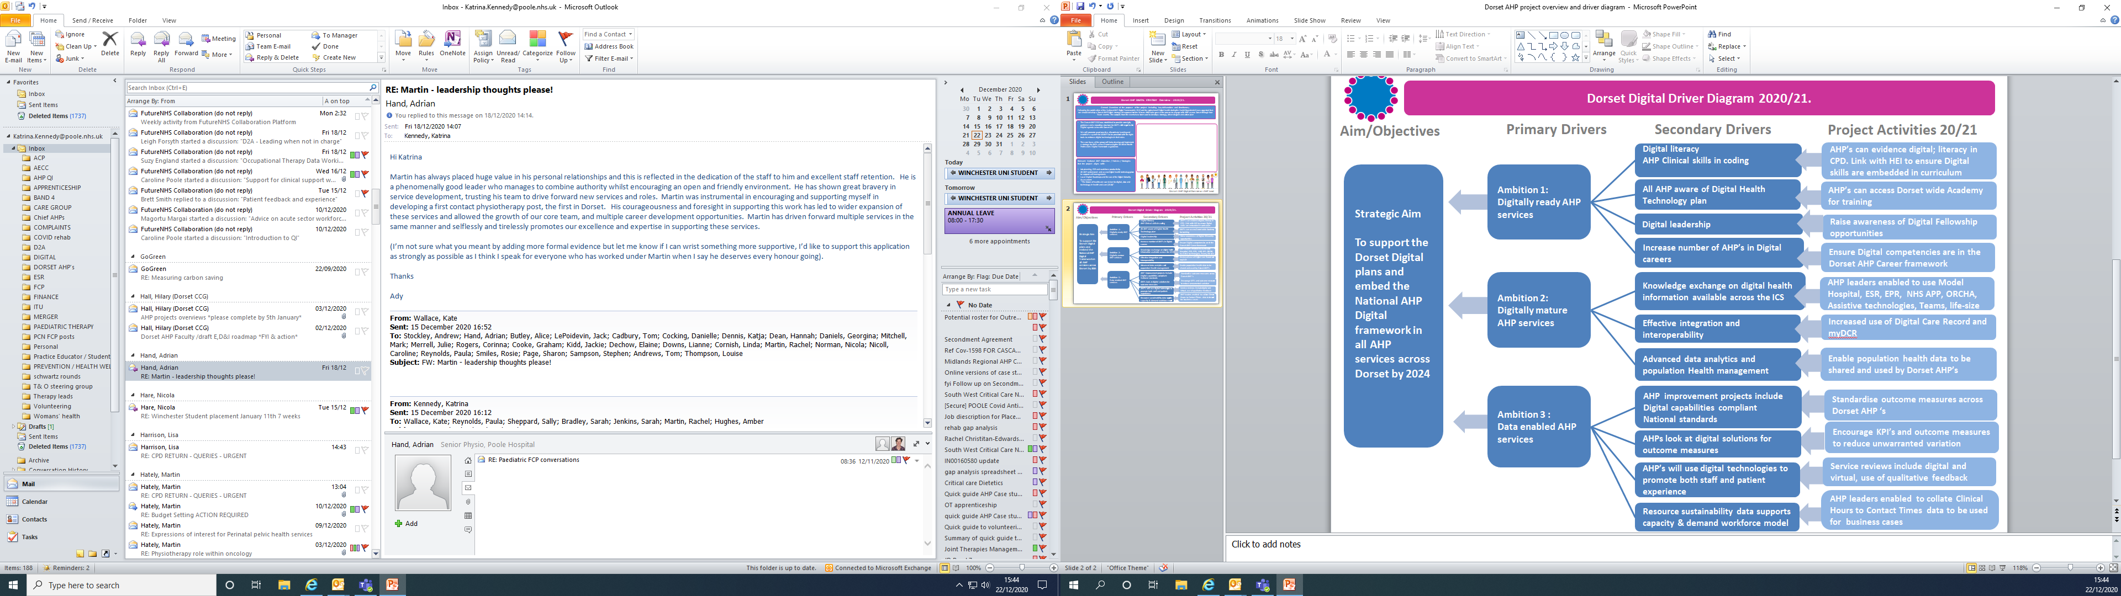

Dorset AHP DIGITAL STRATEGY Overview - 2020/21.
General Overview of the purpose of the project including key deliverables and timeframes;
Following the publication of the National AHP Digital Framework in 2019 and the explosion of Digital health during the Covid19 pandemic it was suggested that we should develop a Dorset AHP Digital strategy. We approached the Wessex AHSN who gave us the process to engage with AHP’s across Dorset through four Team events. The outputs from the events have been used to develop a strategy, driver diagram and action plan
The Dorset AHP DSG was established to provide oversight, guidance and a reporting structure for AHP’s with regard to the Digital agenda across the Dorset ICS.
We will promote good practice, disseminate learning and establish a system for all AHP’s to be provided with the right tools to embrace digital technologies in their roles.
The core focus of the group will be to develop and implement a strategy for AHPs across Dorset using the UK Allied Health Professions Digital Framework as guidance.
Relevant National AHP Objective / Policies / Strategies that the project aligns with:
Job planning, ESR and workforce productivity
All AHP understand and access Digital health technology plans to support self-management.
Local Digital Roadmaps and the use of the Digital Maturity Assessment
“The future of healthcare: our vision for digital, data and technology in health and care (2018).”
Dorset AHP Digital Overview – AHP Lead

Slide 14
Dorset Digital Driver Diagram 2020/21.
Aim/Objectives
Primary Drivers
Secondary Drivers
Project Activities 20/21
Digital literacy
AHP Clinical skills in coding
AHP’s can evidence digital; literacy in CPD. Link with HEI to ensure Digital skills are embedded in curriculum
Strategic Aim
To support the Dorset Digital plans and embed the National AHP Digital framework in all AHP services across Dorset by 2024
Ambition 1:
Digitally ready AHP services
All AHP aware of Digital Health Technology plan
AHP’s can access Dorset wide Academy for training
Digital leadership
Raise awareness of Digital Fellowship opportunities
Increase number of AHP’s in Digital careers
Ensure Digital competencies are in the Dorset AHP Career framework
Ambition 2:
Digitally mature AHP services
Knowledge exchange on digital health information available across the ICS
AHP leaders enabled to use Model Hospital, ESR, EPR, NHS APP, ORCHA, Assistive technologies, Teams, life-size
Effective integration and interoperability
Increased use of Digital Care Record and myDCR
Advanced data analytics and population Health management
Enable population health data to be shared and used by Dorset AHP’s
Ambition 3 :
Data enabled AHP services
AHP improvement projects include Digital capabilities compliant National standards
Standardise outcome measures across Dorset AHP ‘s
AHPs look at digital solutions for outcome measures
Encourage KPI’s and outcome measures to reduce unwarranted variation
AHP’s will use digital technologies to promote both staff and patient experience
Service reviews include digital and virtual, use of qualitative feedback
AHP leaders enabled to collate Clinical Hours to Contact Times data to be used for business cases
Resource sustainability data supports capacity & demand workforce model

Slide 15

HIOW Allied Health Professions Digital network
Priorities for 2021/22

Slide 16
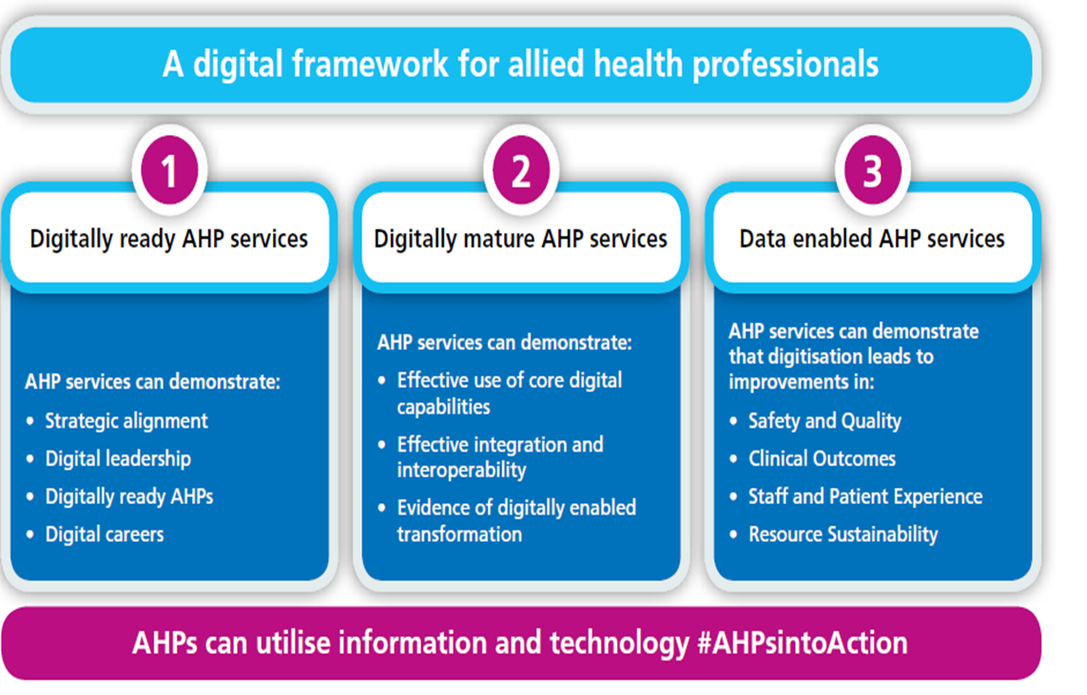
HIOW AHP DIGITAL Network
Introductions
Share local Digital initiatives, learn from each other
Share/discuss national AHP Digital resources/developments
HIOW strategy?

Slide 17
TASK 1 HIOW - AHP DIGITAL Leadership Strategy
VISION
Understanding what digital literacy is so that all staff can contribute
Digital therapeutics and decision support
System wide access to links for NHS evidence for al clinicians Advanced Practice
Assets and resource optimisation
Improved accuracy
OBJECTIVES
Widely available digital literacy training
Digital leadership placement
Develop a system for recording CPD
Integrated IT platforms with shared access
Business intelligence
Apps for self management
Weekly data to track progress
Single point of access
Meta competencies
Cyber security
GDPR

Slide 18
Task 2 HIOW AHP electronic documentation
CHANGES
Access to patient information
Reduce duplication
Integrated health and social care
Duplication
Mobile working
Availability for clinical outcomes to be online
BENEFITS
Times scale reporting
separate training systems
Parity between systems
Wider population engagement
EQUIPMENT
Lap top versus App
More reliable network
Resources
Ability to upload audio visual and images
Docking stations work space
Value in doing things versus time

Slide 19
AHPs Digital Competency Framework
Notes:
Digital technology and data are critical for the transformation of care. In 2019, the Topol Review stated that the UK had the potential to become a world leader in healthcare technologies and anticipated how technology innovation would impact the roles and functions of health and care staff over the next 20 years. Published in the same year, A digital framework for allied health professionals, as well as focusing on the AHP workforce also sought to support local services and AHPs to work towards services that are paper-free at the point of care and well-connected to other services and systems. The framework outlined three core ambitions for AHP services that support the development and implementation of local digital roadmaps and use of digital maturity assessments:

Slide 20
DIGITAL TASK
Examine the domains of the framework as a group.
1
Prioritise which domains would be the central focus on your local AHP digital strategy.
2
Pull together your short-term vision and your objectives.
3

