Slide 1

4 Pillars of Practice – Advanced Clinical Practitioner
Jane Blakey: Trainee ACP Physiotherapist Mental Health Services for Older People
February 2022

Slide 2
4 Pillars of Practice
Clinical Practice
Leadership & Management
Education (self & others)
Research
Multi-professionals framework for advanced clinical practice in England
Notes:
4 pillars of practice are not to be confused with the four pillars of physiotherapy practice
Exercise, movement and rehabilitation
Manual therapy and therapeutic handling
Therapeutic and diagnostic technologies
Allied approaches

Slide 3
Advanced Clinical Practice
It is a level of practice
Encompasses the four pillars of practice
Core capabilities and area specific competence
Notes:
All ACP’s will have developed their skills and knowledge to the same standards, and therefore all posts will contain some elements of each pillar but the composition may be different depending on the job role.

Slide 4
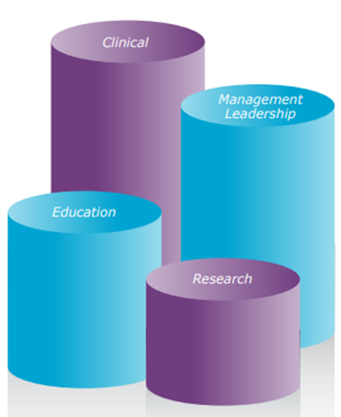
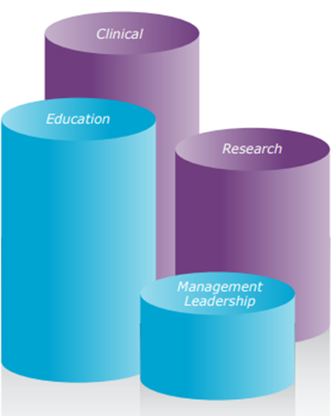
Advanced Practice clinical role with a large management element
Advanced Practice clinical role with strong research/teaching elements
Framework for Advanced Nursing, Midwifery and Allied Health Professional Practice in Wales (2016)
Notes:
Roles contain the same element of all of the pillars but the proportion of their role for each pillar changes.

Slide 5
Leadership & Management
11 capabilities
Education (self & others)
8 capabilities
Research
8 capabilities
Clinical Practice
11 capabilities

Slide 6
Advanced Clinical Practice – Four pillars - capability examples
Clinical Practice
1.1: Practise in compliance with their respective code of professional conduct and within their scope of practice, being responsible and accountable for their decisions, actions and omissions at this level of practice.
Leadership & Management
2.5: Lead new practice and service redesign solutions in response to feedback, evaluation and need, working across boundaries and broadening sphere of influence.
Education
3.7: Supporting the wider team to build capacity and capability through work-based and interprofessional learning, and the application of learning to practice
Research
4.2 Evaluate and audit own and others’ clinical practice, selecting and applying valid, reliable methods, then acting on the findings.
Notes:
In summary;
All ACP’s will have developed their skills and knowledge to the same standards, BUT each practitioner will demonstrate that capability in different ways depending on the scope and context of their practice, role and profession.
The composition of the 4 pillars of practice will also differ between ACP’s as this is determined by service need in and individuals professional scope of practice.

Slide 7
References/Further Reading
Health Education England. (2017). Multi-professional framework for advanced clinical practice in England. Available at: https://www.hee.nhs.uk/sites/default/files/documents/multi-professionalframeworkforadvancedclinicalpracticeinengland.pdf (Accessed: 01/12/2021)
NHS Education for Scotland. Four Pillars of Practice. Available at: https://www.nmahpdevelopmentframework.nes.scot.nhs.uk/post-reg-framework/four-pillars-of-practice/ (Accessed: 01/12/2021)

Slide 8
References/Further Reading continued…
NHS Wales. (2016). Framework for Advanced Nursing, Midwifery and Allied Health Professional Practice in Wales. Available at: https://www.wales.nhs.uk/sitesplus/documents/829/NLIAH%20Advanced%20Practice%20Framework.pdf (Accessed: 01/12/2021)
NHS Wales. (2020). Modernising Allied Health Professions’ Careers in Wales: A post registration framework. Available at: https://gov.wales/sites/default/files/publications/2020-02/modernising-allied-health-professions-careers-in-wales.pdf (Accessed: 01/12/2021)

