Slide 1
Shared Decision Making:
A person with Hip Osteoarthritis
Rob Tyer
Advanced Practice Physiotherapist
Clinical Lead, Northumberland Joint MSK and Pain service

Slide 2
Aim
To outline a “real world” discussion with a person seeking guidance regarding their hip pain.
To unpack some of the aspects of decision making.
To outline considerations which may not be immediately on your radar.

Slide 3
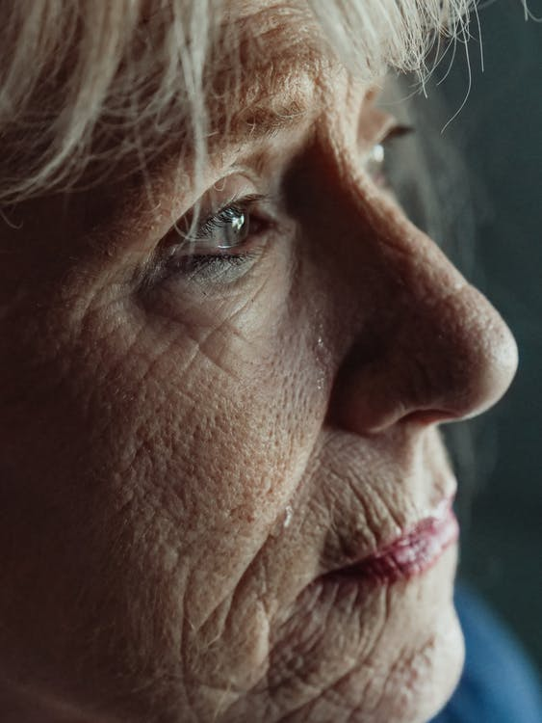

Joan
68 years old.
Reporting right sided groin pain for the last 10 months.
Vague radiation to the knee.
Occasional back pain.
Referred via GP due to Xray outlining moderate hip Osteoarthritis:
Please see Joan, who has hip pain. I think she needs a replacement
Please see Joan, who has hip pain. I think she needs a replacement

Slide 4

Considerations
What does Joan understand about her problem?
What does Joan know is available for her problem?
Chronology and behaviour of symptoms (Could it be something else)?
  How did it start.
  Has it changed since.
  When was the Xray.
Family history?
PMH?
DH?
SH?

Slide 5

What ifs…
Heavy prednisolone use / “out of date” Xray – ? AVN.
Sudden severe worsening, unable to weight bear – ? Bony Collapse.
History of cancer - ? METs
<45 years old** - ? Dysplasia
** (not unique to those under 45 years old, but an age where infant hip screening was poor)

Slide 6

Diagnosis – OA Hip

Slide 7

Shared Decision Making
Nothing
“Watch and wait”
Absolutely a viable option.
Can be useful if not keen on / safe for interventions available.
Not keen on active part of recovery.
May be a flare up and therefore potential to settle down in time.
Something
Lifestyle / activity modification.
Rehabilitation (self directed / guided).
Medication review.
Injection.
Surgery.

Slide 8
So, It’s All Hopeless….?
Obesity:
Risks to post op recovery
Weight loss does not protect from THR.
Lower weight in younger life seems to reduce THR risk.
Manual Therapy: Limited data supporting Manual Therapy beyond short term pain relief.
Exercise: No clear superior type / dose currently in publication for OA hip. Consider Rate of Force Dev.
Remember – YOU CAN’T STRETCH BONE
Psychological treatments: No direct evidence for OA hip, some suggested benefits due to transferability to pain in general or psychological comorbidities.

Slide 9
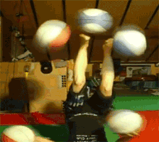
Maybe….. But consider
Trajectory of condition?
What’s going in Joan’s life / head?
What does Joan want / is willing to do?
What are her main barriers?

Slide 10

Other potential variables
Consider:
Pain limiting desire / ability to go out and be socially active.
Decreased activity / increased adiposity liked with pro inflammatory state.
Convenience food diet due to ease.
Fear of disability - issues around being alone and in pain.
Post operative recovery with poor social circle.

Slide 11
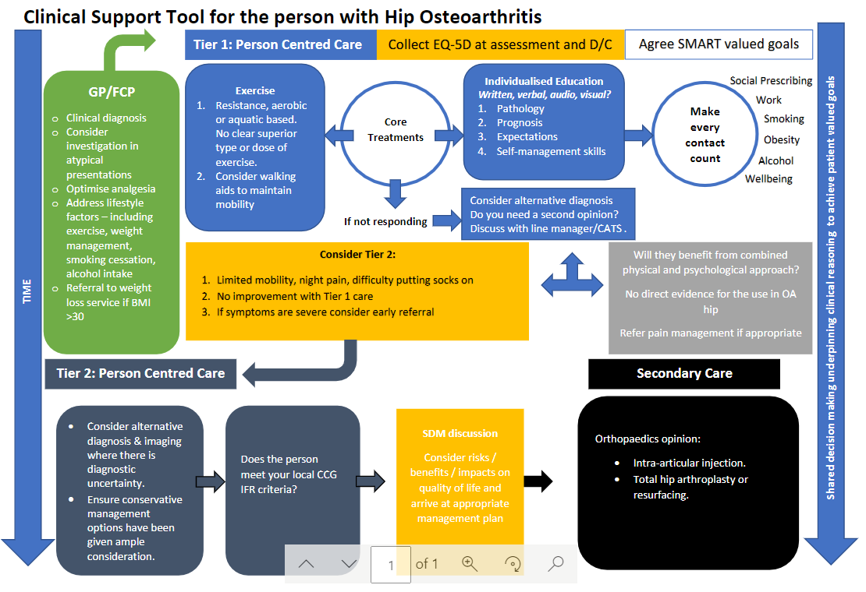
Notes:
.

Slide 12

Steroid injection
Pain relief
Infection
Delayed THR
AVN
Rapid worsening

Slide 13
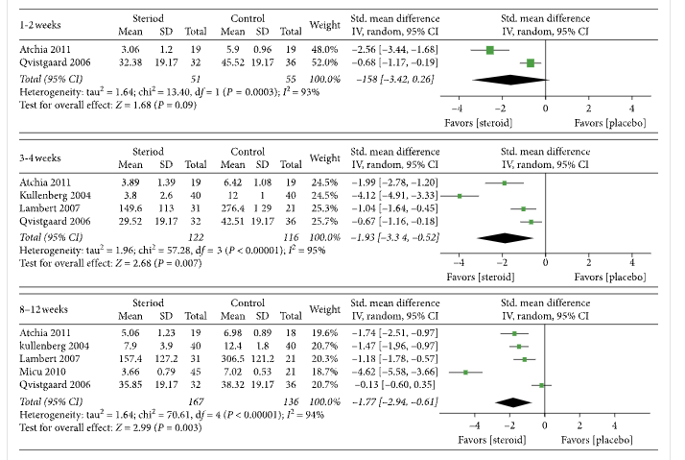
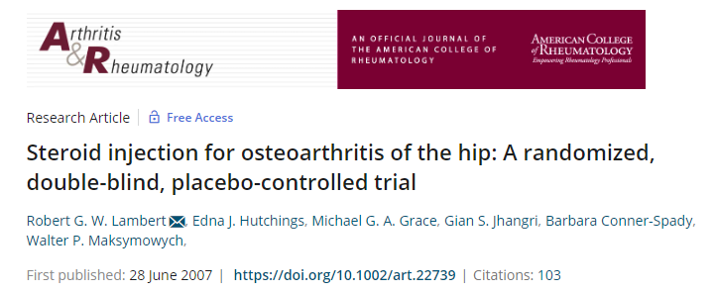
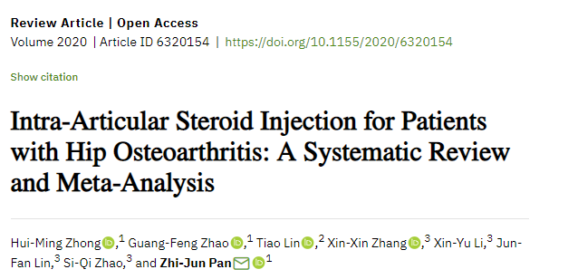
Steroid injection – pain relief
57 patients – Steroid vs Saline
WOMAC reduction of 49% in steroid group.
Benefits can last up to 3 months***

Slide 14
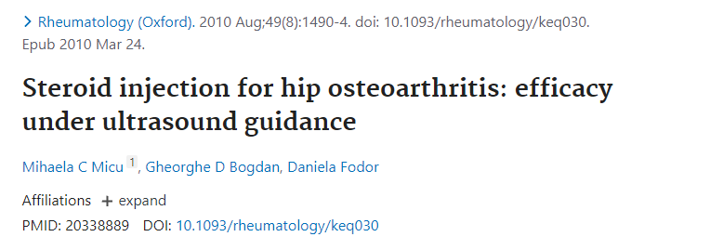
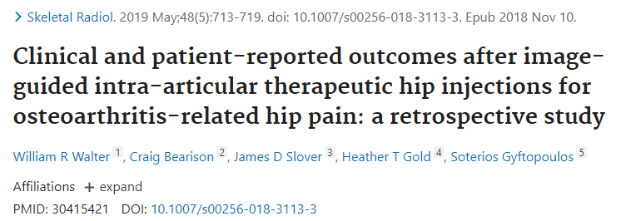
Steroid injection – Pain relief
40 patients with OA and SYNOVITIS.
75% seen reduction in pain 1-3 months post injection.
No control group**
Retrospective study.
113 patients. 79 followed up > 8/52.
No sig change short/long term.
49 had THR within 1 year.

Slide 15
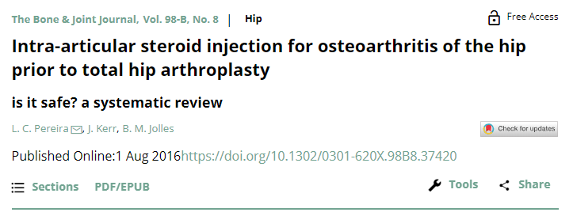
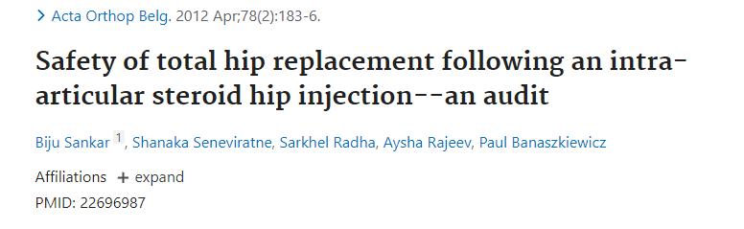
Steroid injection – Risks
Inconclusive. Poor literature quality and low numbers.
40 patients had CSI and then hip replacement (no sooner than 6 months).
No cases of infection.

Slide 16
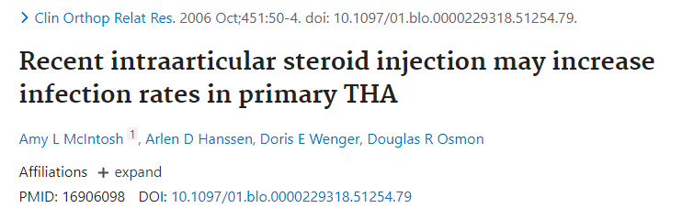
Steroid injection – Risks
448 THR. 50% had injections.
Higher rates of infection injection group (3 deep and 11 superficial vs 1 deep and 8 superficial).
Higher rates of infection seen in those with injection <2 months from THR.

Slide 17
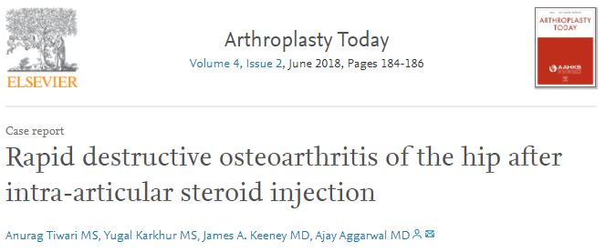
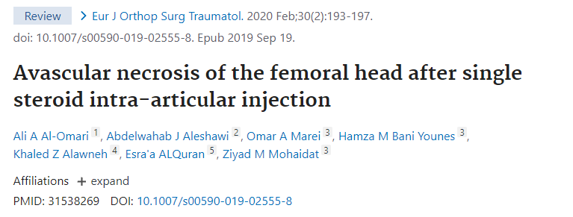
Steroid injection - Risks
Case reports – Rare but there!

Slide 18
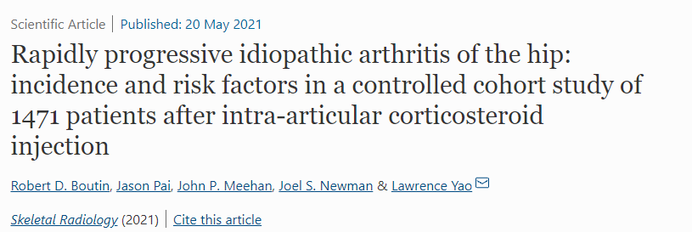

Steroid injection – Risks
106 out of 1471 people developed rapidly progressive joint changes.
7% of cases! One out of every 14 people
Compared to controls – main variable was the injection.

Slide 19
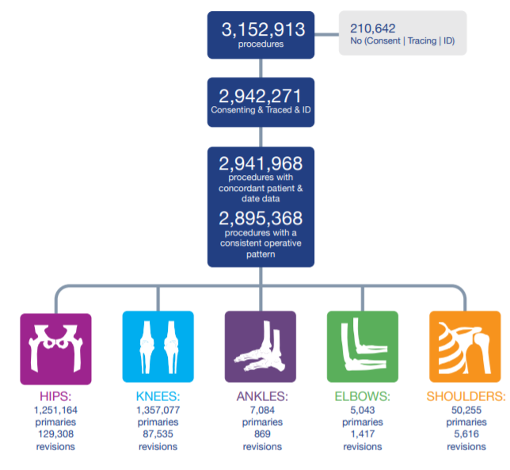
Arthroplasty
Joint | Primary | Revision | Percentage revised
Hips | 1251164 | 129308 | 10%
Knees | 1357077 | 87535 | 6%
Ankles | 7084 | 869 | 12%
Elbows | 5043 | 1417 | 28%
Shoulders | 50255 | 5616 | 11%
National Joint Registry Annual Report (2020)

Slide 20
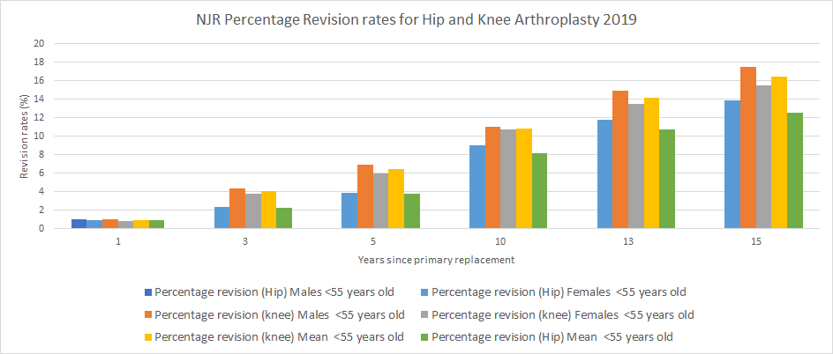

Slide 21
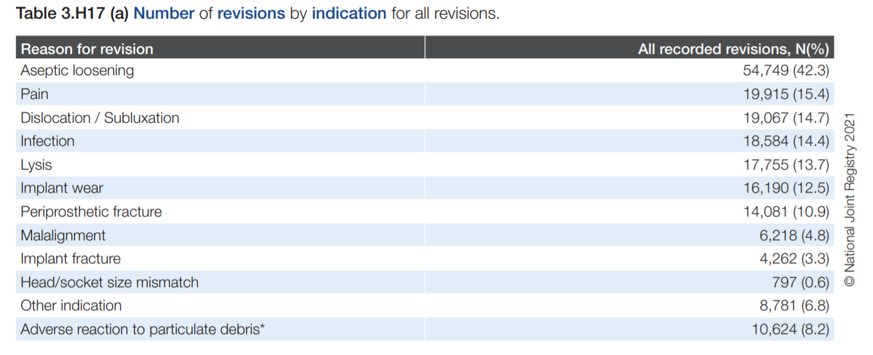
Arthroplasty

Slide 22
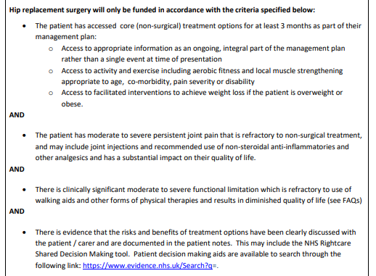
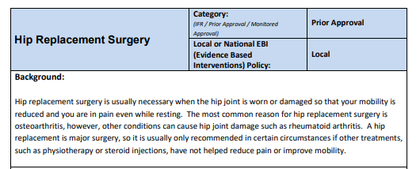
Value Based Commissioning

Slide 23
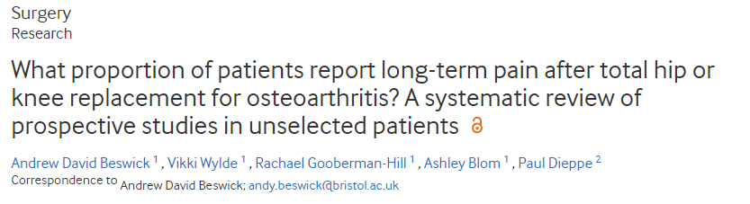
Pain post Arthroplasty
(2012)

Slide 24
Pain post Arthroplasty
Study | N = | Follow up | PROM | Favourable | Uncertain | Unfavourable
1 | 1231 | 12-18/12 | QOL self report | 754 (61%) | 4 died 117 attrition (10%) 62 further surgery, pain ongoing (min QOL impact) | 127 moderate/severe pain (10%)
2 | 242 | 6/12 | WOMAC | 208 (86%) | 14 attrition (6%) | 20 moderate / severe pain (8.3%)
3 | 784 | 6/12 | WOMAC | 456 (58%) | 200 attrition (26%) | 128 no improvement /worse (16%)
4 | 219 | 43/12 | WOMAC | 153 (70%) | 8 died 13 attrition (6%) | 45 <10/100 VAS improvement (21%)
(Beswick et al., 2012)

Slide 25
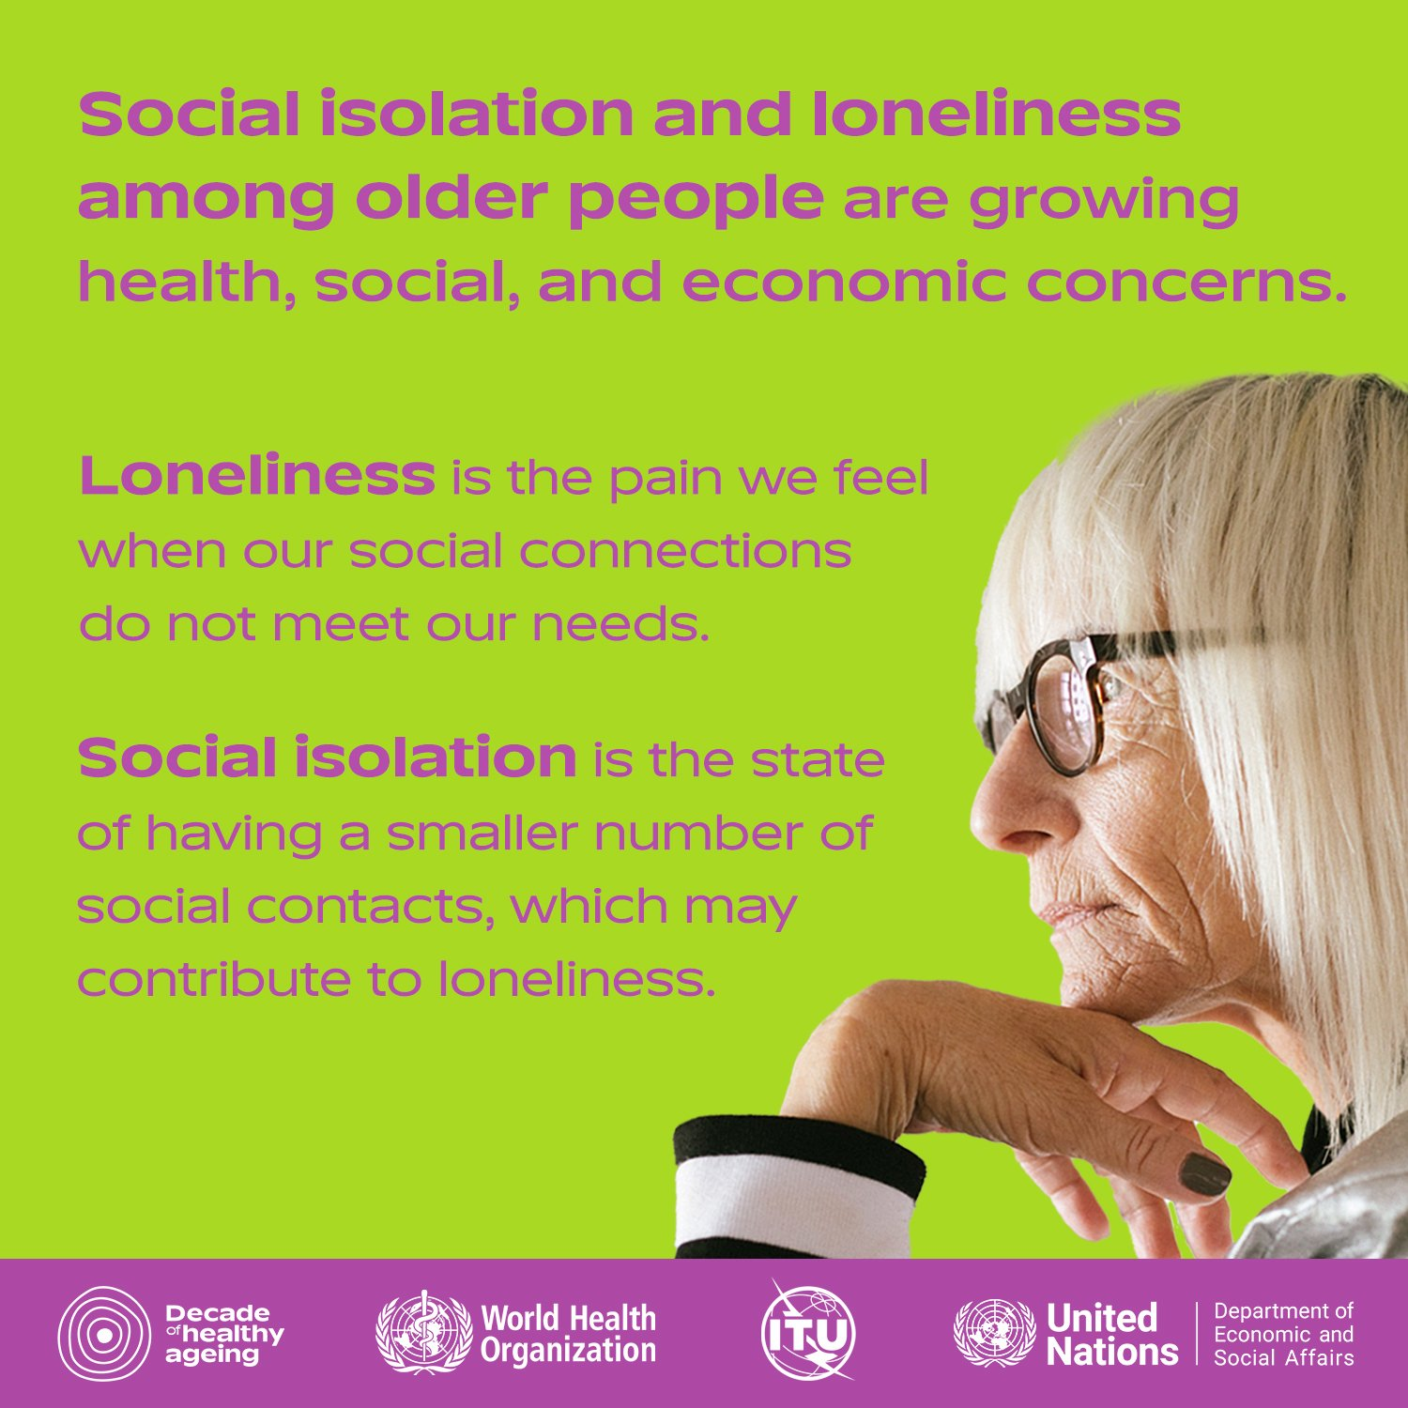
Social isolation and loneliness
Social isolation and loneliness are increasingly being recognised as a priority public health problem and policy issue for older people. During the course of the UN Decade of Healthy Ageing (2021-2030)
World Health Organisation (2021)

Slide 26
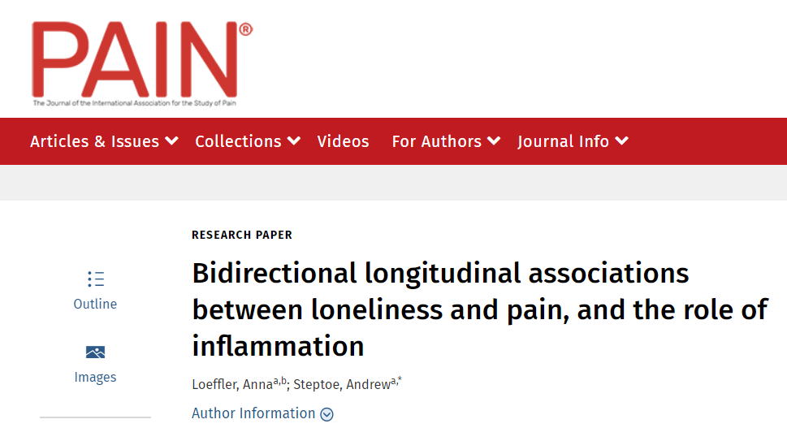

Social isolation and loneliness
ELSA – English Longitudinal Study of Ageing.
50 year study, started in 2002.
Self reported pain and loneliness.
@4 years follow up:
Baseline CRP was associated with pain and loneliness.
Increased CRP was associated with increased future pain, but not loneliness.
Pain seemed to positively predict future loneliness, but CRP did not seem to have an additional role.
Loeffler and Steptoe (2021)

Slide 27
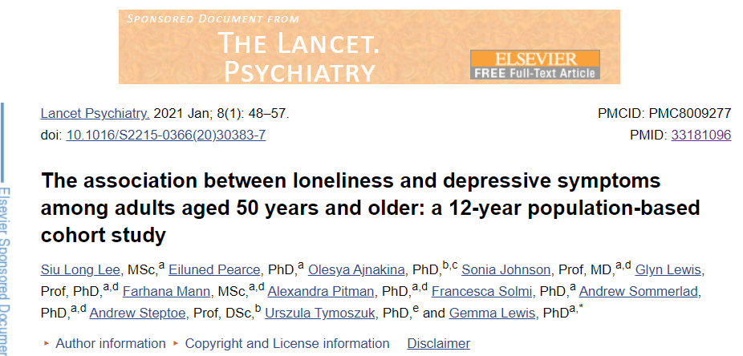
Loneliness and depression
ELSA data again… she just wont let it go!
Population attributable fraction for depression as a result of loneliness of up to 18%.

Slide 28
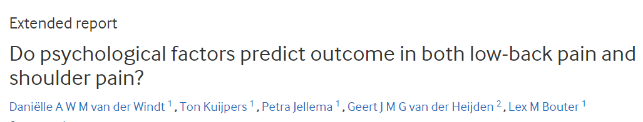
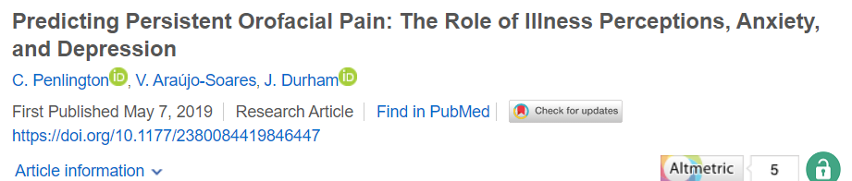
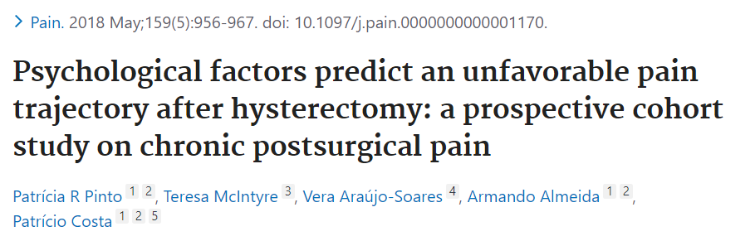
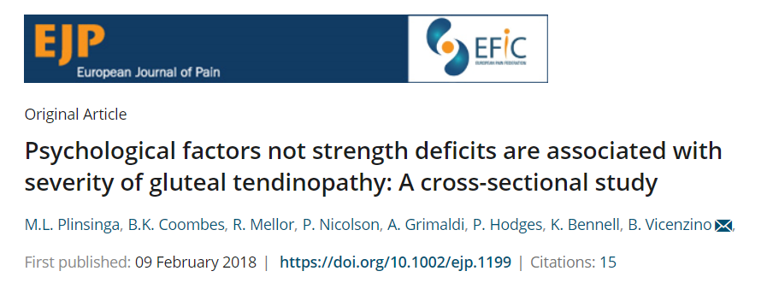
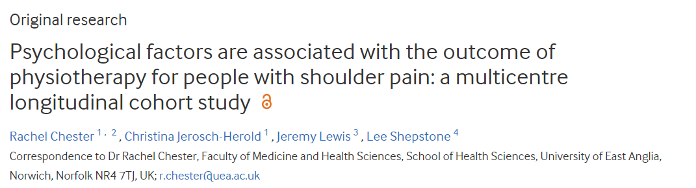
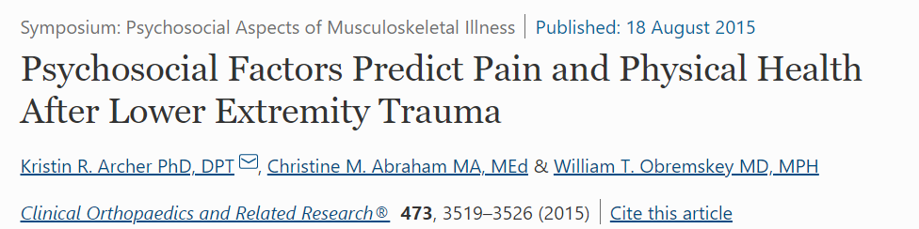
Psychological influences of pain
Depression and psychological distress were predictive of poor outcome,
These effects were no longer significant once measures of illness perceptions were added
Individuals with severe gluteal tendinopathy present with psychological distress, poorer QOL, greater BMI and waist girth.
Depression at 4 weeks was predictive of pain intensity, pain interference and physical health at 1 year follow up.

Slide 29
Why am I telling you this?
B
P
S
Notes:
Large focus (some say erroneously) on biomedical aspects of care. Not led to improved outcomes.
More recent research on psychology aspects of persisting pain.
Current focus on social determinants for health.

Slide 30
Summary
Is it really OA?
What’s the driving factor for the person seeking care.
Single interventions are rarely helpful (also, you can’t stretch bone 😜).
Social determinants of health are complex, sometimes beyond the scope of an individual to solve.
You don’t HAVE to have surgery…..for anything.

Slide 31
