Slide 1
Miriam Fine
Transformational Life Coach
Lecturer in Physician Associate Studies – Queen Mary University of London
Communication Skills
Quality Improvement in Healthcare
Former junior doctor
www.miriamfine.com
@fine_miriam on Twitter
m.fine@qmul.ac.uk

Slide 2
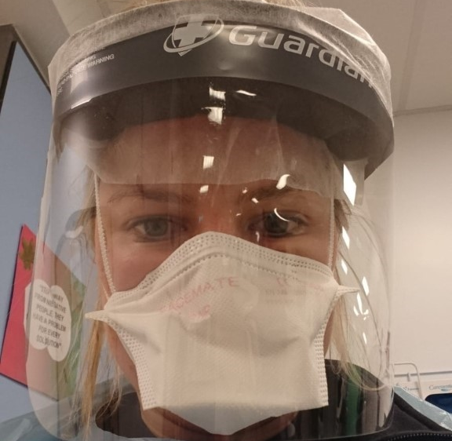
PPE Mask

Slide 8
Narrator

Slide 9
Picture the scene…

Slide 13
What would you say to your best friend?

Slide 14
Recognise
Allow
Investigate
Nurture

Slide 19
Take Home Message
Regular check-in with thoughts and feelings.
Externalise thoughts to gain perspective.
Speak to yourself as you would speak to your best friend.
www.miriamfine.com/blog-1

Slide 22
Focus | Play | Connection | Physical
Time in | Down Time | Sleep Time

