Slide 1
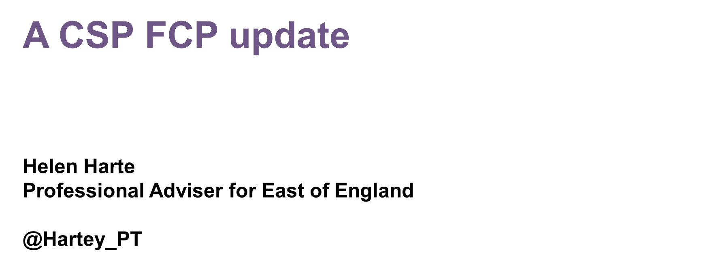
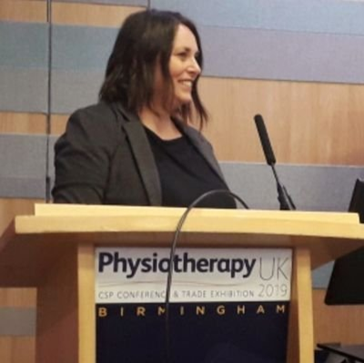

Slide 2
My Brief:
FCP & the CSP’s response to COVID
ARRS walkthrough
FCP 2021 priorities

Slide 3
MSK/FCP services during Covid-19: Survey Results
95 survey responses

Slide 4
Notes:
Haven’t pulled out private practice – not running FCP

Slide 5
Challenges for FCP
Closure of GP practices to face to face appts. Immediate drop in demand in primary care appts incl MSK. Initial redeployment of FCP staff, now reinstating FCP service within primary care. Min MSK pathways for imaging/onward referral - urgent only. Unmet demand still of MSK pts - APP, Wales
Working remotely poses challenges like the lack of a physical examination and the loss of non verbal communication. Patients have also been staying away from GP practices so clinics have been quieter but that has allowed more follow ups – FCP, Stockport
Completely changing the way we work in a short space to time, now using telephone and attend anywhere regularly, ensuring staff safety and support and governance - FCP, Grampian
The almost immediate closure of routine MSK services The rapid reduction of MSK demand. Implementation of virtual consultations, maintaining an MSK presence with majority of MSK staff redeployed – APP Lead, Wales
Lack of investigation options, for example, referrals for MRI are on hold...more reliance on clinical assessment but also lack of F2F appointments ...increased risk for clinicians – Consultant Physiotherapist, South East

Slide 6
Solutions

Slide 7
Strict criteria set for patients attending in person and adequate/appropriate PPE equipment provided. Prioritise care needs of patients. Carrying out telephone assessments and review appointments - FCP, South East
Close working with our ehealth/IT teams to enable remote access. Regular Video meets with staff and drop in check in sessions. Maintaining FCP service albeit remotely to all practices that wish it - close comms with practices – FCP Clinical Lead, Highlands
Improved/different resources for staff and patients. Flexible working practices for staff relocated away from MSK services. Different appointment system. Using video consultation systems. Development of different clinical pathways. Development of pt focus work to ID patient priorities in the new ways of working – APP, Wales
Video consultations implemented. Maintaining strong peer support & more regular meetings to discuss clinical cases - Highly Specialist Paediatric Physiotherapist, Enfield
Lots of networking in the practice even if just making coffee for the poor reception staff who were inundated with calls from anxious patients. Looking at referral pathways within the practice, trends to start making plans for opportunities moving forwards. Improving phone consultations skills – Specialist Practitioner MSK, East Riding Yorkshire

Slide 8
Notes:
- Overhwhlemingly not returning to only f2f appointments was what people want to avoid returning to. It gives more options to patients

Slide 9
Detail – What we should avoid going back to
We should not go back to what we had before. We should see this as an opportunity to embrace IT digital solutions to help manage an expanding MSK caseload – Consultant Physiotherapist, Derby
I feel we are a hands on profession and have the luxury of spending time with our clients, touch our clients and improve their quality of life. It would be devastating to lose that contact time and ability to touch – Practice owner, Scotland
Overtreating patients - empowering pts to make decisions about their care after educating about their options. Not bringing all pt in for a F2F consultation if they are happy for virtual. Not returning to over investigating – APP Wales
Unnecessary physiotherapy appointments without allowing the patient the opportunity to engage with online resources first where possible – FCP, Ipswich & East

Slide 10
ARRS: What’s it all about?
The Additional Roles Reimbursement Sum funding is available to fund additional PCN workforce
Any unused funding in a given year cannot be carried forward into subsequent years, and a PCN’s entitlement to that funding in that year will therefore be lost.
All roles reimbursed at 100% of salary (mid point 8A) plus on costs up to the maximum reimbursable amount.
Each PCN has a single combined maximum sum under the scheme based on its weighted population share
Principle of Additionality – designed to ensure staff recruited under the ARRS are genuinely additional to the PCN workforce

Slide 11
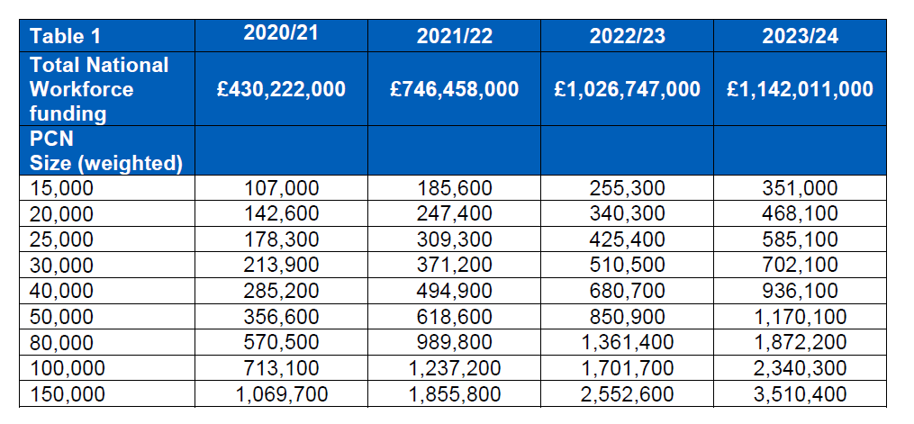
ARRS: Whats included?
By 31 October 2020 PCNs need to share their indicative intentions through to 2023/24. The commissioner will confirm the plan with each PCN’s Clinical Director and, once each plan is agreed, will share with NHS England and NHS Improvement Regional Teams by 30 November 2020 for indicative future plans.
Indicative Additional Roles Reimbursement Scheme Sum per PCN weighted population
Notes:
It is up to each PCN to decide the distribution of roles required, limited only by differentially available supply of different roles in different parts of the country.

Slide 12
ARRS: Whats included?
Role | 2019/20 | 2020/21 | 2021/22
Clinical Pharmacist | Yes | Yes | Yes
Social Prescribing Link Worker | Yes | Yes | Yes
Physicians Associates | Yes | Yes | Yes
First Contact Physiotherapist | No | Yes | Yes
Community Paramedic | No | No | Yes
Pharmacy Technicians | N/A | Yes | Yes
Health and Wellbeing Coaches | N/A | Yes | Yes
Care Coordinators | N/A | Yes | Yes
Occupational Therapists | N/A | Yes | Yes
Dietitians | N/A | Yes | Yes
Podiatrists | N/A | Yes | Yes
Mental Health Practitioners | N/A | No | Yes
Nursing Associate from 1st October 2020 | N/A | Yes | Yes

Slide 13
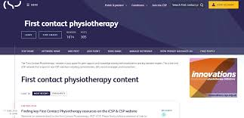
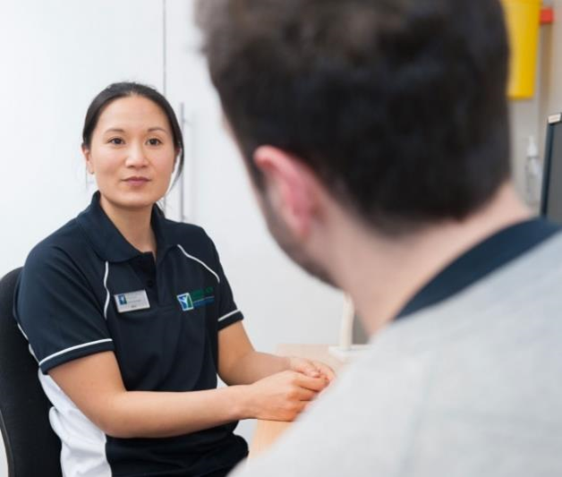
CSP Activity
Notes:
Phase 3 is a mixed methods service evaluation funded by the CSP Charitable Trust and the Joint Work and Health Unit. Led by Keele & Nottingham University. It includes the collection of patient and primary care team experience and patient reported outcome data.
The final report/results will be launched at the end of this week on the CSP website.
advanced practice MSK portfolio route which also fits with the FCP road map work

Slide 14
Phase 3 Evaluation
240 FCPs from 40 services in England participated in the evaluation
Eleven of the twelve success criteria were met
Report being published on CSP website end of this week
There is a joint webinar tomorrow sharing some of the results
MSK FCP: sharing the lessons for successful implementation
12.00 – 13.30
Notes:
Phase 3 is a mixed methods service evaluation funded by the CSP Charitable Trust and the Joint Work and Health Unit. Led by Keele & Nottingham University. It includes the collection of patient and primary care team experience and patient reported outcome data.
The final report/results will be launched at the end of this week on the CSP website.

Slide 15
Key findings
Meeting patient need
Success criterion 1a: The percentage of patients consulting the FCP who report (within 3 months) visiting their GP for the same problem will be: 25% or less (fully met), 26-50% partially met), 51% or more (not met). 20% (fully met)
Supporting self-management
Patients will report receiving self management information/exercises from their FCP relating to their joint or muscle symptoms. 70% or more (fully met), 5069% (partially met), 49% or less (not met). 95% received sufficient information on self-care (fully met)
Securing patient support
Success criterion 3b: Patients report being ‘Likely’ or ‘Very likely’ to recommend the FCP service to friends and family. 80% or more (fully met), 60-79% (partially met), 59% or less (not met). 94% (fully met)
Keeping people in work
Success criterion 4b: Patients will report less impact of their MSK condition on work performance (as measured by the Stanford Presenteeism Scale) at 3 months. 51% or more report reduced impact (fully met), 40-50% (partially met), 39% or less (not met). 54% (fully met)

Slide 16
Emerging themes - Primary Care interviews
Communication
Advertising
Patient understanding of FCP
Poor patients awareness of FCP
Embeddedness
It took some time for the FCP service to become embedded in the culture
Contribution of FCP
Signposting
Shared record systems and processes
Care navigation training
Patients had a lack of understanding physiotherapy and FCP
These factors lead to patient uncertainty
Data collection was essential to evidence efficacy
Patients were satisfied
Staff were satisfied
The MSK expertise of the FCP was welcomed
Unburdening the GP is complex
Scope & model of FCP service
Perceived benefits to the ‘open-access’ model of general practice care
Little evidence of GP protectionism
Advanced practice skills
Individual professional development
Notes:
The second part of data collection is the interviews with patients, FCPs and Primary Care teams. There are some key themes emerging- the importance of communication, patient understanding, embeddedness, the clarity of the FCP contribution and impact.
The importance of good communication to encourage the appropriate flow of appropriate patients to clinic is important but also for example, the wider aspects of the communication such as ensuring
effective systems & processes are in place which has been raised as a barrier in some areas.
Another aspect is the need for more attention to be given to the understanding of patients and the whole primary care team in what is being offered by an FCP
And the time it might take to enable embeddedness and integration needs to be acknowledged
We also see that physiotherapists attempted to influence service implementation using evidence of impact.
Positively, FCP was seen, by those who had worked in the role, as a good career option and a real opportunity to develop alongside other professions

Slide 17
Notes:
We are finalising 2021 plans now – so can’t share up-dated objectives. But these are the workstreams for 2020 and they will continue into 2021 – although the activity will be slightly different the aim of the workstreams will remain the same. In England the focus will especially be on supporting the roll out of services as the new ARRS come into place and supporting the work that HEE are doing around the roadmap and what this will mean for members.
On the topic of the roadmap this is being launched by HEE the second week of October. We will be producing FAQs and supporting members with on-going comms around what this will mean in practice, including blogs, possible podcasts and linking in with HEE, NHSE and other stakeholders to support the on-going discussion and roll-out of it.

Slide 18
EoE Developments
Knowledge
Local
Connectedness
Local
Action
Local
harteh@csp.org.uk

