Slide 1



Jane Clarke
Clinical Director of Pickwick Physiotherapy in Wiltshire
Member of South West Regional CSP Network Committee
jane.clarke@pickwickphysio.co.uk
@janeclarkey

Slide 2

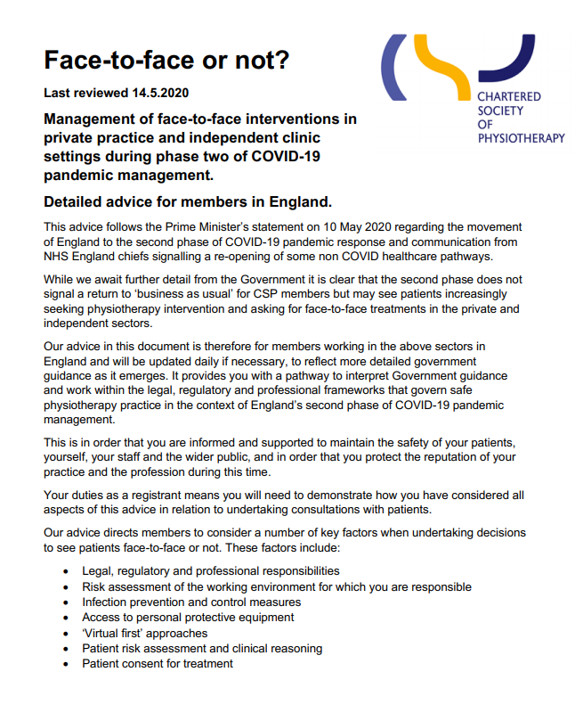
When to re-open? – Planning Phase
Who to?
You have a high suspicion of risk of serious deterioration from underlying pathology and you are unable to determine this remotely.
They have urgent rehabilitation needs, which if not met, will require care from General Practice, secondary care or social care agencies. This is particularly important if they are themselves a carer for someone who is vulnerable.
They require rehabilitation to support their rapid discharge from secondary care.

Slide 3
When to re-open? – Planning Phase
Set up inclusion criteria for face to face consultation.
Over 70’s with no other health issues
  Specific shielding clinic? (when clinic not been in use – physio shield B4 contact, Home visit?)
What will you offer?
1 clinic room/2, staggered appointments, how many, how long per client?

Slide 4

The Paperwork!
Risk Ax in accordance with HSE guidelines
Pre-face to face protocol (includes initial consult online)
Entry protocol
Face to face treatment time protocol and PPE
Exit protocol (walk this through)
Cleaning protocol
Health of Physio’s and who can work
Where has this come from?
CSP, PHE, HSE COVID resources
Zoom with my Pickwick team
Meetings with other Private Physio’s and Sports Massage therapists, NHS managers planning OP services, comparing info/paperwork
Survey of patient expectations

Slide 5
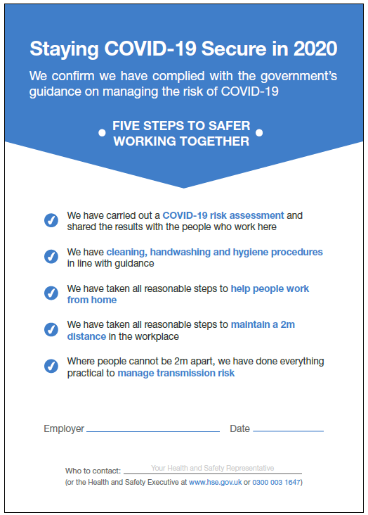

Slide 6

When to re-open – how I will decide!
Are you ready?
Government guidelines
CSP guidelines
The infection rate in local area
The status of local outpatient MSK NHS service
When we open – we will learn, we then need to share our intel!

Slide 7
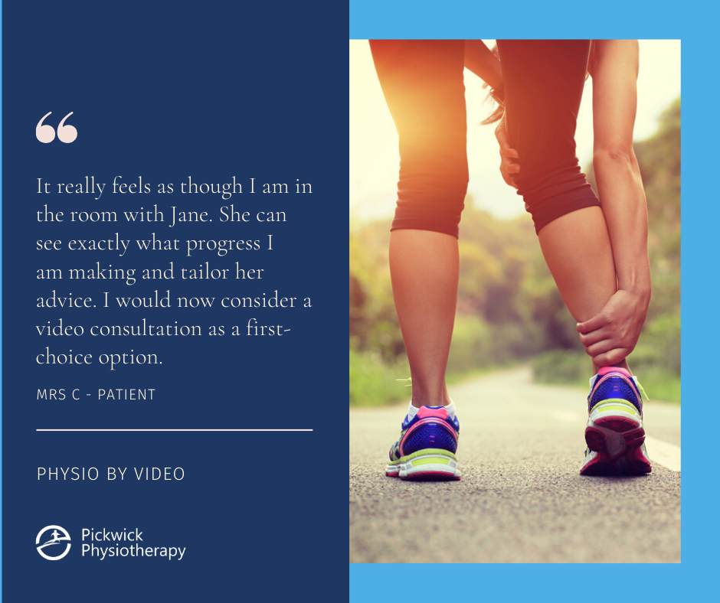

Slide 8

The Virtual Physio appointment!
Advantages
Fosters self management
Considerations
Which option?
Fosters self reliance
Fosters experimentation by patients
Maintain link with customer base
Keeps us clinically sharp
Consent - call, privacy, removal of clothes?
Technology challenges
The public don’t get “physio by video”
On occasions difficult to demo/correct more complex exercises
If you haven’t done it…DO it!

Slide 9

What I have learned so far -“Physio by Video”
Welcome email, what to expect, camera location, what to wear, and technology fail plan.
Listen carefully and don’t interrupt then ask the important questions.
Check list of key unmissable questions.
Pick key objective tests to secure diagnosis.
You Demo, patient demo, set exercise level.
All patient questions answered before sign off?
Send a email summary; diagnosis, exercises /progressions, advice.
Write notes carefully, patient out of shot of camera?

Slide 10
Lets get connected!
Jane Clarke
Clinical Director of Pickwick Physiotherapy in Wiltshire
Member of South West Regional CSP Network Committee
jane.clarke@pickwickphysio.co.uk
@janeclarkey

