Slide 1
The CSP Hip Fracture Standards
Notes:
Roughly a 25 minute presentation.
You can lengthen it or shorten it to take key slides.
Three areas
Sprint Audit
CSP Local Audit
CSP Standards.

Slide 2




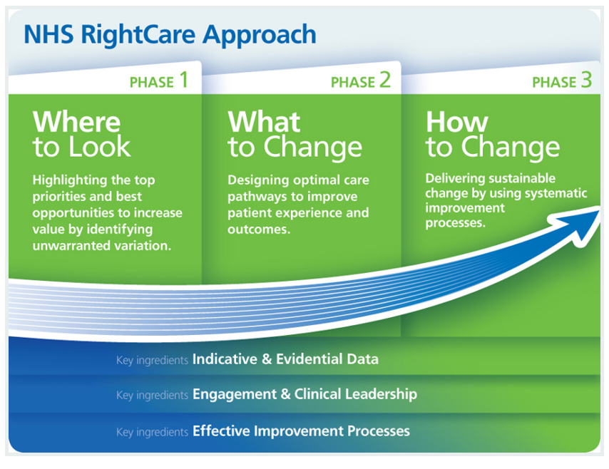

Background
Notes:
Commonest cause of hip fracture is falls.
Long history of work in this area.
Lack of rehabilitation specificity around NICE / SIGN Guidelines
Approaches to service improvement and evaluation
GIRFT
Right Care
None included information on rehab
2017 CSP commissioned the RCP to manage the Physiotherapy Hip Fracture Sprint Audit (PHFSA) ‘Sprint’ audit
*high volume data in a short time
* added as a subsidiary data set to the NHFD national dataset.

Slide 3
HipSprint 1 =
largest audit of UK physiotherapy
Notes:
Hip fracture is a leading cause of morbidity in people over 60 years old.
People experiencing hip fracture require rehabilitation, often from a number of teams, throughout their recovery period.
Communication between these different teams poses a challenge to the continuity of care.
Communication between professionals delivering care is essential to ensure safe and effective care, continuity of treatment and rehabilitation planning.
Hip sprint investigated the patient journey through the whole pathway from the acute trust providing the initial hip fracture treatment, the next step rehabilitation wards and finally on to home and community base

Slide 4

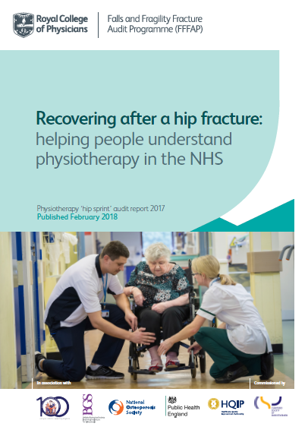
>580 physiotherapists were recruited over 2 months
131/173 applicable acute hospitals in England took part
7000 hip fracture patients were cared for
78.6% of all eligible patients were audited
Data collection between May – August 2017
Notes:
[ talk about your own experience of participating in hip sprint 2 mins]

Slide 5
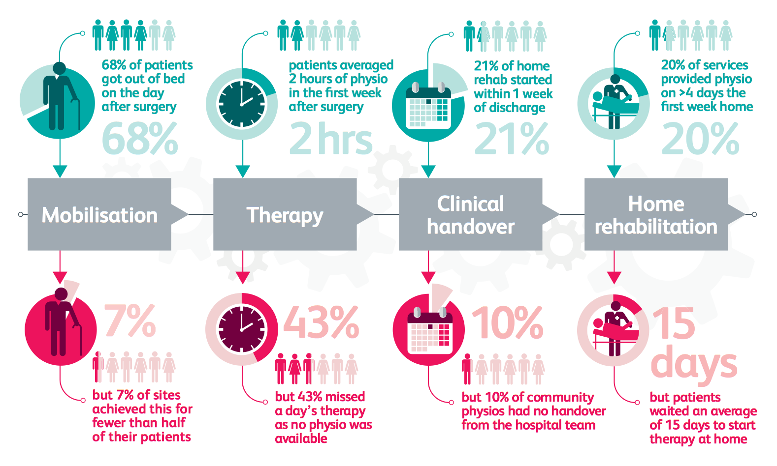
Notes:
Main Findings of Hip Sprint audit
Unwarranted Variation in hip fracture rehabilitation identified throughout England and Wales
Already lots of guidance out there relating to reasonable standards of care for the types of patient experiencing hip fracture.
This is not translating into consistent levels of being delivered by physiotherapy teams across the whole pathway.
Led the CSP developing standards.

Slide 6
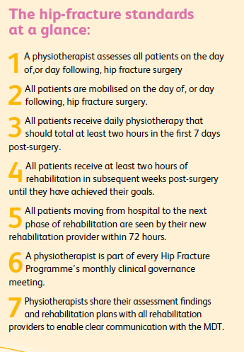
HipSprint
Recommendations -
Early mobilisation
Intensive rehabilitation
Continuity of care
Local governance and
quality Improvement
Notes:
These standards are directly drawn from the recommendations of hip sprint, together with using existing standards from other sources such as NICE.
Many of the reasons given for patients not getting out of bed, such as dementia , delirium, poor pain control may be managed by a registered physiotherapist using real time clinical judgments to modify protocol based care to help these very sick patients get out of bed within 24 hours of surgery.
The more therapy time invested in the first week, the more likely it is that people would return to their own homes. More intensive early physiotherapy early one meant more patients were able to get out of bed on the day of, or day after surgery.
Delays in starting onward rehabilitation may lead to deterioration, and reduce the ability of an individual to regain previous functional status. Models of care do affect how this transition is managed but where there are delays these could be driver for improvement
Physiotherapists need to own their expertise and role in leading rehabilitation and leading the whole physiotherapy workforce , and ought to expect to be part of the MDTs that lead an deliver hip fracture care
The first standard refers to assessment and is critical that this is undertaken by a physiotherapist –
As well as focus on physical abilities, which includes pre-hip fracture status (mobility in and outside), PT assesses cognitive ability and engagement in rehab. The assessment kick starts the tailored rehab programme, focused on returning the individual to pre-fracture status
A registered physiotherapist must perform the assessment.
The first assessment may occur either before or after the operation.
The NHFD data processor is able to identify the specific assessment of the physiotherapist for the purposes of NHFD data entry.
A clear and consistent method for recording the initial physiotherapist assessment is in place.
The physiotherapist assessment is shared with the MDT to facilitate clear communication and efficient care-planning
A physiotherapist may undertake the delirium assessment using the 4AT screening tool, for tariff payments, if they are part of the admission team.
A physiotherapist may undertake the multifactorial fracture prevention assessment (falls and bone health), for tariff payment.
Evidence:
A significant number of patients recovering from hip fracture experience poorly controlled pain, delirium and hypotension. Many patients experience dementia. These associated conditions require careful real-time clinical management according to individual patient needs. They are not absolute contraindications to mobilisation on the first day after hip fracture surgery yet they are commonly reported to unnecessarily delay mobilisation for a significant number of patients.

Slide 7
1000 more patients could return straight home each year
Notes:
¾ ‘ s lived in own homes beforehand, but over all only half returned to their own home after hip fracture.
If every hospital gave 20 minutes or more each day for first 7 days ….
Or if hospitals giving less acute rehab ensured continuity of rehab was provided then….
Some services already meet these standards and we look forward to seeing in the future your data on 4/12 follow up outcomes.
We understand many services have workforce pressures and this may give the opportunity to look at how you use the workforce you have and best use the right skills in the right place of the pathway

Slide 8
Auditing CSP Hip Fracture Standards

Slide 9
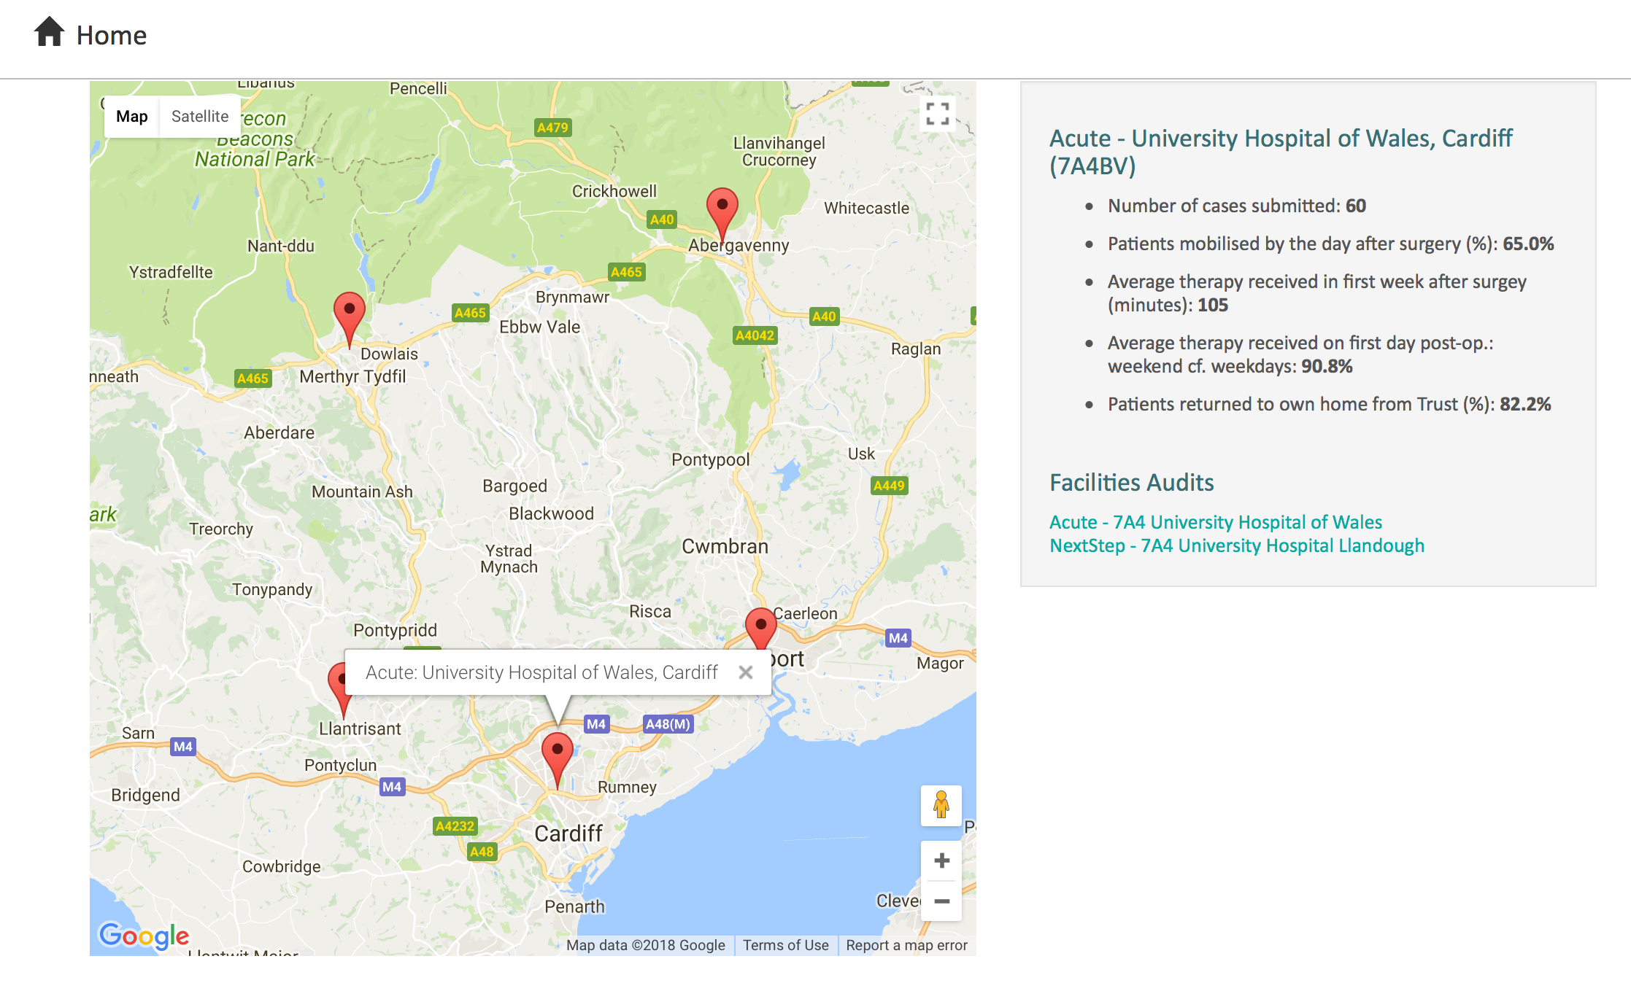
What’s our Hip Sprint data..?
https://www.fffap.org.uk/FFFAP/landing.nsf/phfsa.html
Notes:
Look up your own Hip Sprint data
Cut and paste the data here - talk about your data.

Slide 10
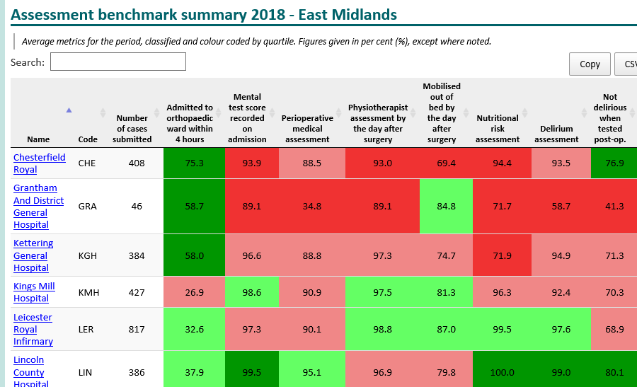
https://www.nhfd.co.uk/20/hipfractureR.nsf/welcome?readform
What’s our NHFD Data..?[insert own data here]
Notes:
CSP Standards 1 and 2
Use this slide to insert your own data…
Compare your latest data.
Can compare so much about your Trust
[insert side for your Trust or feeder Trust if you are in the community]

Slide 11
What’s our Quality Improvement Plan…?
Notes:
Insert local plan / ideas…

Slide 12
CSP Hip Fracture Standards

Slide 13

https://www.csp.org.uk/publications/hip-fracture-rehab-physiotherapy-practice
Notes:
Variation in care – this is impacting service delivery including losing patients and delays in continuing care
A small but significant number of patients do not receive continuity of hip fracture rehabilitation due to poor communication within the care pathway.
Physiotherapists are not involved in local decision making about hip fracture rehabilitation in a significant number of services
Communications methods used may not be efficient or effective between physiotherapists between stages in the pathway as it appears that some referrals are lost in the pathway.
Physiotherapists need to improve communication channels and pathways to ensure that every patient receives continuity of care throughout each stage of the recovery process.
Patient experience of hip fracture rehabilitation can be enhanced by improving the communication across the whole pathway.
Physiotherapists need to embed with local hip fracture governance teams to optimise rehabilitation from Day 1.
Local referral structures between sectors in the pathway should be reviewed to ensure that these are suitable for efficient handover of appropriate information.
Implications..
Moves should be avoided – if necessary obligation to anticipate their impact and develop effective mechs for handover
Standards….
Commissioner s should take whole pathway approach
Hip Fracture Progs in acute services should have responsibility for all patient since they ve left acute care to decrease interruptions
Referral structures need reviewing

Slide 14
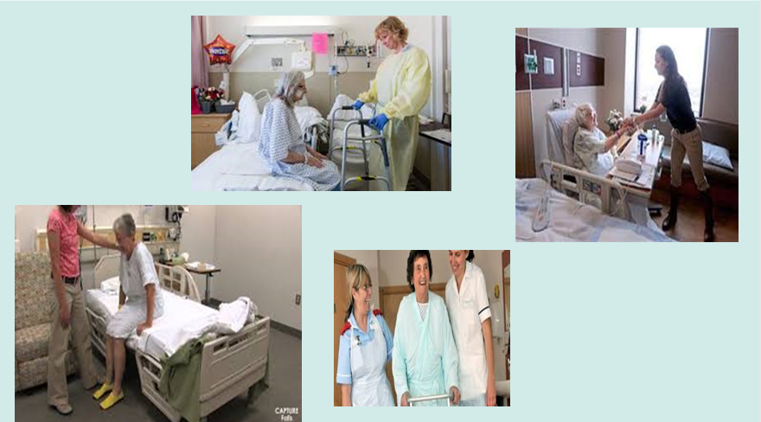
Notes:
Standard 2:
Any healthcare worker may perform the task of getting a patient out of bed.
The type of worker(s) involved in getting the patient out of bed is accurately identified.
A clear and consistent method for recording getting out of bed is in place.
The NHFD data processor is able to identify when a patient gets out of bed for the purposes of NHFD data entry.
A physiotherapist leads modifying physiotherapy treatment plans to enable patients experiencing dementia, delirium, pain and hypotension to get out of bed on the day of, or the day following, hip fracture surgery, where possible.
A physiotherapist reviews any patient who does not mobilise within 24 hours.
For patients who do not get out of bed on the day of, or the day following, hip fracture surgery:
A clear record is made of the reason why a patient does not mobilise within 24 hours.
A physiotherapist is involved in the Multidisciplinary Team (MDT) discussion to address the reasons for extended bed-rest.
A clear physiotherapy action plan with timescales is in place to manage the clinical conditions that prevent a patient getting out of bed on the day of, or the day following, hip fracture surgery.
There is a specific range of motion exercise programme in place for patients experiencing delirium
A patient does not need to have been seen by a physiotherapist before they get out of bed. Need to understand the difference between the task of getting a patient out of bed versus the professional activity of delivering rehabilitation which may include aspects of transferring and moving . Mobilising in this context means getting out of bed and signifies an end to bed rest. It is not the same as walking.

Slide 15

Notes:
Standards 3 and 4
The patient’s previous activity levels over the last six months is identified to ensure that rehabilitation goals are appropriate.
Any member of the physiotherapy team may provide the identified rehabilitation interventions.
A clear and consistent template for recording rehabilitation goals and activities is in place and shared with the wider MDT.
Each rehabilitation session includes domains of range of movement exercise, strength and balance training, transfers and walking, and functional ability.
Each rehabilitation session is suited to the patient’s identified abilities at the time treatment is given.
There is a specific strength and balance training programme in place for patients at low-moderate risk of falls
There is a specific multifactorial programme in place, including strength and balance training, for patients at high risk of falls.
An appropriate outcome measure is used to measure progress against each rehabilitation goal.
Patient who do not receive two hours of rehabilitation
A clear record is made of the reason why a patient has not received 2 hours of rehabilitation
A clear physiotherapy action plan with timescales is in place to manage the clinical conditions that prevent a patient receiving 2 hours of rehab
Muscle weakness and poor balance are significant risk factors for fall. Many patients who have fallen once have a fear of falling. Even short periods of bed-rest and/or altered activity patterns can lead to significant deconditioning. All patients must have specific strength and balance training as part of their early rehabilitation. Delirium should not prevent participation in rehab and active treatment still required.
Strength and balance training can be indiv or in classes
Treatment modified to enable patients experiencing dementia, delirium etc to receive care
Make use of the full team to deliver rehab and exercise ensuring properly trained etc

Slide 16
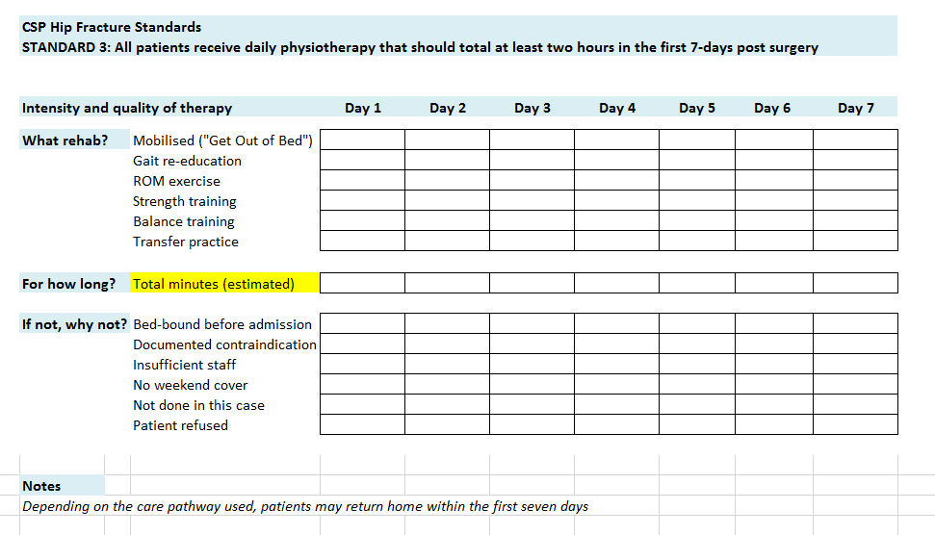
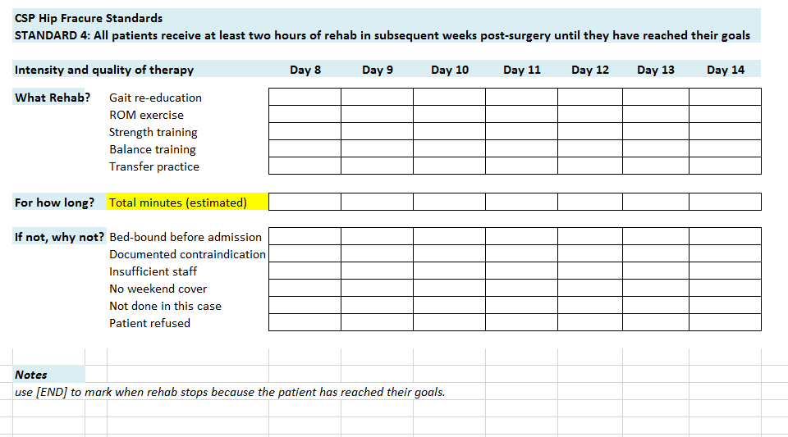
Notes:
CSP Standards 3 and 4
These measure rehab
Build on hip sprint data. And you can use them to measure how your service is progressing against the CSP Hip Fracture standards.

Slide 17

Notes:
Maintenance of strength and balance
Return to function
120 day follow – up
Outcome measures

Slide 18
Standards
Audit
Improve
Share
Network
Connect
Hip Sprint Local –
A project to disseminate the CSP Hip Fracture Standards into everyday practice by building robust and sustainable networks of members.
Through our virtual networks and planned regional events together with ATOCP and AGILE, we want members to use the standards to demonstrate quality improvements (QI) in practice and decrease variation in hip fracture rehabilitation across the country.
By encouraging members to share their completed work we want to contribute to the academic evidence base of hip fracture rehab. We want to encourage our members to be leaders within the QI and research community of hip fracture rehab.

Slide 19

https://vle.csp.org.uk/
Notes:
10 regional hubs covering all of the UK.
Designed to give a virtual forum for CSP members wanting to share local work, connect with local services and discuss issues affecting their regianl service provision.
Each hub suggests the geographical area best served by the Hub.
Hubs can be used to share local events / CPD / results etc.
Welcome to your regional Hip Sprint Hub.
Network and share good practice with members in your local area and within your local pathways.
This hub is aimed at members in South Yorkshire, Derbyshire, Nottinghamshire, Lincolnshire, Leicestershire, Rutland, Northamptonshire, Bedfordshire, Cambridgeshire, Hertfordshire, Norfolk, and Suffolk.
Not sure which Hub to join? Be flexible: Join the hub that is likely to have the most opportunity for you to connect and share with members working in other parts of the hip fracture pathway that your patients are following.
And why not check out your local ATOCP and AGILE networks?

Slide 20
CSP Hip Sprint
Regional Events

Slide 21

Impact of Standards - NHFD Report April 2019
90% of the Trusts reporting a Physio attends the monthly Hip Fracture Governance meeting, compared to 63% in Hip Sprint
100% of patients seen by a registered PT on D0/D1 after surgery increased from 5% of hospitals in 2018 to 30% of hospitals as of 01.04.19
100% of patients mobilised out of bed on D0/D1 after surgery increased from 1 hospital (0.01%) in 2018 to 10% of hospitals as of 01.04.19
Change to 2020 NHFD dataset to include reason why patients don’t get out of bed D0/1
Notes:
).
Agreed NHFD dataset change to include detailed reason of why patient don’t’ get out of bed (GOOB) on D1. Will be modelled in HipSprint qu’s and l will likely ask
Was the patient transferred out of bed (standing or hoisted) out of bed on the day of, or the day following surgery?
o Yes - physiotherapist
o Yes - other ward staff
o No - bed-bound before hip fracture
o No - inadequate post-op. pain control
o No - symptomatic hypotension
o No - patient too agitated or confused
o No - other
Select one option that best describes this patient’s experience

Slide 22
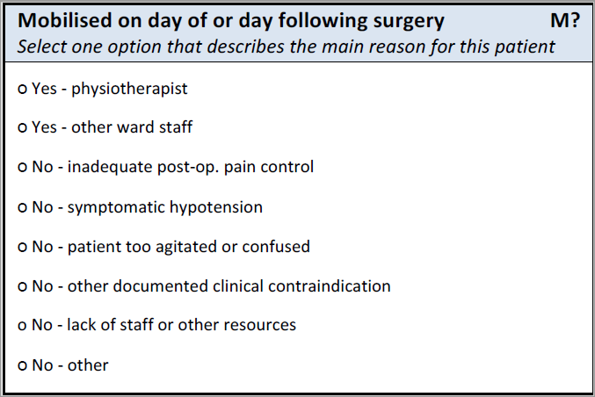
NHFD 2020 dataset- D0/1 mobility

Slide 23
^{www.csp.org.uk}

