Slide 1

Innovation in Community Neuro Rehab. Small Changes influencing the patient experience for the better
Claire Kell, Physiotherapist and Monica Knight, Occupational Therapist.
Community Regional Disabilities and Multiple Sclerosis Teams
Based at Walkergate Park, Centre for Neurorehabilitation and Neuropsychiatry
Benfield Road, Newcastle upon Tyne, NE6 4QD
January 2020

Slide 2
Introduction
Who we are at Walkergate Park and how we work
Innovations:
  Strong Team Mission and Objectives
  Standardising the pathway and processes
  Development of Assistant Practitioner role
  Use of Outcome Measures
  Innovative Interdisciplinary working
  Innovative development of the Physio Role
The Future-The Innovation Continues!

Slide 3
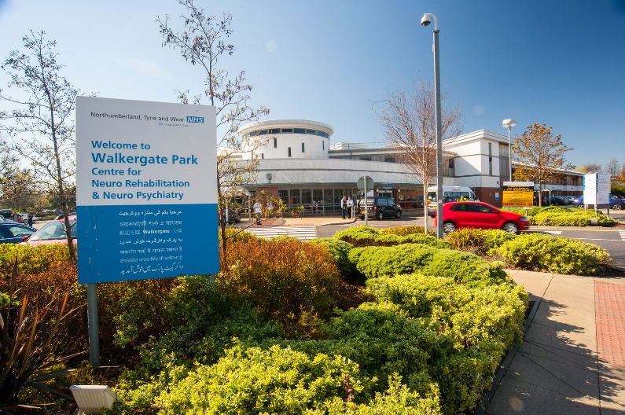
Who are We? - CMST and RDT
Community Multiple Sclerosis Team (CMST)
Therapy team for people with confirmed diagnosis of Multiple Sclerosis
Physiotherapy
Occupational Therapy
Rehabilitation nursing
Regional Disability Team (RDT)
Therapy team for people with a neurological condition (but not stroke)
Physiotherapy
Occupational Therapy
Psychology

Slide 4
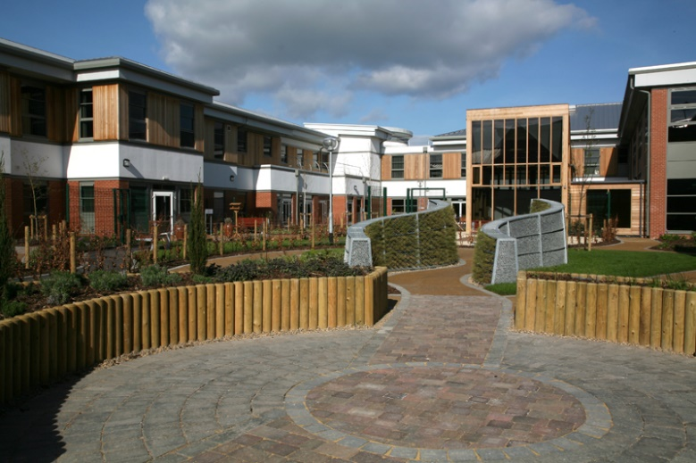
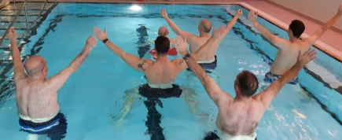
How We Work
Both teams work closely, with some team members working across both teams.
Treat people at Walkergate Park, in their own homes, community or workplace settings – wherever clinically needed!
Rehabilitation
Longer term management
Partnership working between professionals to provide best care possible.
Linking with rehab. consultants with access to specialist clinics and services.
Notes:
Goal focused and what and where is related to function.
Partnership working e.g. attending Benmar house to hand over standing frame work. Complimentary therapy sessions here at WGP from MS research and relief

Slide 5
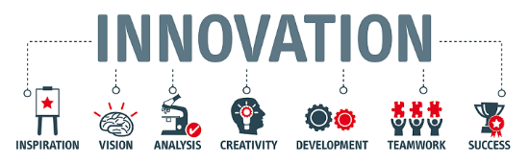
Innovations… well.
Things we do that are new to us!
Notes:
Innovation generally refers to changing processes or creating more effective processes to add value or provide a better service.

Slide 6

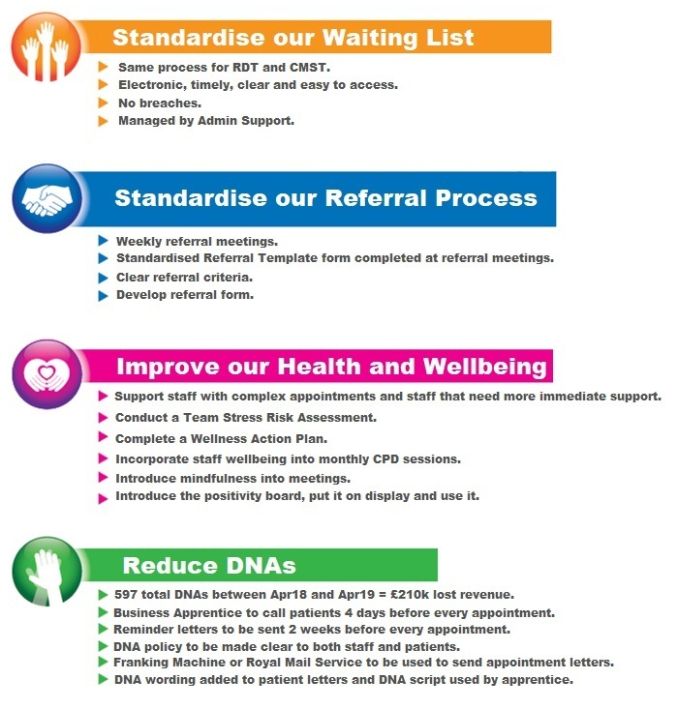
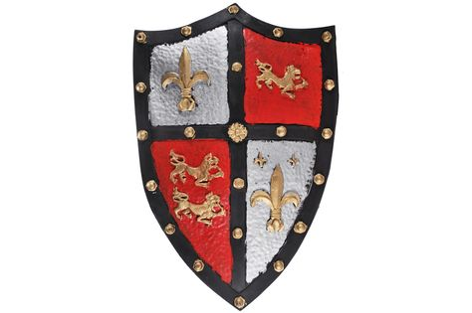
Developing Strong Team
Mission and Objectives

Slide 7

Standardising the Waiting List and Referral Process
Have the same process for RDT and CMST
Get rid of the paper waiting list! Electronic, timely, concise and easy to access for all.
Weekly referral meetings with standardised form to complete
Clear referral criteria – improved quality of referrals.
Using electronic diaries (Outlook) linked to electronic patient record (RIO)
Use of Telephone Contact Assessment
Managed and supported by Admin Team
‘Our 4 Queens of Admin’
Notes:
Benefits:
- Previously Band 7s managed the waiting lists, things went missing, it was unclear who had been picked up, where they were on the referral list.
Now managed by admin team and overseen by Band 7s freeing clinician time to do other things
consistency, more efficient, everyone is able to pick up the process

Slide 8


Telephone Contact Assessment
Initially started to support our patients who were on a long waiting list. Now our waiting list is more manageable and the assessment has been fine-tuned.
Early contact, introduce the team, patient expectations.
Advise – self-management, send out exercises, refer straight to our Assistant Practitioners.
Refer e.g. for a wheelchair, to social services, North-East Drive Mobility.
Provide Information e.g. Disease specific information leaflets, Carers information or information about community services e.g. Benmar house, pop-up gym, recovery colleges
Can prioritise urgent patients – can be responsive and book in fairly quickly.

Slide 9

Improving Health and Wellbeing of Staff
Supporting staff with complex appointments
Team Stress Risk Assessment
Complete a Wellness Recovery Action Plan (WRAP) for the team
Incorporate staff and wellbeing into monthly CPD sessions
Introduce mindfulness into meetings
Positivity board
Notes:
Training staff to complete 5p’s formulation

Slide 10
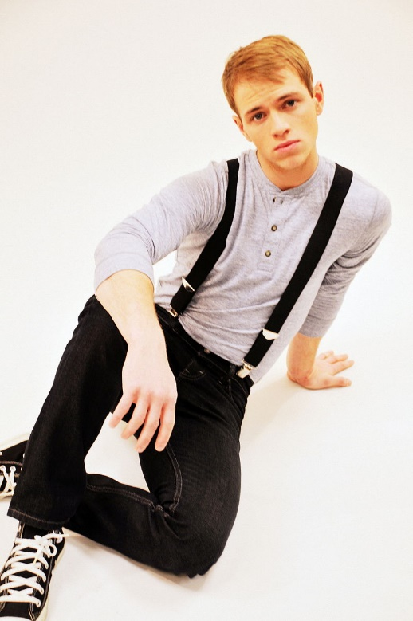
Reducing DNAs
Our service lost £210k revenue between Apr 2018 and Apr 2019 due to DNAs
Reminder letters sent out 2 weeks before every appointment
Text message reminders 1 week before every apppointment
Use of admin to call patients 4 days before every appointment
DNA policy made clear to patients and staff – consistent approach
DNA wording added to patient letters and script for admin telephone calls
Notes:
“Belts and Braces”. Be aware not all DNA’s would of come (some would of declined for example)
Some more work to do on this (text message reminders etc)

Slide 11
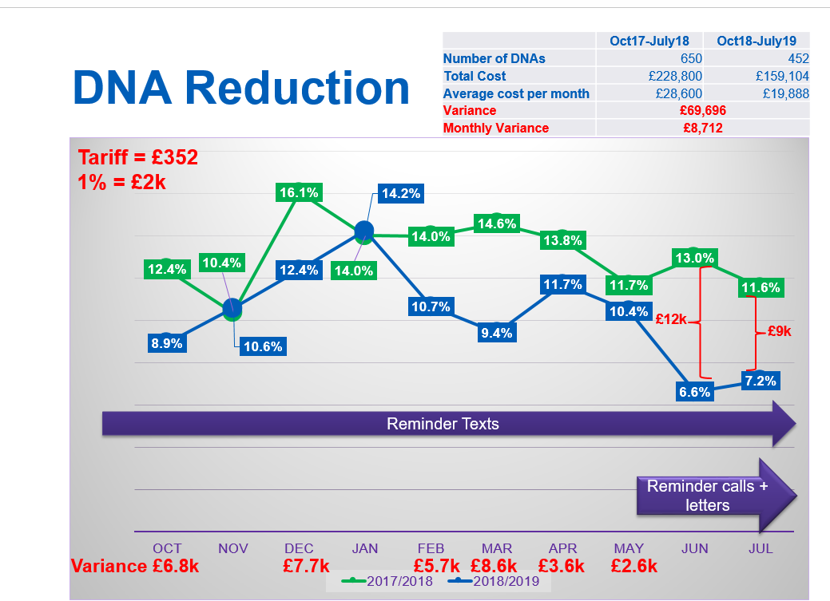
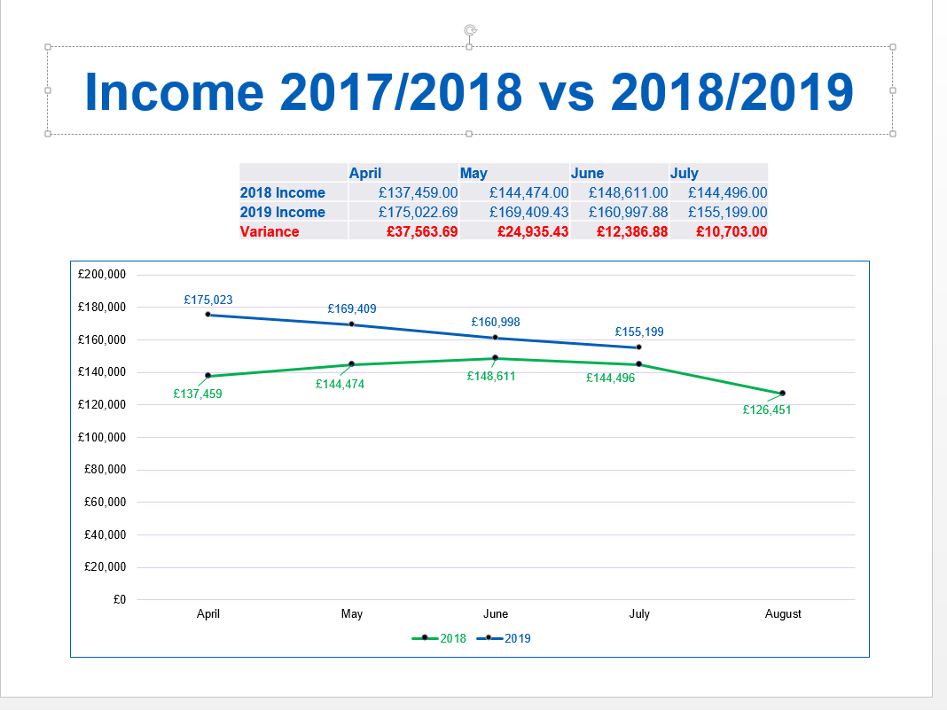

Slide 12
  Innovative Development of Assistant Practitioners
Rehabilitation Assistant completed Foundation Degree in Health and Social Care and was successful in obtaining an Assistant Practitioner role.
Identified scope to develop the role of a Band 4 Assistant Practitioner.
Many of our patients are re-referred due to the progressing/changing nature of their long-term conditions.
If a patient who is well known to the team and it is deemed appropriate to do so at Telephone Triage Assessment they can be booked into the Assistant Practitioner diary for baseline outcome measures and 4-6 sessions to review existing exercise programmes and re-assess need for physiotherapist input.
If Telephone assessment identifies a clear picture we may refer straight to the Band 4 to start and see Physiotherapist after a few sessions - falls pathway.
Clear communication with Physiotherapists, pilot showed success – now rolling out across both Band 4 posts with regular evaluation.

Slide 13
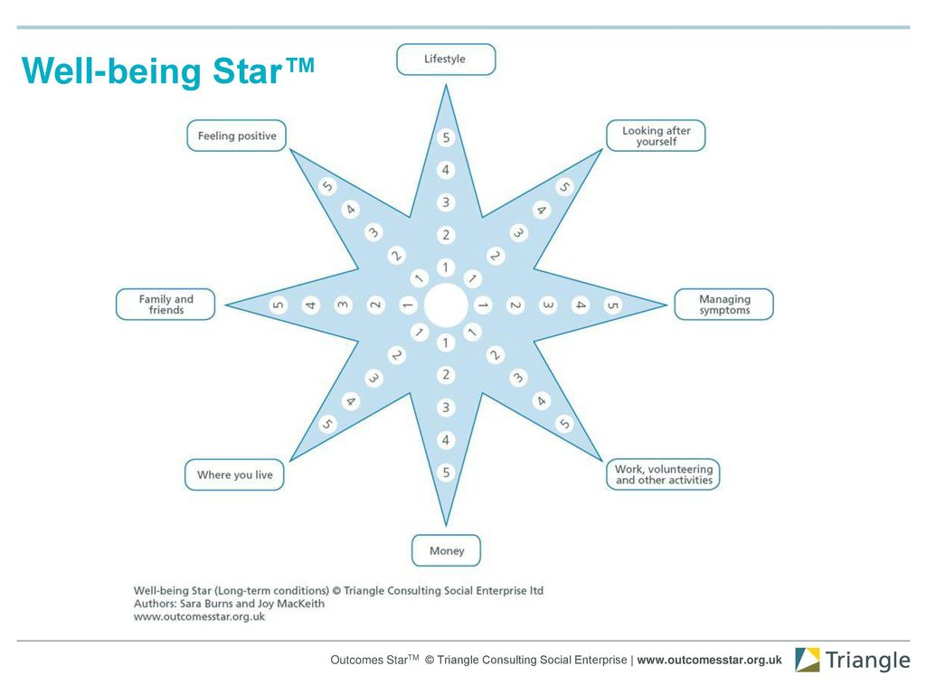
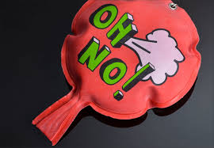
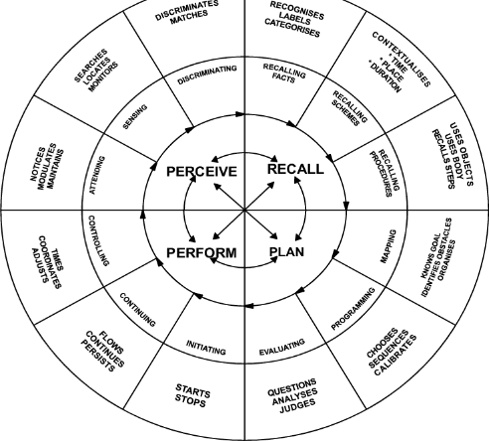
Innovative Use of Outcome Measures
We are consistently using the ‘Well Being Star- for Long Term Conditions’ across all disciplines.
It has been added to our online RiO documentation system
Using data to compare outcomes for all 3 services (RDT/MS and NHIS)
Using electronic Goal Attainment Scaling (GAS) and developing Partnership Agreements
Physiotherapy 10 metre walk and BERG balance score as standard.
Occupational Therapy developing the use of the PRPP tool- cognitive skills to assess capacity
Notes:
Well being star:
- holistic, supports change
- Consistently using across all disciplines and bandings,
- We use it collaboratively with service users and their families/carers
BENEFITS:
- In built into patient records- less scanning, less paper getting lost
Able to access data to complete comparisons/audit

Slide 14

Innovative Interdisciplinary Team
Fatigue Management Course
  based on the Royal College of Occupational Therapists (RCOT, 2018) recommendations using multi-disciplinary approach
Getting to Grips Course
Pathways e.g. Fatigue, falls.
Living Well with Long Term Conditions
    Psychology led bringing mindfulness and acceptance therapy
Rehab Clinic – Band 7’s working alongside rehab. Consultants with the most complex patients. Therapist encouraged to feedback/attend their patients reviews.
Rehabilitation Nurse in MS team runs own clinics –holistic approach to symptom management inc. continence.
Referrals to Sex and Relationships Clinic (SARC)
Notes:
G2G: Two evening sessions
Education focussed with a range of disciplines
Multiagency, voluntary and statutory local services

Slide 15
Innovations in the Physio. Role
Multi-disciplinary spasticity management clinic – new patients.
Review patients seen by non-medical injectors (x3 physios)
Development of MS Clinic spasticity service with non-medical injector.
Orthotics Service – Joint clinic with Orthotist, Podiatrist and Lead Physiotherapist. Developed skills of Band 6 physio’s who rotate into the clinic to develop learning and allows clinic to run all year round.
Development of specialist Community Huntington’s Disease therapy team.
FES service – trialling new tech.
Hydrotherapy Service- Development of Aqua waves service of patient to self-manage their condition.
Self-management Group – service user involvement.
Notes:
Not an exhaustive list but worth mentioning in particular…..

Slide 16

Future innovations- ideas in the pipeline
Re-visit TEAM OBJECTIVES and MISSION
Developing the Self-Management agenda further;
  -‘A Weight Off Your Mind’ resources to support
  -Use of Motivational Interviewing techniques
  -Use of new equipment and technology to support self-management, motivation and activity levels.
Well-Being Star feedback:
    Developing the carer and family aspects of service provision
Developing Well-Being Champions within the team.
Developing role of non-medical prescriber for spasticity management ? Therapy led clinic.
Notes:
Bikes and IT
Could we use on-site facilities more – garden, kitchen

Slide 17
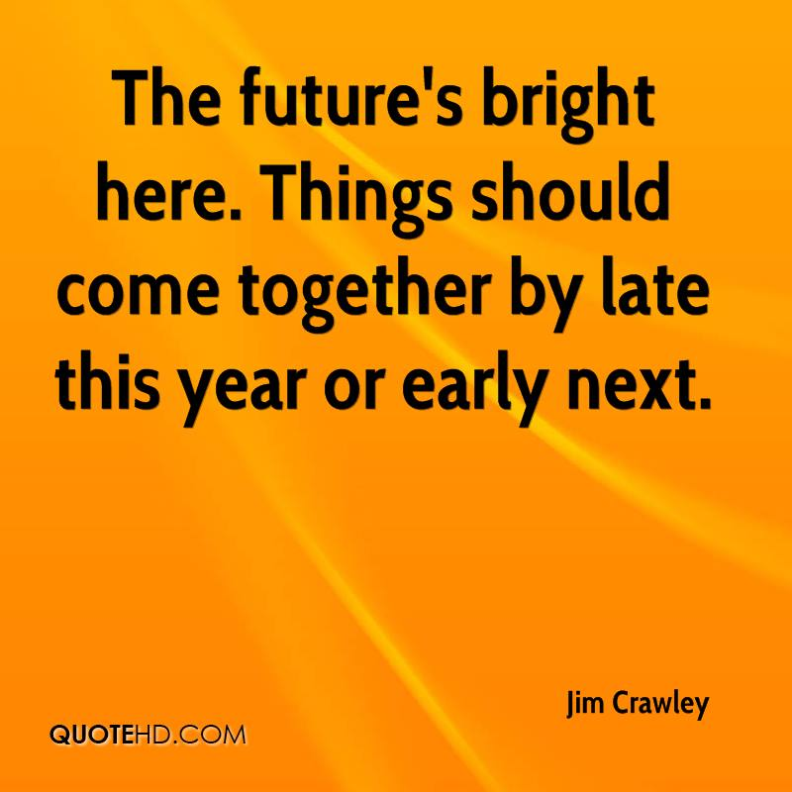
Summary
We took time to reflect and highlight our aims – we re-visit them regularly.
We had an opportunity to focus on those aims and change our processes.
Investing in admin support has enabled change.
Without good support from admin our clinicians couldn’t work as effectively.
We have been able to grow and develop a mind-set of growth.
We are supported by each other and supportive leadership.
We have hugely increased income generation to the service and improved waiting times and the overall patient experience.

Slide 18
Any Questions?
Physio: Claire.kell@cntw.nhs.uk
OT: Monica.knight@cntw.nhs.uk

