Slide 1


Creating a Rehabilitation after Critical Illness pathway
A novel way of ‘funding’ an ICU follow-up service?
Helen Sanger MSc. BSc.
Advanced Physiotherapist in Rehabilitation after Critical Illness
Notes:
Ideally it would be 30 min on the pathway that you have developed for your patients from ICU admission to discharge home or onwards. Perhaps one patients' journey. And how your pathway sits with CG 83. Including what the role of your TA/TI is
A novel way to tackle the problem of funding an ICU follow-up service?

Slide 2


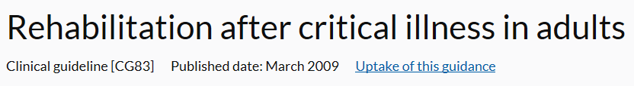


Slide 3
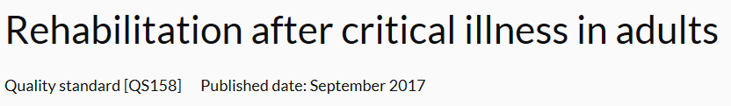
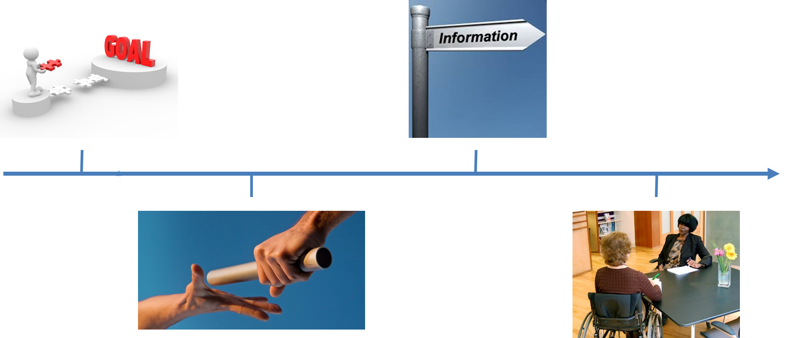

Slide 4
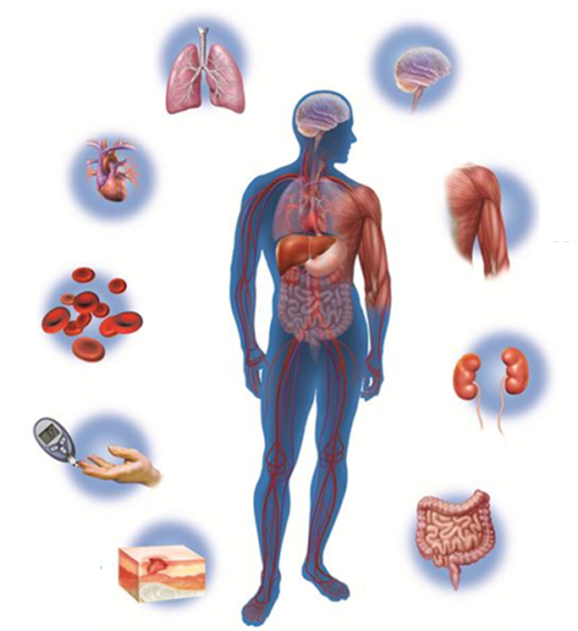
Impact of critical illness
Kress JP & Hall JB N Engl J Med 2014;370:1626-35 Lee et al Crit Care Med 2016;44:2270-74 Pandharipande et al N Engl J Med 2013;369:1306-16
Schellekens et al Critical Care 2016;20:103 Sonneville et al Annals of Intensive Care 2013;3:15
Notes:
Organ systems affected by critical illness

Slide 5
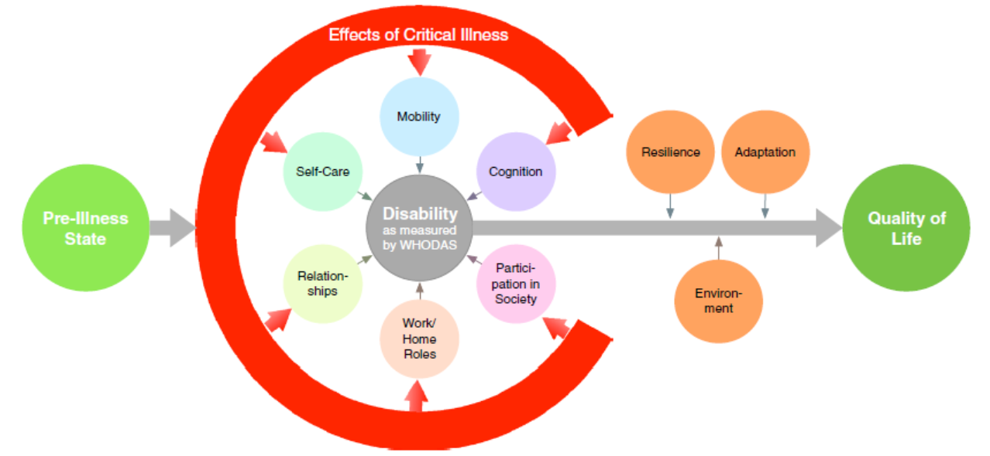
Impact of critical illness
Hodgson et al. Intensive Care Med 2017;43:992–1001 DOI 10.1007/s00134-017-4830-0

Slide 6

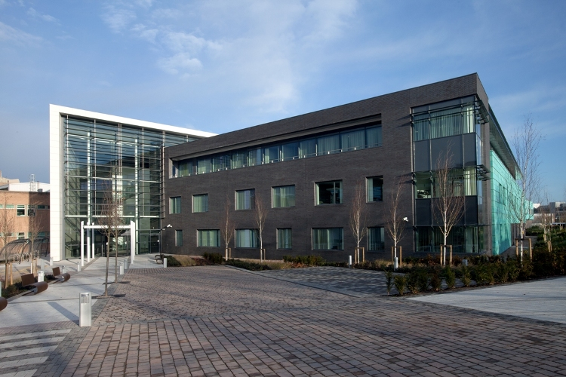
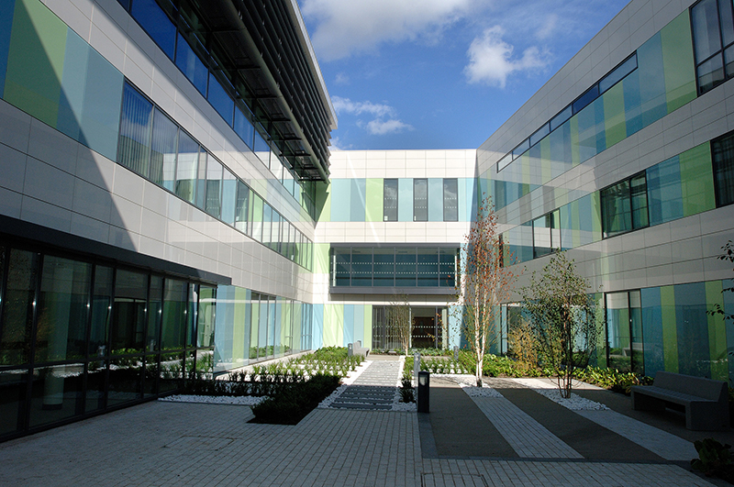
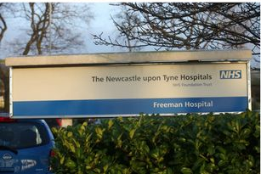
Notes:
Here we are, wanting a RaCI service, knowing that our business case for it had been knocked back on numerous occasions. So, we took a different tack. Go for ERAS, and 7-day services as the headline, and RaCI as the bonus when asking for the money. Think creatively about shuffling the resource we’ve already got. Ask for a trial, and hope like anything that we show benefit.

Slide 7

Physiotherapy Associate Practitioner
Independent ERAS caseload
Increase rehab input with long stay patients
7 days/week with overlap
Notes:
Perform basic respiratory assessments and provide treatment/advice.
Deliver ERAS early mobilisation seven days a week.
Carry an independent caseload of non-complex surgical patients, including assessment on day one post-operatively.
Assist in the delivery of individualised rehabilitation sessions for long term patients.
Supervise exercise programmes with long term patients.

Slide 8
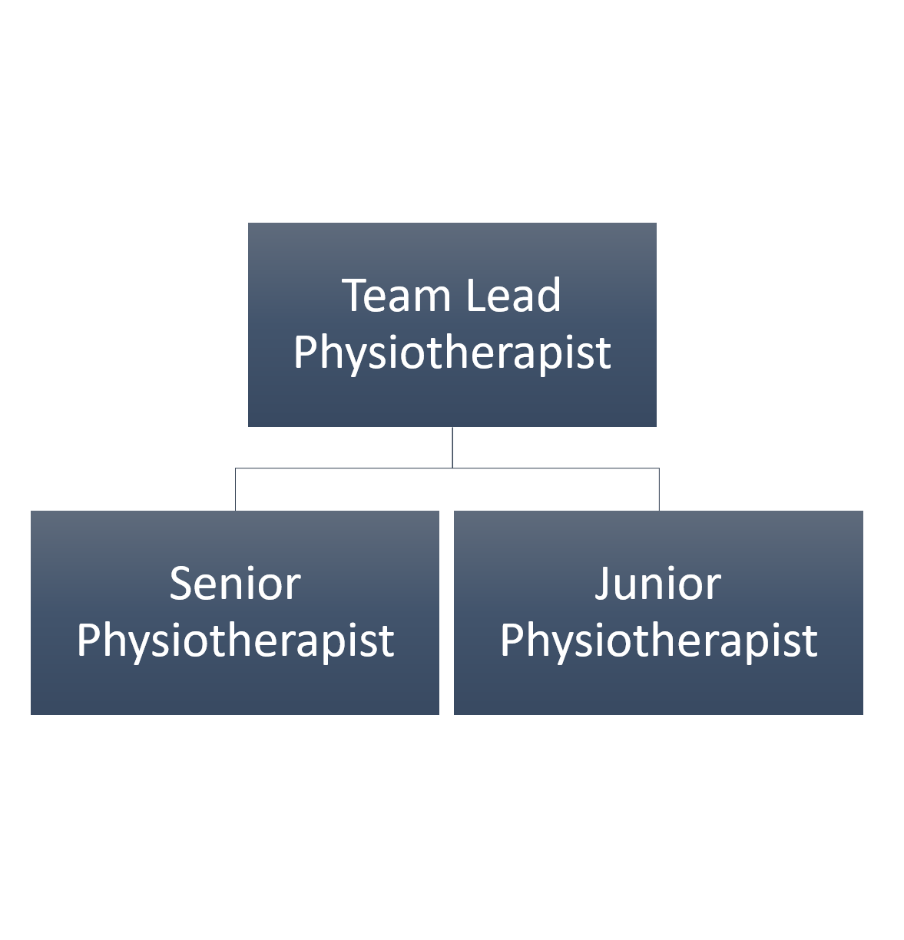
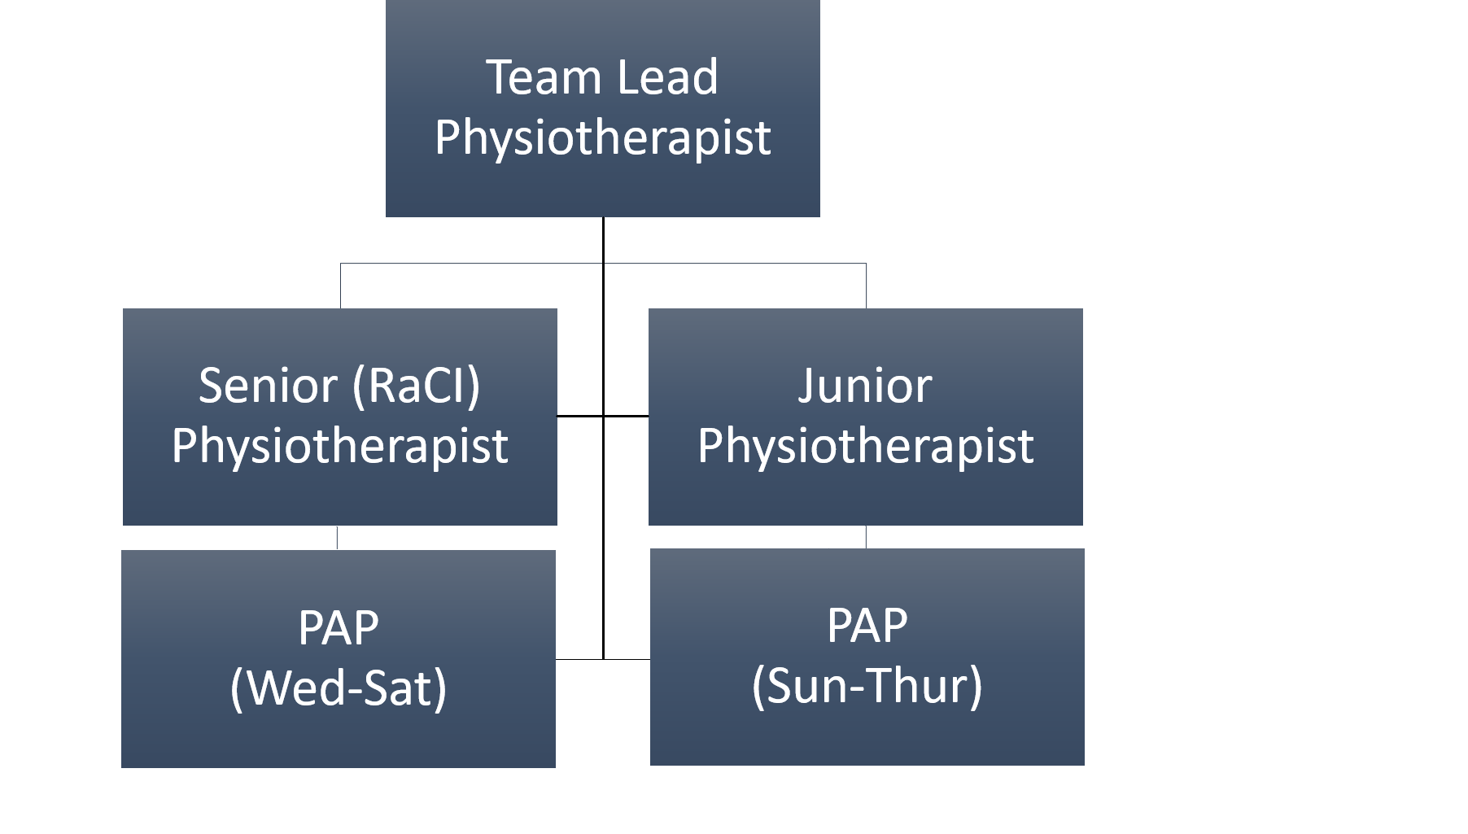
Change in team structure

Slide 9
Developing a RaCI pathway
Hospital ward
After hospital
Critical care
Notes:
Goals,

Slide 10
RaCI outreach round
Physiotherapist and CCOT nurse
RaCI MDT Clinic
Physiotherapist, ACCP
CCOT nurse/Intensivist
‘RaCI’ manual
Onward referrals as required
Discuss critical care experience
Review persistent problems/ask about new ones
Physical activity advice
Psychological screening/triage
Goal setting
Support ward therapists
Liaise with GP
Onward referrals

Slide 11
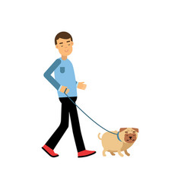

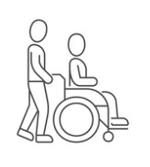

Critical care
Notes:
KN example
54 year old
Fit and well Separated
Lives with son
Severe necrotising pancreatitis; 112 days on ICCU, 95 days with a tracheostomy
Psychology (ongoing), and joint working
Joint working with ward physio team, and K’s son
Regular visits from RaCI team
Trips outside
Gym

Slide 12
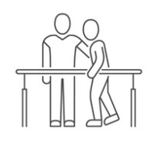

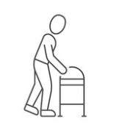


Hospital ward
Notes:
Fatigue
Traumatic memories
Persistent global weakness
Ongoing complex family situation
However,
Motivated+++
Looking to the future
Psychology (ongoing), and joint working
Joint working with ward physio team, and K’s son
Regular visits from RaCI team
Trips outside
Gym

Slide 13


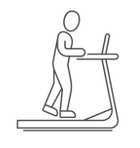


After hospital
Notes:
Psychology (ongoing)
Gym
Telephone follow-up from physiotherapy
Clinic follow-up with RaCI team
Signposting - support groups

Slide 14

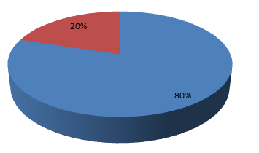
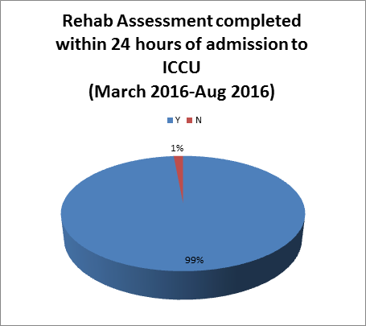
“Excellent service. Delighted to see more input (particularly from physios who understand ICU patients).”
“Improved MDT communication with increased continuity of senior physio staff.”
Surgical admissions: 11.3%
Surgical LOS : 9.3%
Initial rehab assessments completed within 24 hours of admission
Pre-PAP
With PAP
Notes:
Assessing the impact.

Slide 15

Notes:
Band 4s on a surgical ICU are a brilliant idea. We do have some follow up, and it is better than it was. However, it’s nowhere near perfect.

Slide 16
It’s not as simple as that…
Health
Specialised
Disability
Complications
Inpatient
Community
Frailty
Rehabilitation
Follow-Up
Trauma
ICU Adm
ICU D/C
LTC
Survivorship
Acute Illness
Hosp D/C
Home
Multi-morbidity
Disability
Cancer
Emergency
Enhanced Recovery
Surgery
Readmission
Elective
Non-Cancer
EOL
Designed by Gareth Cornell, 2018

Slide 17
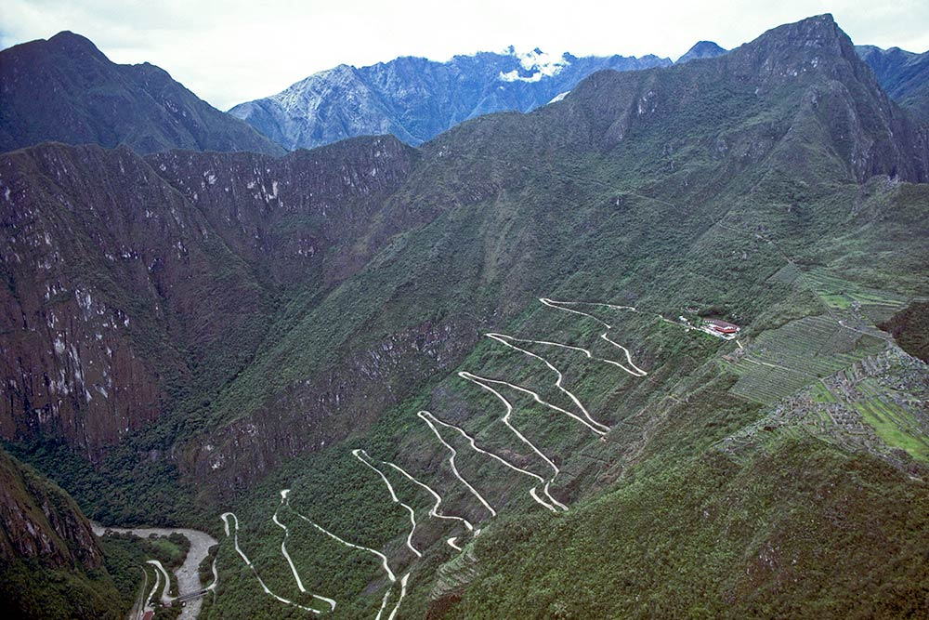

You are here
Notes:
Where are we now? The future. 1 unit down, 3 to go.

Slide 18

Thank you!

