Slide 1

Implementation of the FCP role
from a National Perspective
Sarah Withers
Head of FCP Implementation @CSP_FCP #FirstContactPhysio
Notes:
Great to be here, looking forward to hearing about the work so far in the North East and being part of the discussions on the opportunities and challenges, and ways forward in this area.
This afternoon I’m going to outline the national context for FCP implementation, and some of the key areas of work that are going on to make sure that we can make the most of this opportunity in Primary Care

Slide 2
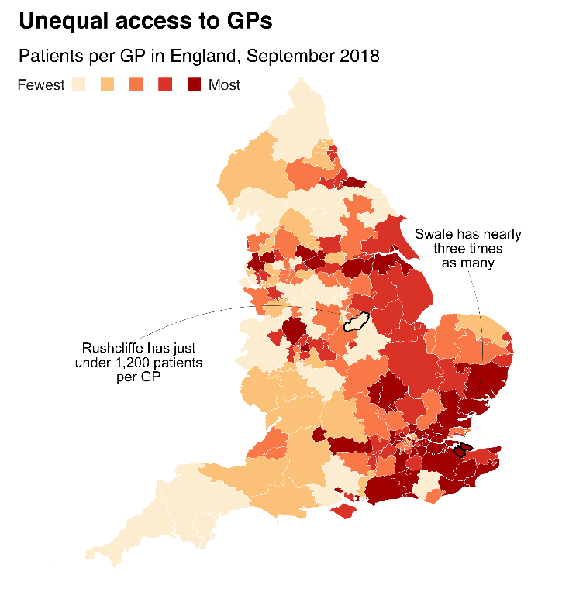


Change is coming…
Notes:
What provokes change is an interesting conversation. In different times different problems or opportunities cause change. Usually there are a constellation of factors coming together – ones that are there, not just for today but for the foreseeable future
Pressure on Primary Care GPs
Pressure on the health care system
Demographic changes in our populations
AND NOW The understanding of the importance and effectiveness of well -resourced self- management in the management of Long term conditions beyond the physiotherapy community
And the work on MSK pathways over the last 20 years which has seen Physiotherapists well established working with advanced practice skills in MSK

Slide 3

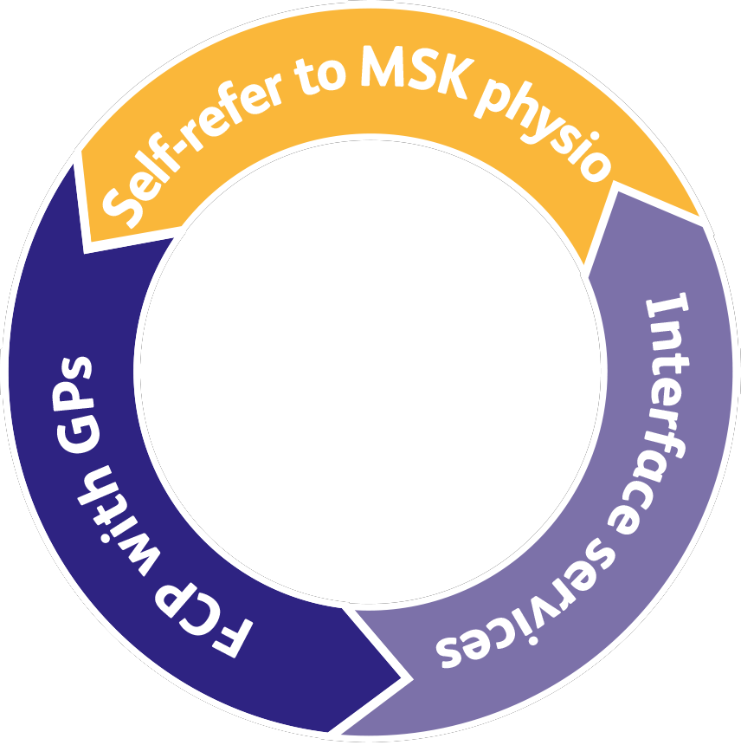
Self-refer to MSK physio /physio teams
What is it?
A means of accessing physio services directly for advice and sessions of physio treatment.
What can’t it do?
Reduce demand on GPs significantly – because most people with an MSK issue will still go to their GP first even if they can self-refer. Can’t usually order or analyse tests, or make a referral directly to orthopaedic rheumatology or pain consultants.
What’s its value?
Enabling people with MSK health issues who know what the problem
is, confident that they need physio, and confident to access this
without going to the GP first.
Notes:
The questions that are often asked by colleagues:
Isn’t this self-referral /direct access to physiotherapy in a GP practice ?
We know that Self -referral and direct access physio treatment services are generally are accessed by patients who know they need to see a physio or have been advised to attend by their GP.
Cant do
Usually access to investigations and onward referral is limited or not in place and there is a wait.
Doesn’t reduce demand on GPs
But is great for those who know what they need

Slide 4
Interface services
What is it?
Advanced MSK physios who can take referrals from GPs, provide expert advice, order and analyse tests, triage and make referrals directly
to orthopaedics, rheumatology and pain teams, based in secondary care.
What’s its value?
Reducing unnecessary testing
and referrals to orthopaedic and rheumatology consultants. They can provide people with complex MSK conditions longer appointments and
a wider set of tests than with FCP.
What can’t it do?
Reduce demand on GPs and offer rapid and direct access to patients.
Notes:
Or isn’t this already available in triage services? Yes, advanced practice skills and access to pathways are available in triage services- often there is a wait for them and sometimes physio treatment itself requires another wait too.
These services are often great at
reducing unnecessary testing and referral and provides those with complex conditions more time
But don’t reduce demand on GPs or get patients early in their presentation

Slide 5
FCP with general practice
What are FCPs?
Advanced MSK physios, attached to
GP practices, booked by patients through regular GP booking. In 20 min consultations they provide advice, diagnosis, order tests,
and analyse results. They can refer to orthopaedics, rheumatology and pain teams.
What don’t FCPS do?
They don’t provide physio treatment sessions. They can’t provide longer appointments or access some tests that might be needed
for some patients with complex cases.
What is the added value of FCPs?
Reduced GP workload; patients seen quickly and directly; reduced steps on the pathway
for the 70% who only need expert advice and
self-care; less referrals, testing and prescribing.
Notes:
Expertise at the beginning of the pathway , supporting populations and individuals to manage MSK conditions effectively by providing specific and timely advice, enabling, advising and sign posting patients to activities and services which will help improve their lifestyles and health whilst confidently recognising and managing people with conditions which may require further assessment, diagnostic work up and intervention.
Don’t provide courses of treatment, may not be able provide the time given in an interface service
Does bring advanced practice skills and knowledge to the patient earlier and does reduce consultations demand on GPs

Slide 6
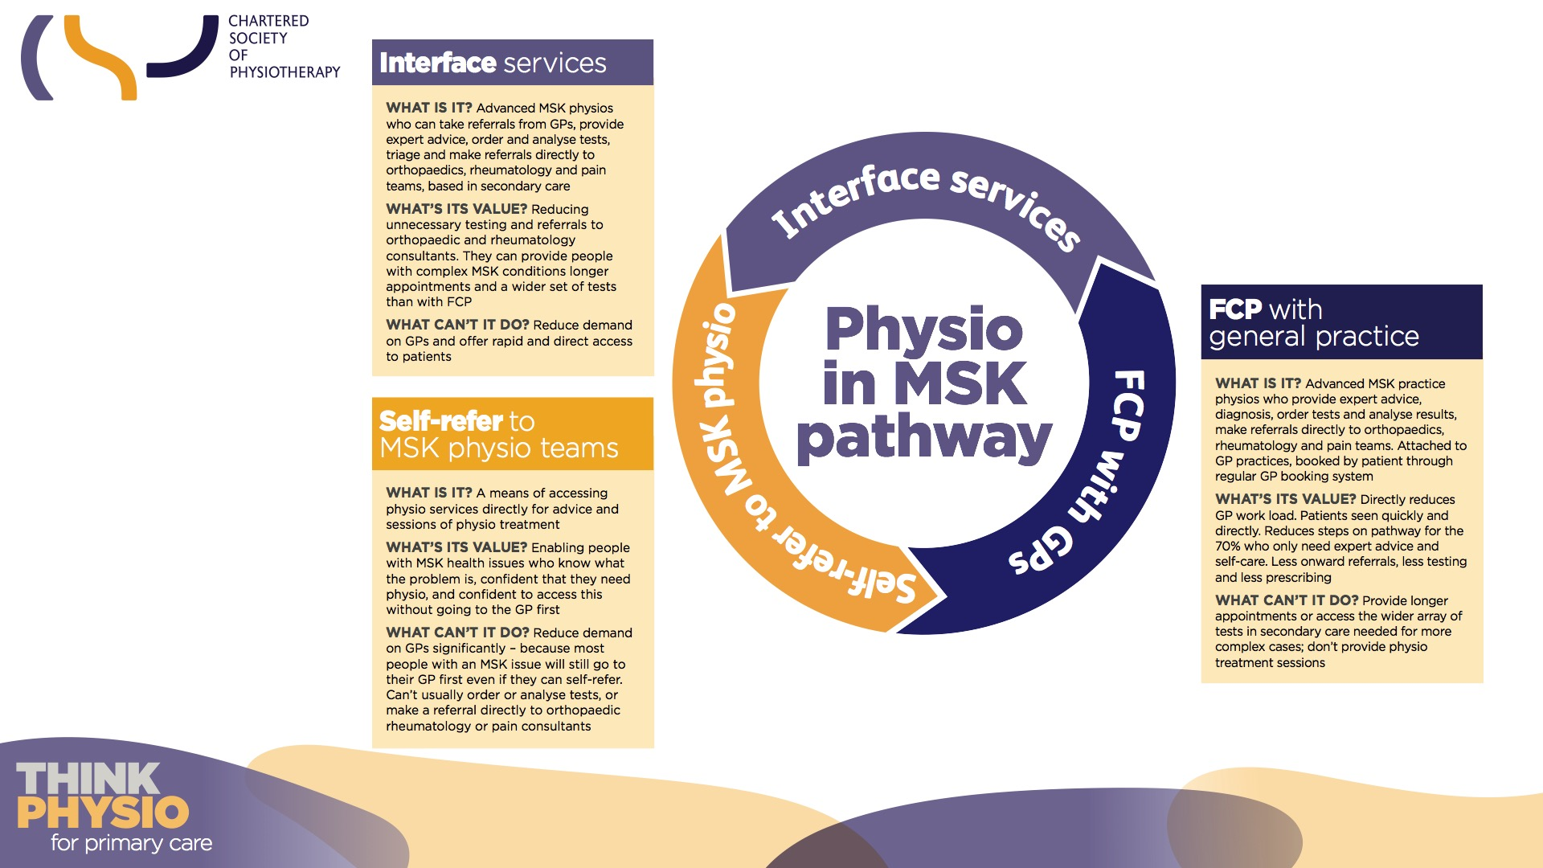

Slide 7
Key Principles
1st clinical contact – they are accessible to patients from General Practice in the same way as a GP is (sometimes quicker!)
FCPs bring specialist expertise utilise advanced practice skills accessing the same referral pathways and services as GPs.
They have an outward focus often supporting rehabilitation with support from community and social interventions
Notes:
FCP Practice in MSK might be implemented in slightly different ways however
There are key principles-
1st clinical contact- they are accessible to patients from General Practice in the same way as a GP is ( sometimes quicker!)
FCPs bring specialist expertise utilise advanced practice skills accessing the same referral pathways and services as GPs.
They have an outward focus often supporting rehabilitation with support from community and social interventions
Checking out where a service fits in the pathway is more straightforward thinking of it through this lens
-A self referral/ direct access service may not have access to the same referral pathways and services
- An Interface or CATS service may not be as accessible as a GP..

Slide 8

FCPs in MSK within the Primary Care Team: What does this approach deliver?
Assess and diagnose
(including screening for serious pathology)
Potential interventions:
Give info on self-care and enable and support behavior change
Discuss fitness for work
Undertake social prescribing
Discuss physical activity and health
Refer to a course of treatment (e.g. physiotherapy)
Refer to a secondary care service
Request investigations
Medicines optimization
Administer joint / soft tissue injections (if qualified).
In one session
First Contact Physiotherapist will…
Person presenting with a MSK condition is booked in to see an FCP by the GP receptionist
…so fewer steps and on the right path from the start
Notes:
In terms of specifics
Direct booking appears to be effective from the reception or care navigator with between 1-5 % going onto see a GP, some areas have implemented GP triage for patients but this does not seem to be required in this cohort.
AN FCP, working with Advanced clinical practice skills will approach a consultation in a way that responds to the needs of the person seeking support with their health rather than taking a tick box approach to either assessment or intervention but has an extensive group of skills in their toolbox to support improving MSK health

Slide 9
NHS England Evaluation
Summer 2018: 41 out of 42 STPs put forward an existing or new FCP service for evaluation. Cited in Long Term Plan in 2019. Consists of:
Local context questionnaire (re: services’ funding, governance, staffing, providers)
FCP appointment data captured on practices’ clinical data systems
Experiences and clinical outcomes of patients ( PROMs and PREMs), GPs and physiotherapists
Notes:
You may be aware that there have been a significant number of individual service evaluations but data is needed that reflects a wide variety of regional contexts, The national evaluation of FCP in England seeks to collect data from every STP which brings a national policy into a regional context. It consists of 3 phases with phase 1 & 2 managed by NHS England & a Commission Support Unit with the CSP’s support
Phase 1 was the local context questionnaire that shows that most of the participating FCP services are commissioned from their CCG or an NHS Community Service Provider. Most offer services either across a cluster of GP practices or in a single practice. There was a mix of both new and established services
Phase 2 uses data collected on Primary care systems (such as Emis, SystmOne and Vision) and is tracking interventions such as referrals to secondary care/ for imaging /prescribing & injections/ provision of self-management advice and use of social prescribing.
Phase 3 is a mixed methods service evaluation funded by the CSP Charitable Trust and the Joint Work and Health Unit. Led by Keele & Nottingham University. It includes the collection of patient and primary care team experience and patient reported outcome data
This will examine the potential benefits to patients and across the health care system

Slide 10
Benefits of FCP
For patients
Safe, efficient and effective
Quick access to treatment, tests and specialists if needed
Quick access to advice and information to start improvement
Quicker…
access to MSK expertise
referral to other services and tests (if needed)
Improved…
delivery of healthy living message
patient self-care through supporting of self-management programmes and social prescribing
patient experience
Notes:
The benefits that are being seen through service evaluations over the last few years are consistent. Patients are experiencing quicker access to care and quicker pathways through to other services or interventions
And more potential – increasing skills in personalised care/ increasing embeddedness use of social and community interventions

Slide 11
Support
75%
of people said they would see a physio instead of a GP for back or neck pain
85%
of GPs agree with
the FCP model
Notes:
What we know so far is that there are high satisfaction rates amongst GPs and FCPs. Perhaps less expected to some is the equally high satisfaction rate amongst the public. Contrary to feeling fobbed off or downgraded, people who see an FCP report high levels of confidence
polling in December 2018 has shown that 73% of the general public would be happy to see a physio first instead of a GP for back or neck pain,
and in other polling, 85% of GPs agree with the FCP model, 52% strongly
FCP is also being promoted by patient groups (including ARMA, Versus Arthritis and National Ankylosing Spondylitis Society) as a way to improve patient care and the roll out is supported by RCGP and BMA.
However there is more to do to spread this message ( speak about key themes coming out of phase 3
Communication, patient understanding, embeddedness, FCP contribution , reconceptualization of physio

Slide 12
Interim Evaluation
54,307
Total FCP attendances Sept 18 to July 19
95%
Notes:
Benefits of FCP for patients – results from Interim Evaluation

Slide 13
Benefits of FCP to local healthcare system
For the healthcare system
Safe, efficient and effective
Shorter waiting times –for tests, appointments, and surgery
Fewer…
inappropriate MRIs & X-rays
inappropriate secondary care referrals
re-referrals for the same condition
More GP appointments available for others Improved conversion rates to surgery
Reduced prescribing rates and costs
Notes:
There are other benefits too, whether we are thinking from the patients perspective, clinicians view or the health care system.
Less testing, less prescribing, fewer referrals with no further treatment. Less backwards and forwards.
More meaningful treatment offered, more GP appointments available.
The conversations with clinical teams and commissioners may be different and challenging.
This might include being able to discuss the autonomy of physiotherapists to make diagnoses, request investigations or refer appropriately. Addressing fears and concerns of orthopaedic, rheumatology, radiology or Primary Care teams.
These are some of the system benefits that we are seeing so far on a wider scale than individual service evaluations

Slide 14
Interim Evaluation
A large proportion of patients seen by FCP’s do not require further follow-up by GPs or referral to Secondary Care after their appointments
43%
(June19)
35%
(start of collection)
Prescribed medication from an FCP has decreased during the pilot
Increased % of patients being provided with exercises during consultation
The total referrals to physiotherapy has decreased across the collection period
29%
(average)
18%
(average)
Notes:
Benefits to local healthcare – results from Phase 3 Interim Evaluation

Slide 15

Evidence from NHS Forth Valley
87.3% managed in primary care
British Journal of General Practice. 69 (682)
Notes:
Give background of Forth valley study
need to see wider discussion and evaluation too/ publications

Slide 16
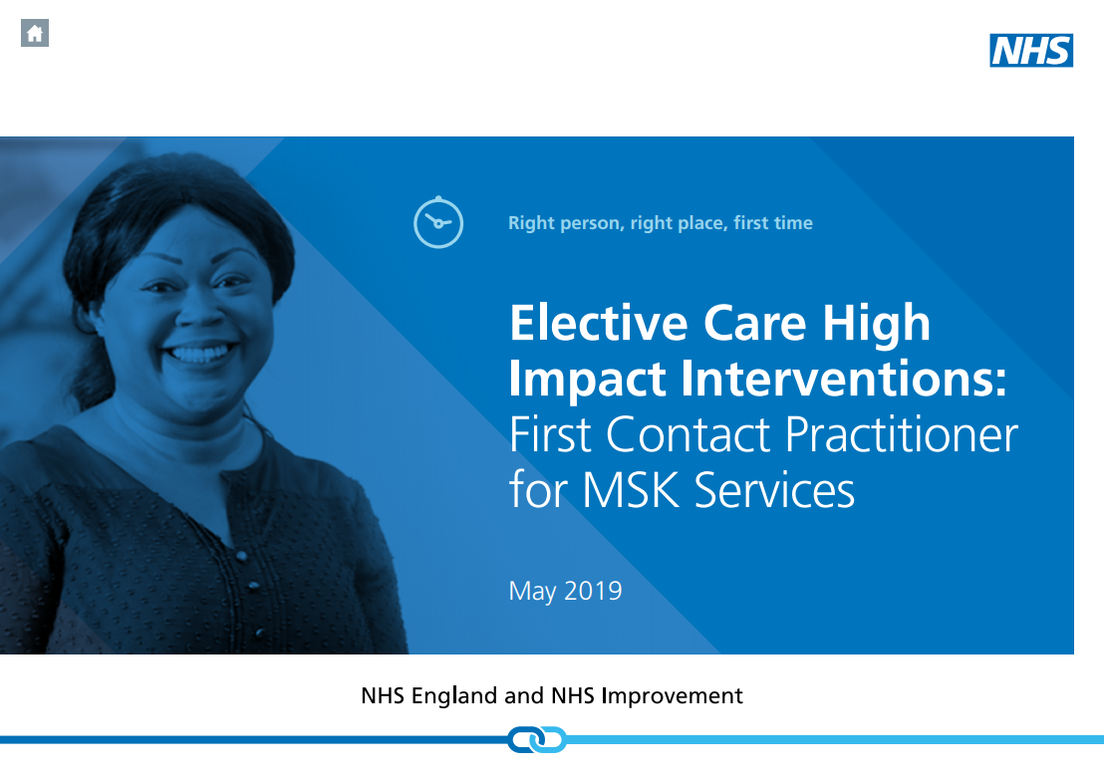
Elective Care High Impact Interventions: FCP for MSK Services Specification (published May 2019)
In 2019/20: STPs are required to select at least two further sites/network of GP practices (circa 50k population) to add to the 2018/19 cohort and establish FCP services in the selected sites.
This implementation plan builds on sites mobilised during 2018/19 and on local and national evidence base
bit.ly/30GY3NA
Notes:
positive contribution is being seen however ongoing evaluation needed and NHS bodies are looking to embed data collection for FCP into services long term….In 2019/20 another 2 sites per STP will be added to the original sites for evaluation, increasing the population coverage with FCP in a graduated fashion.
In May NHSE/I published a document-which is a description of FCP as a High Impact Intervention and gives system level information on what MSK FCP is about and what needs to be in place to go about developing FCP services.

Slide 17
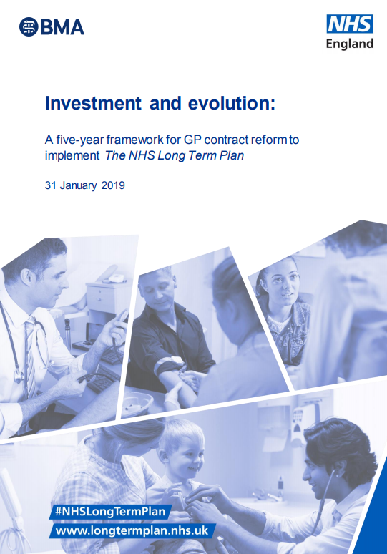
A five year framework for GP contract reform (published January 2019)
In 2020, first contact physiotherapists (at Bands 7 and 8a) will be eligible for 70% reimbursement from the Additional Roles Reimbursement Scheme
By 2024, the new Scheme is expected to have created 20,000+ new posts in general practices, with an average PCN having access to 3 FCPs, 5 clinical pharmacists, 3 link workers, 2 physicians associates and 1 community paramedic (with flexibility for PCNs to determine the staff mix)
Notes:
Supporting implementation needs more than agreement in principle.
Funding is crucial and funding is now going to be available.
The ARRS is a significant step on this journey providing funding in the first instance for 70% of salary and on costs for 1 physiotherapist per Primary Care Network ( 30-50,00 population) increasing to a potential 3 over the period of the LTP
Supporting information and guidance is being developed by NHSE which will support Primary Care Networks and there will be criteria that need to be fulfilled to reclaim the money.
To deliver across the pathways and to get maximum system benefit we need to pay close attention to how an FCP is integrated into the pathways
Appropriate governance-being part of a practice team non clinical and clinical- not an add on, appropriate care navigation at the very beginning, using the same systems and protocols, but also the maintenance of knowledge across the local system referral thresholds and investigation approaches, social and community services.
The right level of skill that allows the management of uncertainty and risk- skills such as NMP and injection therapy are tools in the tool box but that is the easier part of Advanced clinical practice. The right level of skill enhances appropriate safety, treatment, experience and outcome.
And job planning- FCPs need to be a sustainable part of the team..

Slide 18

Solution to meet the needs
MSK Core Capabilities Framework: for self-peer-and employer-based assessment > skillsforhealth.org.uk
Master’s modules on FCP (either standalone or as part of MSc courses)
E-learning: free modules on FCP related areas and on Person Centred Approaches > e-lfh.org.uk
Mentoring: from within the wider MSK service
and/or the primary care team
Notes:
How to move and develop workforce has been a challenge across the health system and professions across the years.
The supply of Physios is increasing with 40% more PT places since 2016 and a very low attrition rate but we need more and we need to enable training to support the MSk pathway.
Health Education England’s MSK Core Capabilities Framework can be used to identify areas of training and development required for the delivery of the local service. The framework sets out clear expectations about what FCPs are able to do. It also supports managers to demonstrate that their staff meet these core capabilities or have developmental plans in place and clinical supervision to do so.
To help get the workforce in place, there is further training available to upskill as part of a phased rollout. More modules are being developed around the UK.
E Learning is available free for all working in the NHS
Mentoring and Continuing Professional Development (CPD) should be part of a sustainable job plan to support the delivery and the maintenance of clinical standards.
There are many groups and organisations working to support development and training, the CSP is working to facilitate access and resources for members to so that the FCP expansion can be delivered on time.
Specifically at the moment looking at
Personalised Care
Self assessment framework
Career pathway

Slide 19






Workforce Challenges and Solutions
Redeployment (19)
Direct recruitment (6)
Internal
training (20)
MDT (8)
External
training (13)
Notes:
Although there are challenges services are working with them and finding a way through
The FCP team have spoken to about 25 services who were:
Early adopters or innovators of MSK FCP
Services known to the CSP (and other national organisations) through the iCSP network, NHSE evaluation, publications events and word of mouth
They had often expanded into FCP service provision from existing MSK services
These services were employers of a wide range of physiotherapists including those with advanced skills
As you can see nearly every one we spoke to cited workforce readiness and availability aspects as workforce challenges to development of FCP services, as we expected. This covered recruitment, loss of senior staff in another part of the service, getting the role balance right for staff working in FCP and triage/ physio or having the appropriately trained staff in place.
Business continuity in terms of maintaining appropriate capacity across other aspects of MSK services provided by physio services or the challenges associated with operational delivery were also frequently cited.
This had not put them off…
Most services redeployed staff, backfilled these posts with existing staff and provided training to those coming into different roles
Most services used internal training programmes supplemented with other training. Support was cited from a wide variety of sources, most commonly MSK teams, GPs and employing Trusts equally with some support from external providers such as universities or HEE. 2 responders mentioned a lack of support
Specific enablers to training and development were identified:
Networks and resources
Culture- positivity about the role
GP & stakeholder support
and access to a training budget
The barriers were more varied – most common was the time for training in terms of release from clinical duties, GP time for supervision and support was identified as was the speed of roll out
The views on what further provision was required was answered by fewer services and ranged across specific aspects of the role including non medical prescribing, radiological and training injection therapy, and did also include person centred care and further supervision.
In this group, system issues such as GP understanding of the role, organisational change or differing employment models were not often mentioned, however these services are all ones who had been successful in implementation which may have had some bearing to this answer

Slide 20
Patient and Public Engagement
Meeting with patient participation groups and returning!
Questionnaires to patient groups
Using information in developing a preferred model across the county
Involving patient ambassadors or patient governors
Notes:
Although as I said earlier patients who experience care from an FCP are highly satisfied, there have been so many changes over the last 10 years with the roles of health professionals that it isn’t surprising that patients and public are not always sure who is who and who does what the Primary Care team is expanding and this can also present a challenge. We do need to focus engaging with and involving the public and patients in service development
Some services are doing this well as part of core business. In Sussex their strategy has included:
-Meeting with the PPGs of all practices and returning to give updates
*letting them choose what the service should be called for their locality. FCP describes a model / an approach – it is not necessarily what physios have on their name badge
-From a commissioning point of view 100+ questionnaires to various patient groups *asking practical questions like how would you like to book in with the FCP, how would you like to receive information, would you like access to website self management info prior to your appointment and finally would you be up for a Skype type consultation.
- the results of this are being used to set up a preferred model to be rolled out across Sussex.
-Also in Sussex MSK, a clinical director runs a band of "Patient Partners" they have been consulted about their wishes to be involved. Interestingly they came up a quality assurance type involvement looking at the competency framework and how they felt they could provide a certification process in terms of signing people off as competent in these roles which built on work in place, this group are already involved in shared decision making, scoring FCPs on shared decision making is embedded into an FCP clinic.
So the challenges are there but they can be successfully addressed

Slide 21
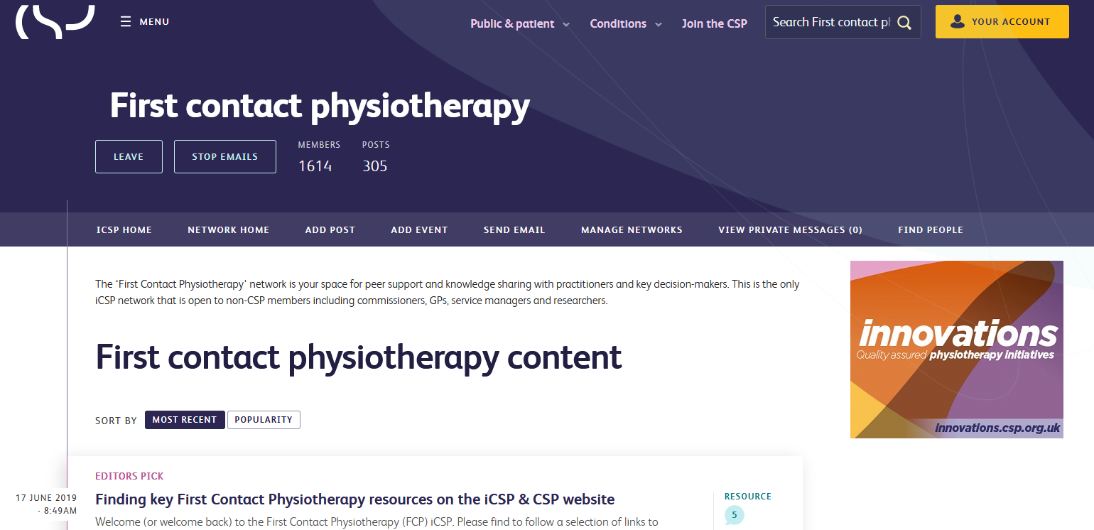
Resources @ csp.org.uk/fcp
Implementation guidance for FCPs
Data collection guidance (and templates for Emis,
SystemOne & Vision)
Job description information
Videos of FCP services (from HEE)
Calculator for estimating potential savings of FCP
Frequently Asked Questions on FCP
Case studies at innovations.csp.org.uk
Notes:
There are also these resources available which are useful at a service level. We are working with members of the network to collect /improve and develop further the range of resources.
Including job descriptions, protocols and induction examples. In addition HEE will be publishing a ‘How To Guide’ shortly to support a wide group of Primary care staff, clinicians and practice staff and commissioners on the practicalities of FCP planning, developing and implementing in their locality.

Slide 22

The CSP’s Priorities on FCP
Supporting FCP implementation
Developing workforce
Leading on evaluation (at national
and local levels)
Working with Higher Education Institutes
on workforce development
Providing resources
Enabling peer support
Informing and influencing public policy
Notes:
And the CSP continues to support for implementation, evaluation and workforce development nationwide.
This includes supporting members, region and country networks on the ground with events, resources and problem solving with a range of concerns.
As well as supporting those with commissioning, planning and primary care clinical responsibility to have the right knowledge and overcome barriers.
We are also working with the Health bodies and governments in all countries to focus on the value physiotherapists can bring to the primary care MDT

Slide 23

@CSP_FCP #FirstContactPhysio
Notes:
Implementation needs courageous conversations with a wide group of people to enable FCP implementation as part of the MSK transformation work in your area
- have knowledge of national and local context
- be clear about the benefits,
- be robust about implementing for sustainability and
- use your core skills to manage fears and concerns –
Thank you

