Slide 1

Welcome
Understanding First Contact Physiotherapy in the North East

Slide 2
Helen Robson
Honorary Chair CSP North East Regional Network

Slide 3
Visit us
@CSPNorthEast
Tweet us
#MyLocalCSP
#FirstContactPhysio

Slide 4
Tony Brown
Managing Partner
Alnwick Medical Group
North Locality Director
Director Lead for Primary Care Development
Northumberland CCG

Slide 5
Liz Lingard
Delivery Partner (North)
NHS England and NHS Improvement

Slide 6
Sarah Withers
CSP Head of FCP Implementation

Slide 7
Break

Slide 8
Ben Alcock and Sue Chester
ESP Physiotherapists
Northumbria Healthcare

Slide 9

FCP – Our experience.
Sue Chester – ESP Physiotherapist
Ben Alcock – ESP Physiotherapist

Slide 10
Where did the service come from
Patient examples
Personal Experience
Outcomes

Slide 11
3 month pilot in Oct 2016 - 10 sessions in 4 locations by 3 staff
22 sessions over 7 locations provided by 7 different staff (Northumbria & Connect)
Notes:
Brief background to the service we provide.
How we got started and where we are now.
Delivered in partnership working with Connect from October 2018

Slide 12
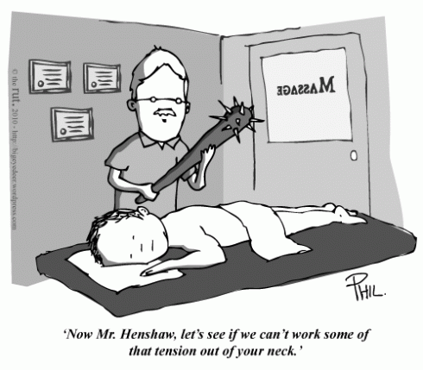
Notes:
Brief bit about the name FCP, Ortho practitioner, MSKP
Previous bad/not positive experiences with physiotherapy.

Slide 13
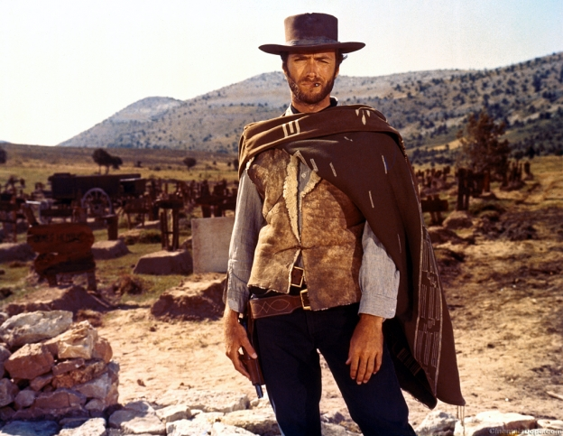

Slide 14
The Good
36 year old woman presenting with acute low back pain.
  No radicular or neurological symptoms
  Unremarkable medical history
  Normally fit and active
Notes:
Perfect – straight forwards – no complex presentation / history
Fits perfectly within the GIRFT / FCP process and incredibly rewarding when faced with these sorts of patients where we a ideally placed to influence the patients experience and outcomes.
Alternative
1st onset knee OA diagnosis
40 odd year old with recurrent de quervains 4/7 history wishing for repeat injection
Patient arriving to discuss options for knee / hip OA
Acute sprains / pain / injury

Slide 15
The Bad…
79 year old chap
  Right sided knee pain
  Left hip pain
  Left side hearing loss
  Right cheek blemish
Notes:
Patient attends with a number of differing problems to first appointment;
- How do you prioritise
- 20mins?
- Any thoughts?
What if I told you he had a past medical history of left hip OA on imaging for which he has had a previous USGI (March 2018) and wants repeat…oh….and skin cancer…(last patch removed 2008)
Subjective clearance of red flags (pmh – skin cancer removal from right ear 2008)
What I did…
Advanced Practice Nurse review for consideration 2WW for ?skin cancer
Consented for right knee OA and injection
Refer for imaging pelvis for left hip – pt keen for USGI but no recent imaging and clinical examination
What happened?
Knee pain improved.
Hip x-ray demonstrated progression of OA and negligible joint space – referred to ortho
Hearing tests organised
Confirmation of BCC and surgical excision following referral

Slide 16
The Ugly…
42 year old woman, chronic low back pain, FMS, anxiety and depression with personality disorder…
  New flare of symptoms
  Radicular pain
    chronic left LL, new right side to posterior thigh
  +’ve impulse sign
  Change in bladder habit, urinary frequency and ?incontinence…. (10/7)
Notes:
Challenging at the best of times and in the space of 20minutes extremely so….
Objective examination
Explaining CES
Contacting A&E on-call consultant
Generate a letter
How do you feel, how do you manage your time, what impact does this have on the rest of your day / patient contact?
Do you have support?
Have you got the pathways in place / knowledge of regional pathways / management
Alternative presentations,
- The patient presenting with headaches, intermittent right sided radicular pain and half tongue numbness (diagnosis MS)
- The late 60’s gentleman presenting with atypical hip pain, normal imaging but gross restriction to movement, explaining the need to perform blood tests and including Psa…(& then finding it is spectacularly high…)
- The standard Friday pm patient squeezed into your clinic as they have called in with LBP…. Drug seeking….
- The young man presenting to his clinic session with his mother whilst under the influence of an unknown substance - has a panic attack, throws himself to the floor screaming I can’t get up and then passes out in the practice toilet after vomiting… (understandably memorable and very funny in a strange way)

Slide 17
Things I’ve learnt……
..…..realised……
….or still don’t know……..

Slide 18


Slide 19
It’s hard not to have your physiotherapy head on.
Initially found it difficult not to get carried away trying to do/give people too much in a short appointment

Slide 20
…don’t under estimate what you have to offer…
A lot of people don’t know about healing time, recovery time, are concerned, anxious or worried

Slide 21
…lots of people out there don’t need a course of physiotherapy
Good advice, reassurance and assessment go a long way
Notes:
…have spend ages assessing someone & suggested physio but then they say
‘ oh no as long as it’s nothing serious I can live with it’
‘just wanted to make sure this normal’

Slide 22


Slide 23
….why IS this patient sitting in front of me…………
Importance of finding out WHY the patient is there – what are their worries or concerns.
Notes:
..which leads onto WHY is this patient here?
Family nagged me to come
Friend, relative had same things and it was cancer
Stressed due to PIP assessment
Due at Arden house
Want surgery
Told 10years ago would need operation in 10years

Slide 24
……. does my assessment/approach need to change…….
screening assessment & looking at the bigger picture
Notes:
Do I need to change the way I approach an assessment
5 points – connecting, summarising, handling over, safety netting, house keeping,,,,
(Neighbour 1987)
ICE - ideas, concerns, expectation of patient.

Slide 25

Notes:
At the end of a consultation sometimes it hard not to feel …

Slide 26
….dealing with uncertainty…..
often don’t know what is wrong with people & have to watch & wait sometimes
Notes:
…go to next slide

Slide 27
......being comfortable with uncertainty…..
accepting the inability to provide an accurate explanation for a person’s health problems
Notes:
Feeling comfortable with this – often a source of stress if don’t know and then can affect ability to think/act straight
It’s ok to admit you don’t know
Accepting that don’t know may make us listen more and pick up more clues

Slide 28
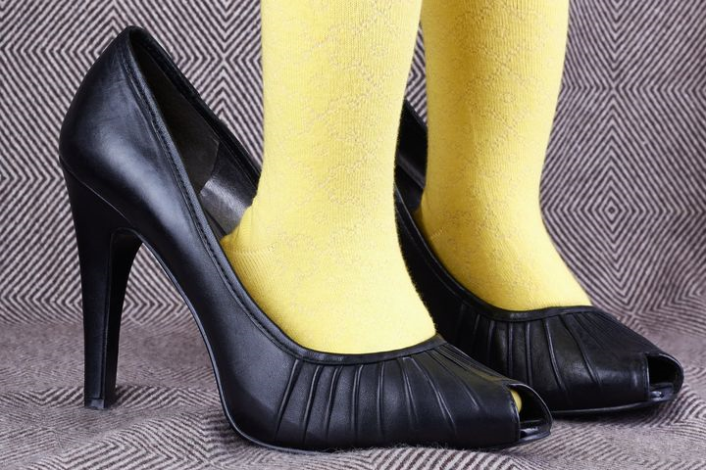
Notes:
If it doesn’t fit

Slide 29
….if it doesn’t fit – then it might be the wrong size……..
You will pick up odd, sinister, unusual pathologies - use the team and trust your instinct
Notes:
You are not there alone and use other members of the team to discuss and raise concerns.
Talk to consultants, C&B advice consultation, AE, rheumatology on call, email Consultants.

Slide 30


Slide 31
….importance of working as a team…..
Building good relationships with GPs working together to unpick patient’s conditions and using their knowledge of things outside of MSKP

Slide 32
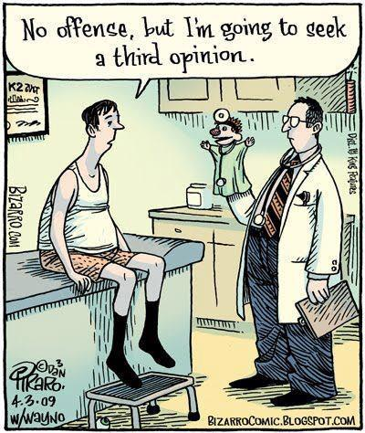
Notes:
…. Patients don’t always agree with what you say / like it or want to hear it

Slide 33
….not meeting people’s expectations makes me unhappy …………
Getting used to some people leaving unhappy, not meeting their expectations which may be unrealistic or don’t like what they are hearing
Notes:
Building resilience .
Learning from these experience – reflecting if you could have done anything differt.
Accepting that now everyone will be happy.

Slide 34


Slide 35
….the more heads – the clearer the view…….
Importance of peer support / mentoring and discussion of patients
Notes:
Importance of having a good network of support and colleagues you can discuss things with, get support from.

Slide 36
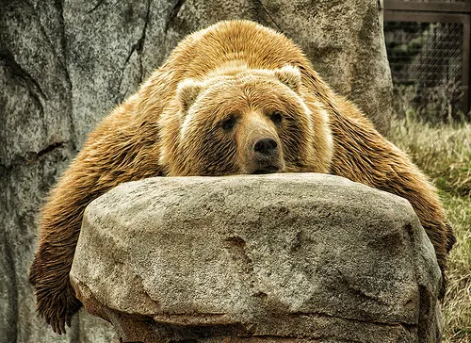

Slide 37
….it’s demanding and tiring…..
Can be mentally exhausting
Notes:
, and sometimes feel like empathy fatigue
Need to have a why to unload, unwind.
Also need to be able to clear head between patients.

Slide 38


Slide 39
….still not always sure about the best way to do things…….
there are always different paths to get there ….not one size fits all

Slide 40
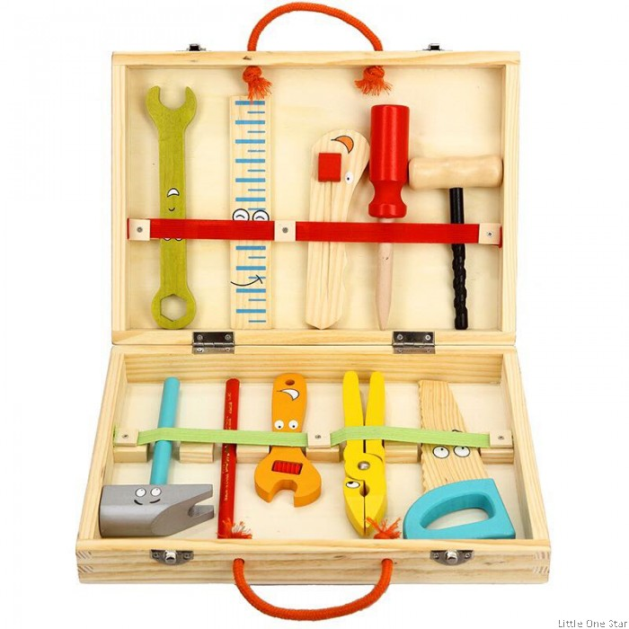

Slide 41
……………....Practical Tips……….
Breath
Listen, really listen - tip of the iceberg
Make a connection – use appropriate language
Be honest – it’s ok not to know
Safety netting
What does the patient in front of you really want?
Don’t panic!

Slide 42
….do I enjoy it …….
Most of the time – it’s never dull

Slide 43
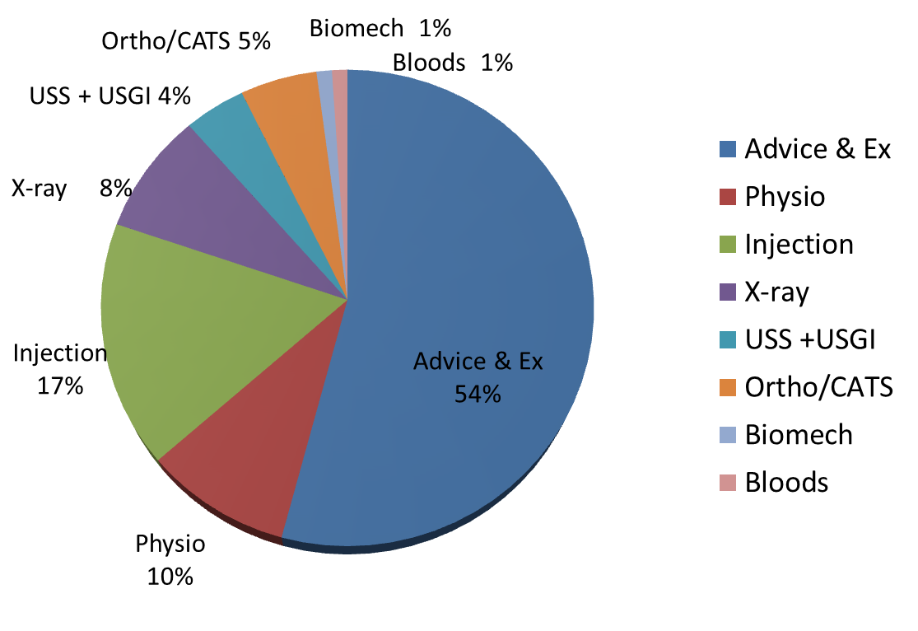
Outcomes for 2019
Notes:
What are our experiences of the job.
Outcomes from 2019 from patient I’ve seen so far.
81% people managed with advise, physiotherapy referral or injection.
Had a change since July with a single point of assess into secondary care.

Slide 44
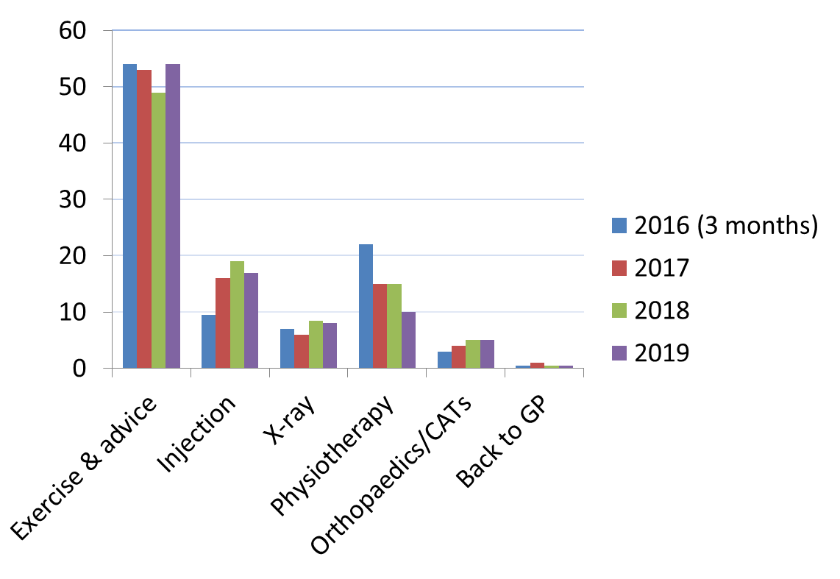
Have I changed what I do ?
Notes:
Over the time been doing the job have I changes in what I do with people?

Slide 45
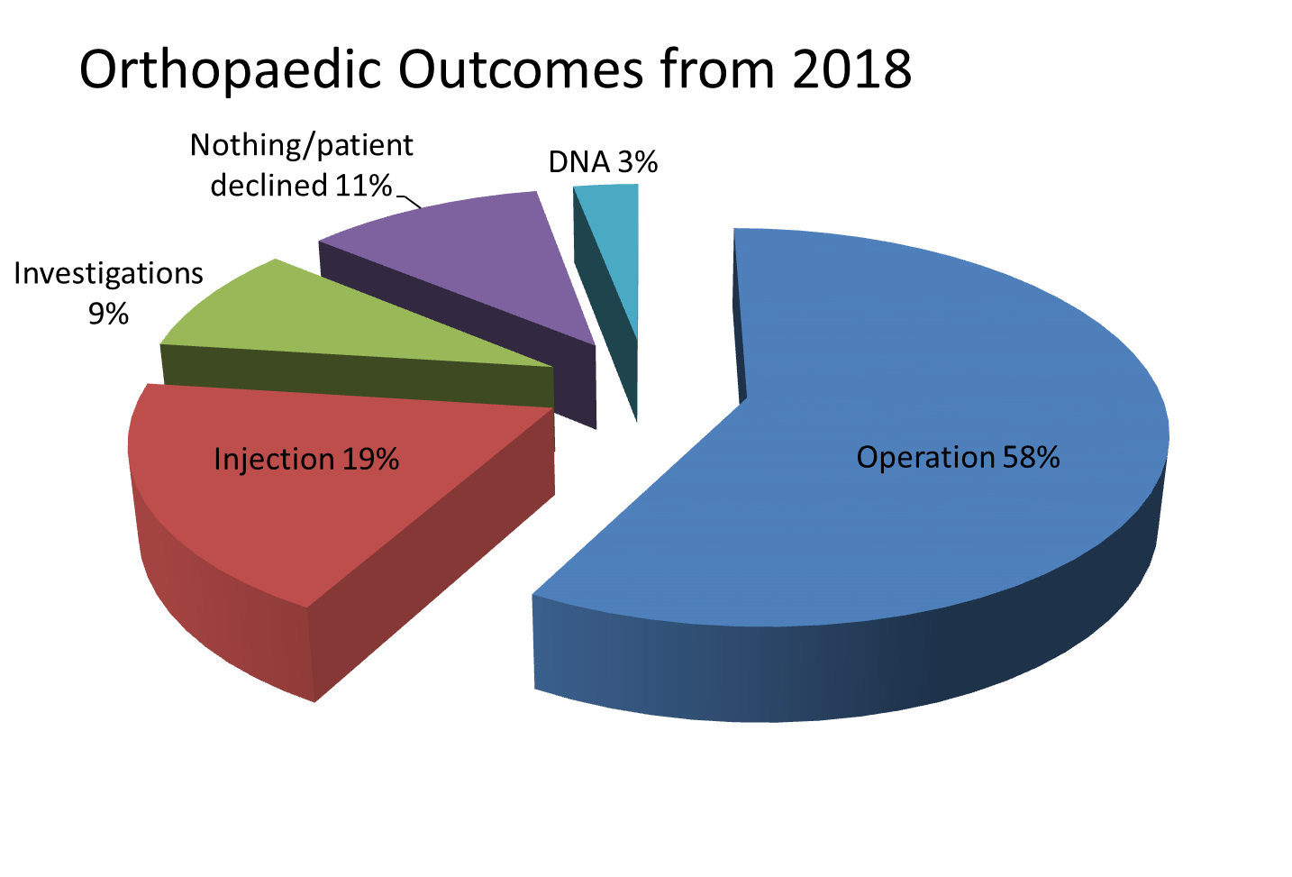
Notes:
77 patients referred on to Orthopaedic – these are their outcomes.
Conversion – 85% to operation, investigation or injection.

Slide 46
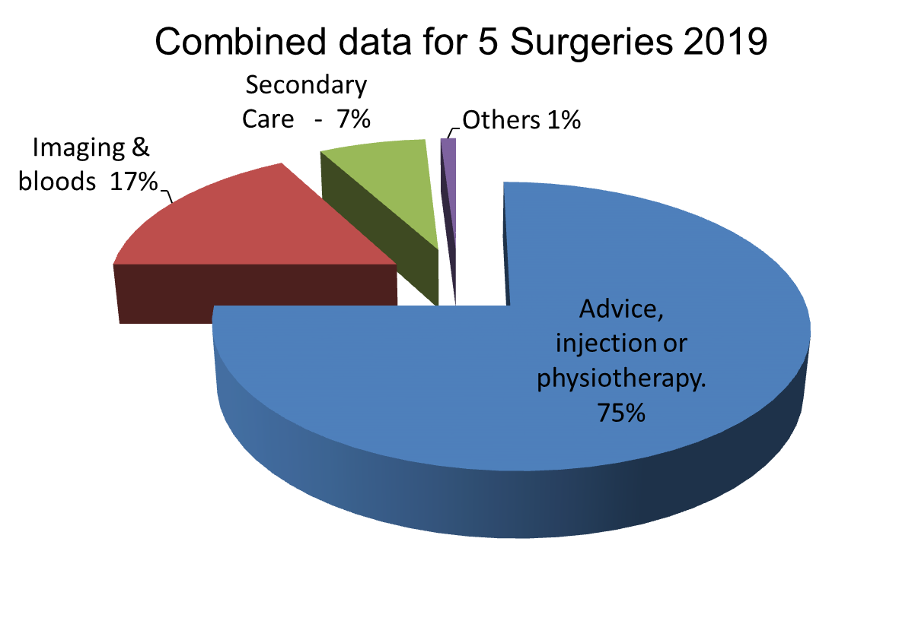
75% patients managed with advice, injection or referral to physiotherapy.
Notes:
Secondary care includes all referral to IMATS – single point of assess – so a back pain that might need imaging or patients that are more complex.
Since July physiotherapy MSK is self referral.
Other: Podiatry, back to the GP, Pharmacy.

Slide 47
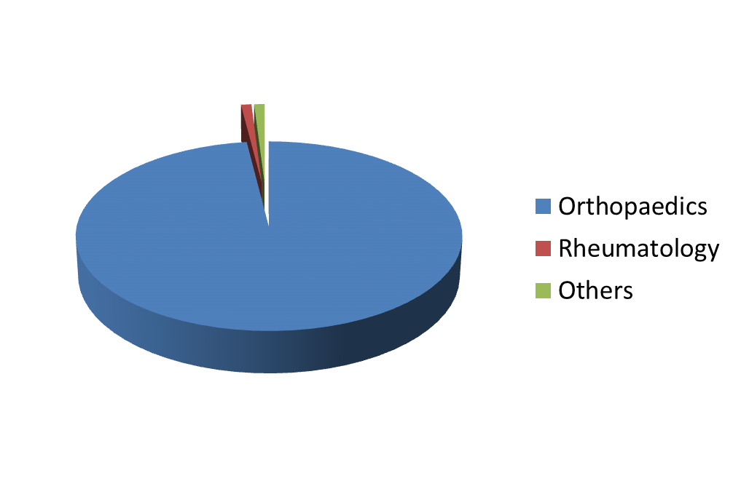
Secondary Care Referrals
Notes:
Other: Pain Clinic, Neurology, General Surgery

Slide 48
Orthopaedic Conversion Rate
Notes:
83% - Surgery/ CT / MRI / MRIA /NCS – which are unavailable to GP practice
17% - Physiotherapy, were better, nothing wrong, suspicion of red flags – spinal with no IMAT service

Slide 49

Thank you

Slide 50
Personal Experience
Volume of patients and shorter appointment times
Importance of finding out exactly what the patient wants
Patient expectation of ‘healing time’ & the ‘miracle cure’
Power of reassurance and a full examination
Fear of doing the wrong thing – missing something serious
Good support from GP
Feeling valued
Some people will go away unhappy
Good communication / liaising with physiotherapy staff to enhance patient care
Hard to turn your ‘physio’ head off

Slide 51
Abi Henderson
CSP Professional Advisor
Interactive session on FCP capacity, governance and sustainability

Slide 52
Q&A Panel
Rob Tyer, Sarah Withers, Ben Alcock, Sue Chester
Chaired by Helen Robson

Slide 53
Tell us what you think!
Visit www.menti.com
and insert code
79 32 35

Slide 54
Thank you for coming
@CSPNorthEast
Tweet us
#MyLocalCSP

