Slide 1
Influencing through data
Euan McComiskie
Health Informatics Lead
@EMAHPInfo

Slide 2

What is health informatics …
"The knowledge, skills and tools which enable information to be collected, managed, used and shared to support the delivery of healthcare and promote health.“
(Making Information Count: A Human Resources Strategy for Health Informatics Professionals Department of Health, October 2002)
@EMAHPInfo

Slide 3
Physiotherapy in 2019 …
Have we (and the rest of health and social care) caught up with other markets in digitalising our services?
  Do we deliver healthcare as digitally as we do our banking?
  Our shopping?
  Our entertainment?
@EMAHPInfo

Slide 4
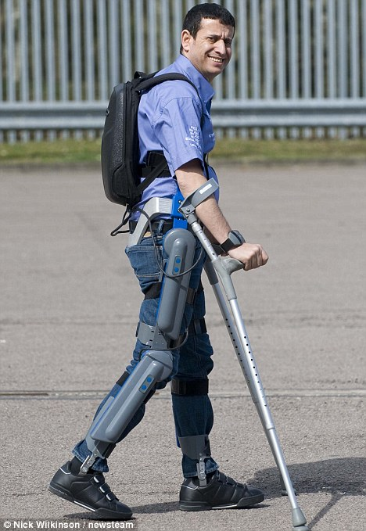
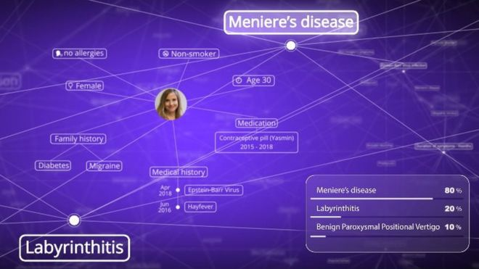

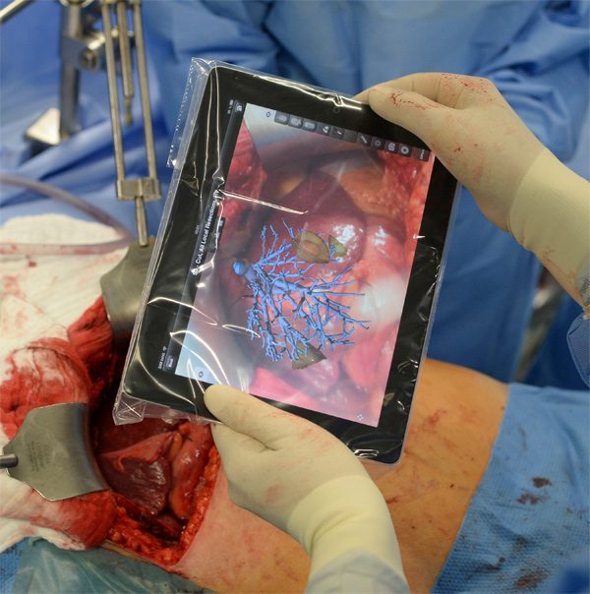
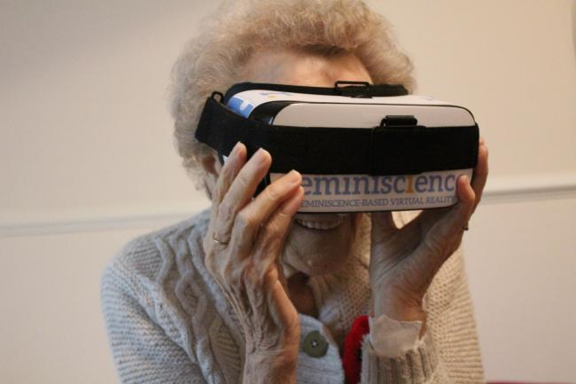
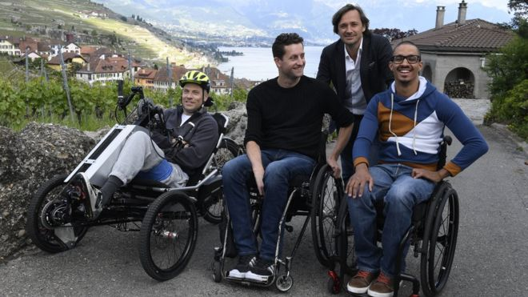
Technology in healthcare …

Slide 5
Physiotherapy in 2019 …
NO!
Have we (and the rest of health and social care) caught up with other markets in digitalising our services?
  Do we deliver healthcare as digitally as we do our banking?
  Our shopping?
  Our entertainment?
The technology is here, it’s just not well distributed yet
Why not?
Barriers and challenges
@EMAHPInfo

Slide 6
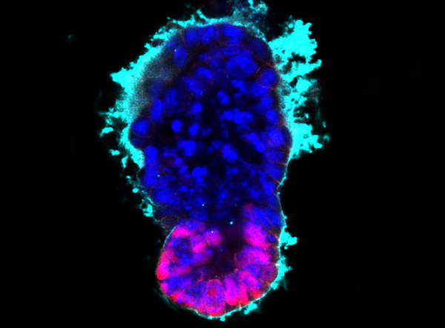
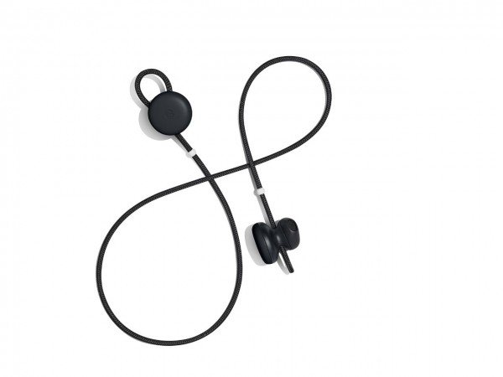
Technology …
@EMAHPInfo

Slide 7


IG …
@EMAHPInfo

Slide 8
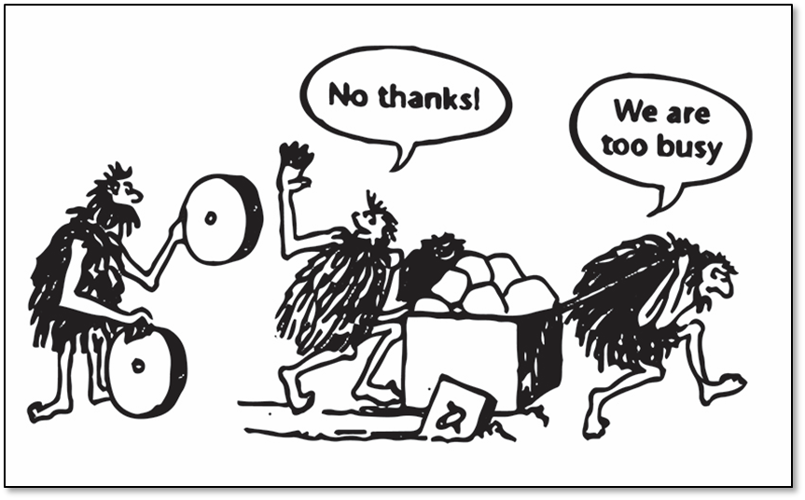
Staff culture …
@EMAHPInfo

Slide 9
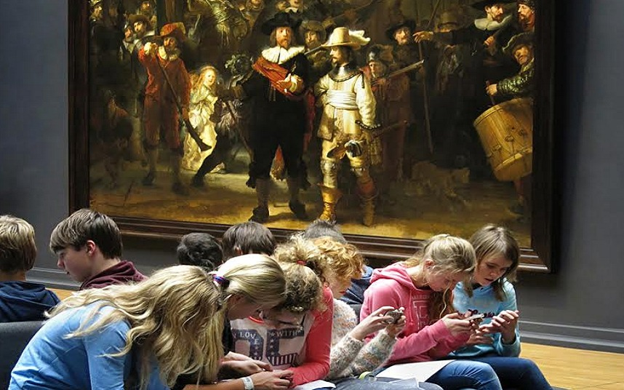
Human interaction …
@EMAHPInfo

Slide 10
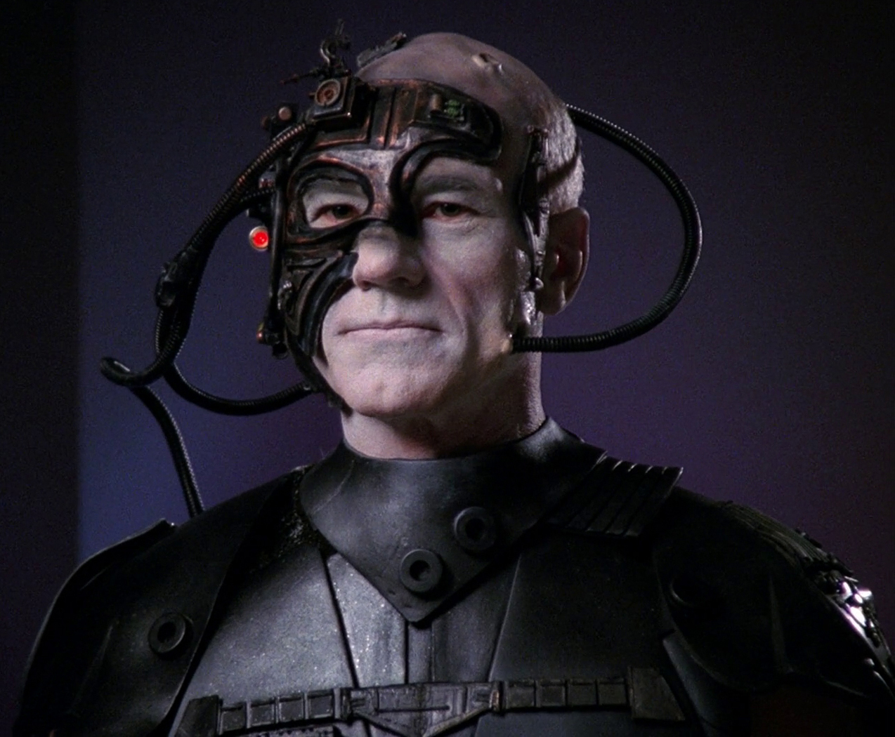
Perceptions of public …
PhysioBot
@EMAHPInfo

Slide 11

Integration…
PhysioBot
@EMAHPInfo

Slide 12

Connectivity …
@EMAHPInfo

Slide 13
Cost …
 | 2008 | 2013 | 2018
iPad | Didn't exist | £699 (64GB) | £409 (128GB)
Desktop PC | $692 | $544 | $633
Smart TV | Didn't exist | $1800 | $800
Notebook | $1008 | $692 | $486
3D printer | Not commercially available | $1400 | $700
Oculus Rift system | Didn't exist | $799 | $599
FitBit | Didn't exist | $100 | $60
Echo Dot | Didn't exist | $89 | $39
@EMAHPInfo

Slide 14
The real currency … DATA!
Data is generated at ALL points in the
physiotherapy service user journey but do we ...
    Collect it systematically?
    Truly understand what it means?
    Consume it as much/well as we create it?
    Use it to drive improvement?
    Use it to demonstrate impact?
If you don’t count, you don’t count!
@EMAHPInfo

Slide 15
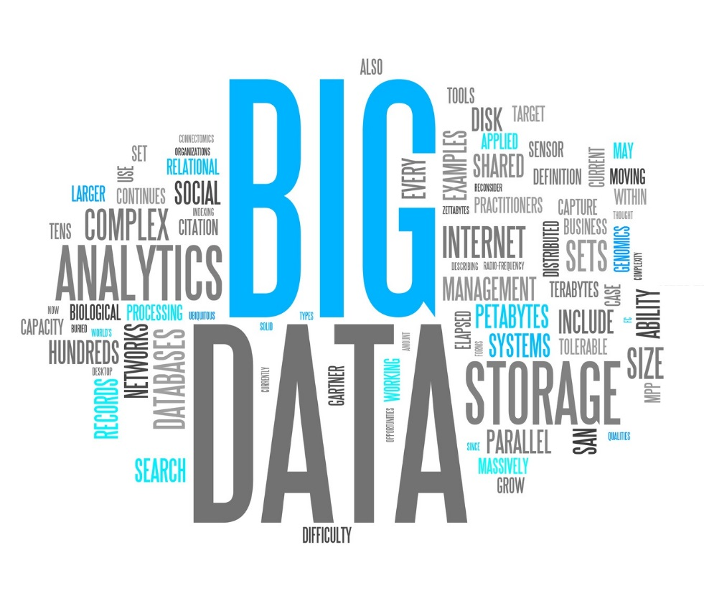
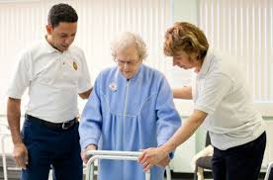
No stories without data, no data without stories
@EMAHPInfo

Slide 16
Data
Information
Evidence
Data is facts, intelligence, experience and statistics collected together for reference or analysis. This includes from qualitative and quantitative sources |  | Information is the product of processing, evaluation and critical appraisal of data |  | Evidence is the management, use and sharing of information
@EMAHPInfo

Slide 17

@EMAHPInfo

Slide 18
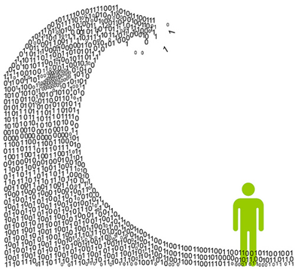


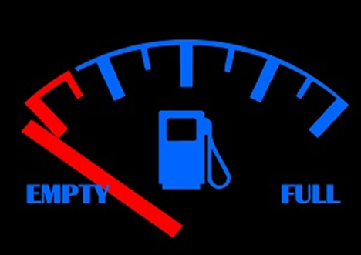
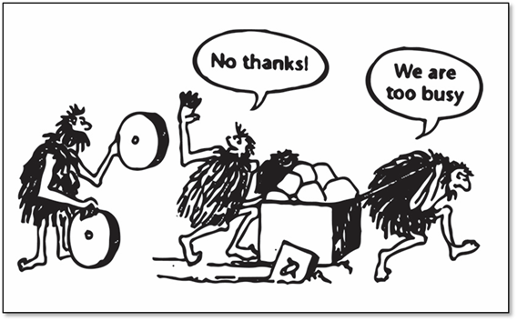
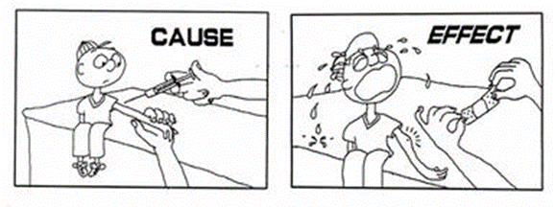
@EMAHPInfo

Slide 19
Data for healthcare is simple …
Collect well
  Standardised appropriate data
  Limited duplication
Use well
  Cost of collecting out weighed by the value of knowing information
  Activity → Output → Outcome → Impact → Influence
Share well
  Share challenges, shared solutions, shared learning from mistakes
  Promote locally, regionally and nationally, both internally and externally
@EMAHPInfo

Slide 20
Data collection top tips …
  Design your answer first
  Confirm metric
  Define and limit data collection
  Use standardised data definitions
  Use clinical champions
@EMAHPInfo

Slide 21
Data at the heart of everything …
Data
Service definition
Service improvement
Workforce
Innovation
@EMAHPInfo

Slide 22
Data at the start of everything …
Is there standardised local collection of data?
Do local standards match national standards?
Do you use an electronic system to collect data?
Do clinical staff have input to develop the system?
Is data presented in reports or dashboards?
Is that information used to demonstrate impact of services?
Is that information used to improve services?
Is that information used to monitor trends?
@EMAHPInfo

Slide 23

Data as a springboard …

Slide 24
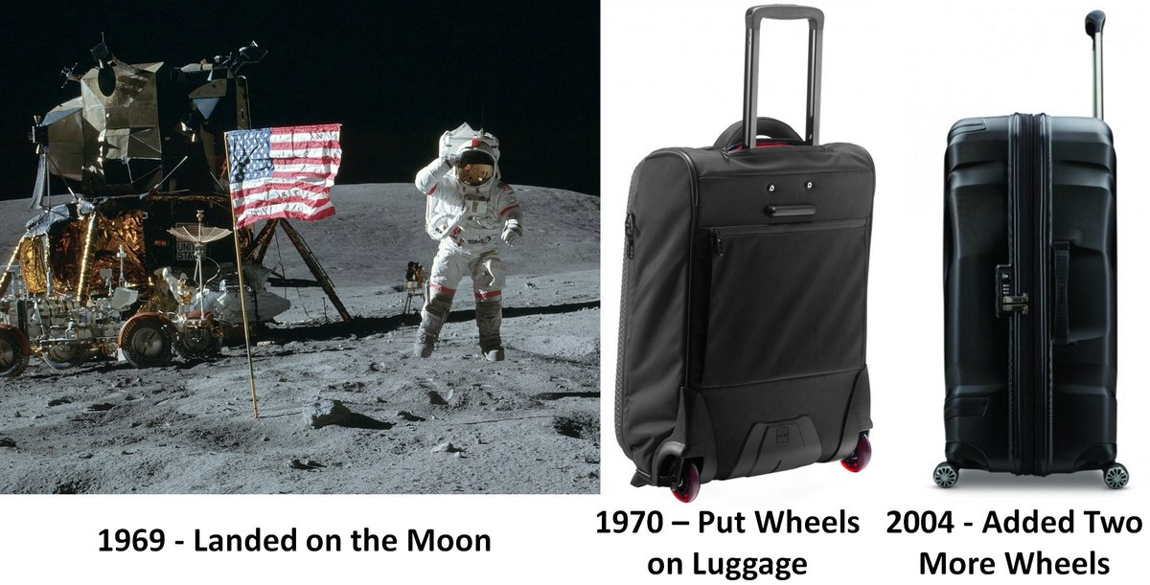
@EMAHPInfo

Slide 25
Data at the start of everything …
Start with a small task list of quick wins
Jobs for this week, this month and this year for individuals and for the group
Quick wins help to start/regain interest and momentum
Maverick → Fast follower → Leader → Normal
Use strength in numbers and interest to influence those in powerful positions (if they’re a good leader then they’ll already know!)
@EMAHPInfo

Slide 26
Data at the start of everything …
Then lead on to strategic and policy drivers for digital and informatics outside of your immediate sphere of influence
East Midlands → England → UK → Worldwide
Career opportunities in clinical informatics
Digital and Informatics Physiotherapy Group (DIPG)
@EMAHPInfo

Slide 27
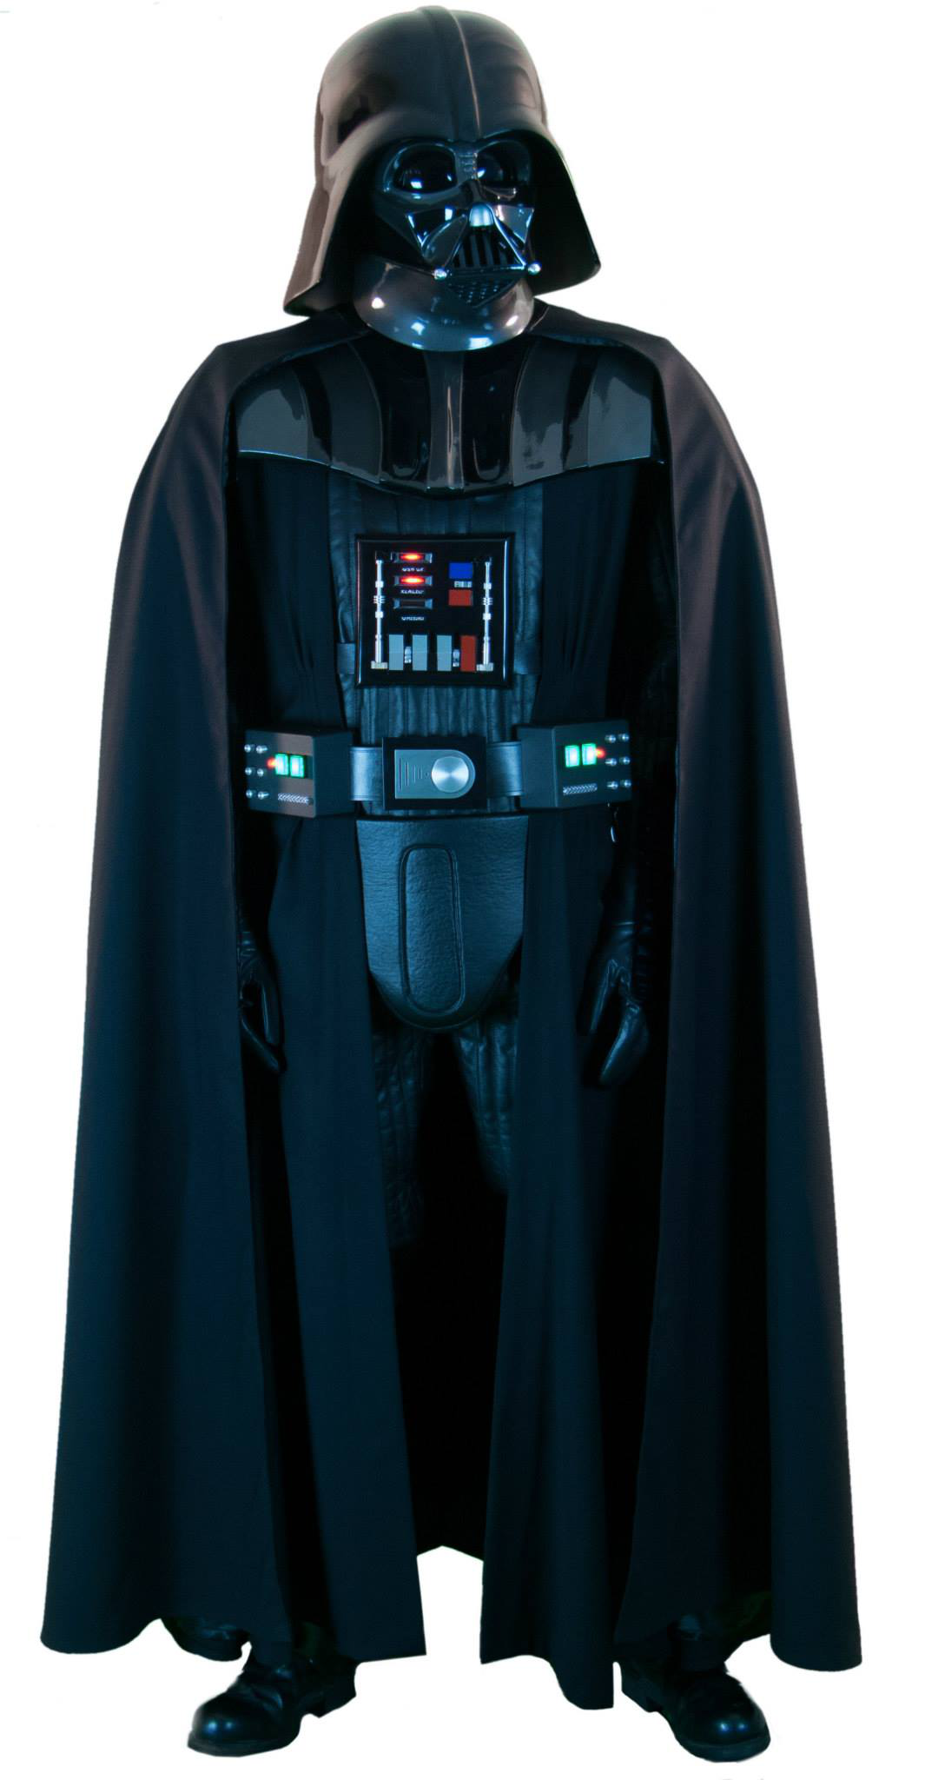

Using data for impact …
@EMAHPInfo

Slide 28
Using data to influence …
Influence
Transactional
Output
Outcome
Experience
Impact
@EMAHPInfo

Slide 29
Data geeks and curious clinicians …
Where are you on the data journey?
  Dubious beginner
    I don’t really see my place in this (Euan is weird)
  Curious clinician
    I can see why we need data and would like to know more (I understand Euan)
  Fast follower
    I want to be part of improving data in physiotherapy (I want to work with Euan)
  Data geek
    I want to lead around data in physiotherapy (I want Euan’s job)
@EMAHPInfo

Slide 30
Data isn’t just for geeks!
MccomiskieE@csp.org.uk @EMAHPInfo
Collect well
Use well
Share well
Standardised
Comparable
Inform
Prove/disprove
Influence
Impact

