Slide 2

Catherine Chappell
chappellc@csp.org.uk
020 7314 7863
@CChappellCSP

Slide 3
www.youtube.com/cspphysiovideos/featured
www.csp.org.uk/networks-campaigns-influencing/campaigns/custom-print
www.csp.org.uk/publications/manifesto-community-rehabilitation
www.csp.org.uk/icsp/influencing

Slide 4


Slide 5


Slide 6


Slide 7
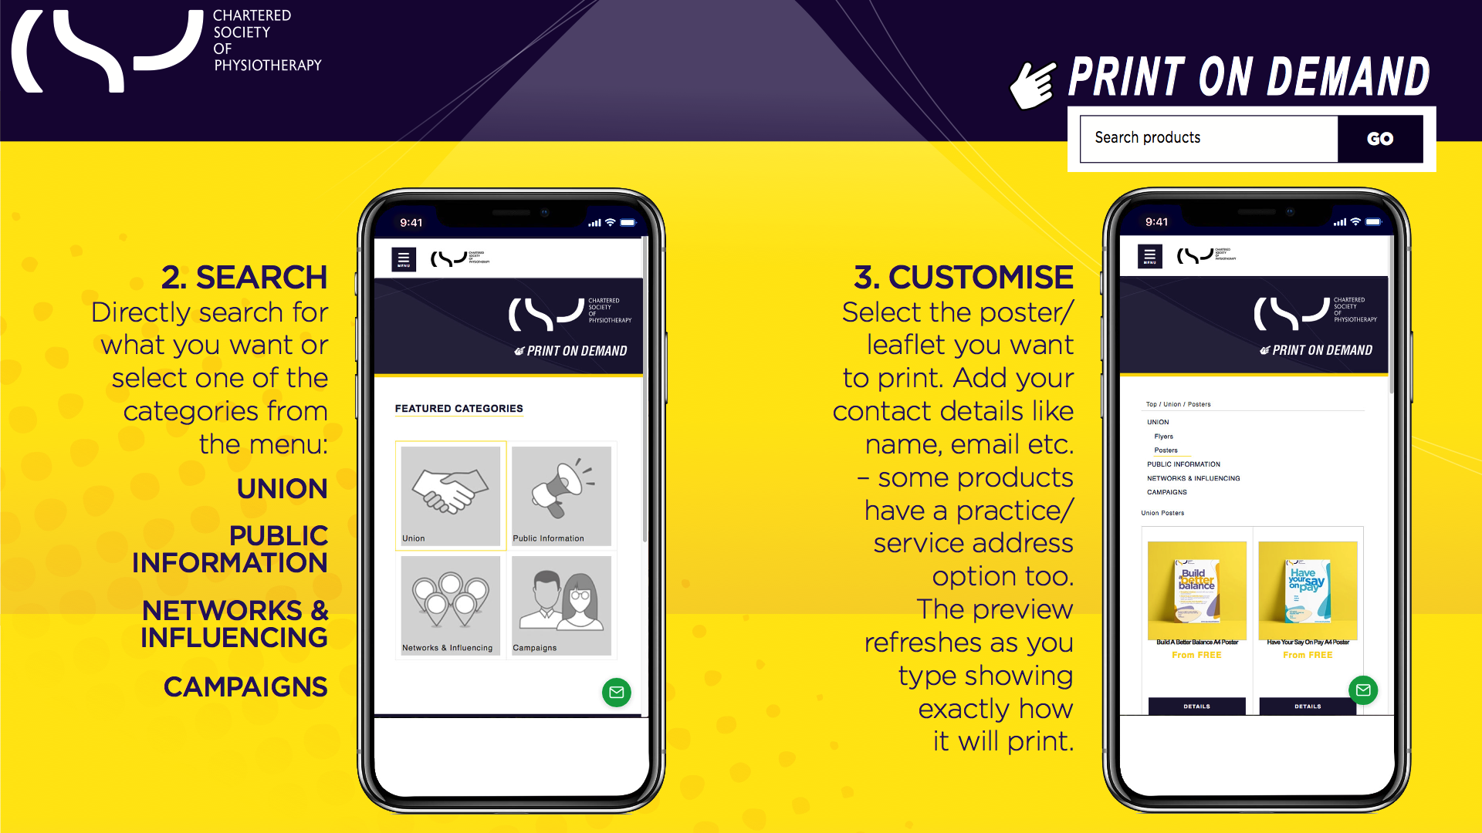

Slide 8
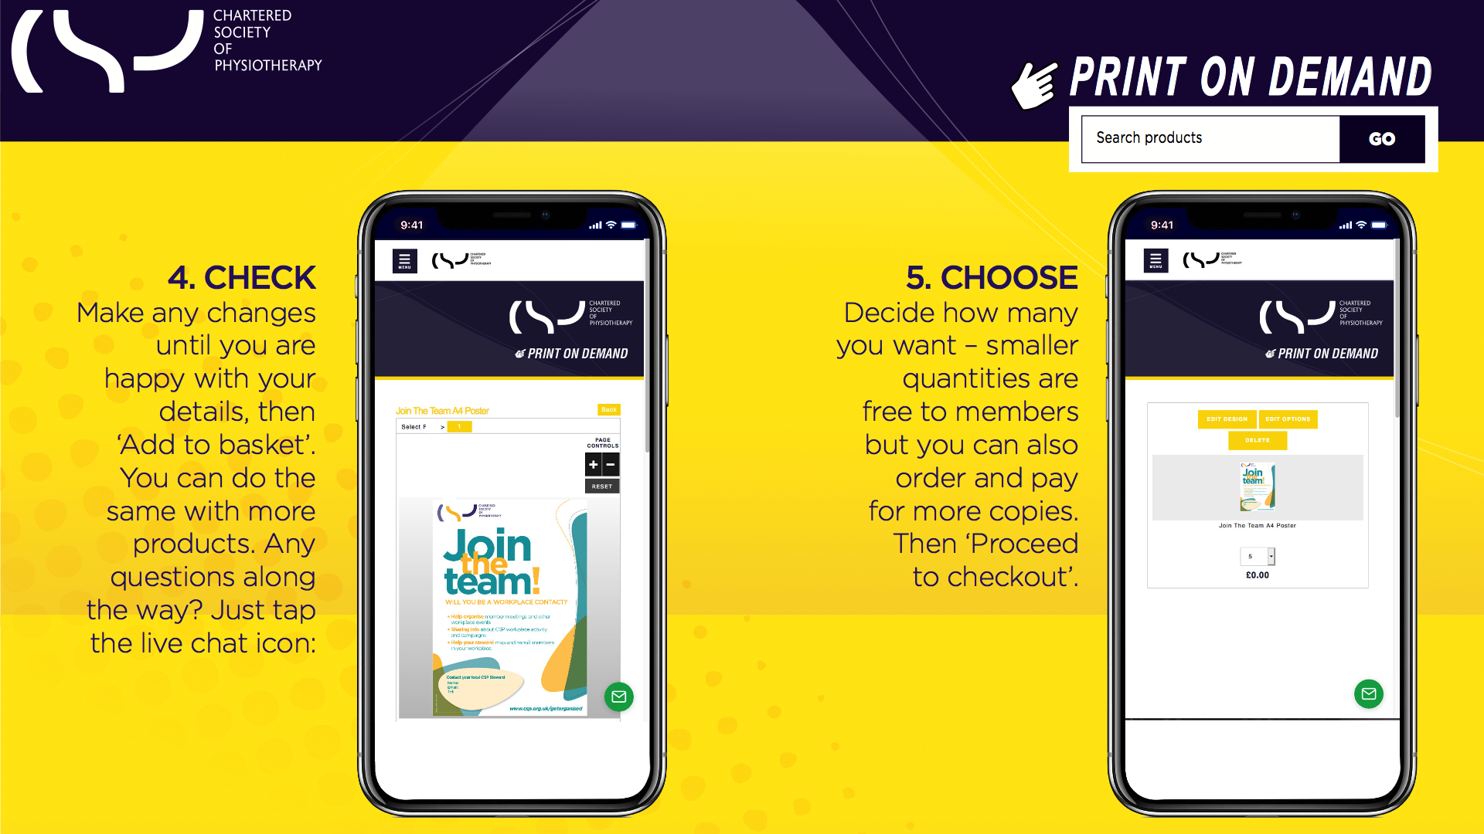

Slide 9
