Slide 1
High Risk Back Pain- CPPP
Ronan Walsh MCSP MMACP
22nd of May 2019

Slide 2

Farming

Slide 3
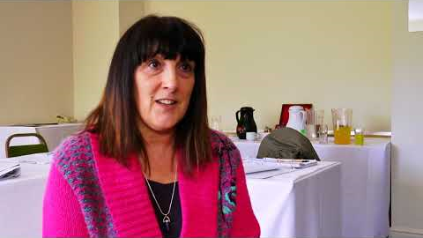
BACK To Health Programme Video

Slide 4
The Programme
3 weeks residential
    Hotel setting
100 hours
MDT
    PT, Nurse, Clinical Psychologist, OT, Pharmacist, Dietician,
Other input
    Exercise taster sessions, smoking cessation, work support

Slide 5

The ‘Good’
Success Rates
Time
    Immersive, better rapport,
    reduced anxiety
Group Dynamics
    Patient problem solving

Slide 6

The ‘Bad’
High follow up ‘drop out’ rates
Intensive for clinician
Group Dynamics

Slide 7
And The ‘Ugly’
DNAs of induction session & cancellations
Inconsistent referral criteria
Patient behaviour

Slide 8
Questions

