Slide 1




Enabling Self-management and Coping with Arthritic Pain through Exercise
Improves lives
reduces resources
deliverable at scale
Mike Hurley
Professor, St George’s University of London / Kingston University
Clinical Director, MSK Programme, Health Innovation Network

Slide 2
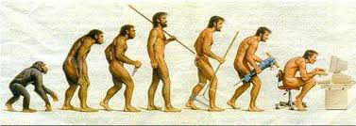


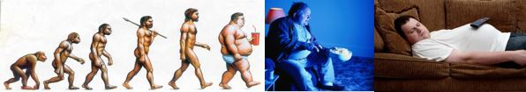
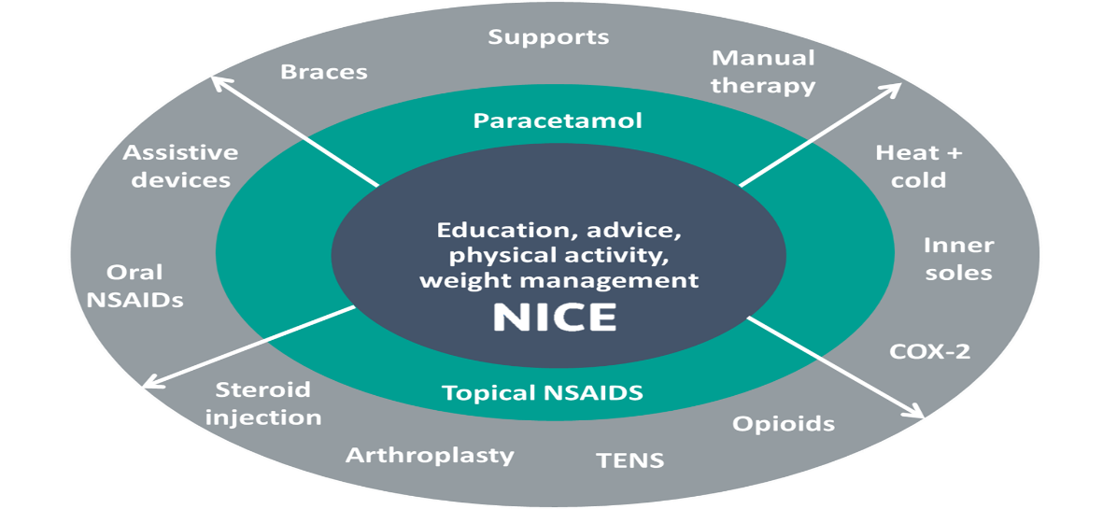
The problem
10 million people in UK live with chronic joint pain / osteoarthritis
  33% >55 yrs have disabling joint pain, 50% over the age of 80 years
longevity, inactivity & obesity = ⬆ prevalence
  2030: ≈17 million people affected in UK
Impact on individuals & society
  Pain, ⬇ mobility, ⬇ function, physical + mental co-morbidity
  1 in 5 primary care consultations
  ~2% GDP
(mis)Management
  Mostly drugs
  Erroneous health beliefs and attitudes
  (movement = pain = harm) not addressed
Notes:
10m people with MSK problems of whom about 4.2m have knee OA
Getting bigger as more people are living longer, but doing less and less of everything apart from eating – inactivity and obesity major risk factors for developing OA
Impacts people, society and healthcare services
NICE recommend everyone gets information about the benefits of activity, healthy body weight, but few people get this advice.
Erroneous health beliefs about pain not addressed
Most maintained on drugs.

Slide 3
COM-B
a “simple” model for behavioural change
Behaviour
Capacity
Opportunity
Motivation
Michie et al 2011 Implementation Science

Slide 4

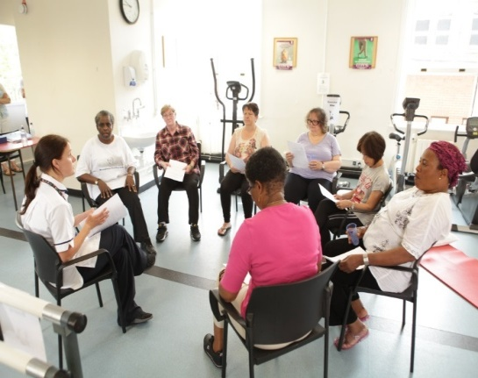
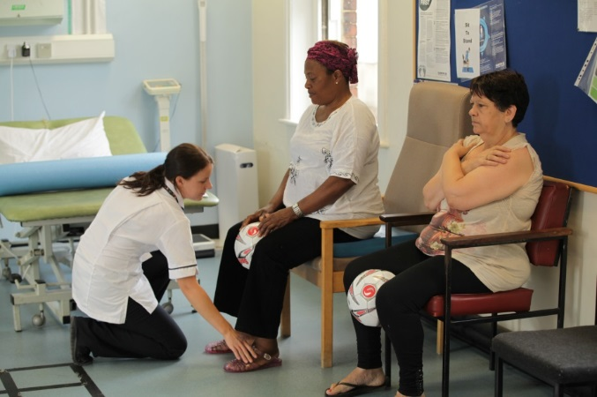
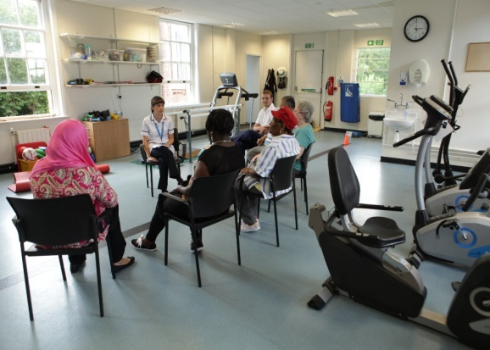
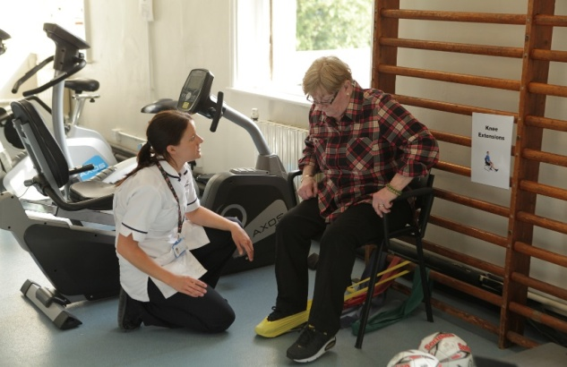
Enabling Self-management and Coping with Arthritic Pain through Exercise
www.escape-pain.org
People attend in groups of ~10
twice a week for 6 weeks
Integrated programme of:
✓ patient information, advice
  their “pathology”, self-management,
  pain coping strategies, weight control
  +
  ✓ exercise
  individualised, progressive, challenging
shows people what they can do
change health beliefs
change behaviour - physical activity
control symptoms + course of condition
coM-B
Com-B
Notes:
4
ESCAPE pain is integrated programme designed to give people the core NICE advice and allow them to experience the benefit attainable from exercise/physical activity
Involve giving Pt info, taking part in challenging exercise programme.
Over the course people start to learn to take control of their problem, understand they can do things that enable them to help themselves, thereby changing their health beliefs and behaviours (in particular become more active) that alters the course of their condition and has long term consequences.

Slide 5






- clinically and cost-effective
Most effective programme ^{ARUK 2017}
RoI £1 spent = £5.20 return ^{PHE 2017}
Easily implementable ^{NICE QIPP 2012}
Safe and more effective than usual primary care ^{Hurley et al 2007a}
Reduced healthcare utilisation ^{Hurley et al 2007b}
  More cost-effective than usual care Hurley et al 2007b; Jessep et al 2009
Participants and therapists love it ^{Hurley et al 2010}
Sustained benefits for up to 30 months ^{Hurley et al 2012}
May avoid surgery Hurley et al 2007b;Svege et al 2015; Pisters et al 2007
Notes:
Lots of robust research evidence to show ESCAPE-pain is effective, cost-effective, saves money, has prolonged benefits (albeit declining without any other input) and may help people avoid surgery.
Independently corroborated by others

Slide 6
Possible routes to spread:
bottom up - front line clinicians
CCGs / STPs
other provider organisations – leisure/community centres
improvement networks / AHSNs
top down - policy, mandate

Slide 7
Possible routes:
bottom up - front line clinicians
CCGs / STPs
other provider organisations – leisure/community centres
improvement networks / AHSNs
top down - policy, mandate

Slide 8
Engaging and getting buy-in from senior clinicians and managers is essential for implementation and sustaining the programme

Slide 9
Leadership
  Local leadership: senior specialist clinicians
  Driven by quality improvement commitment
Evolution within physio practice
Packaged evidence, ready to ‘plug in’ to pathways
Responding to national policy and local need

Slide 10
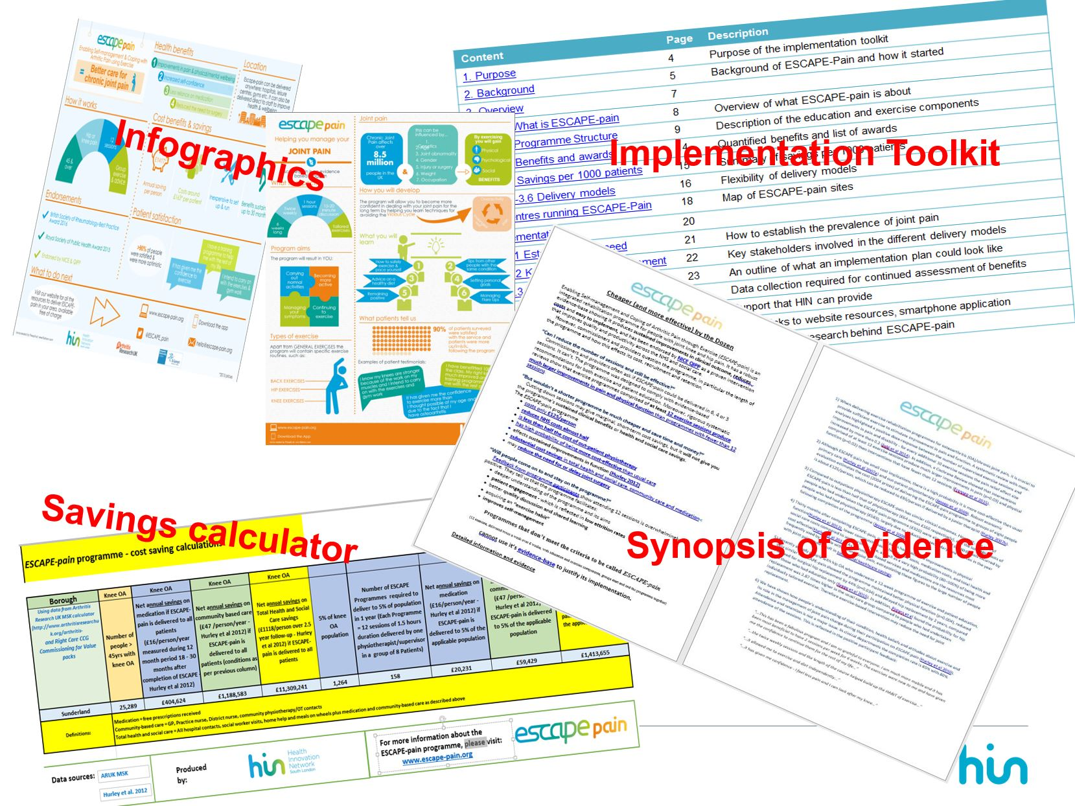
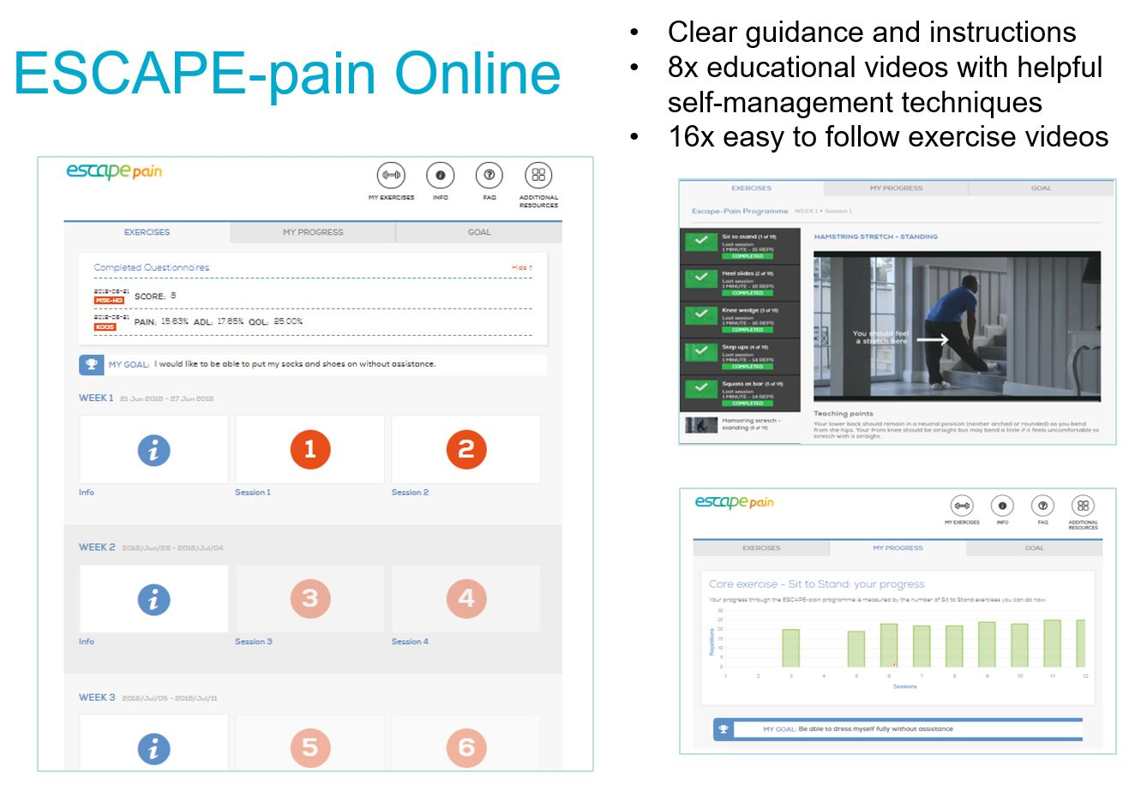
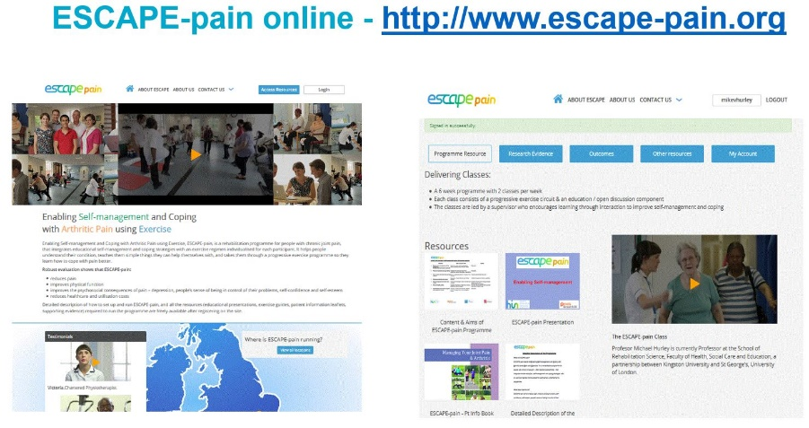

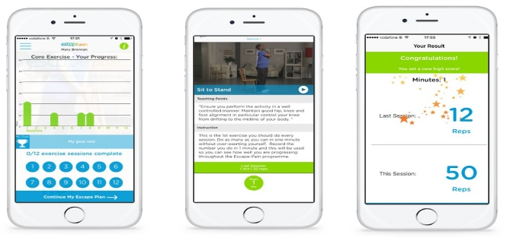

Slide 11
Pathway to implementation flow chart
Local stakeholder engagement
Expression of interest from site
Review of current MSK pathway
Identify referral sources and triage process into programme
Raise programme awareness to all mangers and support staff
Update local administrative systems to include ESCAPE-pain
Determining readiness for training:
An implementation plan is in place
Programme start date has been set
Allocation of staff
Support live sites
Book facilitators onto an upcoming training.
See pre-qualification flowchart attached.
Ongoing support to sites to start programme
Ready to implement/be trained?
Not ready to implement/be trained?
Consider:
Give further implementation advice
Host an ESCAPE-pain information event
Hold a webinar/ meeting/ conference calls to brainstorm and troubleshoot possible barriers
Notes:
Flowchart to help plan the process toward implementation, including when it is appropriate to train facilitators and what considerations need to be taken to determine if they are ready to be trained – and suggestions to help get them ready if they are not.

Slide 12
Clinical resistance
Fidelity to programme while fitting local context
    explain programme, its ethos, content, format
    core 4 – exercise+advice, grps, 2/wk, data
    training – QA
12 sessions doesn’t fit with (arbitrary, non-evidenced) 1:3 f-u:Rx ratio
Local (non-evidenced) programme
Continual pressure to reduce sessions – changes evidence-base
No group tariff – treating group 10 people (~1.2 sessions)
Commercial Providers – programme “cost-ineffective”
Data burden – time, effort, cost, capabilities, capacity
Staffing issues – high turnover, Band 4s - better value...just better!

Slide 13
Possible routes:
bottom up - front line clinicians
CCGs / STPs
other provider organisations – leisure/community centres
improvement networks / AHSNs
top down - policy, mandate

Slide 14
The (black) art of Commissioning
  Difficult to know who to speak to, interim
  Decision-making processes - varied, confusing, impenetrable
  Understand commissioning models, priorities,
  benefit statement
  costs
  savings - drugs, consultations, investigations, interventions, bed days
  what is required to implement and sustain
Be lucky! good timing in commission cycle

Slide 15
Cost of implementing ESCAPE-pain per participant:
Band 7 physio ~ £163
Band 6 physio ~ £105
B4 rehab assist + Band 6 ~ £190
Band 4 + Band 5 ~ £172
Band 4 ~ £95
Exercise Professional ~ £45

Slide 16
Reduction in healthcare utilisation
Potential savings |  | / 1000 participants
Physiotherapy | £87.58 / person /annum | £87,580
Medication Community based care (GP, district nurse, social care) Total health & social care utilization less bed days, fewer GP consultations (investigations, medication, interventions) | £21.64 / person / annum £63.55 / person / annum £1,511.79/person/2.5 yrs | £21,640 £63,550 £1,511,790
2017 prices

Slide 17
Reduction in average number of knee pain-related… | Extrapolated to 1000 pts
…bed days (0.37) | 370
…Out-Pt consultations (0.12) | 120
…GP consultations (0.51) | 510
If 10% of participants eligible for knee replacement choose not to proceed @ £4000/TKR | 100

Slide 18
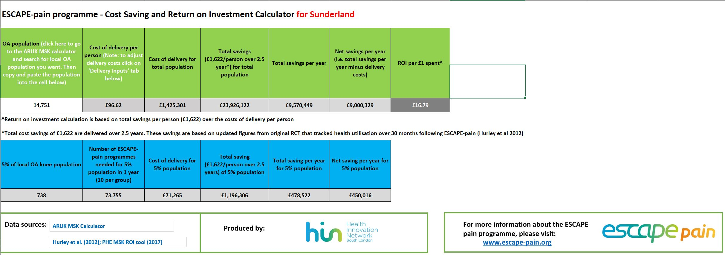

Slide 19
Commissioning resistance -
continual pressure to reduce sessions – changes evidence-base
12 sessions doesn’t fit with (arbitrary, non-evidenced) 1:3 f-u:Rx ratio
no group tariff – treating group 10 people (~1.2 sessions)
commercial providers – programme “cost-ineffective”
short-termism – within-year savings
value activity more than outcomes
secondary care reduces surgery = lose activity = lose money
unwilling to commission if savings made elsewhere in system
not interested in reducing GP consultations
need to reduce enough beds to close a ward
not interested in social care savings – 5YFV, STPs/ICSs?

Slide 20
Possible routes:
bottom up - front line clinicians
CCGs / STPs
other provider organisations – leisure/community centres
improvement networks / AHSNs
top down - policy, mandate

Slide 21
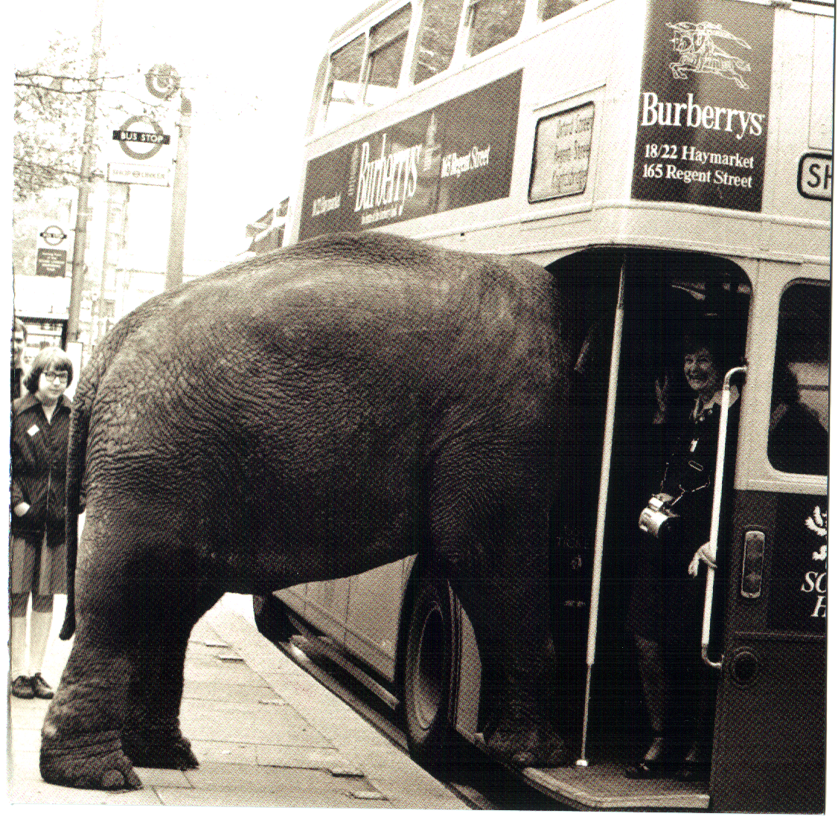
We have a problem here -
CoM-B
We need to improve access

Slide 22

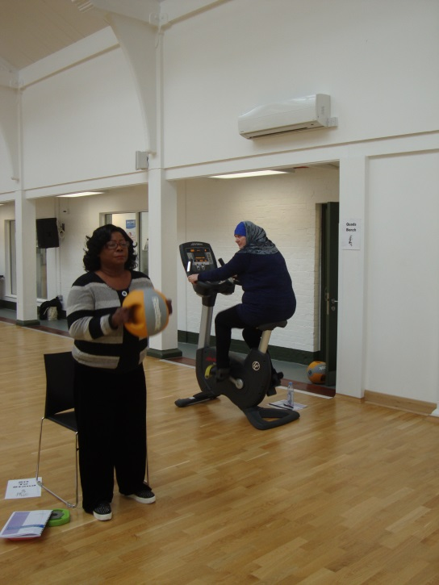
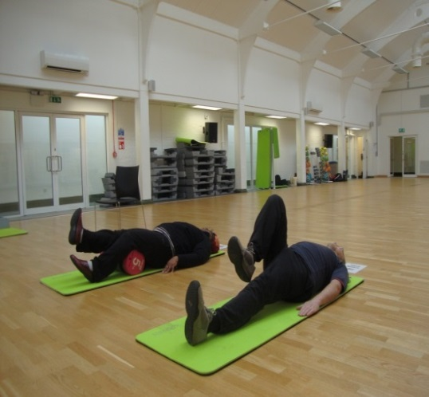
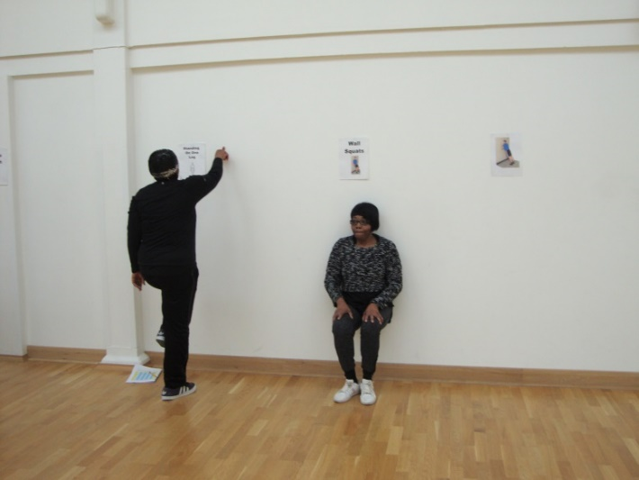



in the community:
13 cohorts = 169 people
Outcomes replicated
Enthusiastic patient and clinician feedback
COM-B

Slide 23
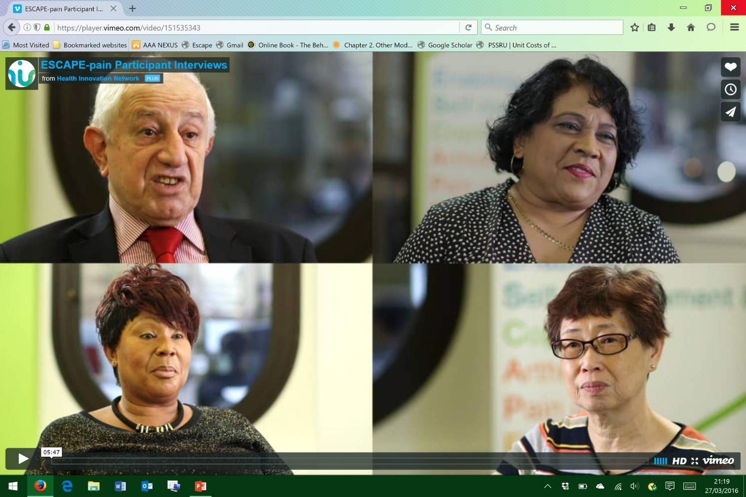
Participant stories - very positive, very persuasive
“…I am much more mobile… [exercises] have given me the confidence to continue with them…”
“…I’m sleeping again...”
https://player.vimeo.com/video/151535343
COM-B
“…I can put on my shoes and socks…”
“…I learnt how to manage pain with exercise and the pain is much less now...”
“…play with my grandchildren…”
“…it saves me from attending the hospital…”
“…a training programme to help me with
the rest of my life.”
“…it was a good start for me to transform my health and weight…”

Slide 24


17 leisure and community delivery partners

Slide 25


Training programme for exercise professionals
accredited by:
Notes:
We have now developed and deliver accredited courses for clinicians and exercise professionals

Slide 26
Outcomes in clinical and community settings before and after participating on ESCAPE-pain

Slide 27
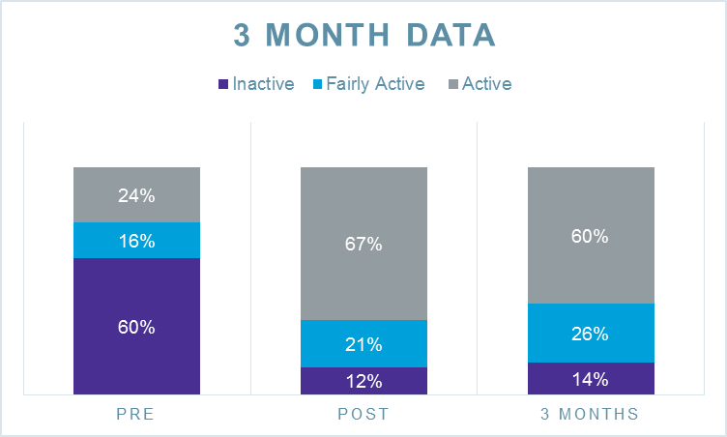
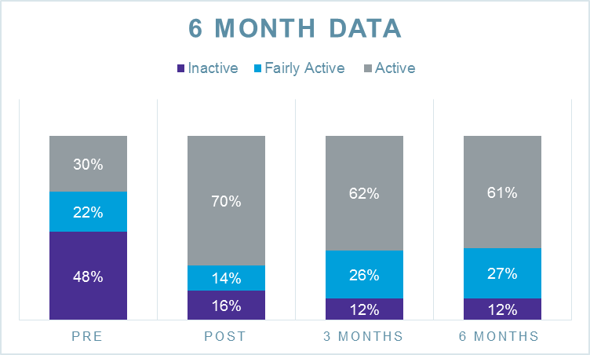
n=206
n=74

Slide 28
Participant feedback:
Enjoyed, understood, informed
Beneficial – pain, function, psychological, emotional
Self-managing
Physical activity – engaged, more active, habitualised, join gym
Organisational feedback:
Compliments organisational ethos, plans, offers
Want to build relationships with NHS, Local Authority, STP/ICS
    - link into MSK pathways for effective referral pathways
  Funding to sustain
  - CCGs
  - charging, post ESCAPE-pain classes, business revenue

Slide 29
Possible routes:
bottom up - front line clinicians
CCGs / STPs
other provider organisations – leisure/community centres
improvement networks / AHSNs
top down - policy, mandate

Slide 30

HIN-ARUK partnership
National leadership
Training
Quality Assurance
Data collation
Digital resources
Development
Funding central team
National and local influencing
Public Engagement
Funding evaluations

Slide 31
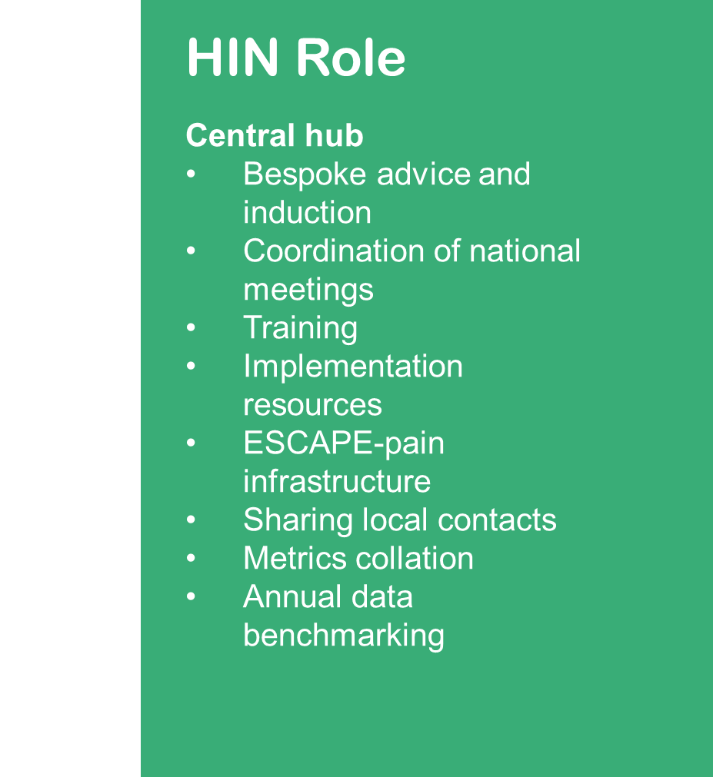

AHSN national rollout – NHS England
Role of AHSNs
Lead on the local implementation
Project Manager (0.6 WTE)
Influence local decision makers
Help setting up new sites
Support existing sites
Support data collection
Keep track of local implementation
Promote fidelity to the programme
Notes:
How you join in, how we can learn from you

Slide 32
5YFV - NHS/community collaboration - new problems
  providers (PH, local authority, CICs, private)
  different drivers, ethos, business models
  need to understand and develop
    bespoke training
    establish access (referral routes)
    overcome concerns (“non-traditional” healthcare)

Slide 33
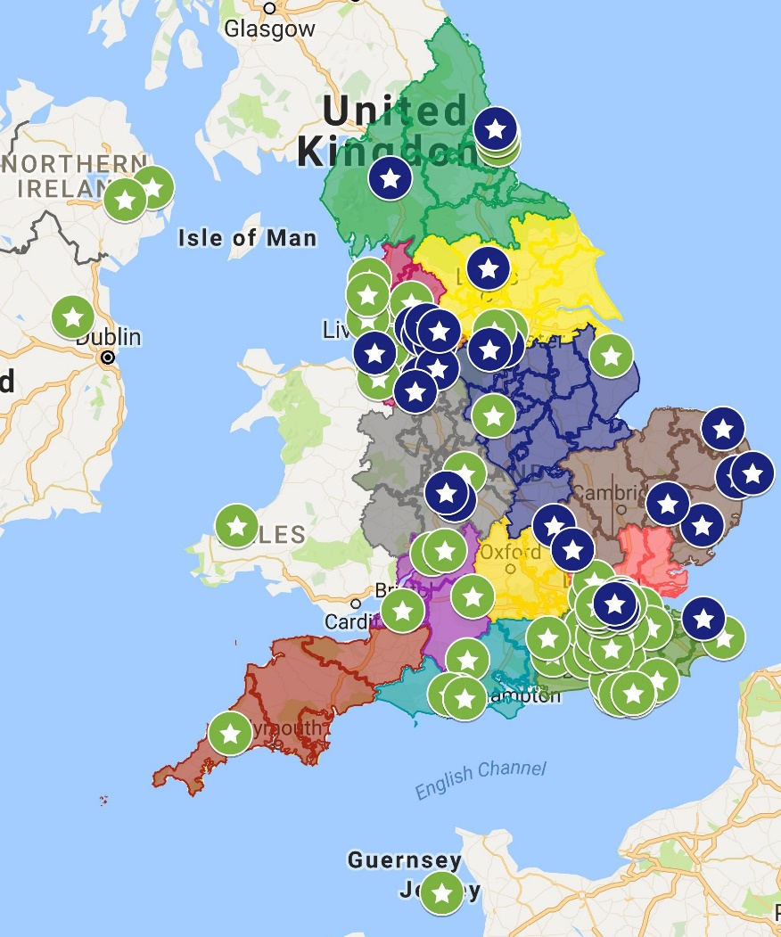
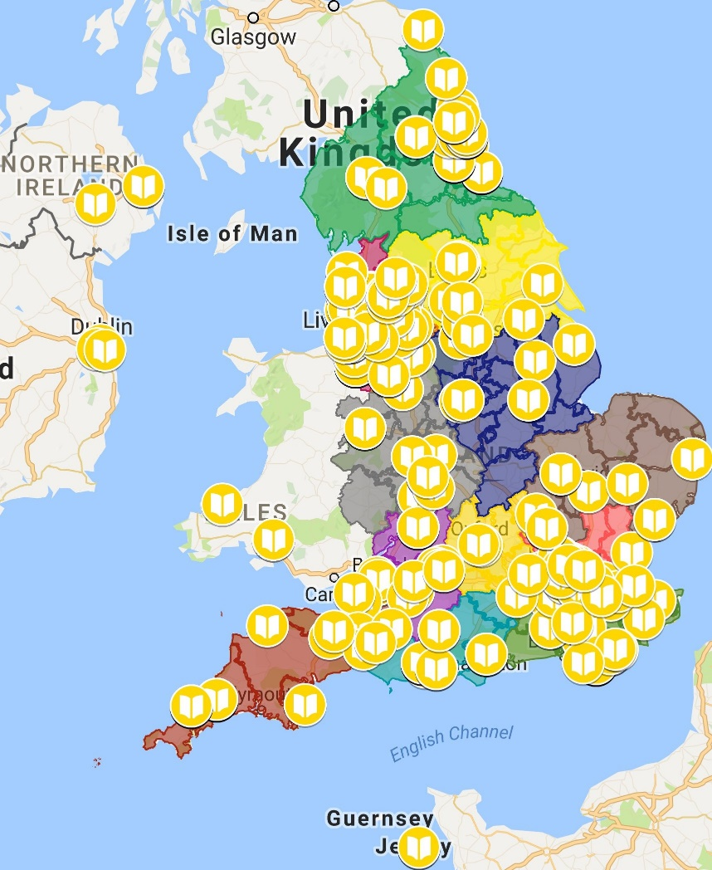
Current spread
174 sites (52 non-clinical)
810 facilitators (291 ex pros)
>11,000 participants
Notes:
We are currently delivering the programme in 170 sites across the UK.
We’ve trained 700+ facilitators
And >10k people have been through the programme

Slide 34
Reduced health & social care >£14m
  less bed days,
  less GP appts – drugs, investigations, interventions
Notes:
Extrapolating from our economic evaluation suggests that ESCAPE-pain has saved the system about £14m – less consultations, drugs, investigations, inetrventions

Slide 35
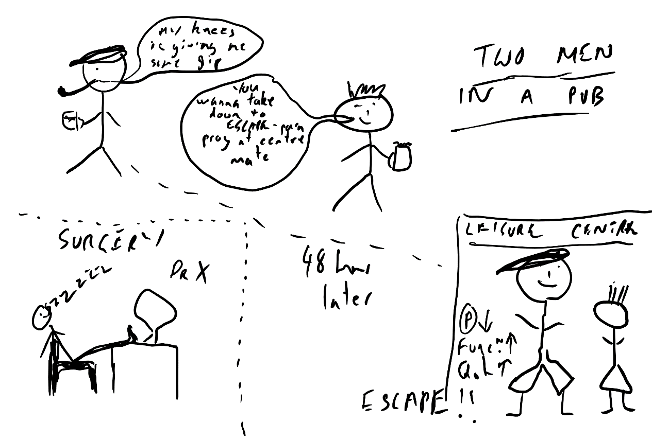
Our vision: Two men in a pub

Slide 36
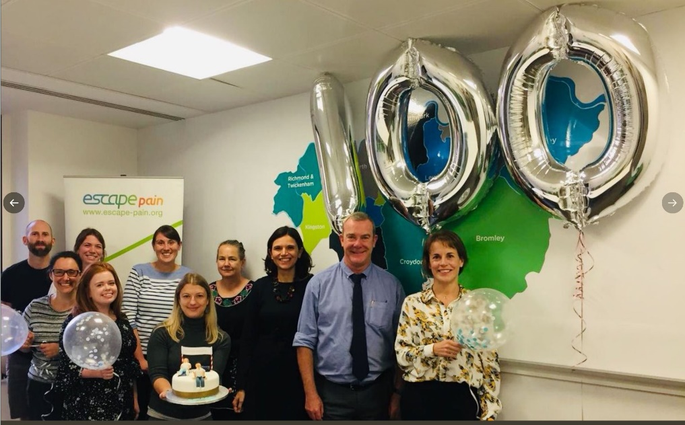

Thank you

