Slide 1
Kay Stevenson
Consultant Physiotherapist and Senior Knowledge Mobilisation Fellow
Midlands Partnership NHS Foundation Trust
Impact Accelerator Unit, Keele University

Slide 2
Closing the gap between clinical research recommendations and implementation into practice

Slide 3
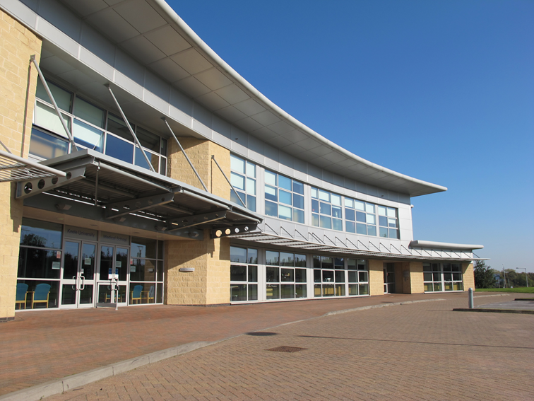

Slide 4
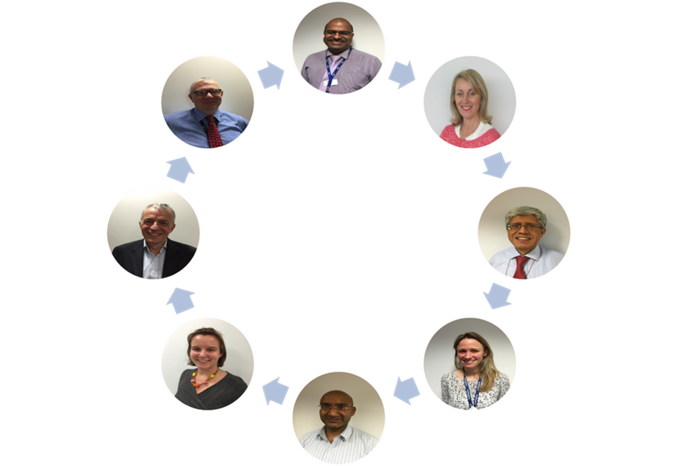

Slide 5
Aims of my session
How can we close the gap?
Use 3 real life examples
STarT Back
NIHR Themed Review- Moving Forwards
Critically Appraised Topic group (CAT)
Reflective moments
Summarise using top tips

Slide 6
Audience participation
What do you think are the key barriers/ solutions to implementing evidence?

Slide 7
Background
17 years
1/3 research evidence informing guidelines is adhered to
30-40% of patients do not receive care according to scientific evidence

Slide 9
A range of approaches that encourage the collation and communication of knowledge
(Ferlie et al 2016)

Slide 10
A range of approaches that encourage the collation and communication of knowledge
(Ferlie et al 2016)
A proactive process that involves efforts to transform practice through the circulation of knowledge within and across practice domains
(Swan et al 2016)

Slide 11
A range of approaches that encourage the collation and communication of knowledge
(Ferlie et al 2016)
A proactive process that involves efforts to transform practice through the circulation of knowledge within and across practice domains
(Swan et al 2016)
Describes the translation of evidence into practice, and recognise it as a central part of the dissemination and implementation process which aims to close the research to practice gap
(Rowley et al 2012)

Slide 12
Example 1
https://startback.hfac.keele.ac.uk/

Slide 13
Stratified Care- STarT Back
The costs of care for LBP exceed £500 million/year
Lost production as a result of LBP costs at least £3500 million/year
30.8 million days lost to MSK pain (including back, neck and upper limb pain)¹
8.9 million working days were lost due to work related Musculoskeletal disorders in 2017, 36% were low back pain (about 3.2 million days) ²
The average number of days absence in the above people was 16.5 ²

Slide 14
The research story
RCT
Implementation study
Qualitative study

Slide 15
The research story
RCT
Implementation study
Qualitative study
Improved outcome
Improved clinical outcomes
Improved patient satisfaction
Stratified care was cheaper
Reduced GP consultations
Much less time off work
Reduced visits to Hospital consultants
Reduced Investigations, MRI/x-rays
Reduced epidural injections
Reduced private healthcare
Reduced medication
Back pain not interesting
Concerns about overloading services

Slide 16
The research story
RCT
Implementation study
Qualitative study
Improved outcome
Improved clinical outcomes
Improved patient satisfaction
Stratified care was cheaper
Reduced GP consultations
Much less time off work
Reduced visits to Hospital consultants
Reduced Investigations, MRI/x-rays
Reduced epidural injections
Reduced private healthcare
Reduced medication
Back pain not interesting
Concerns about overloading services

Slide 17
The research story
RCT
Implementation study
Qualitative study
Improved outcome
Improved clinical outcomes
Improved patient satisfaction
Stratified care was cheaper
Reduced GP consultations
Much less time off work
Reduced visits to Hospital consultants
Reduced Investigations, MRI/x-rays
Reduced epidural injections
Reduced private healthcare
Reduced medication
Back pain not interesting
Concerns about overloading services

Slide 18
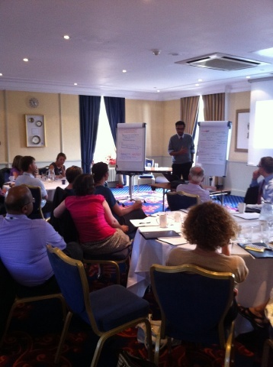
Local workshop key themes
Resourced Champions
Contextualise the problem
Patient power
Research plus real life data
Make it easy to do the right thing

Slide 19
Innovation
Assess risk using embedded tool
Good quality patient information
Rapid referral to physiotherapy

Slide 21
A stepped approach to implementation
Local and regional pilots
Collaborate with strategic organisations e.g. WMAHSN
Maximise national agenda e.g. NICE, NHS England

Slide 22
The science wasn't enough- ‘real life data’
Patient told us to use their expertise
Collaborative discussion
Understand different contexts
Make new friends- local and strategic
Understand context
Language

Slide 23
Example 2- Moving Forward

Slide 24
Methodology
Community of Practice
Key stakeholders
Commissioners, patients, clinicians
Prioritisation exercise
LINK group
Homework

Slide 25
Patient priorities- LINK Group

Slide 26
Prioritisation Framework

Slide 29
Design of the session was important
Mixing stakeholders into small groups was beneficial
Prioritisation framework helpful
Results may depend on your context

Slide 30
Example 3- Critically Appraised Topic Groups (CATs)
https://www.keele.ac.uk/ebp/

Slide 31
Search the
evidence

Slide 33
Clinical impact
Rapid changes in practice
Influence commissioning decisions
Increase research awareness
Improve critical appraisal skills
Create networks
Staff training
Research impact
3 funded trials
Staff training opportunity
Create network
Increase understanding of NHS
Clinical advisory groups

Slide 34
Leadership is important
Needs mixture of clinicians and academics
Collaborative learning decreases fear factor
Clinical and academic ‘buy in’
Change can be rapid

Slide 35
Closing the the gap
Method?
Stakeholders & influence
Context
Flexible/aligns with policy
Dedicated time,
Roles &
innovations
Involve patients

Slide 37
Thank you for your time
Kay.Stevenson@mpft.nhs.uk
@KayPaulBollie
@KeeleIAU
@KeeleStartBack

