Slide 1




FCP Training: Effective Knowledge Translation.
Dr Neil Langridge DClinP MSc BSC (Hons) FMACP
Consultant MSK Physiotherapist
Senior Lecturer
@neiljlangridge

Slide 2
Context and National picture
Advanced Practice -MPFramework
Frameworks
Apprenticeship to advanced practice
MSc Modules and programmes
APEL/RPEL
National academy
FCP

Slide 3
Complexity in current practice
Advanced Practice – level of practice
Clinical specialism – specific to an area – does not fulfil 4 Pillars of advanced practice

Slide 4
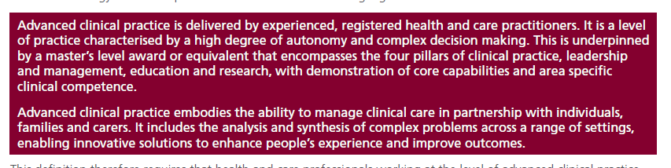
NHSE - Definition

Slide 5
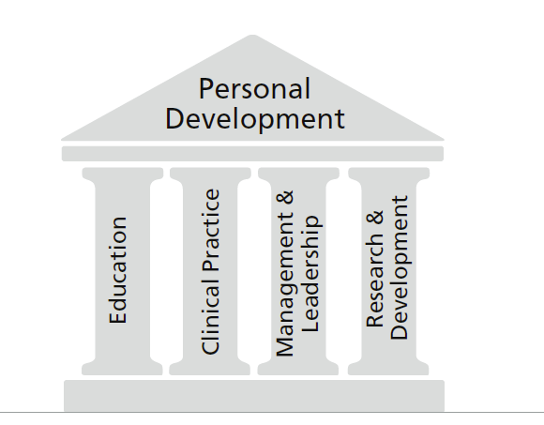
4 Pillars

Slide 6


Slide 7
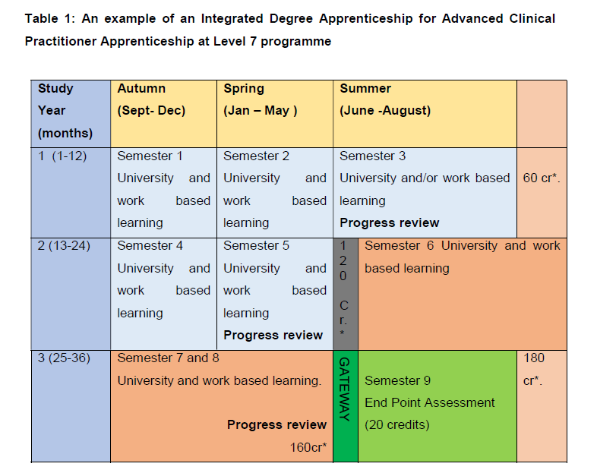

Slide 8
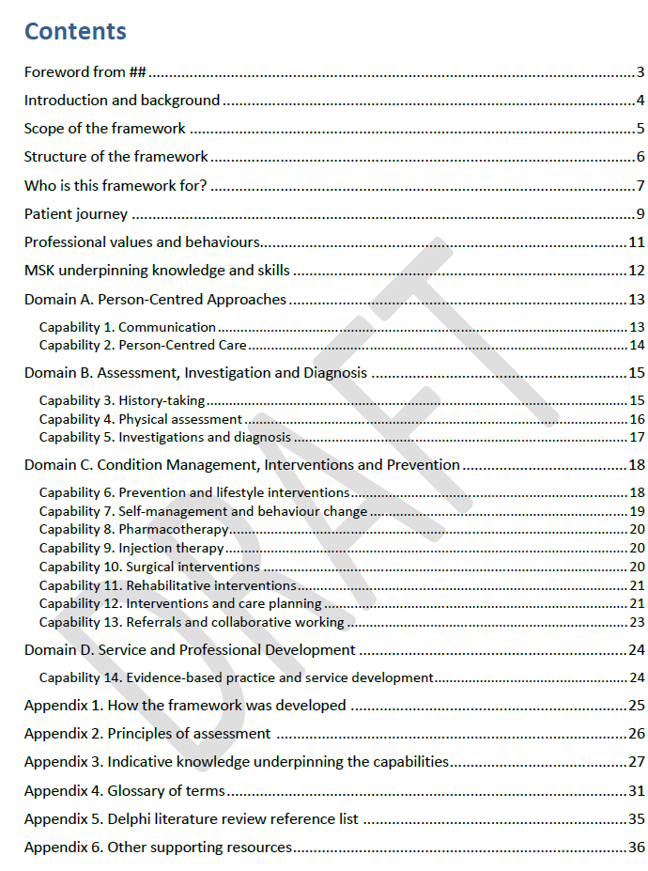

Delphi Study
Collaborative
Feasibility study – “register”

Slide 9
How does this apply to FCP?
Entry point portfolio.
The clinical element to the Advanced Practice academy.
It could still offer some leadership/education/Research.
Need to make supervision closely linked to the frameworks.

Slide 10

Building the clinical portfolio MSc.
Learning outcome & aims
This 30 credit masters level module is suitable for AHPs already working in FCP roles in primary care or those planning to move into these roles. It has been designed with stakeholder and clinicians and is supported by Health Education England. It is a new module, the first of its kind in England. There will be an in depth evaluation to ensure the course meets the needs of all involved so there will be opportunity to feedback and shape the development of the course. The course will be delivered in 5 taught days and 10 days clinical practice. You are required to identify a medical practitioner (GP or reg/ Cos) who will act as your Clinical Mentor (CM) to support, develop and assess your clinical based learning. You will need to spend a minimum of 5 days (8-10 sessions) with your CM. Taught sessions will include some lectures, workshops and discussions sessions covering topics including
Primary care and how it works
Clinical skills training, differential diagnosis and the unwell patient,
Leadership, development, reflection and PDP planning,
Red flags, risk management and learning from critical events,
Mental health, Public health, wider determinants of health and social prescribing/ long term condition management
Measuring value, outcomes and impact in primary care alongside the national agenda and frameworks.
It is anticipated that clinicians will already have clinical expertise in their area and will come from a range of backgrounds. This multi-professional nature will support interdisciplinary working and critical reflection and debate which are core skills for these roles and when working at level 7.This module aims to provide a governance framework for those working in FCP roles

Slide 11
Developing the work-based requirements.
Injection Therapy
Independent Prescribing
Radiological interpretation
Requesting investigations

Slide 12
E-Learning Support
Commissioned through HEE.
Consensus via SoMe on content.
Range of authors/collaborators.
Developed 8 modules
Underpinned by PCA

Slide 13
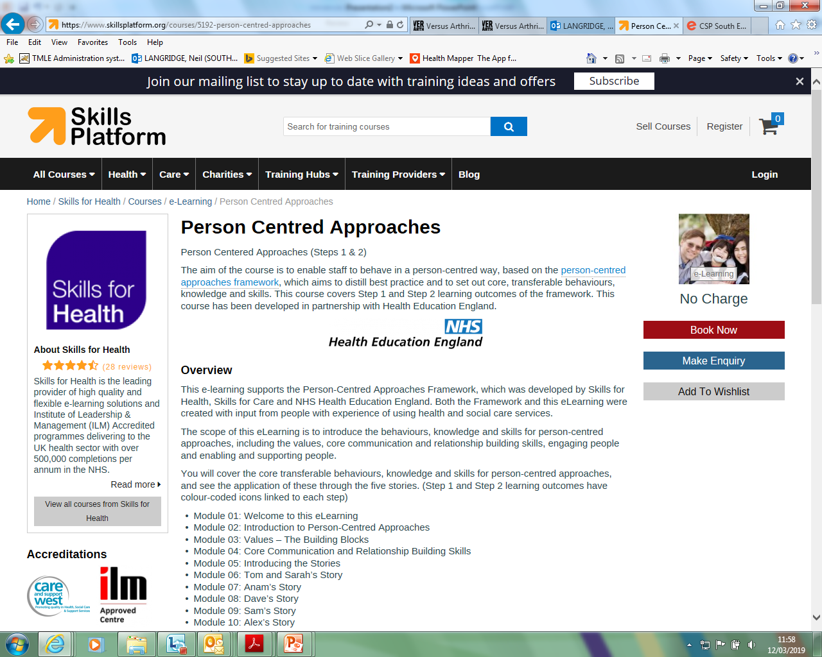

Slide 14
FCP programme
First Contact
1)Basic MSK assessment skills and knowledge -Orthopeadic management, physiology, anatomy.
2)Advanced skills - Injection therapy, radiology, independent prescribing, basic blood tests.
3)Primary care skills

Slide 15
Acknowledgements – Team!
Quality Assurance – Laura Finucane, Amanda Hensman-Crook, Matt Low, Janine Ord.
Authors – Dr Greg Warner, Dr Esther Clift, Dr Sheila Hardy, Linda Hindle, Gill Rawlinson, Amanda Hensman-Crook, Matt Low, Justin Strain, Kathryn Marcus, Sue Greenhalgh, Chris Mercer, Laura Finucane, Jack March, Dave Baker
PCA – Petrea Fagan , Anya Iongh

Slide 16
Content
What is primary care? What are its challenges and how should these be addressed?
The unwell and physically at-risk patient - identification and interventions Frailty- identification and interventions
Identification, decision-making and early management of mental health in primary care
Clinical Decision Making in time limited contexts managing multi-morbidity and complexity
Public health Practice in Primary Care
Psychology and pain management strategies in the assessment and treatment of persistent pain
Overview of Medicines and Prescribing – Physiotherapists working in Primary Care
Overview of Serious pathology masquerading as musculoskeletal conditions and Inflammatory Joint Conditions (axial and peripheral).

Slide 17
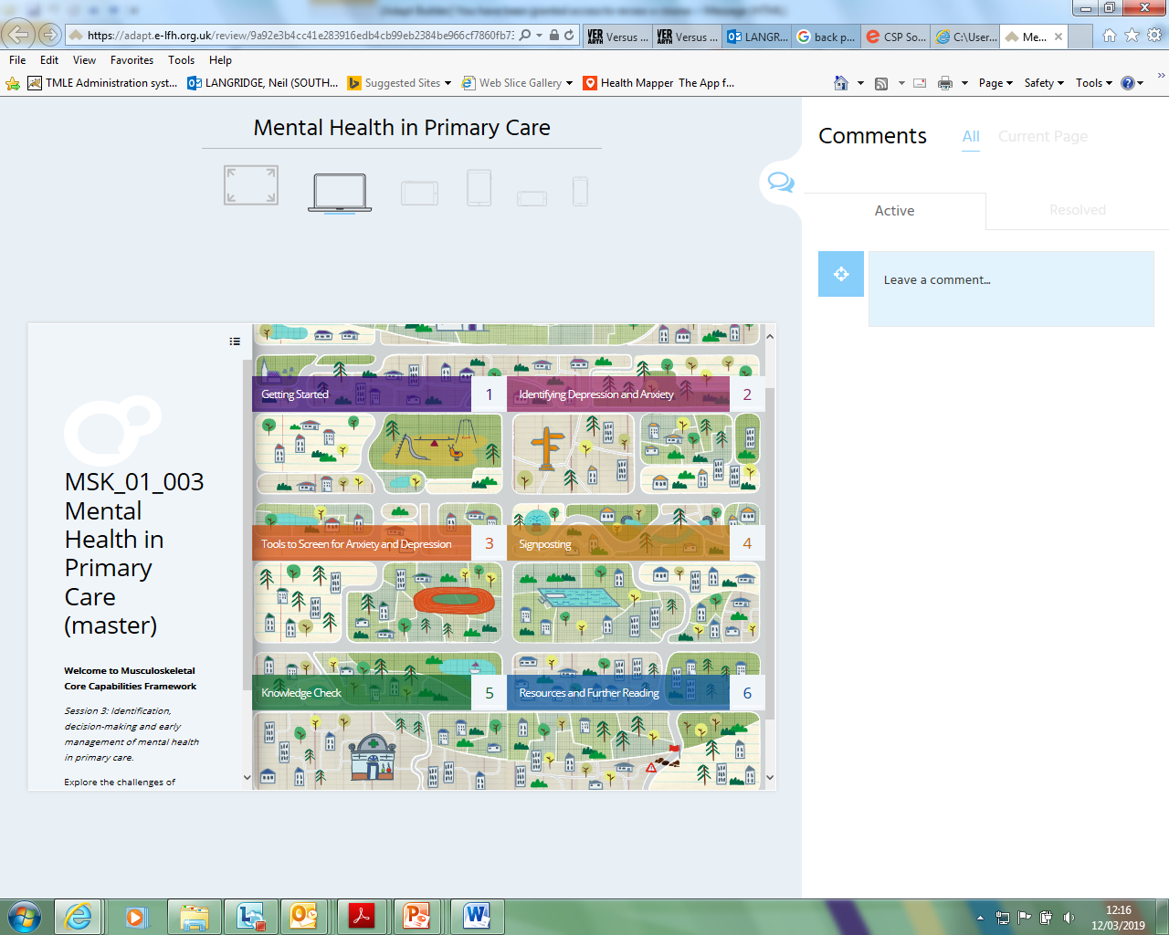

Slide 18
Presentation Components – Yes/No
What are the symptoms?
Here, you will be presented with symptoms that may or may not indicate depression. Decide if they are true diagnostic symptoms.
Instruction: Select Yes or No for each one. This is a quick fire round lasting 90 seconds. Select Start to begin.
Time to complete question (secs)
90
State how many attempts required
2
Disable yes/no icons
n
Button text
Yes
No

Slide 19



Presentation Components – Yes/No – images page
Symptoms
Little interest or pleasure in doing things
Feeling down, depressed, or hopeless
Trouble falling or staying asleep, or sleeping too much
Correct e.g. y/n?
y
Correct e.g. y/n?
Y
Correct e.g. y/n?
y
Little interest or pleasure in doing things is one of the nine diagnostic symptoms of depression (American Psychiatric Association 2013)
Feeling down, depressed, or hopeless is one of the nine diagnostic symptoms of depression (American Psychiatric Association 2013)
Trouble falling or staying asleep, or sleeping too much is one of the nine diagnostic symptoms of depression (American Psychiatric Association 2013)

Slide 20

"The skills, knowledge and attributes needed as a first contact physiotherapist in musculoskeletal healthcare." Langridge 2019 in press
Themes
Medical assessment and systems knowledge
Speed of thought in an uncertain environment
Breadth of Knowledge
People and communication skills
Common-sense/simplify
Responsibility and experience

Slide 21
HEE Project ACP implementation
Large NHS Trust
Review of current practice
Significant concern regarding;
Title
Three pillars (non-clinical)
Outcome will be to establish HEI/NHS Trusts Links to supplement the gaps.

Slide 22
How to link FCP with ACP.
Service implementation.
Service evaluation.
Service education of clinicians, service users, stakeholders.
Service leadership.

Slide 23
ACP/FCP
Previous experience- HEI accreditation
Previous MSc Modules –APEL
Work-based accreditation – portfolio
MSc Modules
E-learning

Slide 24
Interaction of Roles
Academy of ACP –Level of practice
Register of FCP – Specialism of practice

Slide 25
The Future?
ACP - Academy
Consultant -Academy
FCP – specialism MSK, Frailty, neuro, respiratory
Strong – clear career guidelines
Strong work-based evaluation linking with HEI.
This is a starting point to a new generation of accreditation.

Slide 26
Many thanks for the invitation.
Neil.langridge@southernhealth.nhs.uk

