Slide 1
Opportunities for
development
MSK and beyond
Sarah Withers
Head of FCP Implementation, CSP
#FirstContactPhysio

Slide 2
What opportunities do the NHSE GP Contract and Long Term Plan offer?

Slide 3
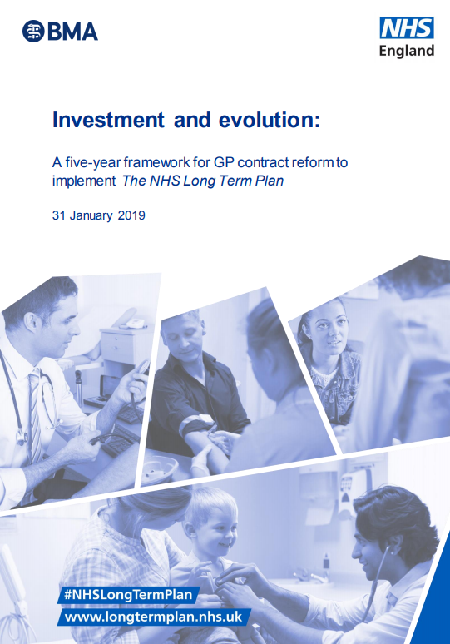
Five year framework for GP contract reform
The Framework announces the new Additional Roles Reimbursement Scheme, which will create 20,000+ new posts in general practices by 2024. These will include:
  first contact physios
  clinical pharmacists
  social prescribing link workers
  physician associates
  first contact community paramedics.

Slide 4
What are Primary Care Networks (PCNs) and why are they being developed?
General practices across England will form into PCNs. These groups of practices will share decision-making responsibilities.
Each PCN will cover a patient population of 30,000-50,000.
They are intended to facilitate the development of more proactive and coordinated primary and community care services.
This model builds on existing NHS initiatives, such as multi-specialty community provider vanguards and the Primary Care Home.

Slide 5
When will this happen?
By 2024, an average PCN will have access to funding for 3 FCPs, 5 clinical pharmacists, 3 link workers, 2 physicians associates and 1 community paramedic. (However, the framework grants flexibility to PCNs to determine the staff mix of the Scheme-funded team.)
From 2020, each PCN will be allocated a single maximum reimbursement sum to freely employ any combination of these 5 roles
The Framework states reimbursement will only be made available for demonstrably new roles (including staff replacements due to turnover in later years of the scheme).

Slide 6
How will this impact the employment of FCPs?
NHSE anticipates that FCPs will be employed on terms equivalent to NHS Agenda for Change Bands 7-8a through the scheme.
The Framework agreement leaves it to PCNs to decide how new roles are employed. Options include, for example, FCPs being directly employed by a lead practice or GP federation, or commissioned by way of a NHS community trust.
The CSP, BMA and RCGP recommend the latter option (that FCPs are employed by existing providers of NHS services).

Slide 7
What opportunities does the Framework offer other physio services?
PCNs are expected to play a key role in the transformation of community health services (as described in the Long Term Plan). NHS community providers are being asked to configure their community teams on PCNs’ footprints from July 2019.
Integrated Care Systems required to cover all of England by 2021 – will be expected to develop comprehensive anticipatory care services, such as proactive case finding for patients’ moderate frailty risk (commissioned by CCGs directly from PCNs).
PCNs’ multi-disciplinary teams will likewise be expected to contribute to the redesign of urgent response and reablement services, with general practices’ core funding tied to this participation.

Slide 8
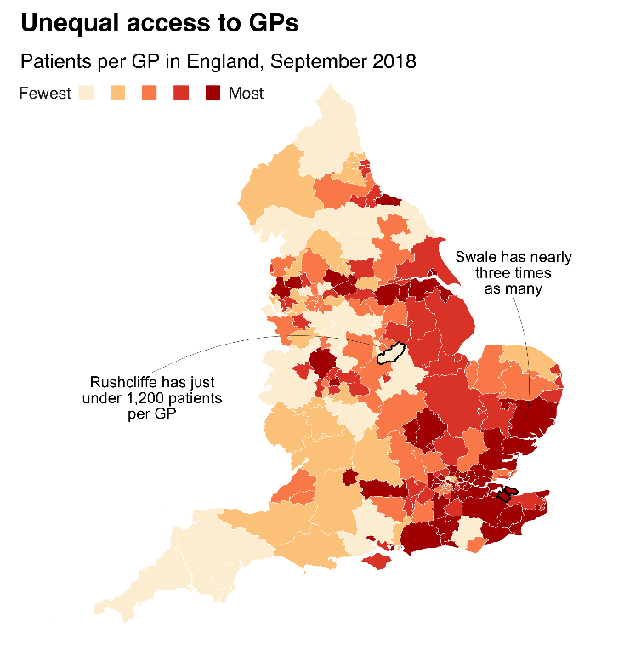

What does your community need (now and in the future)?

Slide 9
Principles of FCP
brings expertise to the beginning of the pathway
Improves access to patients for effective treatment
Reduces GP workload/ duplication
Improved use of medication/ diagnostics
Reduces inappropriate onward referral or admission
Where else can we apply these principles?

Slide 10
Example of a FCP led MDT Frailty clinic (pilot)

Slide 11
‘Bounce Back’ clinics: a multi-disciplinary service in primary care
(led by Amanda Hensman-Crook and team)
Referrals came from:
  GPs
  Patients discharged from hospital following a fall (identified by ICC Admin)
  Patients identified by Age UK community workers
  Community care navigators
  Community service providers
  Acute trust staff
  Primary care health care providers
  Self- referral
  Relatives or carers (with the patient’s consent)
Grange & Lakes Integrated Care Community (ICC) in Cumbria ran a pilot ‘Bounce Back’ Falls Prevention Clinic in Primary Care funded by Gainshare
The pilot ran over 12 months (November 2017 - October 2018)
The clinics served 9 GP practices (via 3 hubs)
The clinics were led by the First Contact Physio and involved Pharmacy, Nursing and Third Sector (Age UK)
Remit: reduce risk of falls & hospital admissions in target population
Target population: those with confidence loss pre-falls; those who have just started falling; regular fallers (within ‘mild’ / ‘moderate’ frailty category)

Slide 12
‘Bounce Back’ clinics: a multi-disciplinary service in primary care
(led by Amanda Hensman-Crook and team)
Outcome measures
Clinic capacity
Source of referral into clinic
Electronic Frailty Index (Efi)
Confbal scores
Edmonton Scores
Referral to community/core physiotherapy services
Number of interventions from the case management team
Number of individual interventions (case management team)
Age UK referrals
Number of hypo/hypertensive patients identified
Number of Irregular heart- beats identified
Body temperature increased
Patient satisfaction
During the pilot:
142 patients attended clinics with 57 (40%) attending a review appointment at 12 weeks. (117 of the referrals came via GPs.)

Slide 13

Examples of other early intervention services in Primary Care

Slide 14
Services in Wales - occupational therapy
South Pembrokeshire and Merthyr & Cynon cluster : OT staff working with patients with Frailty providing early intervention to expertise which is reducing admission and GP contacts
Ceredigion and Llanelli: OT staff focussing on patients with Mental Health conditions reducing secondary care admissions and GP demand
Taf/Tywi cluster: OT & PT support worker who acts as conduit between the practices and community resource team. Addresses low level physical needs, i.e. equipment and minor adaptations, speedier access to appropriate care

Slide 15
OT in Wales
Neath Port Talbot: Pathway development focussed on patients with fibromyalgia, ME, Chronic Fatigue Syndrome. Aims to reduce medication use, GP visits and improve functional outcomes. Introduced direct referral from primary care to OT which eliminates a secondary care Rheumatology referral in order to access OT.

Slide 16
Principles of FCP
brings expertise to the beginning of the pathway
Improves access to patients for effective treatment
Reduces GP workload/ duplication
Improved use of medication/ diagnostics
Reduces inappropriate onward referral or admission
Where else can we apply these principles?

Slide 17
Effective-ness
Safety
Sustainability
Safety
Skills
Resources
Sustainability
Funding
Future workforce
Effectiveness
Patient & public expectations
Practice teams
Evaluation

Slide 18
Challenges and opportunities…
Implementation
FCP models beyond MSK
e.g. frailty, self-care advice for people with chronic obstructive pulmonary disease (COPD) and/or other long-term conditions
Workforce
Sustainable FCP workforce supply
Professional development opportunities to sustain the FCP pipeline and build workforce capacity

Slide 19
If you were developing services in Primary Care in a similar First Contact/early intervention model what would be the greatest challenge ?

Slide 20

Thank you

