Slide 1
First Contact Physiotherapy:
the national scene
Sarah Withers
Head of FCP Implementation, the CSP
@sarahwithers20
#FirstContactPhysio

Slide 2
First Contact Physiotherapy
What it is…
Expert Practice accessed in the same way as a GP
With access to other services and adjuncts as the GP team
With a focus on self management, community and social interventions to improve outcomes
High impact on improving many patients' care and the health care system

Slide 3
First Contact Physiotherapy
What it isn’t…
Fast track or self referral
A triage service
Primarily early input to physiotherapy advice
Some impact on improving some patients’ care and MSK services

Slide 4
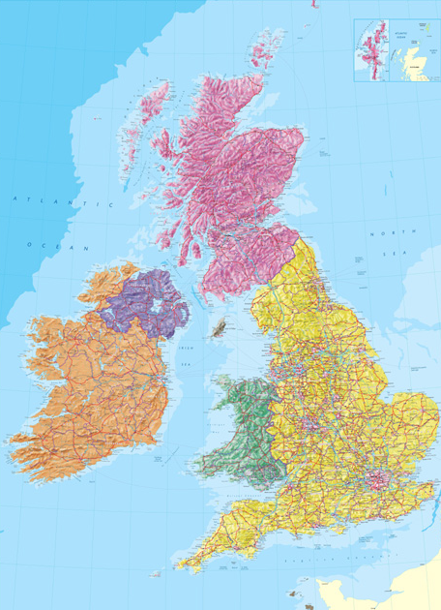

National Context - Background
By 2017, about quarter of all CCGs had commissioned
at least one pilot FCP – but mainly small scale
In 2018, NHS England recommended that MSK pathways
include FCPs - and instigated large scale pilots
In 2019, NHS England published its Long Term Plan
- this endorsed the pilots and requiring the roll out of FCPs
in all local delivery plans.

Slide 5

Challenges across the UK
Implementation & sustainable funding
Workforce
Evaluation

Slide 6


FCPs within Primary Care: areas to consider
Local
Context
Provide diagnosis
Give patient advice and exercises – self-care
Discuss Fitness for work
Prescribe Medication
Give Injection therapy
Undertake Social prescribing
Give Physical activity advice
Operational processes
…so fewer steps and on the right path from the start
Person with MSK
condition booked in by receptionist to see FCP
In one session FCP will…
Knowledge
Knowledge
If needed:
Refer for course of physio treatment
Triage for orthopaedics
/rheumatology/ pain
Order investigations
Operational processes
Local
context

Slide 7



Resources @ csp.org.uk/fcp
Implementation guidance for FCPs in General Practice
(developed by the CSP with the BMA and the RCGP)
Data collection guidance (and templates for Emis,
SystmOne & Vision)
Think Physio for Primary Care policy briefing
Job description example
Videos of FCP services (from HEE)
Calculator for estimating potential savings of FCP
Frequently Asked Questions on FCP
Case studies at innovations.csp.org.uk

Slide 8
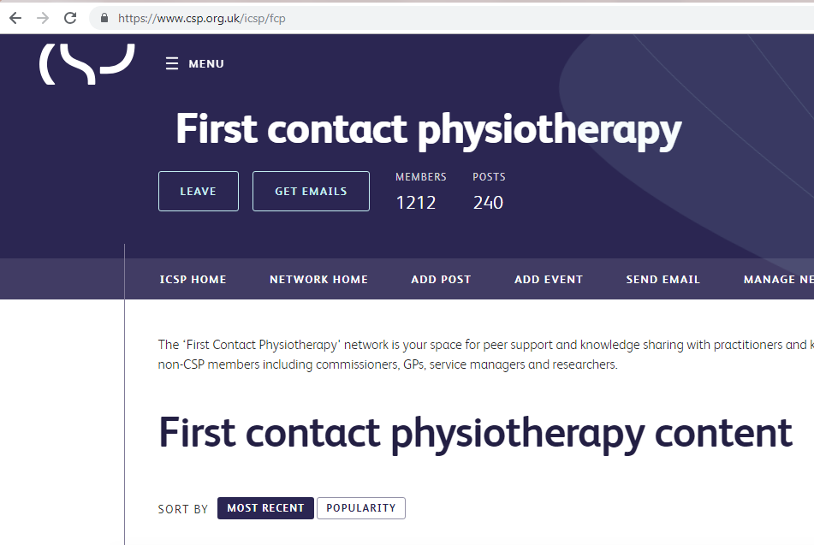
Support available
Join the growing FCP network www.csp.org.uk/icsp/fcp
or email fcp@csp.org.uk
Sign up to the twice monthly bulletin by clicking on ‘Get Emails’
Have a question or something to share? Post to start a discussion.

Slide 9
Growth in supply
41% increase in physiotherapy pre registration university places in England, 2015/16-2018/19
30% increase in university programmes in England through expansion of existing courses and new providers entering the market in same period
Low attrition rates - 2.2% first year attrition for 2016/17
High translation to practice - 90% of recent graduates reporting having moved into physiotherapist roles after 6 months
Physio Degree Apprenticeship is also now ready for delivery at both BSc(Hons) and MSc level

Slide 10


Advanced practice and FCP
The GP Contract Framework supports employing advanced physios at B7 & B8a who have the advanced skills and knowledge to:
  clinically assess, diagnose, treat and manage undifferentiated caseloads
  prescribe and administer therapeutic injections
  manage high-level risk and complexity
At present: around 9000 physios at B7 and above are
employed by NHS providers in England
The MSK Core Capabilities Framework should be consistent
with the clinical pillar for Advanced Clinical Practice

Slide 11
Solutions to meet the mix of needs?
Align with broader plans for recognition
Self-/peer-/employer-based assessment
Modules/e-learning support/ mentoring
Use of existing/emerging provision & models (e.g. the ACP apprenticeship)
Optimise MDT CPD opportunities / facilitate communities of practice

Slide 12
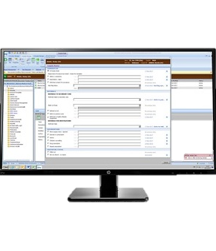
Evaluating impact
NHS England evaluation of FCP
Last summer: 41 out of 42 STPs put forward an existing or forthcoming FCP service for the evaluation. Cited in LTP in January 2019.
Phase 1: provided local context (re: services’ funding, governance, staffing, providers, etc)
Phase 2: collation of appointment data captured on practices’ clinical data systems

Slide 13
Key success outcomes
Maintaining safety
Improved access for patients to the musculoskeletal services as required
Improved GP capacity for other caseloads
Fewer inappropriate secondary care referrals
Improved conversion rates to surgery
Fewer inappropriate MRIs & X-rays
Reduced prescribing rates and costs
Fewer re-referrals for the same condition
Increased (and speedier) returns to work through issue of AHP Fitness for Work Reports
Improved patient self-care through supporting of self-management programmes and social prescribing
Improved ‘wellness’ healthy living message from FCP
Improved patient & staff experience

Slide 14
Evaluating impact
Phase 3: Demonstration of outcome and experience for patients (including PROMs and PREMs), GPs and physiotherapists.
Consists of:
  Stakeholder consultation to agree on service aims and success criteria.
  Online follow-up questionnaires post FCP consultation
  Interviews and focus groups with healthcare professionals and patients
Later in 2019 > Phase 3 opens to all qualifying FCP services across the UK

Slide 15
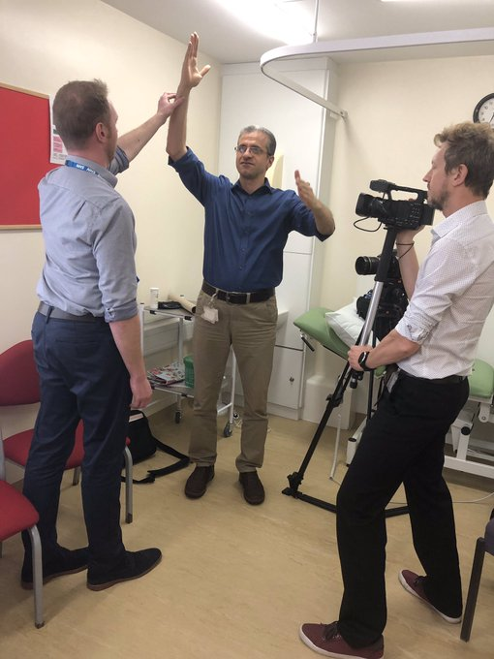
Fly the FCP flag!
Raise the profile of your FCP service locally and regionally
Promote your service on your website & social media
(photos and video can help to make an impact)
Talk to your local media (the CSP press team can help)
Invite your local MP for a service visit
Submit an abstract to the CSP’s Physiotherapy UK
conference & share a case study on the
Innovations website
More ideas are in the FCP Promotional guide in your packs
FCP service in Rotherham

