Slide 1

Sally York
Physiotherapy Lead Sussex MSK Partnership
HEE KSS Fellow 2018 - First contact Practitioners
Spine Advanced Practitioner / MACP
Currently establishing services in Crawley, Horsham and Mid Sussex
@sallythinks
#Firstcontactphysio

Slide 2
What are the differences in roles within our profession?
What do GPs think of the FCP roles in our region?
What different models do we have locally?
How have I established the roles in Sussex?
What’s ahead?

Slide 3
What’s the difference between a Physiotherapist, Advanced Practitioner and a First contact practitioner?

Slide 4
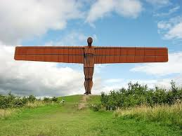
Advanced Practice Physiotherapist

Slide 5
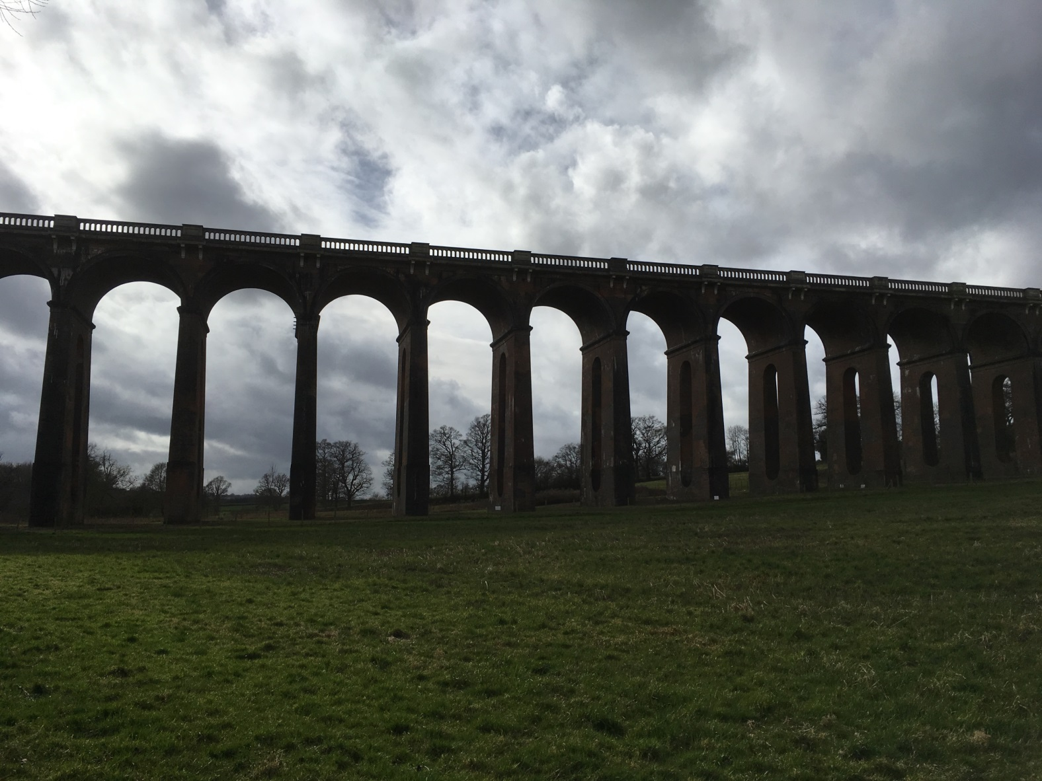
First Contact Practitioner

Slide 6
GP Survey
The aim of this project was to scope the use of FCPs within primary care in KSS, to explore the views of our GPs and key stakeholders of these roles and to raise awareness of these roles within Primary care.
The survey was done through 1:1 interviews, questionnaires through the CCGs and Survey Monkey, we had over 100 responses.
The Key themes covered:
Advantages and disadvantages
Competency required
Employment, funding and governance arrangements

Slide 7
GP Survey – Concerns raised:
“They will need training in consultation skills, eliciting the patients’ concerns, learning to manage risk and allowing time for things to get better before diving in”
“I would worry they would over investigate as dealing with uncertainty might not be their strength”
“Potential delays in seeing patients with serious pathology”
“Lack of space is an issue”
“Demand for FCP at B8a level will strip current services”

Slide 8
GP Survey Positive feedback
There was overwhelming support to introduce these posts at their practices – 80% positive, 10% negative 10% not sure or other barriers
“This is exactly the kind of initiative that really enhances patient care, promotes multidisciplinary teamwork and improves working lives. The sooner the better from my perspective”
“This is an opportunity to improve the ability to see patients at the right time, by the right person, whilst also reducing the current excessive demand on GPs”
“8-10 MSK patients each morning, who would be much better served by seeing an expert rather than a generalist.”

Slide 9
Different Models
East Surrey Pilot
Band 7 Physios
Governance through First community health & care and 1 hour mentorship with GP each week
East Sussex
Band 8A APP
Governance through GPs and Sussex MSK Partnership East
Dorking Model
Senior Private physiotherapists
Governance and training through Lead GP
Horsham & Crawley
Any requesting through duty Doctor
Radiology requests and prescriptions through GPs
Able to do Advisory fit notes
Prescriptions, radiology, bloods & Advisory fit notes through GP
Band 8A APPs
Governance through GPs and Sussex MSK Partnership
Able to request bloods, x-rays, MRIs, Advisory fit notes
Medications through GP / Duty Doctor

Slide 10
Preparation
First contact Practitioners
Patients
Practice Staff

Slide 11
Preparing for the role:
Peer support
Whatsapp
Experienced APP’s
Pharmacy teaching
Sitting with GPs
Mentorship Amanda Hensmen-Crook

Slide 12
Ongoing teaching program:
Reflective practice
Basic observations / abdominal palpation / the unwell patient
Lumps and bumps
Dermatology
Mental health

Slide 13
The Practice
Doctors
Patient Participation Groups
Admin reception teams

Slide 14
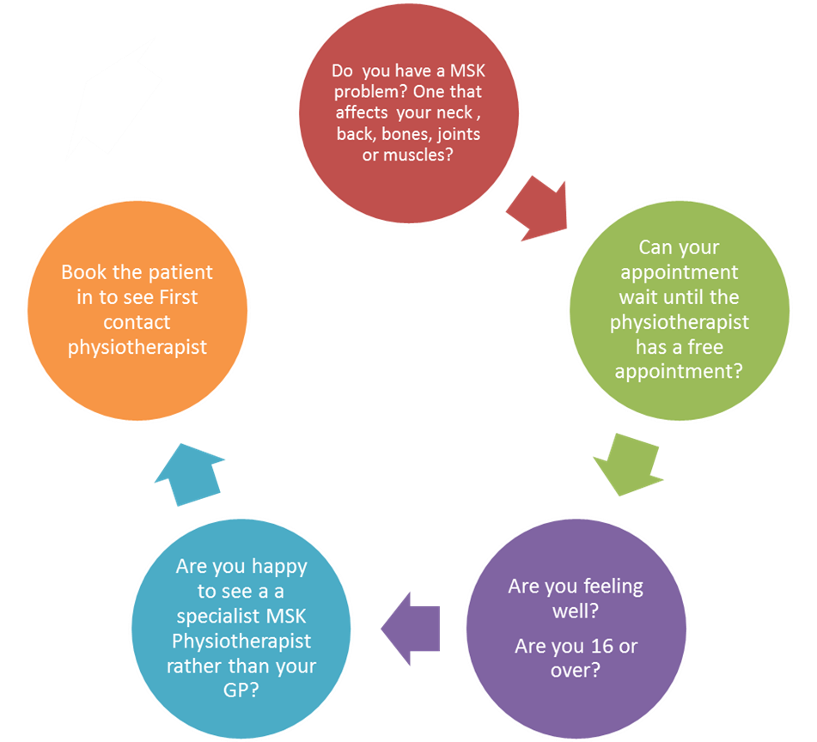
Make friends with the reception team and the practice manager– they are your allies!

Slide 15
Patient participation Groups
Get input, feedback and buy in from your patient groups
eg: “Specialist Physiotherapist”
How do we communicate with patients to upsell this idea?
Answer machine
Website
Twitter
Posters
Leaflets

Slide 16
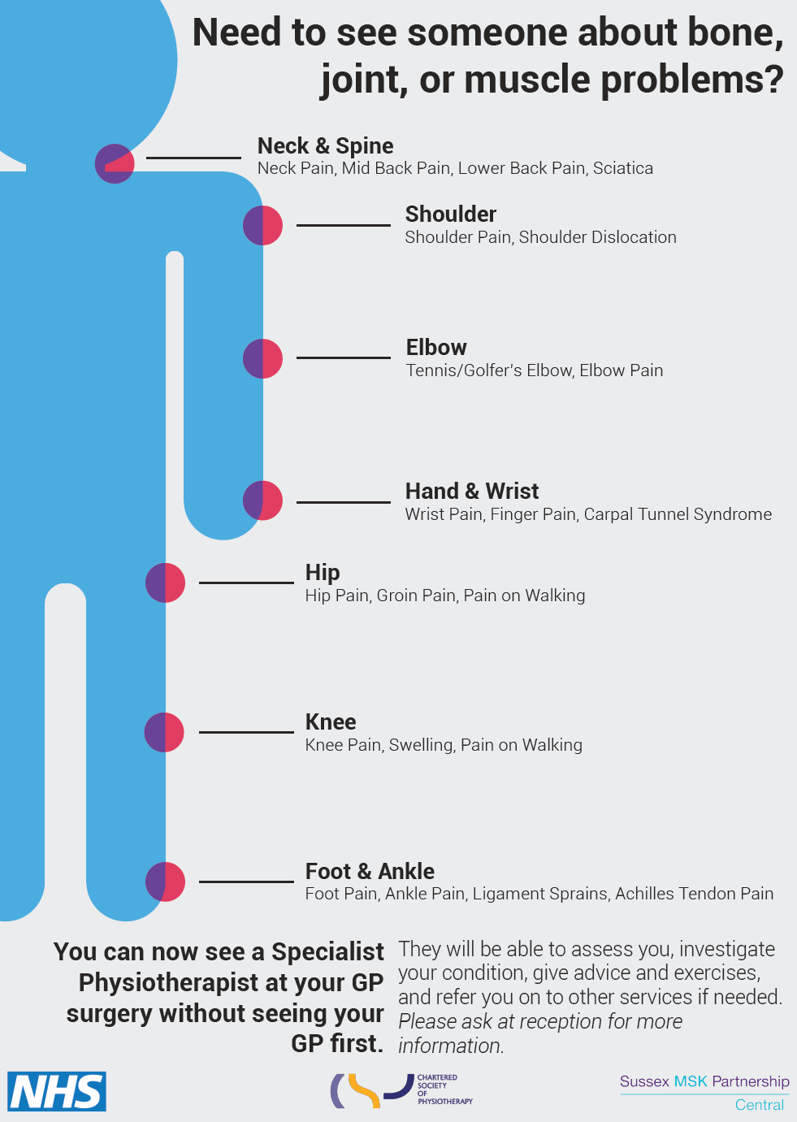

Slide 17


Slide 18

Doctors
Attend practice meetings
Be aware 80% of them will be in favour – it’s all about building trust
GP Registrars ST-3 Buddy scheme / Upskilling Primary Care

Slide 19
Data to date:
Number of patients seen | New Patients | F/U Appts | DNA | Investigations | Outcome %
100 | 97 | 3 | 10 | X-rays 5 MRI 1 | Discharged 66% Physio self-referral 23% MSK ICATS 8% Follow ups 4% Return to GP 1%

Slide 20
Patient feedback
Measure | Score
Involved in decisions about their care (1-10) | 9.8
Family and friends recommendation | 100%
Did you have enough information about the service? | 83%
Average satisfaction score (1-10) | 9.8
Invaluable service especially as a follow up to injury
Good service to have via the surgery – I do hope it is retained
Thought it was brilliant

Slide 21
Case Studies:
Knee Injection | Red Flag
Male early 40s with knee pain X-ray confirms early OA Knee Referred by GP for steroid injection O/E mild wasting quads Shared decision making Patient chose not to have injection but engage with rehab change Feedback to GP | Male early 60s with thoracic pain for 6/12 following heavy lifting O/E patient SOB, pale, struggling to mobilise Severe unrelenting thoracic pain 10 stone weight loss over the last year, but now still losing weight although not dieting Describes significant malaise and night pain Significant thoracic kyphosis Severe pain on palpation Booked to see GP at end of session Suspected metastatic disease Booked for xrays and bloods

Slide 22
Case Studies:
Hip Patient | CES
47 year old female, started running July 2018, 2-3 weeks ago 13 mile run, severe groin pain and unable to weight bear, Seen by 3 physios various diagnoses. Immediate suspicion stress # MRI requested through MSK clinic – stress fracture confirmed. Bloods requested NAD awaiting DEXA scan. NWB management started Early diagnosis in FCP clinic – fast confirmed diagnosis and management plan | GP requested quick look at their back Fallen from a recycling bin 1 week earlier Acute severe sacral area pain and bruising Lumbar flexion and SLR reproduced peroneal parathesia Need to exclude CES Admitted to A&E for MRI scan

Slide 23
The Future:
Strengths | Weaknesses
Improved access to expert and timely MSK assessment and advice Raising MSK expertise across Primary care Savings and capacity in Primary Care Improving pathways for patients No adverse clinical incidents (Keele) Recognised by the NHS Longterm plan | Need to establish high quality training routes quickly Need to align with current MSK services Need to align Primary care and community services and funding to create rotational posts therefore not deskilling Physio departments
Opportunities | Threats
Advanced clinical Practice becoming widespread within our profession Upskilling primary care Reduce costs associated with Primary care Increased number of Physio undergraduate training places | Not enough physiotherapists at the right level - 3611 FCPs anticipated Lack of mentorship opportunities Lack of space within GP Practices Aligning IT systems

