Slide 1
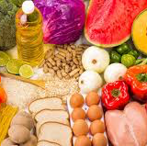
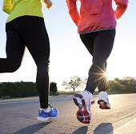
Comorbidities in MSK Health
Dr Giles Hazan
GPwSI MSK Medicine

Slide 2
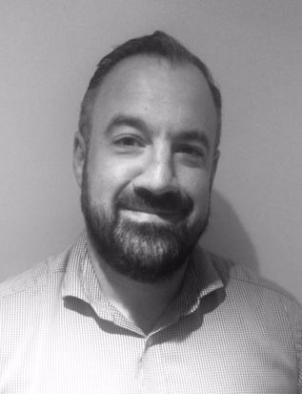



GP with extended role
  Sussex MSK Partnership Central
  Sussex Community Foundation Trust
Core skills Trainer – Versus Arthritis
Member of BASEM Education Committee
Member of Spinal Intervention Society

Slide 3
Aims
To explore comorbidities and musculoskeletal health
  Metabolic and Musculoskeletal health
To consider the role of the msk clinician in addressing them

Slide 4
Notes:
BUT tends not to be primary cause of mortality so people die with it but not because of it ?cause for not attracting the same attention

Slide 5
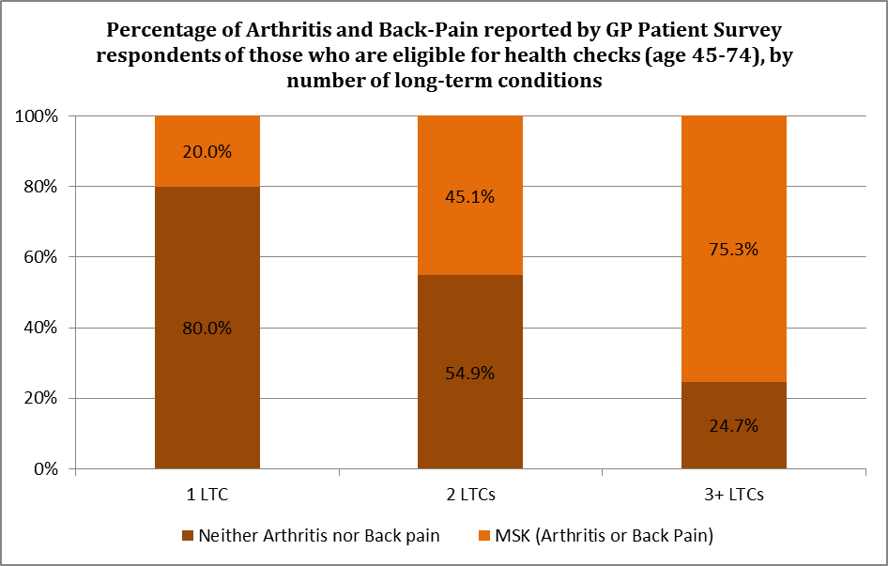
Multi-morbidity: person living with two or more long term conditions
Comorbidity: more than one issue where one condition increases the likelihood of another
Arthritis UK
Notes:
Multimorbidity as reported by respondents to the GP Patient survey. It shows that if you have 2 long term conditions then there is a 45% chance that one of them is arthritis or back pain. If you have 3 or more long-term conditions then this increases to 75% chance that one of them is arthritis or back pain. Yet the majority of people will be receiving no planned or anticipatory care for their musculoskeletal condition.
MSK LTC’s tend to have a more significant impact on morbidity and function compared to other LTCs

Slide 6
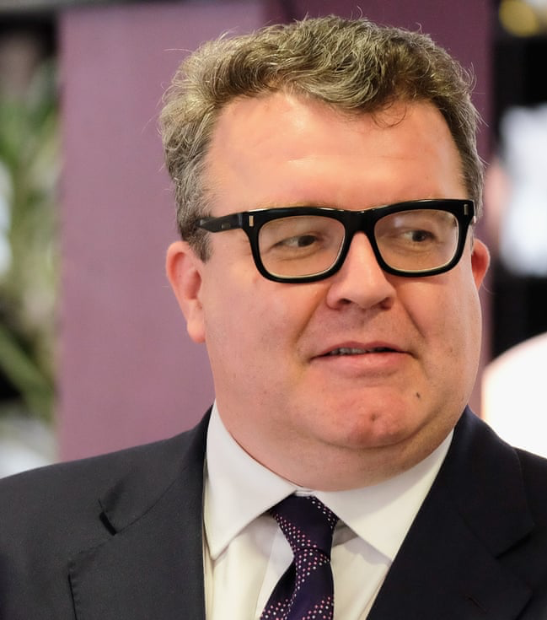
Case study in primary care - ‘Tom’
early 50’s, very busy career
new onset medial knee pain
worse after recently played squash – no mechanical symptoms
Medial joint line tenderness
Notes:
  BP: 143/92
  Lipids – triglycerides 2.1
  Type II Diabetes
  Obese

Slide 7
Thoughts?
Diagnosis?
What’s your management plan?
Contributory factors?

Slide 8
Osteoarthritis
Estimated 8.75 million people >45 years old in the UK have sought treatment for OA
60% Female 40% Male, Increased risk with age
Risk increases with BMI – overweight and obese people are 2.5 and 4.6 times more likely to develop knee arthritis compared to normal weight.
  State of musculoskeletal Health 2017 – Arthritis UK
Notes:
3rd largest area of NHS program spending
Back pain costs UK economy £1.6billion direct and £10billion indirect costs in 2000
Prescription costs for msk problems numbered 33.6million costing £223.6 million

Slide 9

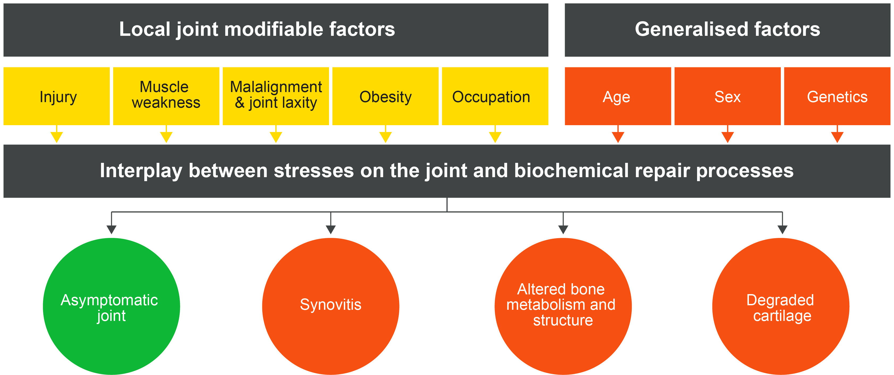
Pathogenesis of OA
Local joint factors (modifiable)
Generalised factors (nonmodifiable)
Notes:
The joints are changing over time and the body is trying to achieve an altered but asymptomatic state
We are trying to help patients achieve an asymptomatic joint by addressing modifying factors

Slide 10
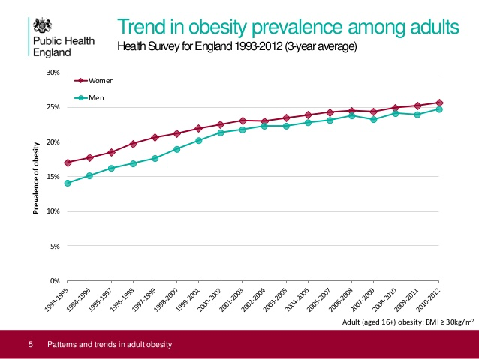

Slide 11
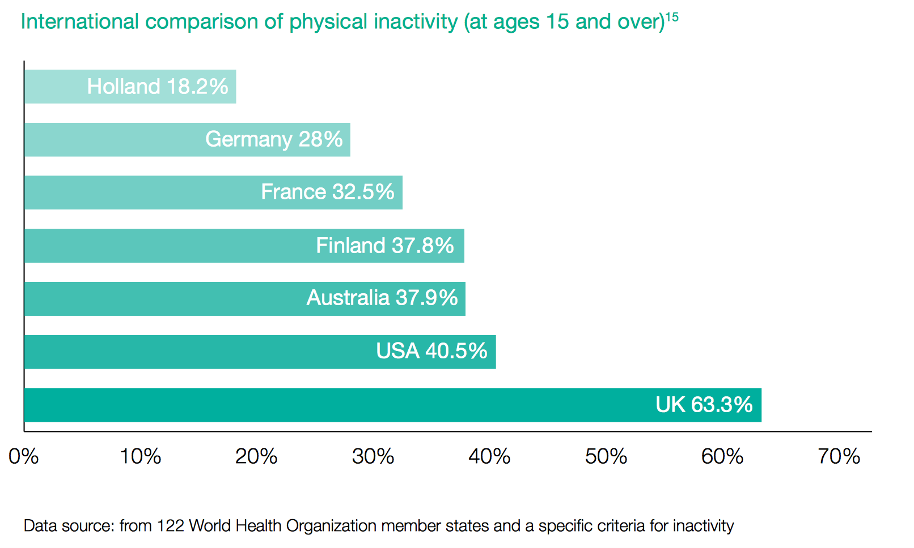
The UK - Inactivity Champions of the world
11

Slide 12
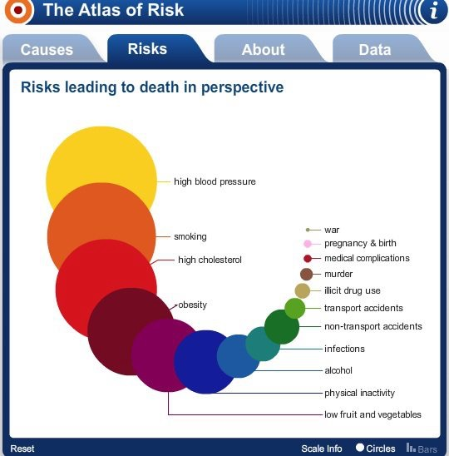

Slide 13
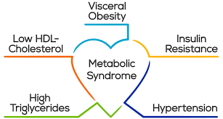
Obesity & Metabolic Syndrome
Impaired glucose regulation or diabetes
Insulin resistance
Raised arterial pressure ≥ 140/90 mm Hg
Raised plasma triglycerides (≥ 1.7 mmol/L; 150 mg/dL) and/or low HDL cholesterol (< 0.9 mmol/L, 35 mg/dL men; < 1.0 mmol/L, 39 mg/dL women)
Central obesity (males: waist to hip ratio > 0.90; females: waist to hip ratio > 0.85) and/or BMI > 30 kg/m2
Microalbuminuria (urinary albumin excretion rate ≥ 20g/min or albumin:creatinine ratio ≥ 30 mg/g)

Slide 14
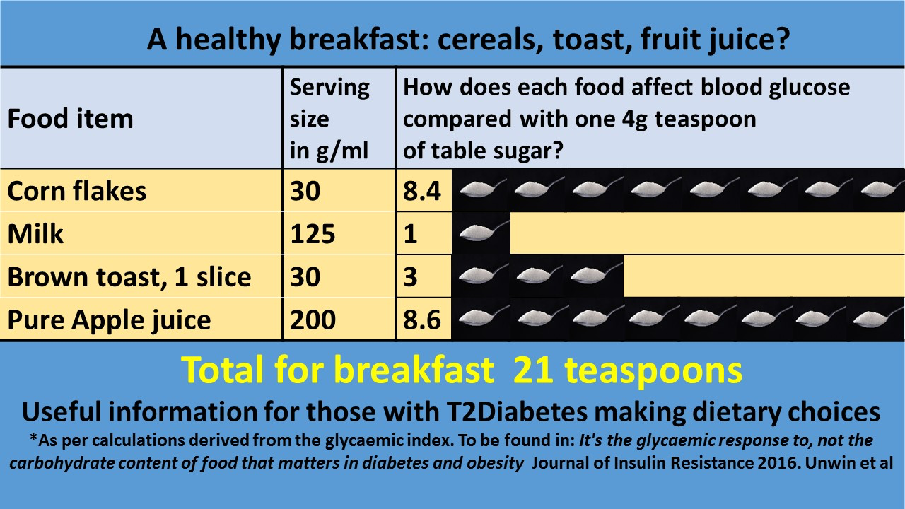
Diet
Type II Diabetes driven by excessive intake of dietary sugar
Western diet – but I eat a healthy diet??

Slide 15
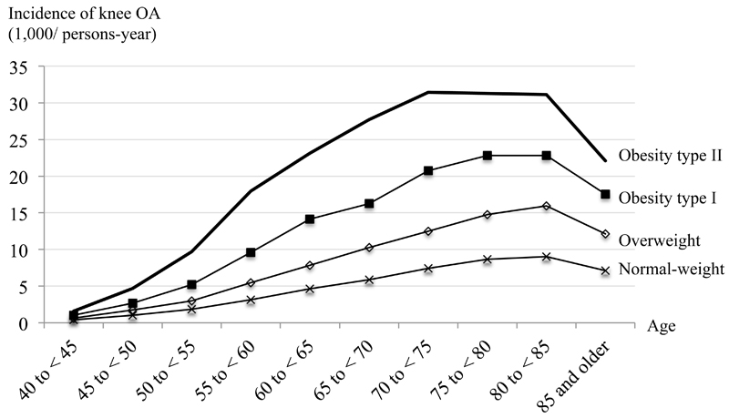
Obesity and OA - Knee
Peter Bush – University of Brighton
Notes:
Historical model of biomechanical forces through knee – overload and damage to cartilage

Slide 16
But……..

Slide 17
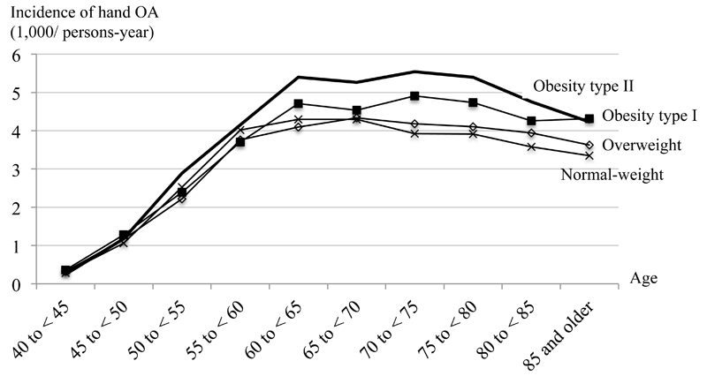
Obesity and OA - Hand
Peter Bush – University of Brighton
Notes:
Why don’t we see any ankle OA? Different rates of progression of hip and knee oa

Slide 18
Diabetes and Tendinopathy
“strong evidence that diabetes is associated with higher risk of tendonopathy….(and) may affect adherence to exercise interventions for diabetes”
Is there an association between tendinopathy and diabetes. A systematic review with meta-analysis. Ranger, t. Wong, A. Cook, J. Gaida, J. BJSM November 2015
Notes:
Meta-analysis: 31 studies

Slide 19
There’s a 17% increase in risk of developing a chronic disease (CVD, Cancer, Diabetes) if you have a musculoskeletal condition
Notes:
Causation?
Chronic inflammation
Reduced mobility
Iatrogenic – NSAIDS and increased CVD morbidity/mortality

Slide 20
Obesity & OA – a missing link?
Obesity
Diabetes
CVD
OA
Notes:
Risk factor for OA – both biomechanical and metabolic changes
Long viewed as a degenerative condition but role for low-grade inflammation in pathogenesis

Slide 21
Mechanisms
Fat is metabolically active
  White adipose tissue (WAT) is an endocrine organ secreting adipokines (Leptin, Adiponectin, Visfatin, Resistin)
Adipokine secretion causing low-grade inflammation
  Atherogenesis – causing cardiovascular disease
  Diabetogenesis
  Joint damage
    Synovial hyperplasia and low grade inflammatory infiltrates often found in synovial aspirates (Resistin –associated with cartilage defects, intra-articular injection causes OA) .
    Lipid deposition in chondrocytes induced by dyslipidaemia.
    Advanced oxidative stress to cartilage via pro-inflammatory factors and degredative enzymes
Guilak F. Biomechanical factors in osteoarthritis. Best practice & research Clinical rheumatology. 2011 Dec 1;25(6):815-23.
  Metabolic syndrome meets osteoarthritis. Qi, Z. Wei, Y, Chen, J Yan, W. Nature review Rheumatology 8 729-737, December 2012
Abella V, Scotece M, Conde J, López V, Lazzaro V, Pino J, Gómez-Reino JJ, Gualillo O. Adipokines, metabolic syndrome and rheumatic diseases. Journal of immunology research. 2014;2014.
Notes:
Intra-articular injection induces OA - Lago et al (2007) Nat Clin Prac Rheumatol 3:716-724
Resistin serum associated with cartilage defects - Wang et al (2016) Mod Rheumatol 11:1-6

Slide 22
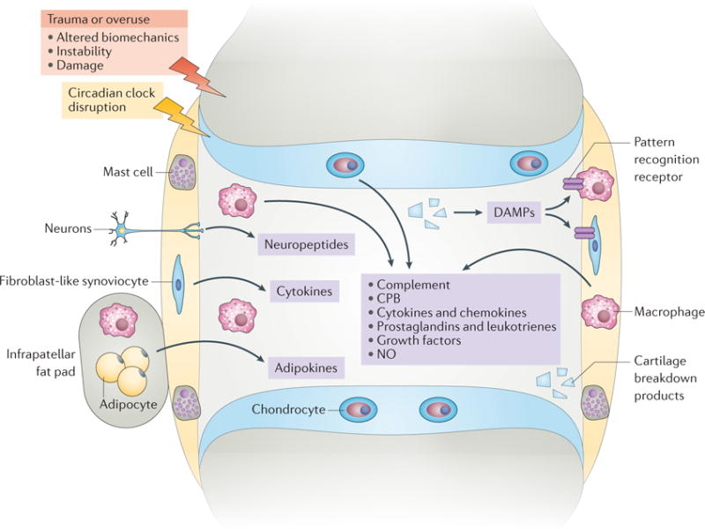
Molecular mechanisms
Robinson, W.H., Lepus, C.M., Wang, Q., Raghu, H., Mao, R., Lindstrom, T.M. and Sokolove, J., 2016. Low-grade inflammation as a key mediator of the pathogenesis of osteoarthritis. Nature Reviews Rheumatology, 12(10), p.580.

Slide 23
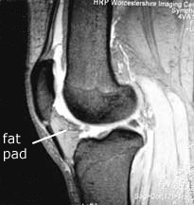
Role of the fat pad
Infrapatellar fat pad (IFP) as a potential source of cytokines
IFP tissue found to have higher rates of Il-6 compared to adipose tissue in the same patients
Implicated in local inflammation and cartilage damage
Distel, E., Cadoudal, T., Durant, S., Poignard, A., Chevalier, X. and Benelli, C., 2009. The infrapatellar fat pad in knee osteoarthritis: An important source of interleukin‐6 and its soluble receptor. Arthritis & Rheumatism: Official Journal of the American College of Rheumatology, 60(11), pp.3374-3377.

Slide 24

Circadian rhythms
Link exists between protein involved in circadian rhythms (BMAL1) to maintaining homeostasis and integrity of cartilage.
Disruption of mice circadian rhythms lead to OA like changes in knee cartilage.
Disruption of circadian clock in cartilage may contribute to diurnal variation seen in OA symptoms.
Circadian ‘clock’ in pulmonary epithelial cells seen to vary neutrophil recruitment - potentially explaining diurnal variation in symptom severity in inflammatory lung disease
Robinson, W.H., Lepus, C.M., Wang, Q., Raghu, H., Mao, R., Lindstrom, T.M. and Sokolove, J., 2016. Low-grade inflammation as a key mediator of the pathogenesis of osteoarthritis. Nature Reviews Rheumatology, 12(10), p.580.

Slide 25
The role of Microbiota

Slide 26
Cardiovascular disease and Chronic Inflammation

Slide 27
Long Term Conditions are linked to higher rates of depression (increased by 2-3 fold)
  60% rate of depression, (33% severe depression) amongst complex chronic pain patients.
Higher levels of CRP and neuro-inflammation seen on brain imaging in people with depression
Association with imbalance of neurotransmitters including serotonin, norepinephrine and dopamine
  Decreases descending inhibition
  Impaired immune function
    Increased cytokine secretion
    Dysregulation of cortisol
Notes:
Debate remains over association vs causation

Slide 28
Stress – HPA Axis
Notes:
Cortisol effects
Capacity of body to heal wounds
Impact on human behaviour: mood, appetite, sensory input perception, cognitive level
Influence on pain perception and mechanisms of its integration into memory

Slide 29
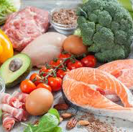


Therapeutic approaches

Slide 30
Tom – What’s our plan?
What are the…
  treatment goals?
  resources available?
  other members of the team to include?
How?
  What are his goals?
  How can we approach this?
  What language/consultation skills can we use?
  How can I manage this in 10-20 minutes?

Slide 31
A strategic approach to management
Effective listening and contextualising their symptoms based on the individual – what matters to him/her?
Multidimensional approach based on function & context
  BIO- Physical activity, sleep, mobility, managing comorbidities, lifestyle advice
  PSYCHO – Understanding, coping strategies, anxiety/depression
  SOCIAL – financial, housing, benefits, social interaction
Are they ready to change?
Patient specific goal setting – what is important to the person in front of you?
Primum non nocere - careful use of language

Slide 32

Do you actually do this?
What are the barriers to us doing this in practice?
  Time
  Knowledge
  Confidence
  Resources

Slide 33
Lifestyle advice
Smoking cessation
Alcohol reduction
Sleep
Exercise
Stress management
Diet……..
Notes:
Show of hands – who feels confident giving dietary advice – what to say? Where to find resources?

Slide 34


Slide 35
Dietary advice
To support reduction in visceral fat & reduce biomechanical load
To reduce
  joint pains
  cardiovascular risk
  insulin resistance/diabetes
  risk of developing depression/dementia(?)
How?
  Reduce sugar, processed foods (more than 5 ingredients)
  Drinks – “empty calories”
  Reduce starchy carbohydrates – bread, rice, pasta, potatoes
  Anti-inflammatory diet?
    Anthacyanins – Radish, Cherries, Beetroot & Broccoli?
    Omega-3 Fatty acids/High Fibre/Vitamin E?
Signpost

Slide 36
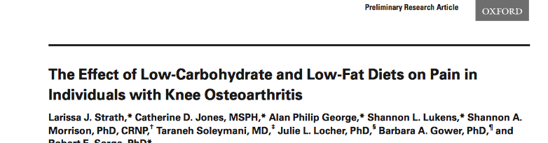
Evidence base?
Notes:
Low to moderate evidence low carbohydrate diet (<40%) yields better metabolic control than low fat in people with Type II Diabetes
Low carbohydrate diet vs low fat diet or control saw lower pain scores and serum leptin/Il 6, TNF alpha etc levels

Slide 37
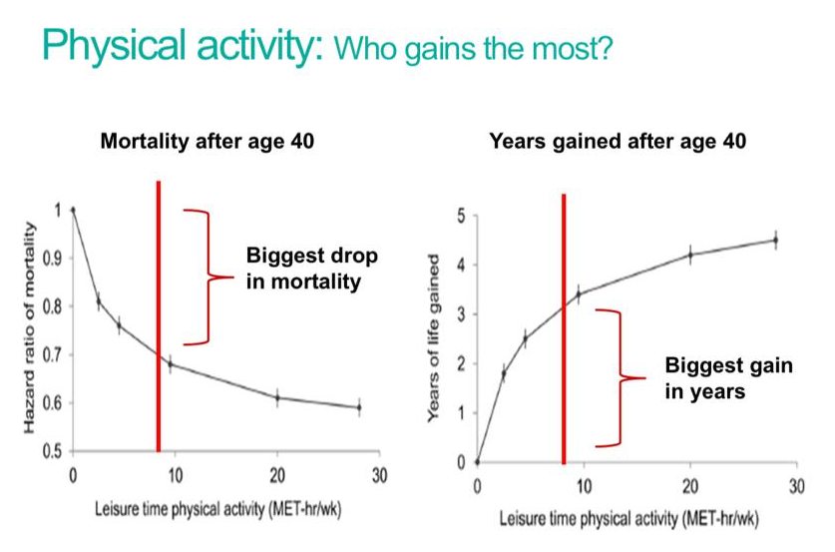
Value – lifestyle interventions
Notes:
Red bar represents approximate cut off for 150mins moderate intensity exercise (10 mets = 180mins)

Slide 38
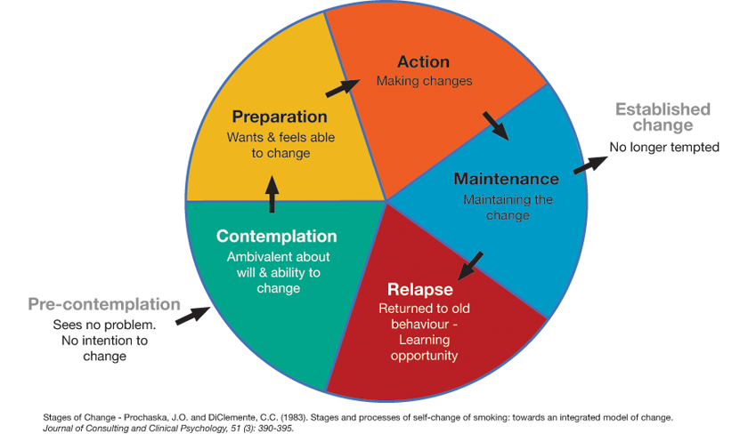
The 6 stages of behaviour change
At each stage, there are certain barriers that can make the decision of whether to change or not complicated
You can help people appreciate the benefits of positive change and encourage them to take responsibility and ownership of their decisions

Slide 39
Strategy for raising the issue
Making Every contact count to explore emotional wellbeing, consider the Four A’s:
Brief conversation (3-4 minutes max)
1
2
3
4
ASK
ADVISE
ASSESS
ASSIST
Notes:
Hover the mouse over each of the buttons to find out more

Slide 40
Ask
“Can we spend a few minutes talking about your X?
Ask...
permission to have the conversation
the client about their emotional wellbeing?
ASK
1
ADVISE
2
ASSESS
3
ASSIST
4

Slide 41
Advise
“What do you know about... already?”
Advise:
Ask what they already know about the link between their pain and their mood
How is there emotional wellbeing impacting on their lives
Ask what they already know about how low mood, anxiety can be treated
Ask permission to share information including how common mental health problems are..
Provide tailored information
ASK
1
ADVISE
2
ASSESS
3
ASSIST
4

Slide 42
Assess
Assess:
Does the client recognise a problem?
Does the client want to know more about local services that support people
  What importance do they place on this getting supporting this this, and how confident do they feel about doing it? [could rate on scale of 1-10]
  Behaviour change is most likely to occur if both importance and confidence rate high
ASK
1
ADVISE
2
ASSESS
3
ASSIST
4
“If you did decide to make a change, what might hold you back?”

Slide 43
Assist
Assist:
Signpost to an appropriate service if they would like this
Offer simple guidance, or a leaflet with further information
ASK
1
2
ADVISE
“Would you be interested in information about...?”
ASSESS
3
4
ASSIST

Slide 44
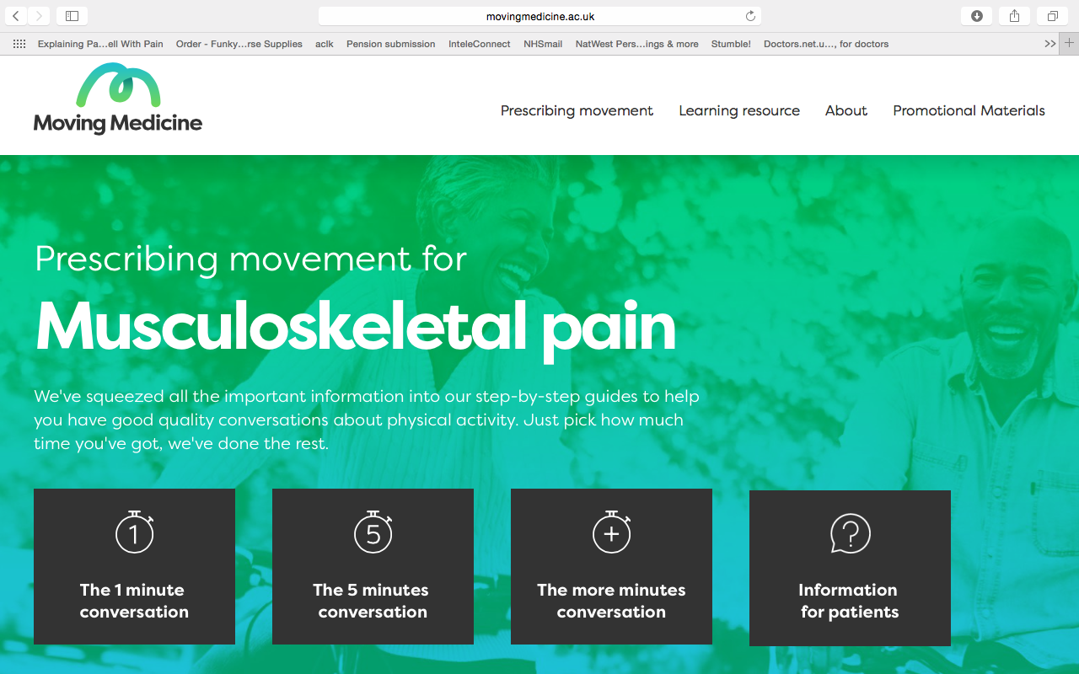

Slide 45
Multidisciplinary team management
GP
Dietician/Nutritionist
Lifestyle coaches
Practice Nurse
Physiotherapy
Gym – Strength and conditioning coaches
Community Support Teams
?Mental health support

Slide 46
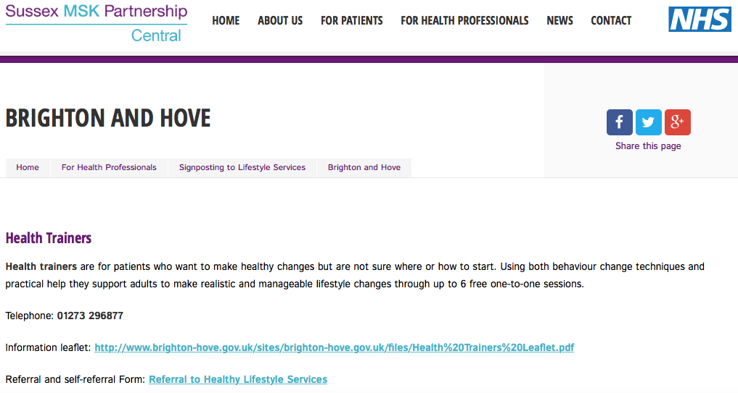
Local Resources
www.sussexmskpartnershipcentral.co.uk
Links to voluntary sector – social prescribing
  Health trainers - https://oneyoueastsussex.org.uk
  Weight Management - (The Brighton and Hove Food Partnership, Why weight)
  Gym referrals
  Brighton and Hove Wellbeing Service, Time to talk

Slide 47
National Resources
Diet/Nutrition
  www.nationalobesityforum.org.uk
  www.versusarthritis.org
  https://phcuk.org/sugar/ - downloadable infographics re sugar
  Dr Rangan Chatterjee – The Four Pillar Plan
  Dr Aseem Malhotra – The Pioppi Diet
  Zoe Harcombe - The diet fix
  www.dietdoctor.com is also good but also pro low-carb, plant-based health professionals is a good resource for vegans
  ‪The Energy Plan: Eat Smart, Feel Strong, Perform at Your Peak - James Collins
Physical activity resources
  Guide for clinicians
  www.movingmedicine.ac.uk
  https://gpcpd.walesdeanery.org/images/Motivate2Move/Busy_Doctors_brief_guide.pdf
  Advice for patients:
  https://gpcpd.walesdeanery.org/images/Motivate2Move/The_one_page_version.pdf
Videos:
  A short YouTube video to help get over some of the common excuses https://www.youtube.com/watch?v=obdd31Q9PqA
  A superb cartoon video expressing the benefits of exercise. Millions of hits, worth watching and see why. 9 min long
  http://uncrate.com/video/23-and-a-half-hours/
  Cartoon video about avoiding being so sedentary. https://www.youtube.com/watch?v=whPuRLil4c0

Slide 48
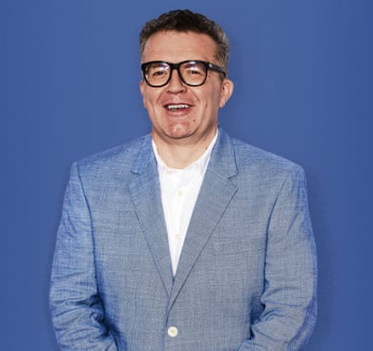
Tom Watson
Cut out refined sugars
Avoid starchy carbohydrates
Started walking 10,000 steps then gradual increase exercise
Lost 44kg
Improved sleep, energy, concentration
Blood sugars normalised and off diabetic medication

Slide 49
Take home points:
Chronic low-grade inflammation is implicated in a wide range of chronic diseases
Diet and obesity are key drivers behind chronic inflammation
Look for comorbid features such as diabetes and cardiovascular disease as a prompt to discuss lifestyle changes
Consider behavioral change techniques and motivational interviewing skills to help engage the patient.

Slide 50
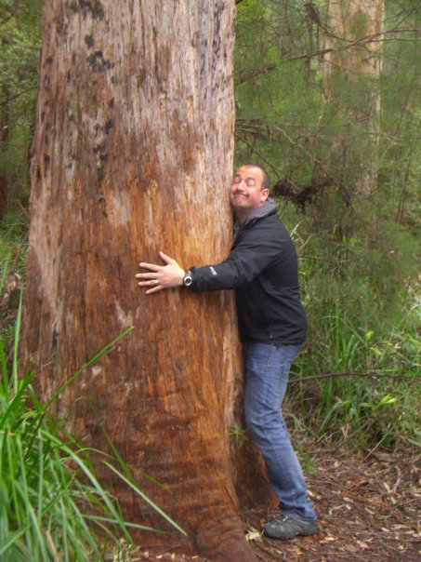
Thank you

