Slide 1


Health Coaching for Behaviour Change
West Suffolk NHS Foundation Trust
Trudi Dunn & Zoe Noble
Health Coaching Trainers
Clinical Specialist Physiotherapists
Notes:
Hi I am Zoe and this is Trudi.
Thank you for inviting us to your meeting, we are really pleased to be here to share with you the work we have been doing in health Coaching over the past 3 years.

Slide 2
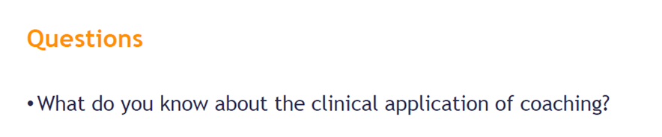
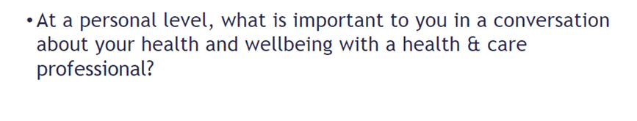


Slide 3
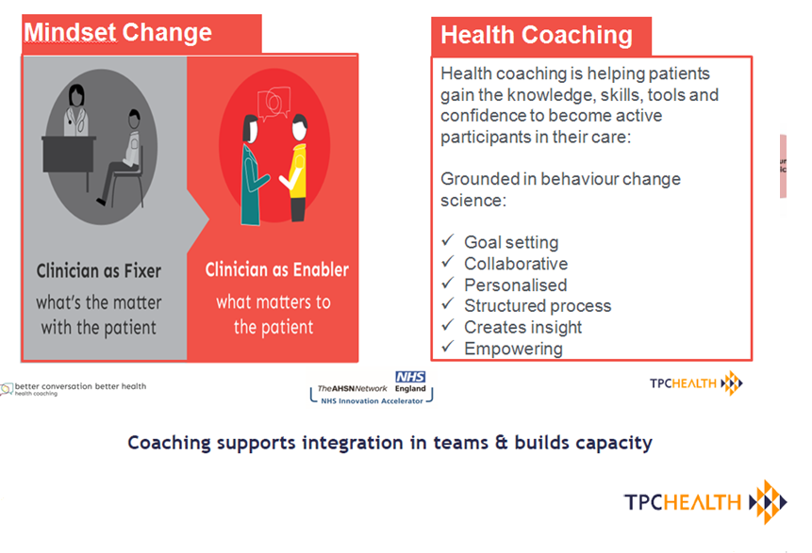

Slide 4
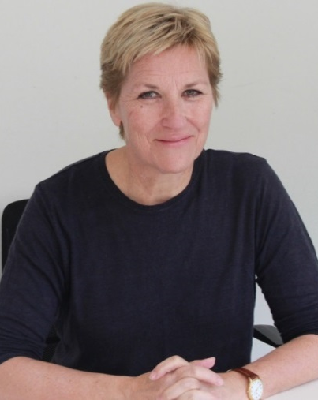
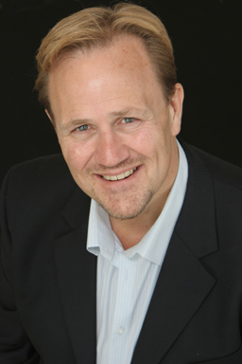




Health Coaching
#betterconversation transforms relationships and health behaviours
www.betterconversation.co.uk
@betterconvo #healthcoaching
Dr Penny Newman
NHS Innovation Accelerator Fellow
Trained in general practice and public health
Executive coach
Dr Andrew McDowell
Director, TPC Health & TPC Leadership
Psychologist, Executive Coach and Leadership professional
Previously academic specialising in the areas of health psychology and behavioural medicine
Notes:
So where has this programme come from
This programme is the work of Penny Newman and Andrew and has running since 2012. Their original project was based in the East of England and was funded by Health Education East of England. Since then it has gone from strength to strength and to date they have trained over 4000 clinicians from across the country.
During that time their work has undergone 3 independent evaluations.
In 2015 Penny was awarded an NHS England Innovation Accelerator Fellowship which is a fellowship programme designed to deliver on the commitment detailed within the five year forward view for her work in HC. Across the country HC is gaining momentum in the form of a social movement - Better conversation.
NOT SPEAK which showed that health coaching was used across all LTCs, was effective in changing behaviour including lifestyle and increased patient self-efficacy and satisfaction.

Slide 5
Clinician feedback post training
Mind set shift amongst those trained
97% strong or very strong
Likely to recommend training to others
98% likely or extremely likely
Coaching helpful for working with people with LTCs
100% agree or strongly agree
Health Coaching encourages greater responsibility & self-management
100% agree or strongly agree
47% Nurses, 44% AHPs, 7% doctors, 2% others
Notes:
At West Suffolk Hospital we have been delivering training since 2015 and to date over 275 clinicians have been trained from across the acute and community sector and we are pleased to say the feedback has been really positive.
97% of those trained have undergone a strong or very strong mindset shift
98% were likely or extremely likely to recommend to recommend training to others
100% feel HC would be useful when working with people with LTCs.
100% feel that HC would encourage greater responsibility and self-management
NOT SPEAK
research done by the Institute of Employment Studies in East of England found that 2/3 retained their skills at one year, and clinicians use it to structure difficult conversations.

Slide 6
Application of skills
Clinical Application of HC
Women's health
CHD & Cardiac rehab
Foot ulcers
Voice therapy
Discharge planning
Relaxation
Persistent pain
Obesity
Amputee rehab
COPD, asthma
↑Activity
Complex social readmission
Stress
Paediatrics
Diabetes

Slide 7
Evaluation – Benefits
Clinician feedback
6 weeks post training
↑ Empowerment
Improved communication skills
Shared decision making
Improved listening skills
Facilitating not telling
Promotes self management
↑ Motivation
↑ patient involvement
Improved patient experience
↑ confidence on discharge
↑ adherence to treatment
Notes:
So this was the feedback we received immediately after training but we also evaluated the training at a CPD session at least 6 weeks following training and we were particularly interested in this feedback as this was the feedback clinicians were receiving after they’d been using the skills in their clinical practice.
So clinicians reported benefits such as

Slide 8
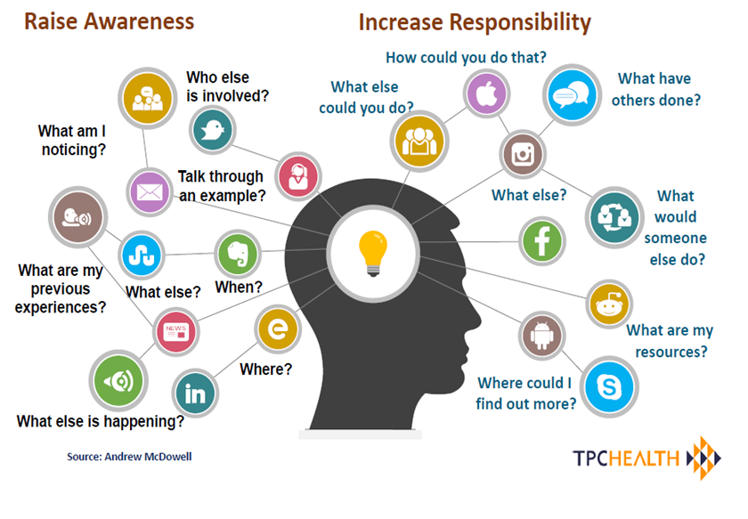

Slide 9
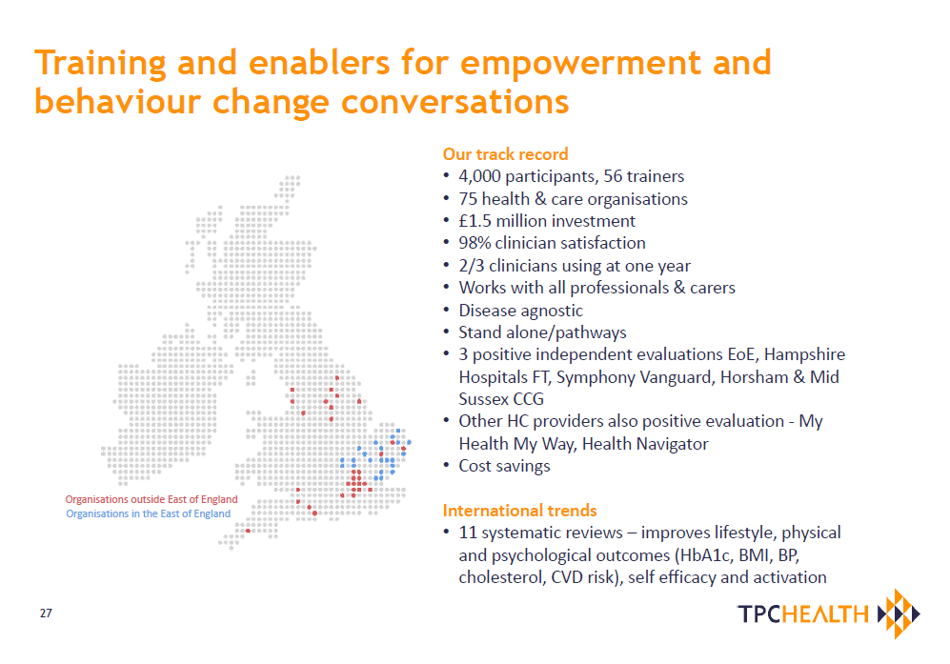
Notes:
?? National perspective

Slide 10
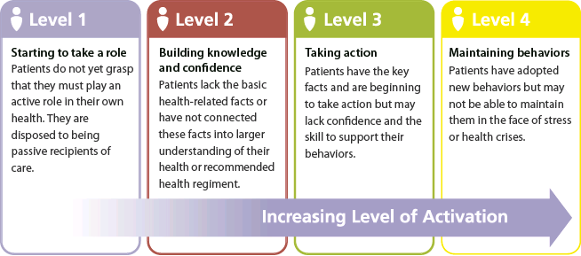
Building Activation
Source: Prof Judy Hibbard, University of Oregon (2008)
39

Slide 11
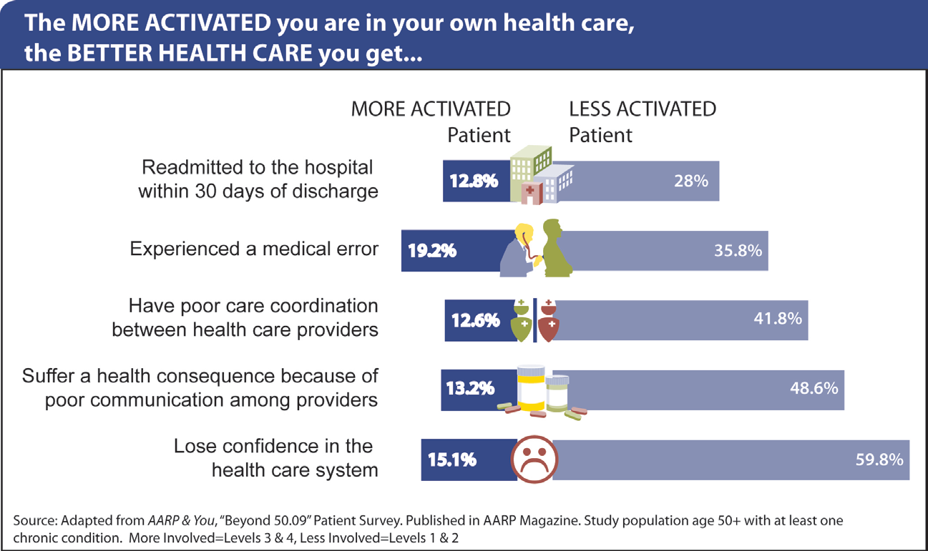
Low activation signals problems
(& opportunities)
40

Slide 12
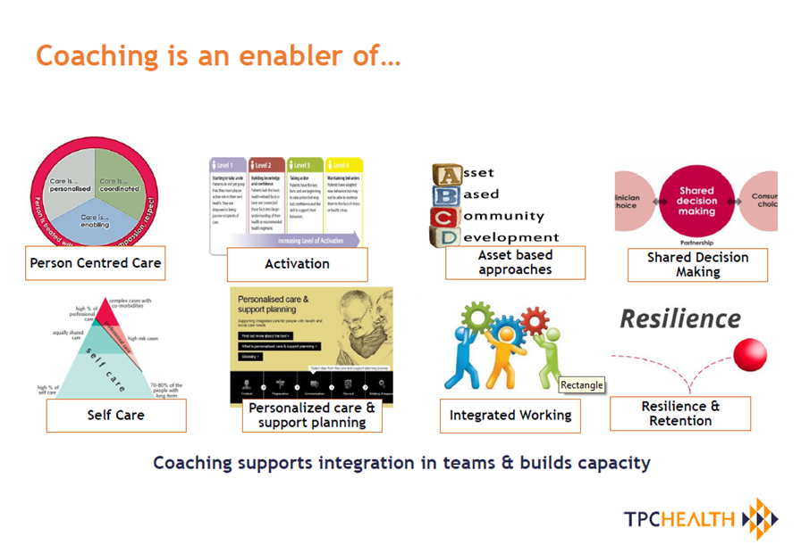
Building Activation
Source: Prof Judy Hibbard, University of Oregon (2008)
39

Slide 13
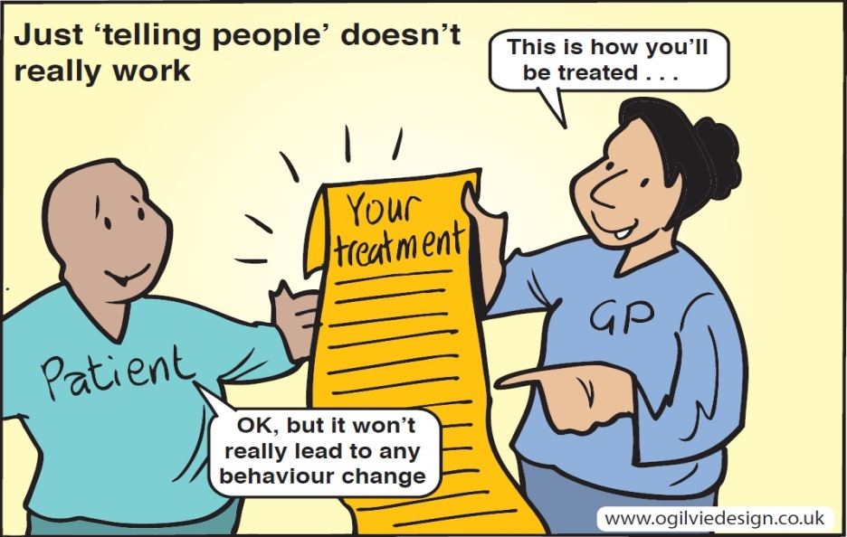
2019 Health Coaching Dates
Thurs 9th & Thurs 16th May* - West Suffolk Hospital, Education Centre
Wed 12th & Thurs 20th June - West Suffolk House, Bury St Ed’s
Wed 10th & Thurs 18th July - West Suffolk House, Bury St Ed’s
Thurs 22nd & Thurs 29th August - West Suffolk House, Bury St Ed’s
For bookings and enquiries please contact: health.coaching@wsh.nhs.uk
Notes:
Chaotic slide

Slide 14
