Slide 1

What can the CSP do for you?
The Professional Advice Service
Library Services
Influencing
Helen Harte
Professional Adviser
@Hartey_Pain PT
harteh@csp.org.uk

Slide 2
Professional Advice Service
Professional practice issues
Service design and commissioning
International working
Practice standards, values and behaviours
Policy in practice
Notes:
The Professional Advice Team aim to provide a service that provides a valuable benefit of your CSP membership. We provide professional advice and resources to support our members in their work and help us deliver the CSP mission.

Slide 3
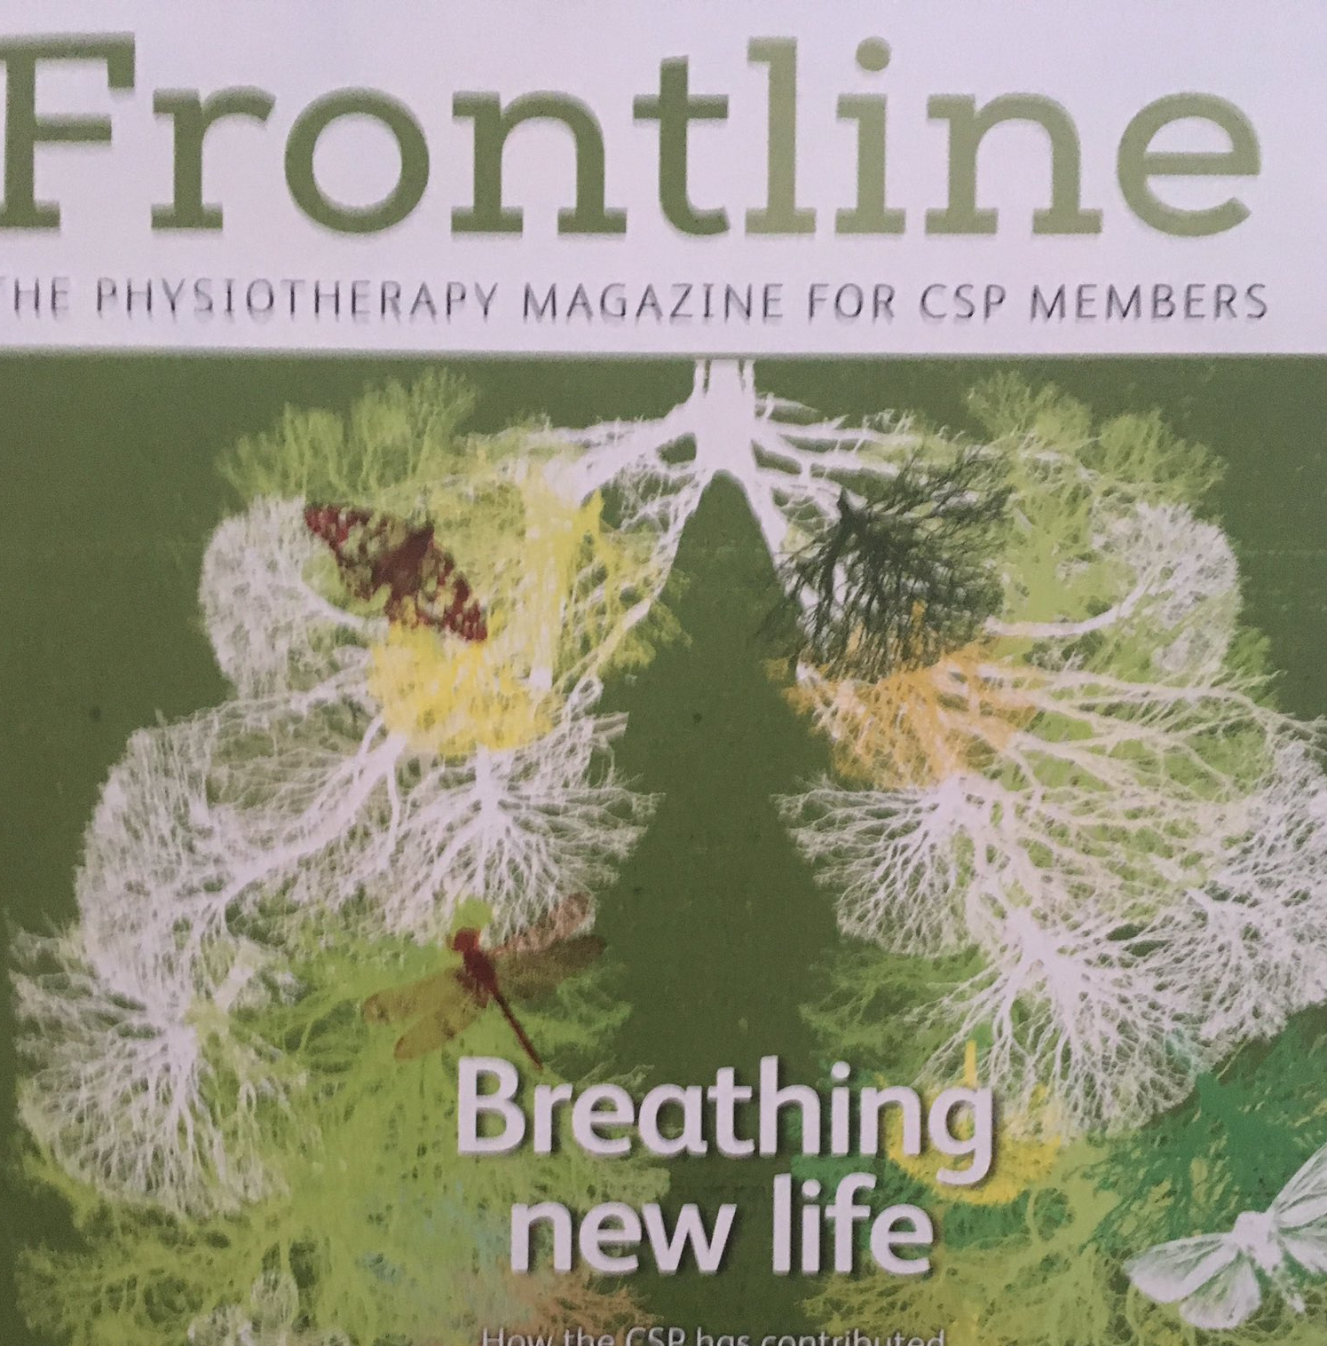
Professional Advice Service
Valuing the CSP’s professional advice
“I am happy with the support I received from the CSP’s Professional Advice Service during the last 12 months. Your advisers guided me through a very difficult situation. In addition, it was reassuring to know that I had the backing of my physiotherapy professional body.”
Karen Field
Notes:
The Professional Advice Team aim to provide a service that provides a valuable benefit of your CSP membership. We provide professional advice and resources to support our members in their work and help us deliver the CSP mission.

Slide 4
CSP Library Services
o Subscribed databases - AMED, Cinahl, Cinahl Plus, Medline and SportDiscus
o Ejournals, ebooks, e-theses
o Grey literature
o Full text articles
o Easy-to-use search function to expand, limit, filter and save your searches
o Your own personal folder – e.g. to save your searches
Notes:
About CSP Library and Information Services (LIS)
All CSP members have access to our collection and service - wherever you are, whatever work and/or study you do
The collection - (probably) the UK’s largest specialist collection of physiotherapy-related published information – print, digital, text, images, sound, archive – all for you!
Staffed by experienced, knowledgeable professional Librarians and a new Library Assistant
Discovery - Evidence and Knowledge Search Tool
* 24/7 free access anywhere
* Brings together all our Library resources in one place online
*
CSP Library Online Catalogue – login via CSP website
* Electronic and print collection:
o E-books and books
o E-journals and journals (Physiotherapy; Clinical Biomechanics; and 3 others);
o E-theses and theses
o E-documents (grey literature produced by non-commercial bodies)
o CSP publications (current and archived) e.g. clinical briefings, guidance, etc.
* Purchase suggestions – propose new print and digital items for the collection
Archive
* Details are on the CSP website
* Archive – images, sound, CSP publications, minutes, etc. – stored mostly at the Wellcome Trust Library
Other Services for You: Loans
* Any member can borrow any print item in the collection for free! – books, theses, etc.
* Reserve, loan (28 days), renewal (x2), return (prepaid return Freepost label).
* Automatic email or text reminders to return item on time
Photocopying
* most articles where Full Text isn’t available
* may be a small charge for some articles
Using the Library space
* WiFi, 4 PCs, printer, copier, quiet space – based in London (Lower Ground floor)
* Software and hardware for visually-impaired members
* On-hand support available
* Free tea and coffee!
Online help and tutorials
* Tips and help-sheets to enable and empower you
* Ways to access, browse, search, request items and keep updated simply and quickly
Literature searching: please note we no longer provide a literature search service.
Library enquiry service * E: library@csp.org.uk
* T: 020 7301 6666 and ask for your CSP Library
Or follow us:
@CbanksTlc / @LibnLindag

Slide 5
CSP Library Services
Electronic and print collection:
o E-books and books
o E-journals and journals (Physiotherapy; Clinical Biomechanics; and 3 others)
o E-theses and theses
o E-documents (grey literature produced by non-commercial bodies)
o CSP publications (current and archived) e.g. clinical briefings, guidance, etc.
Notes:
About CSP Library and Information Services (LIS)
All CSP members have access to our collection and service - wherever you are, whatever work and/or study you do
The collection - (probably) the UK’s largest specialist collection of physiotherapy-related published information – print, digital, text, images, sound, archive – all for you!
Staffed by experienced, knowledgeable professional Librarians and a new Library Assistant
Discovery - Evidence and Knowledge Search Tool
* 24/7 free access anywhere
* Brings together all our Library resources in one place online
*
* Purchase suggestions – propose new print and digital items for the collection
Archive
* Details are on the CSP website
* Archive – images, sound, CSP publications, minutes, etc. – stored mostly at the Wellcome Trust Library
Other Services for You: Loans
* Any member can borrow any print item in the collection for free! – books, theses, etc.
* Reserve, loan (28 days), renewal (x2), return (prepaid return Freepost label).
* Automatic email or text reminders to return item on time
Photocopying
* most articles where Full Text isn’t available
* may be a small charge for some articles
Using the Library space
* WiFi, 4 PCs, printer, copier, quiet space – based in London (Lower Ground floor)
* Software and hardware for visually-impaired members
* On-hand support available
* Free tea and coffee!
Online help and tutorials
* Tips and help-sheets to enable and empower you
* Ways to access, browse, search, request items and keep updated simply and quickly
Literature searching: please note we no longer provide a literature search service.
Library enquiry service * E: library@csp.org.uk
* T: 020 7301 6666 and ask for your CSP Library
Or follow us:
@CbanksTlc / @LibnLindag

Slide 6
CSP Library Services
Library enquiry service
* E: library@csp.org.uk
* T: 020 7301 6666 and ask for your CSP Library
Or follow us:
@CbanksTlc / @LibnLindag
Notes:
About CSP Library and Information Services (LIS)
All CSP members have access to our collection and service - wherever you are, whatever work and/or study you do
The collection - (probably) the UK’s largest specialist collection of physiotherapy-related published information – print, digital, text, images, sound, archive – all for you!
Staffed by experienced, knowledgeable professional Librarians and a new Library Assistant
Discovery - Evidence and Knowledge Search Tool
* 24/7 free access anywhere
* Brings together all our Library resources in one place online
*
* Purchase suggestions – propose new print and digital items for the collection
Archive
* Details are on the CSP website
* Archive – images, sound, CSP publications, minutes, etc. – stored mostly at the Wellcome Trust Library
Other Services for You: Loans
* Any member can borrow any print item in the collection for free! – books, theses, etc.
* Reserve, loan (28 days), renewal (x2), return (prepaid return Freepost label).
* Automatic email or text reminders to return item on time
Photocopying
* most articles where Full Text isn’t available
* may be a small charge for some articles
Using the Library space
* WiFi, 4 PCs, printer, copier, quiet space – based in London (Lower Ground floor)
* Software and hardware for visually-impaired members
* On-hand support available
* Free tea and coffee!
Online help and tutorials
* Tips and help-sheets to enable and empower you
* Ways to access, browse, search, request items and keep updated simply and quickly
Literature searching: please note we no longer provide a literature search service.

Slide 7
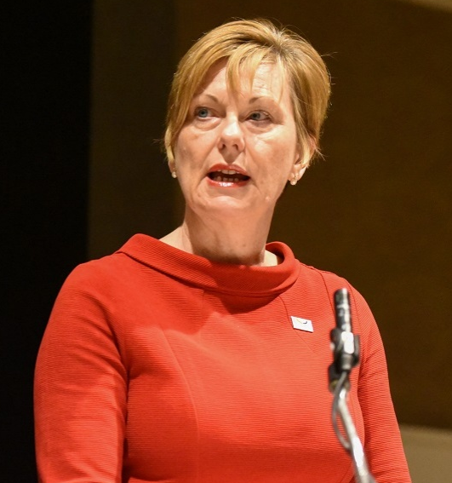
Influencing in the East of England
“I am often heard to say that to be an excellent clinician is no longer sufficient. Clinicians need to be able to influence within teams, within services, organisations and on a national and international scale. The CSP staff are here to assist, but there is nothing as powerful as the frontline clinician – perhaps only surpassed by a group of well-organised frontline clinicians!”

Slide 8

Influencing in the East of England
Generate 3 positive statements about your service:
Who are you?
What does your service deliver?
Take home message?
Notes:
Who are you? Make sure commissioners know who you are and what you do.
What does your service deliver?
Take home message for the commissioner. One short key message, eg: how you can help the commissioner understand the importance of physiotherapy or how timely physiotherapy can improve patient outcomes and enable quicker discharges.

Slide 9




Influencing in the East of England

Slide 10
^{www.csp.org.uk}

