Slide 1
FCP Overview for Lincolnshire
Emma Ivemey
Clinical Team Lead
Lincolnshire Community Health Services

Slide 2
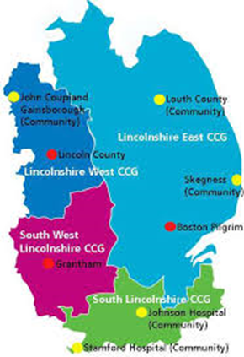
Lincolnshire Demographics
4 CCGs
Population of 732,000 spread over an area of 6,959 km²
Higher levels of obesity, diabetes & traffic-related deaths
Higher deprivation along East coast
Staff recruitment often difficult

Slide 3
Lincolnshire MSK services overview
Multi-provider physiotherapy service (GP referral only)
Interface (face to face) clinical triage services abolished by CCGs (except Spinal in the West CCG)
Electronic triage of secondary care referrals; little standardisation across the County

Slide 4
First Contact Progress so far..
Fully established FC service in a large GP surgery in South Lincolnshire following a successful 6-month Pilot (now STP NHSE Pilot)
Other fragmented FC services occurring around the County (no standardised model or data collection)- different providers
CCGs all keen to incorporate FC into their MSK models, but no agreement as yet as to how! (ie. funding, governance or ownership)

Slide 5
LCHS Pilot
Market Deeping Sept 2017-March 2018
South CCG commissioned LCHS to provide 5 months of full-time cover at the Deepings Practice (further month co-funded by CCG and GP surgery)
Based on Nottingham initial Pilot model (Goodwin & Hendrick, 2016) which reflects NHSE FCP model.
Physiotherapist independently refers patients for all relevant investigations (bloods, imaging, etc) and refer to secondary care services.
15 x 20-minute appointments available daily (seeing 44% of total MSK patient caseload)
Ref: Goodwin, RW & Hendrick, PA Physiotherapy as a first point of contact in general practice: a solution to a growing problem? Primary Health Care Research & Development 2016; 17: 489–502

Slide 6
Outcomes
Very large cost savings to the CCG due to;
  Halved AQP Physiotherapy referrals
  Halved number of patients sent for X-ray
  70% reduction in Orthopaedic referrals
  Massive improvement in secondary care referral conversion rates (47% GP Vs 80% FCP)
High Patient satisfaction
Low DNA rates (0.1%)
22 GP clinics per month freed up
High GP satisfaction and acceptance
NHS England recognition

Slide 7
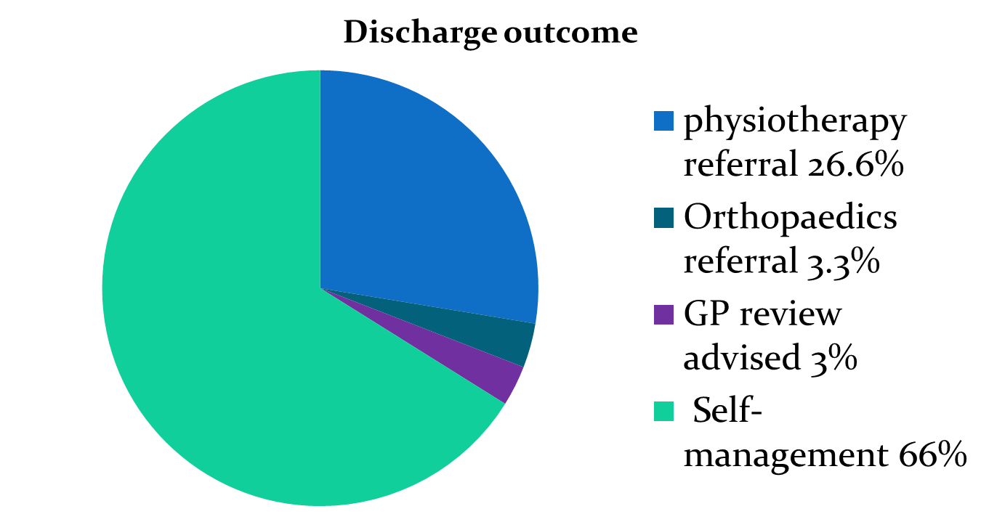
Outcome of FC Consultations
(October 2017)

Slide 8
Next Steps: County-wide Unification
County-wide, multi-provider staff training (with HEE support)
County-wide stakeholder engagement (with HEE, CSP and NHSE support)
Multi-provider collaboration and networking to incorporate FC into County-wide MSK pathway

Slide 9
QUESTIONS?
CSP
NHSE
HEE
Networking
Training
FCP model
Governance
Data collection
Stakeholder Engagement

