Slide 1
Falls and Parkinson’s Groups
AKA Balance and Safety Groups and
Exercise Classes for People with Parkinsons
Sine Rickard
Physiotherapist
Livewell SW (sine.rickard@nhs.net)
Private Practice (sinerickard@blueyonder.co.uk)

Slide 2
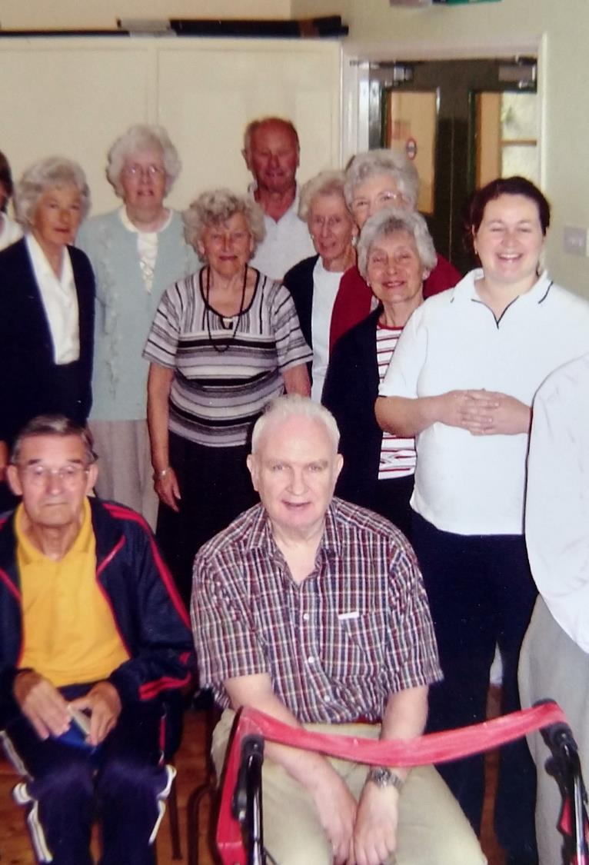
Exercise Classes with Parkinson’s UK in Plymouth
Started 2003
Initiative from local branch
Started with 3 people exercising
Currently has a rota of 3 physios providing weekly classes in 4 venues
Physio role includes triage, signposting and onward therapy referral

Slide 3
Group ethos
To provide accessible exercise classes for people with Parkinson’s Disease (and Parkinsonism) and their carers
Warm welcome to exercise class
Army of volunteers – prepare and clear venues
Teas/ Coffee/ biscuits and cake after each session
Volunteers phone if people unexpectedly missing sessions
Subsidising transport - contract with local taxi firm

Slide 4
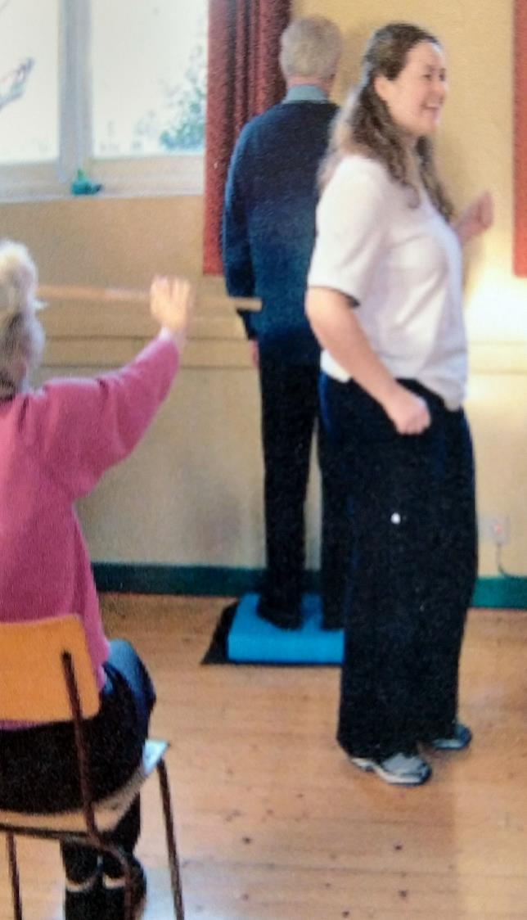
Class format
Evolved over the last 15 years
Resources – chairs, theraband, mats and pillows provided
Therapists bring their own music and exercise equipment – weights, balls, sticks, hula hoops
Classes now ‘all ability’
Photo of previous attempts at circuit class

Slide 5
Group Content
Quick Reference Cards (UK) and Guidance Notes for physiotherapists working with people with Parkinson’s Disease (2009)
Based on the Royal Dutch Society for Physical Therapy Guidelines for Physical Therapy in patients with Parkinson’s Disease (2004)
European Guidelines (2014)

Slide 6
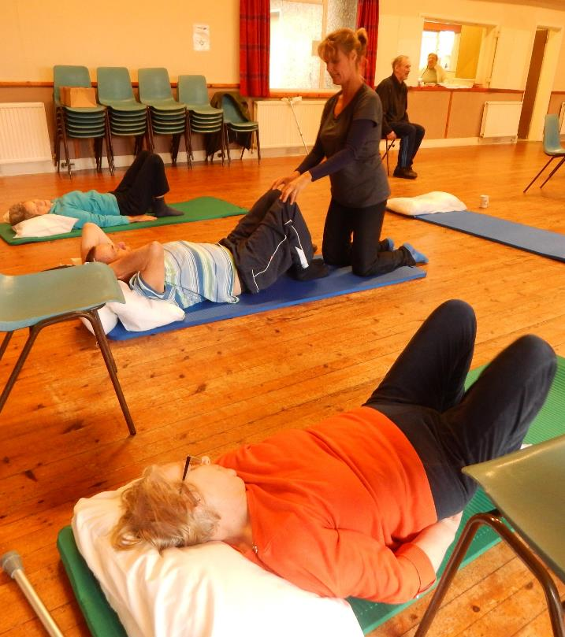
Floor exercises 30min
- On/off floor practice
- Pilates style exercises
- Stretches
- Exercises in prone
- 4 point kneeling
- Large volume exercises

Slide 7
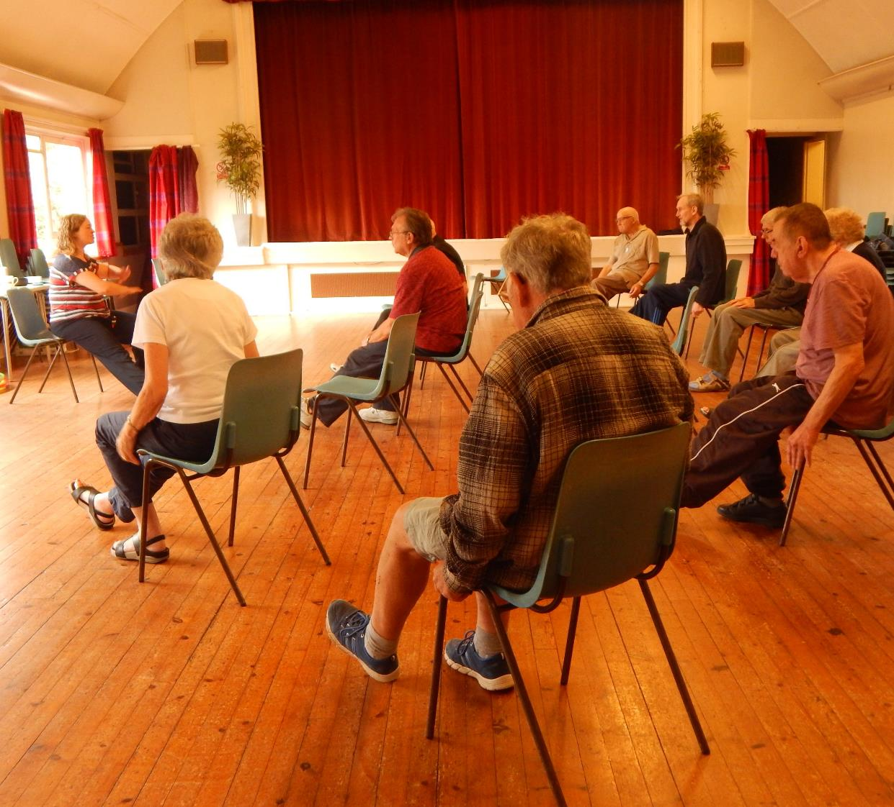
Main Exercises
Warm up
Stretches
Seated posture practice
Strengthening
Standing posture practice
Stand balance i.e. OTAGO or Tai Chi

Slide 8
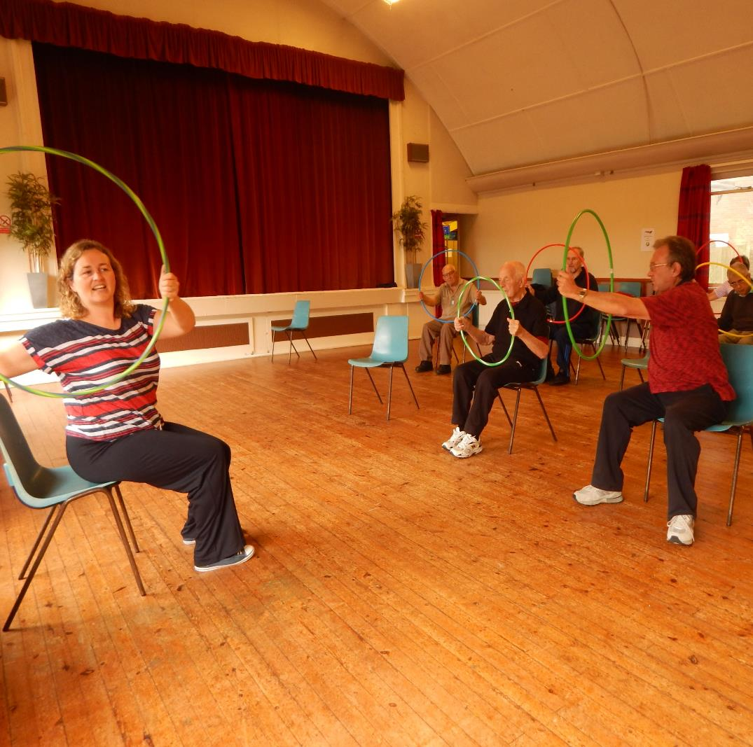
Keep programme varied
Each physio does own programmes
Vary the music
Vary equipment
S&LT exercises
Co-ordination exercises

Slide 9
Falls Prevention and Cueing
Exercisers have high incidence of falls
Exercises cued to the beat
Metronome to borrow
Walking poles to try in group sessions
RESCUE information sheets

Slide 10
Future plans?
Add floor exercises to other venues
Consider higher level exercise class
Consider PD Warrior
Nordic walking

Slide 11
Falls Therapy Team (Livewell SW)
MFFA
Vestibular Screening
Home Assessment
Balance and Safety Groups
1:1 sessions

Slide 12
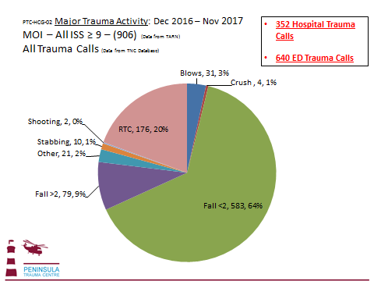
Major Trauma Centre

Slide 13
Falls Therapy Team
Team Lead PT
Clinical caseload Older persons rehab OP
1 WTE Falls PT band 6, 14 hours Falls OT band 6 FTT
1 WTE Band 5 in Older persons rehab OP
Falls Band 3 - 28hours, Band 2 - 25 hours Admin
Band 3 – 18 hours Older persons rehab OP

Slide 14
Referral into Falls Therapy Team
Falls Clinic
Any other therapist
FTT assessment and treatment
Balance and Safety Group
Complete a MFFA
Complete a B&S group referral
Includes BERG (14point) and Short FES –I (7 point)
Balance and Safety Group

Slide 15

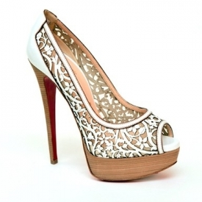


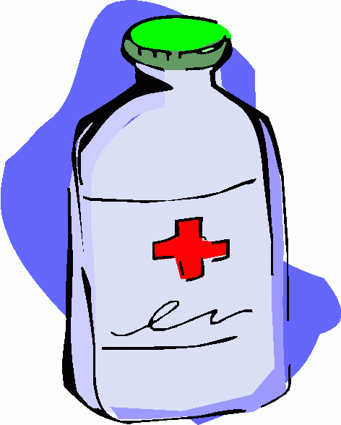
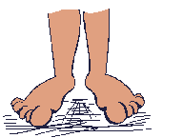

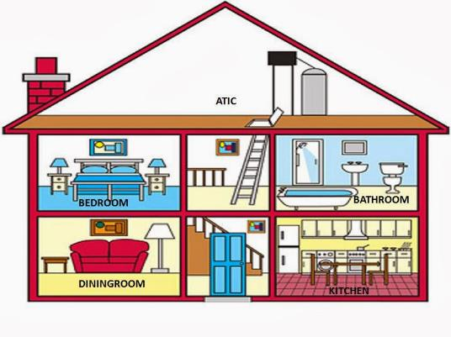
Staying Steady?

Slide 16
Balance and Safety Group
12 week programme
  Exercise and education
  HEP and support between sessions
  OTAGO (ish)
  Multisensory
3 groups currently running
  Group 1 BERG scores 44+
  Group 2 BERG scores 30+
  Group 3 waiting list initiative BERG score 38+

Slide 17
Facilitated discussions
Home Safety
Vision
Bone Health
Footwear and looking after feet
Continence
Relaxation and sleep
Coping with a fall
Postural Hypotension
Medication and falls
Local Services
Mobility and posture
Exercise, Classes and Goals

Slide 18
B&S Group demographics
Quick look at the last 60 patients through B&S Group
Age 82 (71 – 92)
Completed 10.5/12 Groups
Started with Berg 40/56 (31 – 53)
Finished with Berg 44/56 (20 – 55)
7 out of the 60 have had at least 1 further fall
Database: dizzy, postural hypotension, LLD (+/- THR or TKR), AMTs score and other OMs (TUAG and Functional Reach)

Slide 19
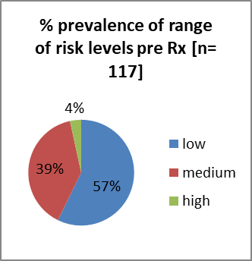
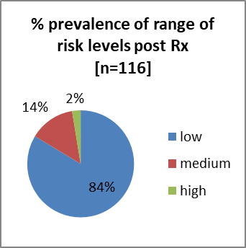
B&S Group - Berg Balance Score as Falls Risk
High risk (<20) Medium (20-43) Low risk (44+)

Slide 20
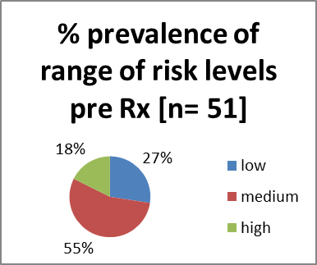
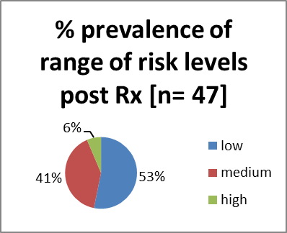
‘Group at home’
Berg Balance Score as Falls Risk
Falls Risk – High (>20) Medium (20-43) Low (44+)

Slide 21
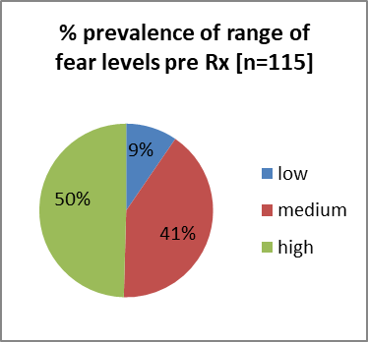
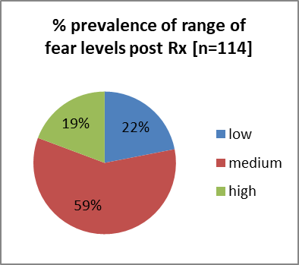
Short FES – I for B&S Group
Low (7-8) Medium (9-13) High (14+)

Slide 22
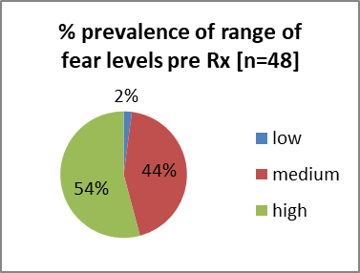
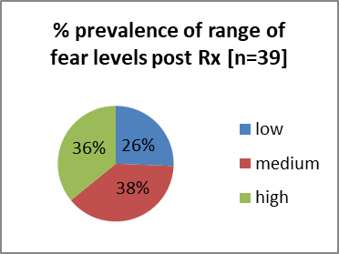
Short FES – I for ‘Group at home’
Low (7-8) Medium (9-13) High (14+)

Slide 23
What next?
Falls are everybody’s problem
Encourage MFFA for therapists working with at risk groups
Continued links to target the next wave of people who fall
Continue to lobby for bespoke 3rd sector balance classes to be included in our pathway
Review of database

Slide 24
Any Questions?
Sine Rickard
Physiotherapist
Livewell SW (sine.rickard@nhs.net)
Private Practice (sinerickard@blueyonder.co.uk)

