Slide 1
‘Overcoming the generational divide to achieve well-being’
Dr Melrose Stewart
@MelroseStewart1

Slide 2
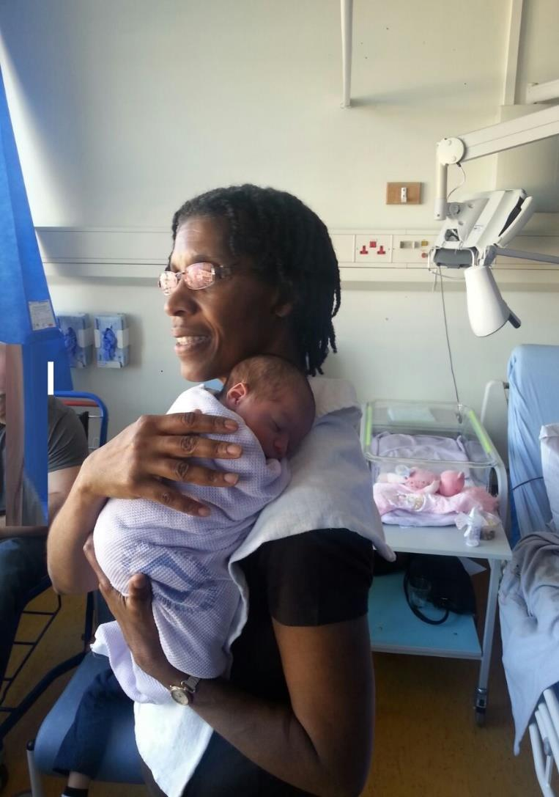
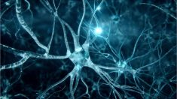
Generations

Slide 3
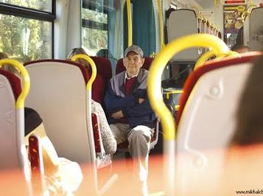
Older adults are a rapidly growing population group and are also the least active and most sedentary age group.
‘

Slide 4
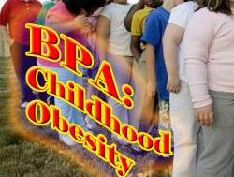

Slide 5
The Generations
2000 to present: New Silent Generation, Generation Z.
1980 to 2000: Millennials or Generation Y.
1965 to 1979: Thirteeners or Generation X.
1946 to 1964: Baby Boomers.
1925 to 1945: Silent Generation.
1900 to 1924: The Greatest Generation
1873- 1900: The Lost Generation

Slide 6
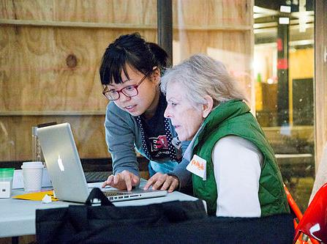

Slide 7
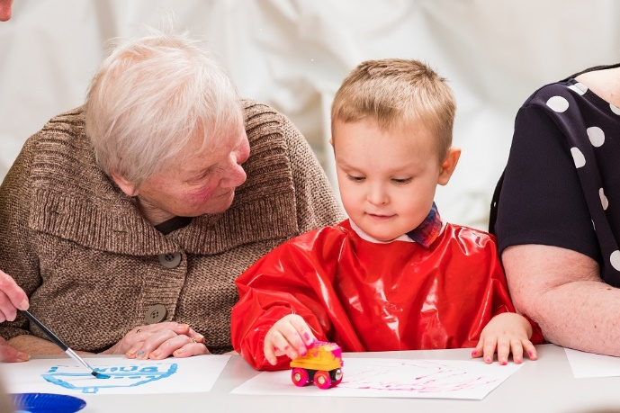
Howard House Intergenerational Project

Slide 8
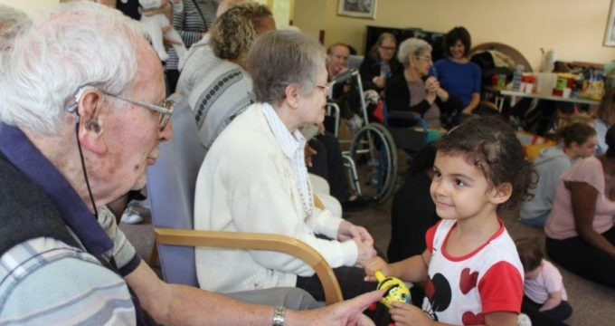
Apples and Honey Nightingale

Slide 9
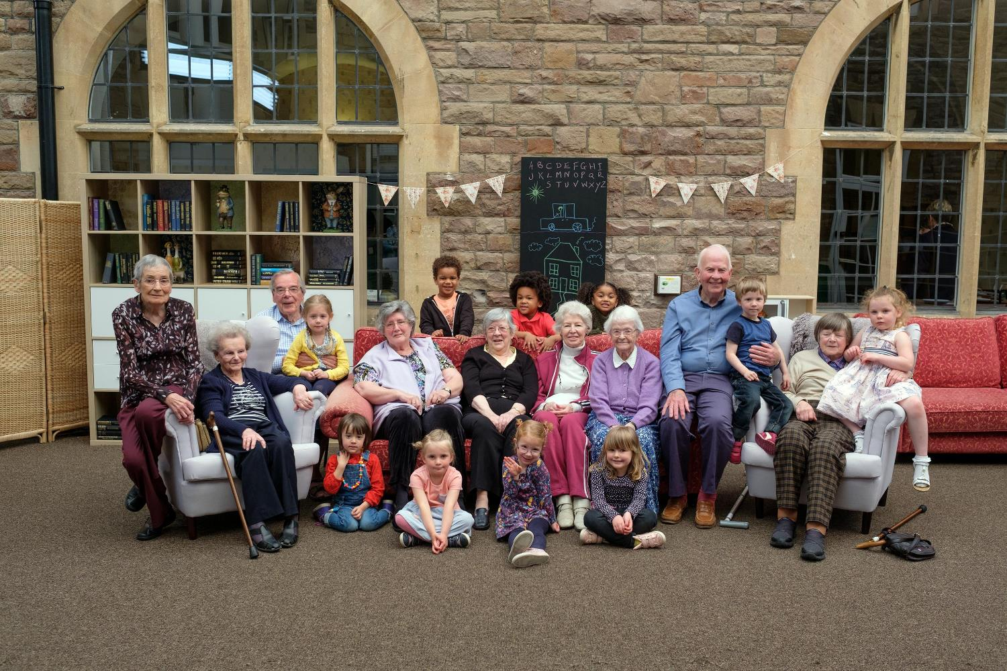

Slide 10
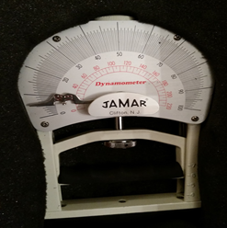
Measurements
Hospital Anxiety and Depression Score (HADS)
Timed Up & Go (TU&G)
Balance
Dynamometer
Barthel Index
Physical Activity Tracker

Slide 11
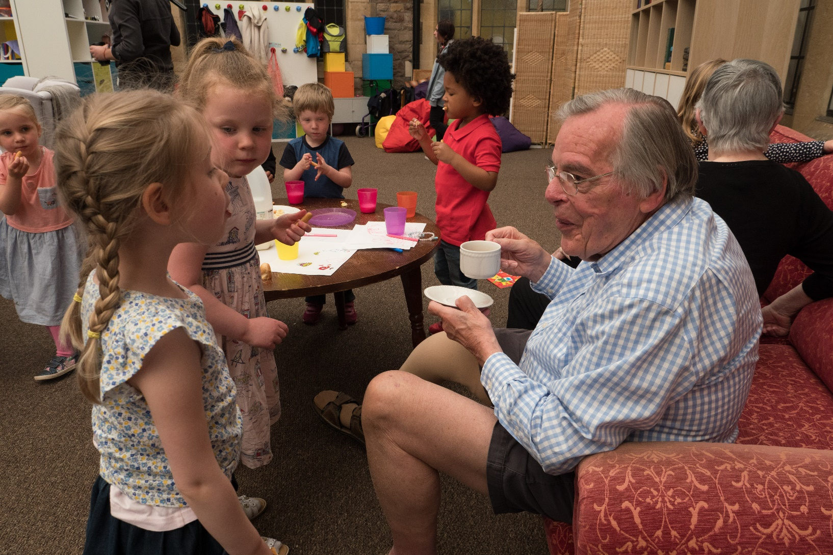

Slide 12
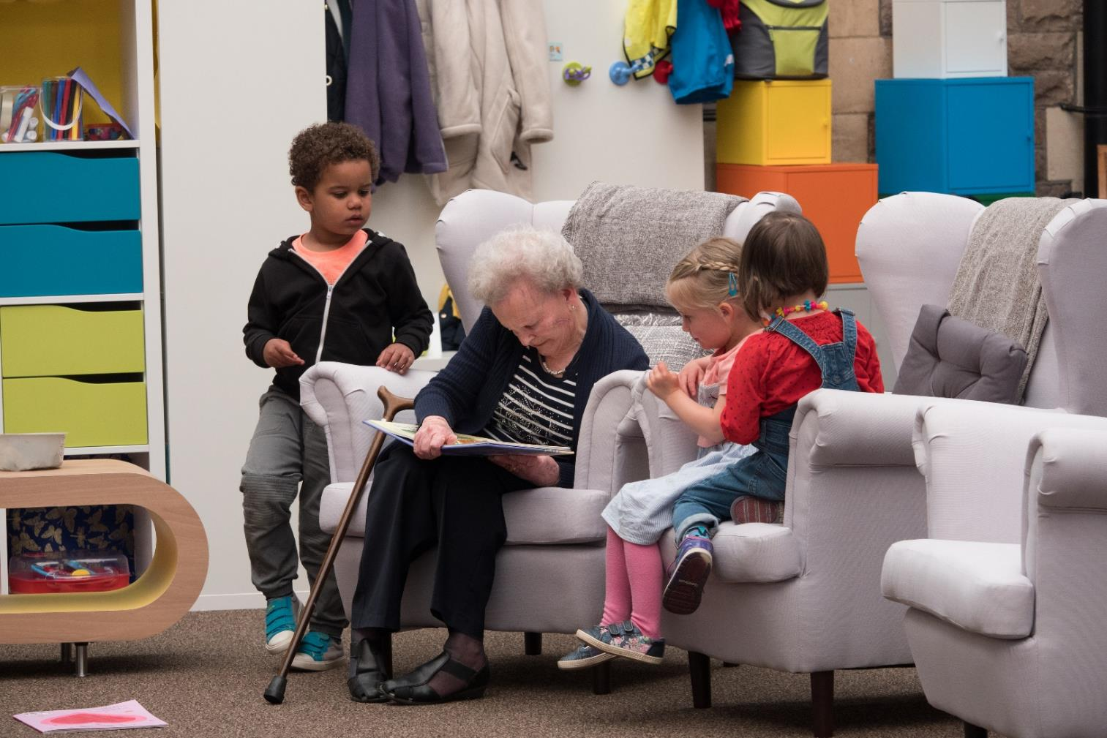

Slide 13
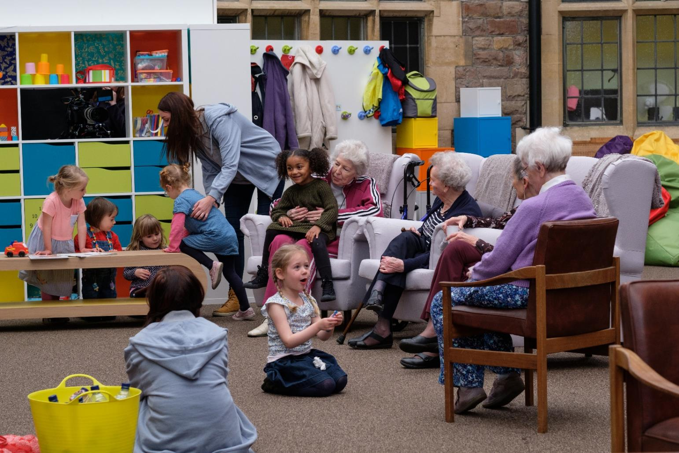

Slide 14
Intergenerational programmes - Advantages
For Older people
For younger people
Ongoing contacts and communication
More positive attitudes towards children
Decrease social isolation
Increase sense of belonging, self-esteem and wellbeing (Barnes et.al.2004, Seeman et.al.2001
Offers different learning environment
Enhanced engagement
Increase empathy and social skills
Addresses pervasive ageism (Pastor and Carter, 2012; Robbins, 2015)

Slide 15
Hope
Hope has been identified as an intrinsic human response, adding significance and meaning to individuals desire to live (Herth, 1993; Herth & Cutcliffe, 2002; Milne et al., 2009

Slide 16
Definition of IG Practices
‘Intergenerational practice involves bringing people together in purposeful, mutually beneficial activities that promote greater understanding and respect between generations and contribute to building more cohesive communities.’ (Hatton-Yeo and Ohsako, 2000).

Slide 17
Considerations
Embed programme in the institutions
Learn about social histories
Adopt culturally sensitive instruments
Offer choice
Training
Collaboration
Planning

Slide 18
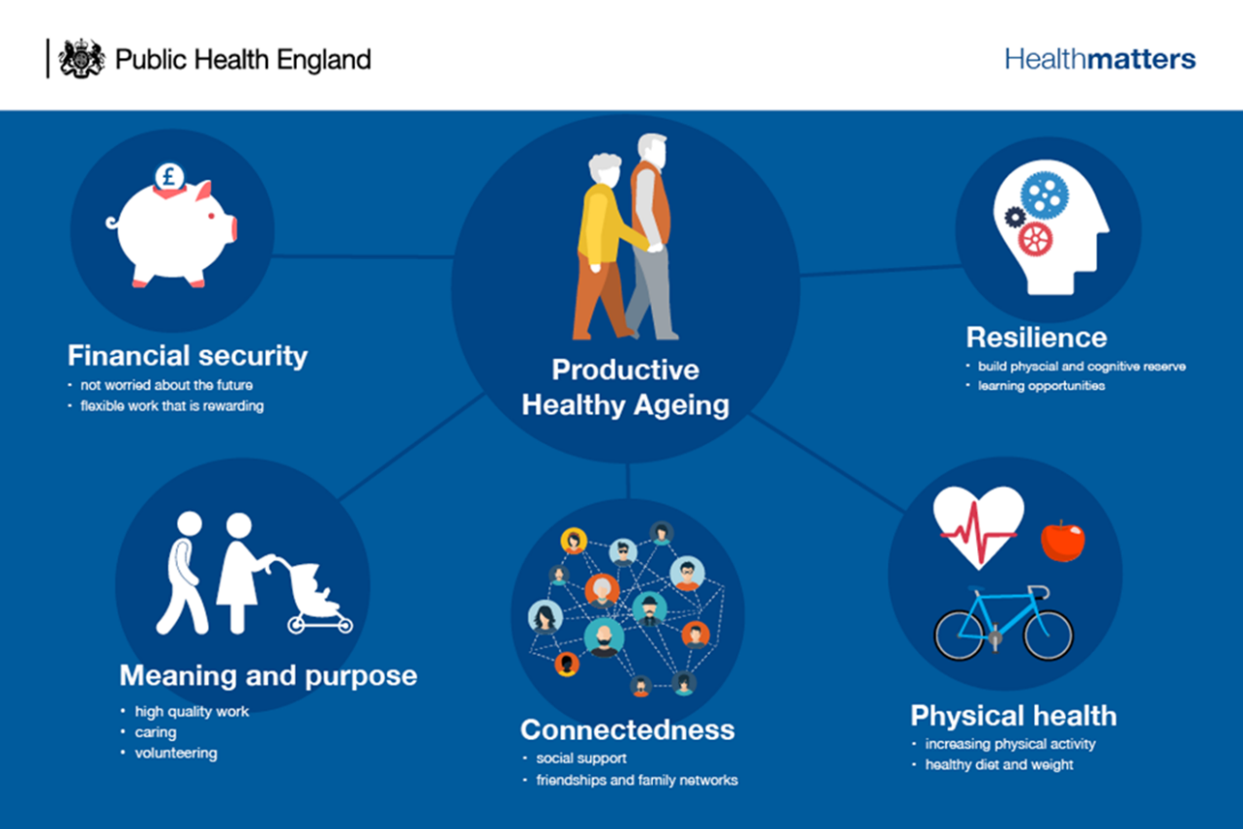
Guidance: Productive healthy ageing and musculoskeletal (MSK) Health

Slide 19
Standard set of health outcome measures for older persons(Akpan et al 2018)
…….mood and emotional health, loneliness and isolation, activities of daily living ………

Slide 20
‘Intergenerational activities’ – The Verdict?
Park, A-La (2014) Do intergenerational activities do any good for older adults well-being?: a brief review Journal of Gerontology and Geriatric Research, 3 (5). 181. ISSN 2167-7182

Slide 21
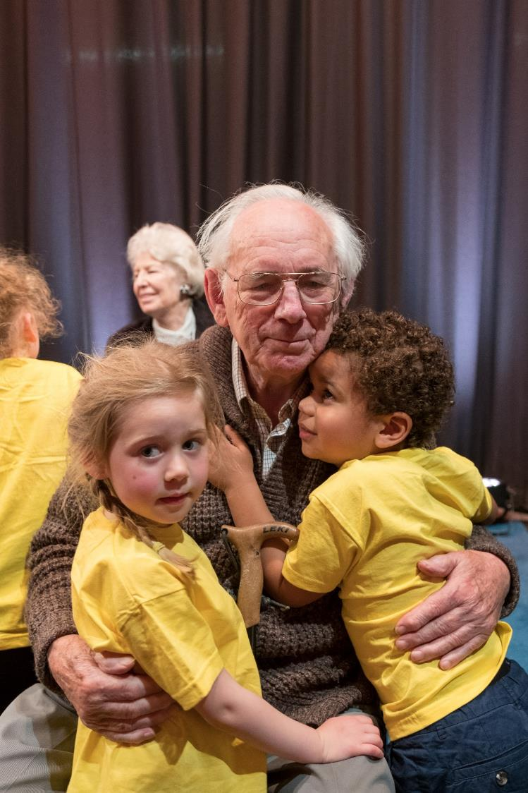

Slide 22
Channel 4 returns to the Old People's Home for 4 Year Olds 8th October 2018
“Heart-breaking and uplifting all at once” – The Guardian
“Wonderful” – The Times
“What an extraordinary piece of television Old People’s Home for 4 Year Olds is” ***** – Daily Mail
“One of the most important shows of 2017” – Stylist

Slide 23
Acknowledgements
University of Birmingham
Joss Barratt, Channel 4

