Slide 1
Stephanie Mansell
One dyslexics journey to consultant physiotherapist
Consultant Respiratory Physiotherapist
Royal Free London NHS Foundation Trust
July 2016

Slide 2
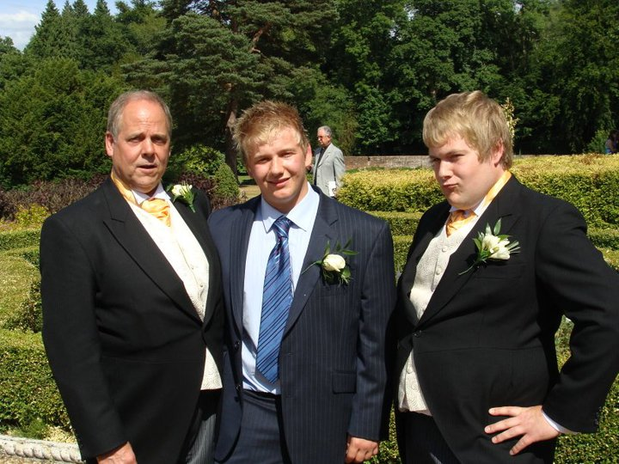
Diagnosis
Diagnosed in my last year of my undergraduate physiotherapy degree
University of Brighton supported my educational psychologist assessment
DSA funding for essay coach, by then I’d finished all my exams and most of my placements

Slide 3
Career history
After graduating worked for a year in the community at Guildford and Waverley PCT
Completed junior rotations at Frimley Park Hospital NHS Foundation Trust
Senior respiratory rotations and then clinical specialist posts at Ashford and St Peter’s NHS Foundation Trusts
Secured consultant post at Royal Free London NHS Foundation Trust September 2014

Slide 4
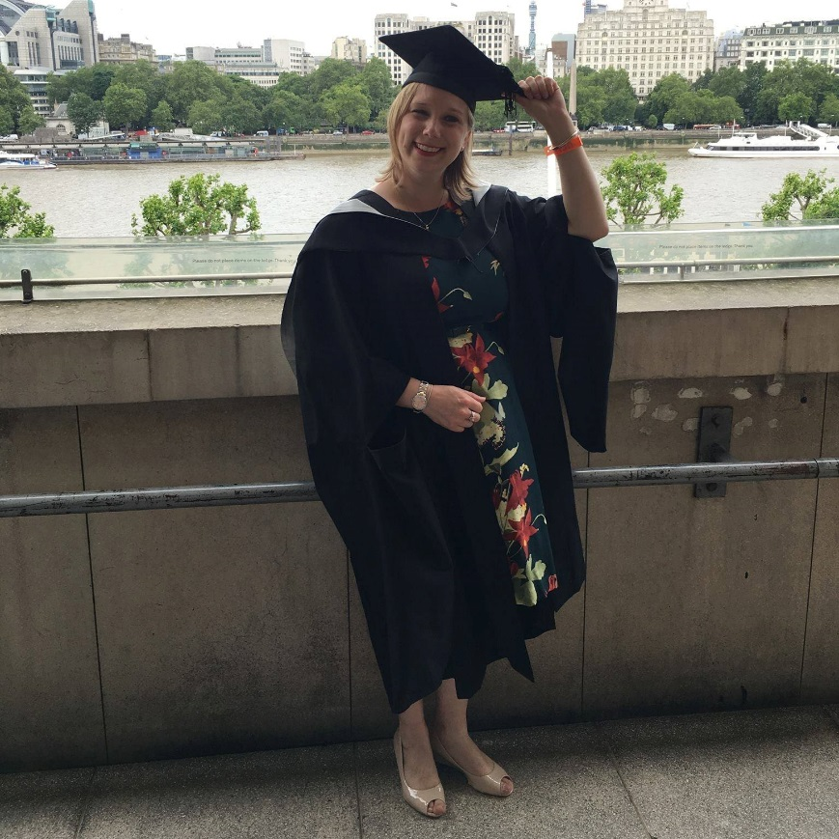
MSc advanced cardiorespiratory physiotherapy at UCL
Had DSA support:
  Extra time in exams
  Declaration on assessments
  Assistive technology
  AT tutoring
  Specialist coaching
  Allowance for supplies
  Extra borrowing time at library

Slide 5
Dyslexia is a strength
Communication skills
Holistic approach to patients
Whole system view
Problem solving/lateral thinking/think outside the box/creative
Comprehension
Persistent
Eye-hand co-ordination/dexterity
Learn from experience

Slide 6

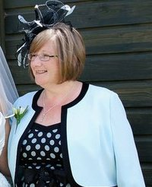
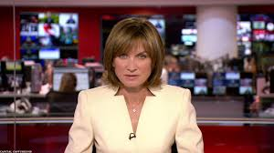

Strategies: what works for me
Turning automatic spell check on my emails
“Writing” reminders (diary, notes on phone)
To do lists: prioritise
Diary
Quiet time
Proof readers (family, friends, colleagues)
Assistive technology
Coaching

Slide 7
Top tips
Be open and honest
Be positive
Embrace your strengths
Know your weaknesses
Find strategies to adapt: know your solutions
Access to Work

