Slide 1
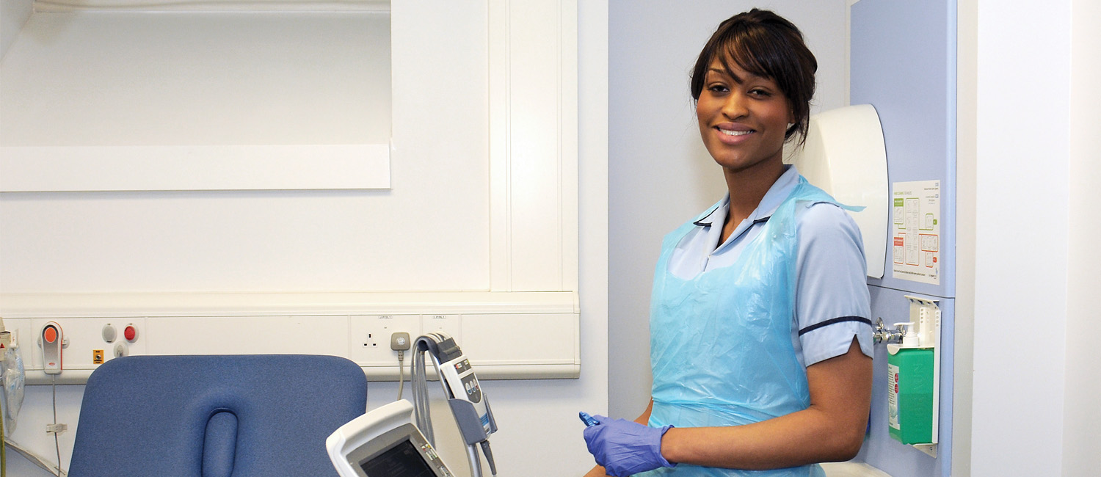

Dr Richard Collier PhD MSc PFHEA GradDipPhys MCSP MMACP richard.collier@hee.nhs.uk
Health Education England
Clinical Lead ACP & Consultant Practitioners
Capability Framework for FPC Practitioners

Slide 2
Outline of Presentation
Scope of Framework – intended purpose
Commissioning, Why?, What? & Who?
Drivers for Framework
MSK Capability Framework
  Structure
  Capability Review
Questions

Slide 3
MSK Framework
Scope of Framework
  all health professionals with a role as a first point of contact for adults presenting with undiagnosed MSK conditions
  assess, diagnose, develop and agree a management plan, offer initial treatment advice (including self-management and treatment if the pathway allows) and discharge or make an onward referral

Slide 4
Capability Framework for FPC Practitioners
Who Commissioned the work?
‘This framework was commissioned by Health Education England and NHS England Medical Directorate, building upon work previously undertaken by a national work programme delivered by the Arthritis and Musculoskeletal Alliance and its member organisations, working in partnership with the NHS England Clinical Policy Unit and the National Clinical Director for MSK.’

Slide 5
Why??
…to support the transformation of services, placing skilled MSK practitioners earlier in patient pathways.
The aim is to ensure expert diagnosis, prevention, supported self-management advice, early treatment and onwards referral, where needed, is available to anyone presenting with an MSK condition. It meets the needs and wishes of people with MSK conditions, identified through focus groups.

Slide 6
The framework sets out standards for consistent, safe and effective practice across a range of practitioners working as part of a multi-professional team…
This includes those working in a range of settings, including primary and community care, emergency care or occupational health services.
The framework supports the implementation of the NHS England supported first contact practitioner model of care into service delivery.

Slide 7
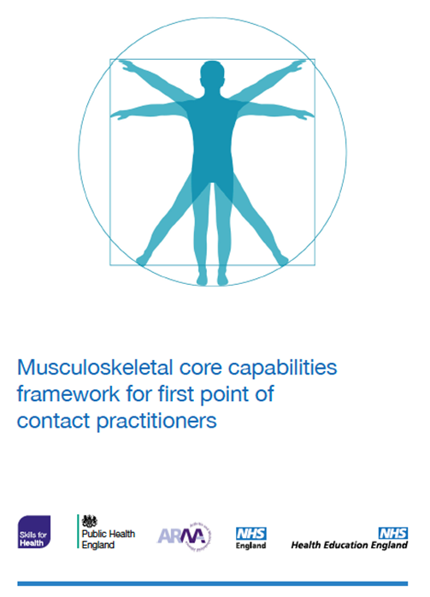
Who is the Framework for??
‘Many health professionals (such as GPs and physiotherapists) will already be working in accordance with the capabilities, while for others the capabilities will provide a framework for continuing professional development.’
FCPs can be other professionals who have demonstrated appropriate training and experience.

Slide 8
Drivers
Drivers for development of the framework include policy e.g. GP Forward View and the national work programme delivered by the Arthritis and Musculoskeletal Alliance (ARMA) and its member organisations, working in partnership with the NHS England Clinical Policy Unit, with the National Clinical Director for MSK and the Elective Care Transformation Programme.
Workforce demands and reducing GP numbers
Patient safety, public & peer confidence and scope of practice demands/issues.

Slide 9
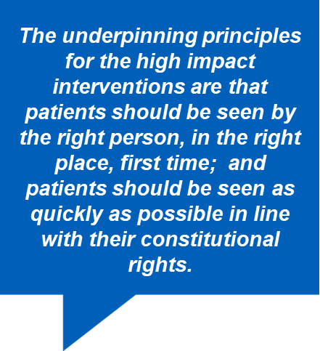
Drivers
Five Year Forward View Next Steps highlights that some patients are referred to hospital unnecessarily with significant unwarranted variation in referral patterns

Slide 10
Elective Care High Impact Interventions: NHSE - First Contact Practitioner
… regions should work with STPs and their CCGs to deliver High Impact Interventions (HII) in the localities where they are most needed… include(ing) the development of First Contact Practitioner (FCP) services to ensure patients with musculoskeletal (MSK) conditions are seen by the right person in primary care setting and can receive appropriate care in a more timely manner.
… service specification sets out the key enablers and actions that each STPs should take - including identifying a minimum of one pilot site to roll out a first contact practitioner service and engagement with the national evaluation.
As a minimum FCPs need to meet the criteria of the HEE & NHSE Capability Framework and be supported by appropriate governance and indemnity.

Slide 11
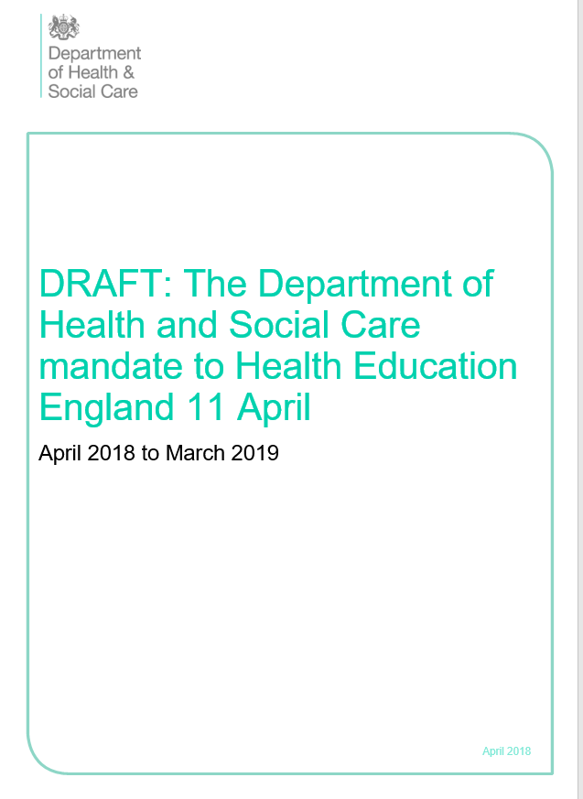
Drivers
General Practice Forward View and Primary Care Workforce Commission report The Future of Primary Care: Creating Teams for Tomorrow
With NHS England, support the delivery of 5,000 more doctors working in general practice by 2020 and an increase to other multi-professional primary and community staff of 5,000, including 1,000 Physician Associates.

Slide 12
Structure of the framework
The framework begins with a description of professional values and behaviours (including knowledge and understanding) that underpin all the capabilities set out under four domains (14 capabilities). With each capability divided into further components.
The four domains of the framework are:
  Domain A. Person-Centred Approaches
  Domain B. Assessment, Investigation and Diagnosis
  Domain C. Condition Management, Interventions and Prevention
  Domain D. Service and Professional Development

Slide 13
Professional values and behaviours
The values and behaviours set out in this section for first point of contact MSK practitioners emphasise a commitment to collaborative, person-centred and integrated services. The importance of these values and behaviours have been confirmed through focus group discussions with people with MSK conditions.

Slide 14
MSK underpinning knowledge and skills
..comprehensive understanding of the normal structure and function of the MSK system.
…understand the impact that MSK conditions have on individuals and on society in the context of the bio-psycho-social model and the framework of the World Health Organisation International Classification of Functioning, Disability and Health.
…must have clinical-reasoning and problem-solving capabilities and critical self-awareness skills both to apply their knowledge and skills within their professional scope of practice…

Slide 15
Domain A. Person-Centred Approaches
Capability 1. Communication
Capability 2. Person-Centred Care
Domain B. Assessment, Investigation and Diagnosis
Capability 3. History-taking
Capability 4. Physical assessment
Capability 5. Investigations and diagnosis
Domain C. Condition Management, Interventions and Prevention
Capability 6. Prevention and lifestyle interventions
Capability 7. Self-management and behaviour change
Capability 8. Pharmacotherapy
Capability 9. Injection therapy
Capability 10. Surgical interventions
Capability 11. Rehabilitative interventions
Capability 12. Interventions and care planning
Capability 13. Referrals and collaborative working
Domain D. Service and Professional Development
Capability 14. Evidence-based practice and service development

Slide 16
Domain B – Assessment, Investigation and Diagnosis
‘MSK first point of contact practitioners demonstrate skills in problem-solving, critical thinking and evaluating the impact and outcomes of their interventions. They analyse and synthesise information, particularly in relation to unfamiliar contexts and presentations where information may be incomplete or contradictory...’

Slide 17
Domain B – Assessment, Investigation and Diagnosis (cont.)
‘MSK first point of contact practitioners demonstrate safe, effective, autonomous and reflective practice, informed by available evidence and established best practice.’

Slide 18

Domain B – Assessment, Investigation and Diagnosis
Capability 3
  History-taking
Capability 4
  Physical assessment
Capability 5
  Investigations and diagnosis

Slide 19
The practitioner can do the following:
Capability 5 - Investigation and Diagnosis
a) Assess the importance and meaning of presenting features from the clinical assessment, recognising the different patterns, syndromes and conditions commonly seen in first point of contact roles.
b) Identify potential serious pathology and make appropriate onwards referral.
c) Identify risk factors for severity or impact and use tools where they exist to analyse and stratify risk of progression to long term pain and disability.
d) Diagnose common problems that can usually be managed at first point of contact.
e) Recognise and act where an early referral and diagnosis may be particularly important for optimising individuals’ long term outcomes..

Slide 20
The practitioner can do the following:
f) Recognise how MSK conditions and their impact can interact with mental health, and identify when this is relevant.
g) Understand how MSK problems may be a manifestation of injury not only from trauma but also abuse, recognising particular at-risk groups (such as older people with frailty and those with cognitive impairment) and take appropriate action when there are grounds for concern.
h) Instigate appropriate investigative tests to aid diagnosis and assessment.
i) Understand and interpret test results and act appropriately, demonstrating an understanding of the indications and limitations of different tests to inform decision making and the imperative of using scarce, expensive or potentially harmful investigations judiciously.

Slide 21
Principles of Capability Review
This would be the process by which Practitioners would demonstrate that they meet the requirements of the Framework
Needs to be comparable with the process that GPs in training undertake and be aligned to the ACP process already in use, e.g. ARCP.
Needs to ensure that Patient safety and Public & Peer confidence is demonstrated.

Slide 22
Principles of Capability Review
1. Health and care professionals developing competences or evolving scope of practice should do so within the framework of an agreed curriculum that sets out the knowledge, skills, values and behaviours that are required. The curriculum should specify appraisal and assessment requirements.
2. Learners should have access to a portfolio that allows collection and presentation of evidence that demonstrates competency progression.

Slide 23
Principles of Capability Review
3. Learners should be supported by trained supervisors/mentors/tutors with available time, resources and access to professional support where necessary.
4. There should be a widely recognised, valid and reliable assessment process to review progression against the curriculum that provides a consistent standard to protect patient safety and supports transferability of competences across employers/roles/clinical environments.
5. Once a defined level of competence has been achieved this should be documented within a register recognised by learners, faculty, employers and the wider public.

Slide 24


