Slide 1
South Tees Pulmonary Rehabilitation
Why Pulmonary Hydrotherapy is working for our patients.
Innovation in exercise (North-East CSP event May 2018)
Rebecca Shea
Service Lead for Pulmonary Rehabilitation, South Tees NHS Foundation Trust.

Slide 2
Background to the service
Recently expanded Pulmonary Rehabilitation service
Covers a large catchment area within South Tees region
Number of different lung pathologies treated
MRC 2-5, diverse variety of patient ages
Small Domicillary home visit service
Established service that has evolved over past 20 years

Slide 3
The idea and the development of a pilot
Team discussion- why do some of our patients struggle/drop out of land-based programmes?
Hydrotherapy resources available within South Tees to trial. Supportive managers.
The completion of a risk assessment!

Slide 4
Evidence…
In the past, water-based exercise had been thought unsafe for people with COPD because of potential increases in cardiac and respiratory work with increased chest wall pressure resulting from water immersion(Arborelius 1972).
There is some research that has been done…
There is limited quality evidence that water-based exercise training is safe and improves exercise capacity and quality of life in people with COPD immediately after training (McNamara et al., 2013).
Perk (1996) found that a single head out of water exercise session in water can be performed safely without adverse events and with maintenance of oxygen saturation even in those with severe disease.

Slide 5
Evidence…
The ‘for and against’ argument continues…
There is controversy in the literature regarding the beneficial and harmful effects of water exercise for the respiratory system in people with respiratory problems.
Studies have shown that hydrostatic pressure exerts resistance against inspiratory muscle strength and limits chest expansion (Frontera, Herring, Micheli, & Silver,2008)
On the otherhand, patients with chronic obstructive pulmonary disease may benefit from the hydrostatic pressure exerted during immersion, which facilitates expiration (Schoenhofer et al., 2004)

Slide 6
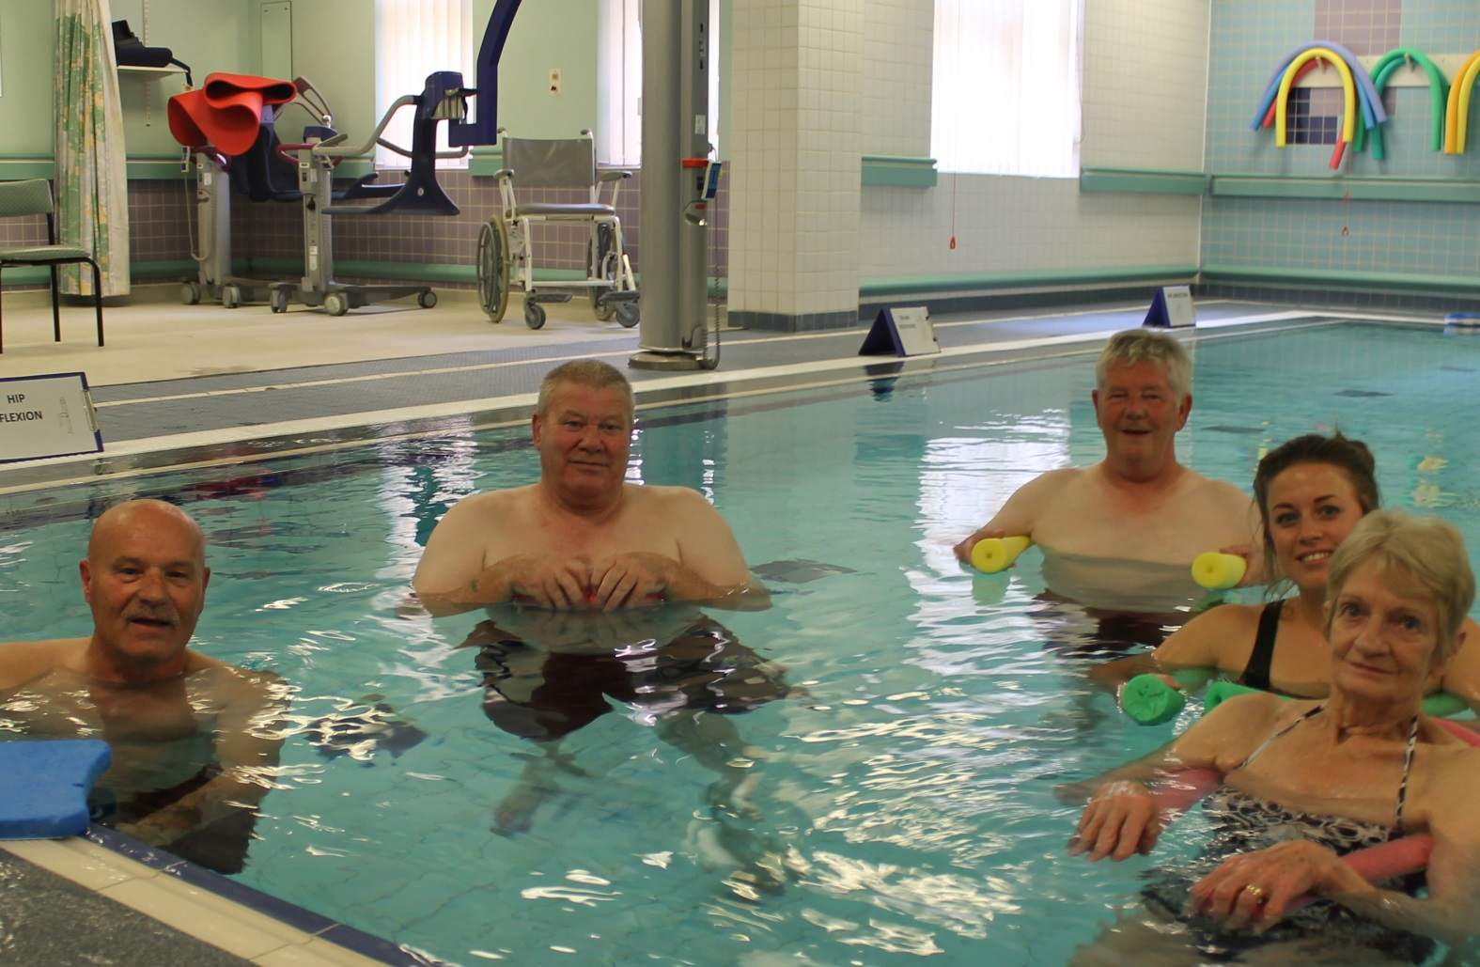
The 2016-2017 pilot

Slide 7
Outcomes
6 minute walk
CAT TEST
PHQ-9 GAD 7 trial
Patient satisfaction

Slide 8
Innovations and Developments
TV- LOCAL NEWS!
CSP publication
Visits/networking with other professions in our own Trust and other UK Trusts
NHS bright ideas application and subsequent positive feedback
Currently we are collecting data and auditing any admissions or re-admissions to JCUH in a 12 month period (post-course).

Slide 9
Future thoughts/ideas
For South Tees: Increase in slots in the hydro timetable or a twice weekly option. This would enable us to roll the programme out to more people whilst keeping a low waiting list. Also the possibility of including frailer patients: MRC 4-5’s or Oxygen users
Other NHS venues and services adopting the idea.
Possible projects in conjunction with local councils or the private sector

Slide 10
References
Arborelius M, Balludin UI, Lilja B, Lundergren CEG (1972). Hemodynamic changes in man during immersion with head above water. Aerospace Medicine;43:592–8.
Frontera, W.R., Herring, S.A., Micheli, L.J., & Silver, J.K. (2008). Medicina deportiva clínica: Tratamiento médico y rehabilitación. Wicker A. Rehabilitación acuática (pp.257–271). Madrid: Elsevier.
McNamara RJ, McKeough ZJ, McKenzie DK, Alison JA (2013). Water-based exercise training for chronic obstructive pulmonary disease. Cochrane Database of Systematic Reviews, Issue 12.
Perk J, Perk L, Boden C. (1996) Cardiorespiratory adaptation of COPD patients to physical training on land and in water. European Respiratory Journal;9:248–52.
Schoenhofer, B., Koehler, D., & Polkey, M.I. (2004). Influence of immersion in water on muscle function and breathing pattern in patients with severe diaphragm weakness. Chest, 125(6), 2069–2074

