Slide 1

First Contact Practitioner pilot in a South Lambeth GP practice
Rashida Pickford- Consultant Physiotherapist
June 2018
Sarah Friel- Advanced Physiotherapy Practitioner

Slide 2
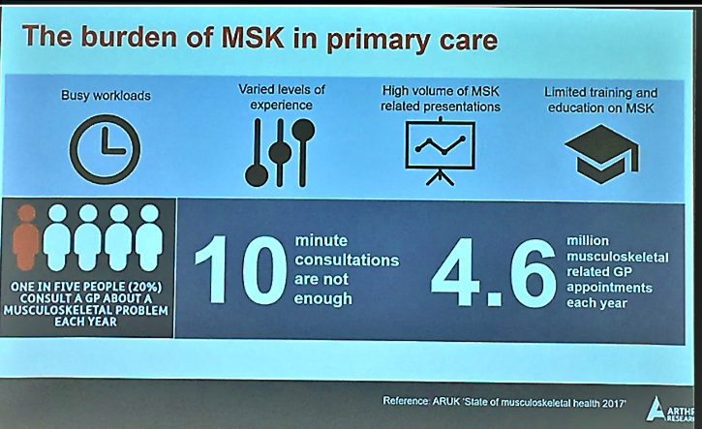
Impact on population Health
Greatest cause of disability
3rd greatest impact on health. 2nd most common cause of sickness absence
Co morbidities common e.g 79% of patients with arthritis report anxiety and depression because of their condition
91 % say they are not given information about exercise or self care
Cost and variation
MSK treatment in England costs the NHS £5 billion, with the highest spending areas allocate 3 times more for MSK treatment than the lowest not accounting for in variation of incidence, prevalence or severity
Variation due to levels of unnecessary investigations and GP referrals 24% of all orthopaedic referrals by GPs judged by consultants to be unnecessary and 43%to be of low value
Demand on GPs
1 in 5 people see their GP with an MSK issue every year
Is 17% of all GP appointments
The most common cause of repeat appointments

Slide 3
The potential for improved patient care- now proven
Meeting patient demand through improved choice for patients- successful self referral models
Increased professional responsibility for allied health professionals- physios best placed
Reducing the workload of general practitioners- now proven
Missing Red flags
GP better at dealing with patients with complexity and multi morbidity
The general practitioner as patient advocate in systems with gate-keeping services
Use of general practitioners with special interest in musculoskeletal medicine
Notes:
It is time to have this debate with openness, dialogue,
and curiosity and to set aside professional tensions and
traditional hierarchies. Although such tensions are
understandable, focusing on them draws attention away
from the primary goal, namely to improve the care of
patients with musculoskeletal problems. Any change in
care pathways will, of course, need to be closely examined
in terms of patient experience, safety, and clinical and
cost-effectiveness.

Slide 4
FCP Pilot
April to October 2017’, 6/12 pilot service of an ‘advanced MSK practitioner’ within a South Lambeth GP practice .
1 afternoon per week, 4hr session
Close supervision by a GP
Initially 30 minute slots, reduced to 20 minutes.
Direct referral - Patients booked in by reception
- GP/pharmacist/Nurse.

Slide 5
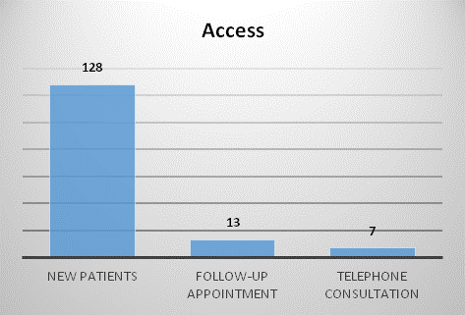

Slide 6
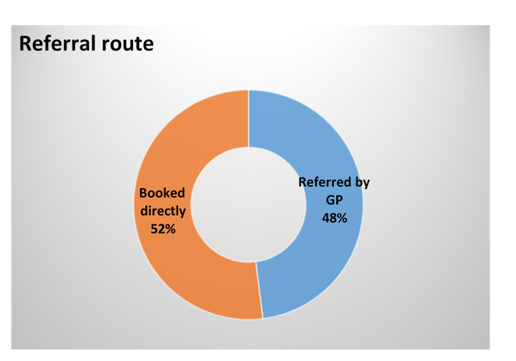

Slide 7
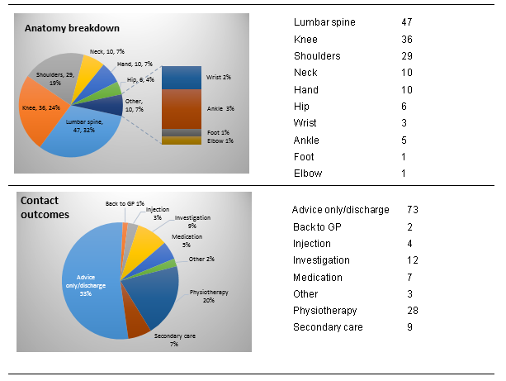

Slide 8
Managing demand for elective care
Reduction in referrals to secondary care
Conversion to surgery
GP capacity- 155 GP appointments saved
Safety
No adverse incidents reported
53% of patients were given advice only and continued self management
Reduced prescription cost - 40% fewer prescriptions were requested
Impact
40% more patients were managed with advice only
Low referral to secondary care – 6%
Reduced referrals to physiotherapy services by 14%.
Low investigation rate - 8%
High patient satisfaction
– 100% rated the service good or excellent, 100% would recommend service to friends and family
Health and work Potential to speed up return to work- needs to be measured
GP capability
Training GP team and Student placement
A&E attendances To be measured
Notes:
Saved GP appointments and cost both direct and indirect –
155 appointments saved over a period of 6 months.
Compared to a GP trainee 40% more patients were managed with advice only.
Reduced prescription costs - Compared to GP trainee, over 40% fewer prescriptions were requested by physiotherapist
• Low investigation rate of 8%
• Low secondary rate referral of 6% with 100% conversion rate
• Reduced referrals to physiotherapy services by 14%.
• High patient satisfaction
– 100% rated the service good or excellent, 100% would recommend service to friends and family

Slide 9
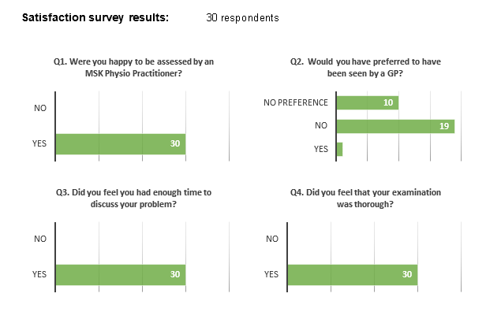

Slide 10
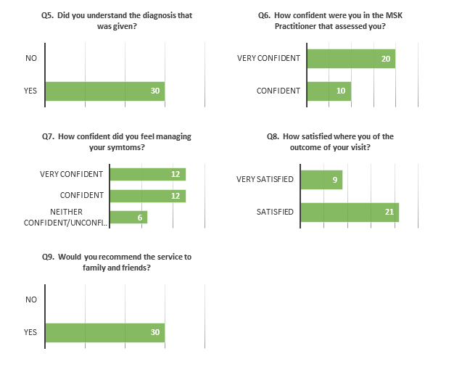

Slide 11
Difficulties with implementation
Integration across whole pathway
ACP training
Receptionist training
Funding- Pump Priming needed
Sustainability- Training
Governance, supervision and mentoring
Patient access- Direct booking via reception, Telephone triage, e-consult
Confusing titles- Clarity of Roles
Equity across Lambeth and Southwark

Slide 12
Self manages
Accesses e-consult
Telephone triage by FCP for MSK
Sustainable practice receptionist training. What is the ‘triage’ criteria?
Request investigation
ERS if not GSTT
Confidence of GP receptionist will vary
FU by FCP
Discharged with advice
Reception signposts according to nature of problem
Referred to secondary care??
What is the self care option?
Patient telephones GP surgery
Referred to mental health, voluntary sector or community services
Patient sees FCP for assessment
How do we define the subset of patients or conditions for FCP? Decision cannot be based just on capacity
Potential deskilling of GPs?
Patient has an MSK problem
Patient sees GP
Request investigation
Patient books appointment online
Online decision support for patients?
How does this fit into the pathway? Southwark pilot evaluation
Medication?
No conversation with patient to give direction
Manages according to checklist/stratification tool
Refer to LIMS
Face to face Assessment
Patient self refers to physio
Telephone assessment
Discharged with advice

Slide 13

Conclusion
Unique challenges of London- different drivers, Hubs and Federations
Get commissioners on board
Engage all stakeholders early
Don’t give up!

