Slide 1
Halton MSKCATS Service Transformation
Lisa Horne BHSc, SRP, MCSP
Team Lead and Advanced Musculoskeletal Physiotherapy Practitioner
Halton Hospital

Slide 2
Service Description
Commissioned service from Halton CCG offering first point of contact service for patients with MSK conditions
Based in Widnes and Runcorn, North West England
Team of 9 clinicians (5.5wte) and 4 admin staff (3 wte)
Had orthopaedic/rheumatology triage service at Halton for 14 years- but it was an interface service between primary and secondary care.
April 2017 moved to first point of contact service based in primary care
Have a specific base in both Widnes and Runcorn towns rather than being based in GP practices, so service deals with all GPs practices in our own department.
Patients contact our service direct via telephone line, register with our admin team and then answer Red flag questions. Depending on answers to red flag questions given an urgent telephone triage appointment (same day) or routine appointment (currently 2 weeks)
Addendum May 30th – not currently able to run telephone triage as demand far outweighs capacity - will discuss this later in presentation!!!

Slide 3
Current Process due to capacity and demand
Self referral paper referral
Patients register as previous – red flag questions asked- positive ones- still get a call on day
Everyone else send a paper referral in post and send it back to us
Triaged by AMPP daily
Thought get complaints as not how we marketed the service originally but no complaints so far!!! In fact less complaints as not complaining about the wait for telephone triage.
Temporary measure as making changes (again!!) to MSKCATS service in June 18

Slide 4
Service Description (cont)
Next steps could be :
Self management
Face to Face appointment in MSKCATS
Primary care Rheumatology or Pain Clinic
Therapies
Secondary Care
GP
If Face to face MSKCATS appointment – have same management options plus AMPPs can order diagnostics

Slide 5
Transformation Process Timeline Key Dates
Dec 2014
Jan 15- Aug 15
Sept 15
Oct 15
Jan 16
March 16
April 16
May 16
July 16
Aug 16- March 17
April 17
ongoing
Initial consultation with stakeholders, patients and CCG
Workgroups & process mapping of current and potential models
Lisa Horne became MSK Clinical lead for Halton CCG
3 month trial began in a GP practice to see effects of 1st point post
Collating trial evidence and preparing business case for CCG
1st proposal taken to CCG Service Development Committee-rejected
Audit done in GP practices on hidden demand
Resubmitted proposal –accepted subject to Finance approval
Full financial support given and green light for service redesign
Recruitment, Pathway design, marketing of service, EMIS training
Service went live
Several redevelopments and ongoing changes to keep up with demand

Slide 6
Barriers
Length of time transformation takes
Limited services already doing role to help us with the process
GPs- some where against the change (and still are) and appear to want it to fail
Feel their GP role is under threat
Feel some funding is under threat eg injection
Cultural shift for patients- feel they need to see GP
GPs doing things we don’t agree with- ordering investigations when not needed, even if patients are under MSKCATS care
Changing to EMIS
Stress of staff – were not fully staffed until Sept due to competencies training and holidays and 8a need to give 3 months notice so external recruits had to wait longer for!
For a time had to run our old service in parallel with the new service as our old service was on Lorenzo and some patients still in the system. Never got to neutral position prior to launch
Acute Trusts- if these 1st point contact services are successful, then acute trusts may lose business and income! Might not be as supportive as they could be

Slide 7
Outcomes
Reduced pathway for patients- 2 week wait for telephone triage and 2 week wait for face to face appointment rather than 8 week wait for GP appointment and referral into MSKCATS
Paper self referral- posted out within 24hours- when get them back triaged within 48 hours. Sending physio/OT/Podiatry referrals direct so cutting out telephone triage wait.
Reduced investigations
Reduced referrals into secondary care
Reduced physiotherapy waiting list from 16/17 weeks to 7 weeks
To date saved CCG £750K since go live (£500K taking into consideration the £250K pump prime) (awaiting more accurate figures from CCG)
Conversion rates in secondary care 75-90% (April 17-Aug 17)
Friends and Family Test
Monthly report to CCG using data collected from EMIS

Slide 8
Hindsight
Capacity/demand still not correct- wish would have asked for more pump prime money to get more staff however, if we had, probably would have got rejected.
AMPPs due to capacity are 100% clinical at present- should have factored in a 80/20 split to allow for service development time. Affects waiting times when they do service development.
Push for GPs not to be allowed to order investigations from very beginning as they go over our heads if they don’t agree with what we do (even if ours is evidence based)
Don’t launch service during a holiday time (it was Easter holidays when we launched!)
Try to be as fully staffed as possible when launch
EMIS training was not tailored properly to our needs but only know that now we understand the system!
If doing a trial- be careful how you market it. The trail almost cost us the service as didn't get right type of patients initially- all chronic patients and didn’t give us good evidence initially

Slide 9
Future for Halton
Digital solutions- referral portal
Continue to build a case for reinvestment of the savings- just put bid in with CCG for more staff
Benchmark for other services just starting out on the process
Redesign from June- due to trying to comply with NLBP guidelines and local pathways to maintain efficiency of signposting patients
Splitting into 2 teams- spinal and peripheral on 6 month rotation
All spinal patients, all multijoint pain and shoulder patients will be seen directly face to face- no telephone triage of these
Everyone else will be telephoned triaged or sent the paper referral
Review it and change if needed or hopefully enjoy a period of stability in the service
lisa.horne1@nhs.net (from 5th March)

Slide 10
TRANSFORMATION IN PICTURES

Slide 11
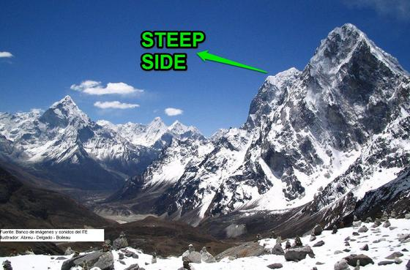

Slide 12


Slide 13


Slide 14


Slide 15


Slide 16


Slide 17


