Slide 1

‘The physiotherapy offer to health and care challenges’
Karen Middleton
Chief Executive, The Chartered Society of Physiotherapy
Twitter: @KMiddletonCSP
'Physiotherapy: This is what WE can do for YOU!'

Slide 2
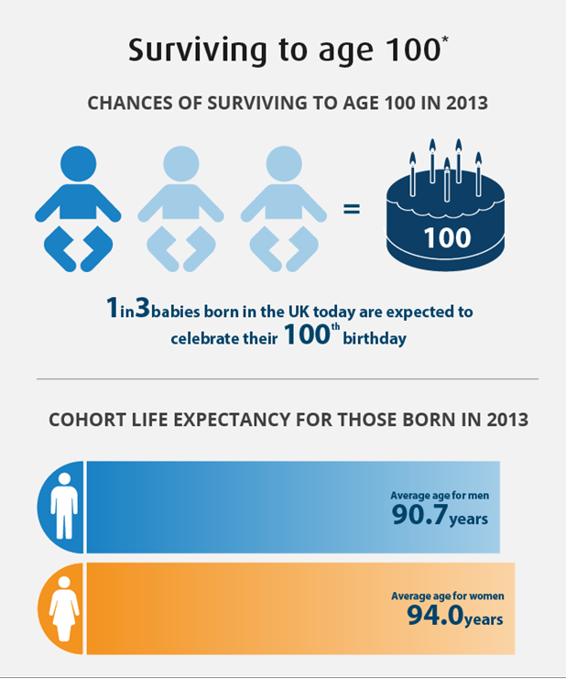
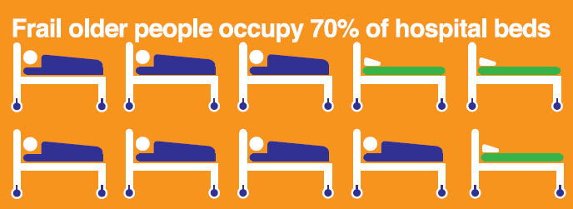
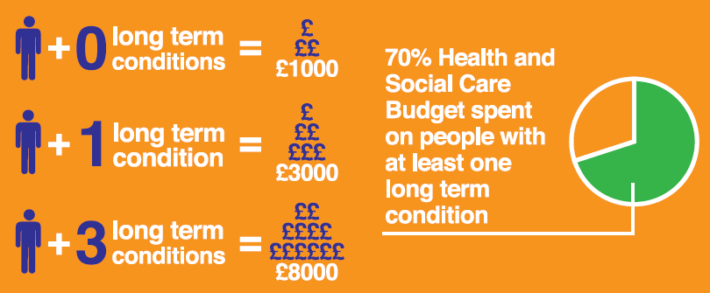
Changing Population
Notes:
Cost effectiveness challenge not just due to financial austerity, in the longer term it is needed due to aging population and increased prevalence of long term conditions (better success as preventing mortality but introducing more morbidity into general population...e.g. More people living with cancer). Since it’s inception the NHS has been a cost constrained, tax payer funded health service for the public. The pot of money has always been finite. Need to “think like a patient, act like a tax payer”.
NOW
Number of people over 85 years old has doubled in the past three decades
People over 65 account for 51% of gross local authority spending on adult social care
> 65 yr olds account for 2/3 of primary care prescribing costs
70% of health and social care spending on long term conditions
FUTURE
Centenarians (>100) will continue to be fastest growing population age group
Those born today can expect to retire at 77
By 2030 1/3 workforce will be over 50
By 2030 ½ population will be over 50
4% year on year increase in demand for health services. Typically, 3% met up increased funding and 1% from efficiencies. Currently 1% met by funding and 3% met by efficiencies (Stephen Dorrell)
The longer we keep people alive the more expensive it might be
Increasing cost of healthcare in environment of increasing financial restraint
The UK can not afford the cost of increasing demand on healthcare
STEVE CAN WE INSERT AN INFOGRAPHIC?????? (downloadable not CSP produced)
HOWEVER....physios – the more we contribute to living well the less resources/demand will be required...needs a change to make this happen
Living longer: living well
“Think like a patient act like a tax payer”. Simon Stevens

Slide 3


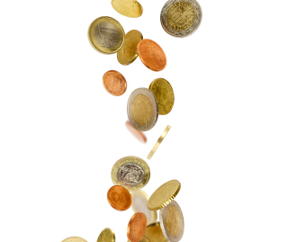
NHS needs at least £200m to avert winter crisis, says trade body
Financially struggling CCG has 'no plan' to hit deficit target
Tory government quietly doubles number of NHS properties it is selling off
NHS England’s plan to introduce hospital referral reviews shows how the service has been reduced to nothing more than a skeleton
Secret NHS cost-cutting plans sound 'death knell' for British healthcare, warn campaigners
NHS trusts may have held their own in Q1, but risks are growing
Trusts hit by £500m unexpected inflation costs
Revealed: The NHS trusts falling well short of financial plans
NHSI investigates trust over financial governance concerns
Notes:
Some example headlines from September 2017
Describing which ever is the most pressing financial issue of the day/week/month. NHS is underfunded but it’s always been cost constrained. There is a social responsibility for the whole workforce to be efficient and effective.

Slide 4
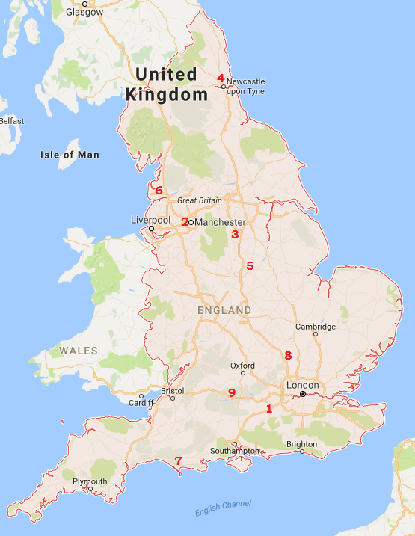
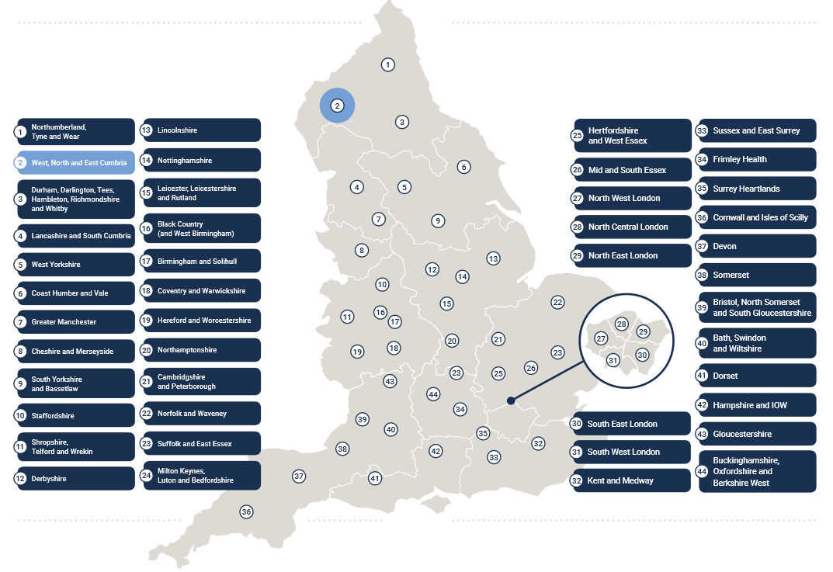
STPs & Accountable Care Systems
Notes:
National Policy – to transition to STP model and Accountable Care Systems.
Image to the left, shows 44 STPs. Image to the right shows 9 Accountable care system STPs
STPs in this region
Sussex & East Surrey
Frimley Health (Accountable Care System)
Surrey Heartlands
Hampshire and IOW
Buckinghamshire, Oxfordshire and West Berkshire (Accountable Care System)
So TWO accountable care systems on this patch.
An ACS brings together a number of providers to take responsibility for the cost and quality of care for a defined population within an agreed budget. ACS take many different forms ranging from fully integrated systems to looser alliances and networks of hospitals, medical groups and other providers.
ACSs have attracted interest as one way of overcoming fragmented responsibility for the commissioning and provision of care in the NHS. They are a practical expression of ‘place-based’ working under which NHS organisations and their partners agree to collaborate in order to meet the needs of the population they serve.
****P&D new ways of working in response to external environment changes and member need.****

Slide 5
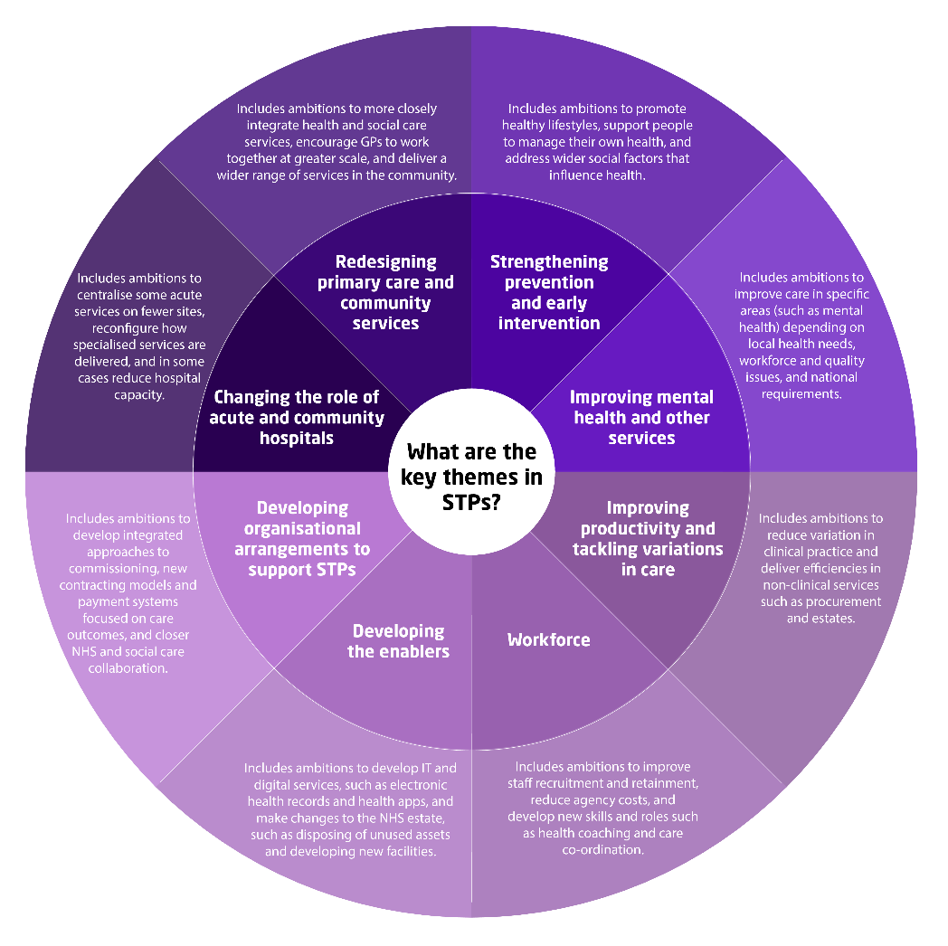
Enhancing physio roles as part of #TeamGP in primary care
Providing preventative services, such as falls prevention and physical activity interventions
Providing services closer to home, including in primary care, digital consultations and through virtual wards and community services
Committed and capable at leading quality improvement programmes across health, care and mental health systems.
Working across boundaries, providing early supported discharge and integrated models of care
Reducing variation through EBP; reducing dependence, increasing resilience and expediting care
Making best use of new technology, e.g. telehealth. Developing bio-psychosocial electronic health records
Developing skills and roles based on the needs of the system, e.g. first contact practitioner, prescribing, advanced ventilation skills
Notes:
Broad goals of STPs and high level examples of physio offers to each theme.
Redesiging primary care and community services
Strengthening prevention and early intervention
Improving mental health and other services
Improving productivity and tackling variation in care
Workforce
Developing the enables (e.g. digital)
Developing organisational arrangement to support STPs (e.g. ACS/ACO)
Changing the role of the acute and community hospitals

Slide 6
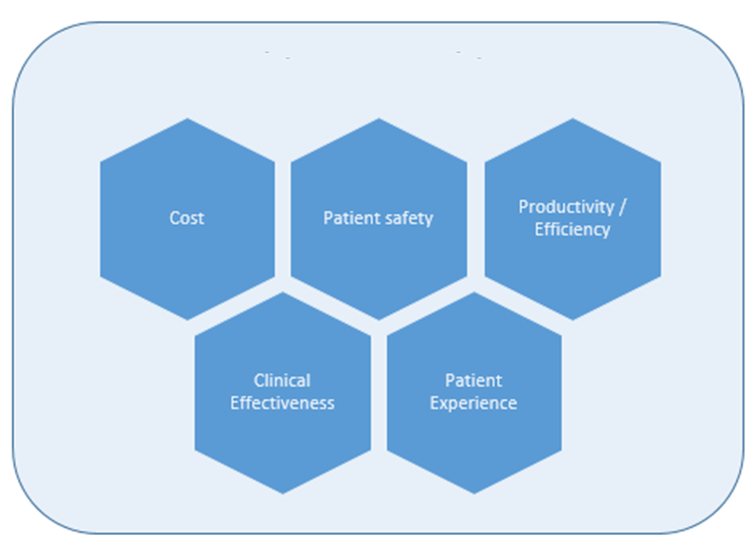
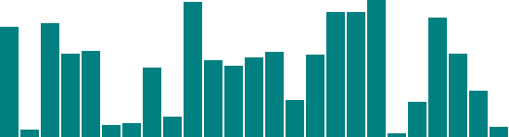
Unwarranted variation
Notes:
Meeting the challenge of unwarranted variation through evidence based practice. CSP using Valuable Productivity model to help members engage with reducing variation and improving system design. Physiotherapists have a contribution to all these domains.
Unwarranted variation in:
Cost effectiveness
Patient safety
Clinical effectiveness
Patient experience
Productivity
CSP working with national stakeholders around managing unwarranted variation include:
RightCare
GIRFT
NHS Improvement – Model Hospital
CSP Hip Sprint Audit work
The CSP has commissioned the Royal College of Physicians (RCP) to undertake a sprint audit of hip fracture rehabilitation services throughout England and Wales as part of the existing work of the National Hip Fracture Database (NHFD).

Slide 7
Physiotherapy’s Offer
Breadth and depth of qualifying training
Strong foundations in the ‘medical model’ but also the ‘bio-psychosocial model’ of care
First contact diagnosticians & practitioners
Perform essential diagnostic & therapeutic roles
Work across healthcare spectrum (NHS & private practice)
Work throughout the wellbeing-illness-rehab spectrum
Independent prescribers
Increasing resilience, reducing dependence, expediting care

Slide 8
The challenges facing primary care
AGING AND GROWING POPULATION
The number of people over the age of 85 in the UK is predicted to double in the next 20 years ⁽²⁾
INCREASING RISK FACTORS
By 2050 60% of adult men and 50% of women are predicted to be obese
INCREASING COMPLEXITY
Patients with multi-morbidity account for 8 in 10 primary care consultations⁽¹⁾
RAISED CITIZEN EXPECTATIONS
WORKFORCE SHORTAGE
5000 GPs needed by 2020 plus 20% GPs due to retire in next 10 years

Slide 9
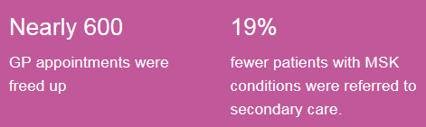
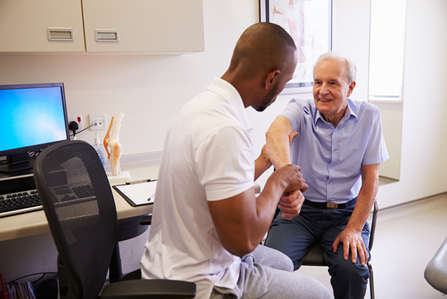
Cumbria: a new physiotherapy role in Primary Care
A physiotherapy service provides direct access to a specialist MSK physiotherapist for assessment, investigations as appropriate, injection if indicated and triage into secondary care/ allied health professions where needed
The pilot saved nearly 600 GP appointments and delivered cost savings from reduction in investigations, such as MRI
The GP physio role has reduced the referral rate to secondary care by 20%. This is a great saving for the practice as it costs £132 per new referral into orthopaedics.
www.csp.org.uk/primarycare
Notes:
Musculoskeletal related problems make up almost 30% of General Practitioners caseload taking up a considerable amount of GP consultation time
The Windemere service which you’ve visted.

Slide 10
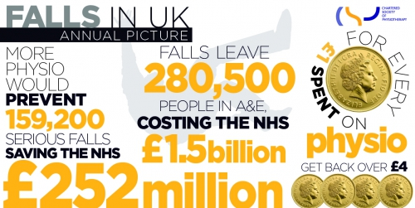
Falls prevention
Notes:
Consistent priority in NHS services.
Across the UK every year 280,000 people end up in A&E after a fall, costing the NHS £1.5 billion
If everyone 65+ at risk of falling was referred to physiotherapy 160,000 falls would be prevented, saving the NHS £250 million every year
Every £1 spent on physiotherapy produces a return on investment of over £4.00
Physiotherapy saves money and helps older people to enjoy an active life

Slide 11
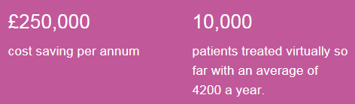
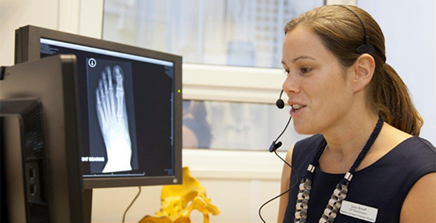
Virtual Clinic for the Orthopaedic Fracture Clinic (Brighton and Sussex University Hospitals NHS Trust)
Specialist physiotherapist Lucy Arnott:
“For simple fractures, we are able to offer phone advice about rehabilitation and email over specific videos and information to help with the patient’s recovery.
For those with more complicated problems who have to come in again, we can make sure they get a specific appointment with the right specialist or physiotherapist”
Notes:
Over three years, the clinic has managed over 8,500 patients, with specialist physiotherapists assessing X-rays online to make a decision on the next steps of care.
The clinic has meant patients who were treated in A&E with a broken bone no longer have to come to hospital for face-to-face assessment. As well as the benefits to patient care, over three years the clinic has also saved the Trust £558,000.
Specialist physiotherapist Lucy Arnott said: “For simple fractures, we are able to offer phone advice about rehabilitation and email over specific videos and information to help with the patient’s recovery.
“For those with more complicated problems who have to come in again, we can make sure they get a specific appointment with the right specialist or physiotherapist.
“This cuts right down the number of times patients have to come in and is making a real difference.
“We developed the project as a way of improving patient care but it has also had the added benefit of cutting down on costs.
“The basic cost of a new patient attending the fracture clinic is about £128 but the cost for a virtual clinic is just £64. It has been working out really well and everyone is benefitting.”
Over a one year period, just 36 per cent of patients referred to the virtual fracture clinic needed a follow up appointment with a consultant and six per cent needed a specialist physiotherapist.

Slide 12
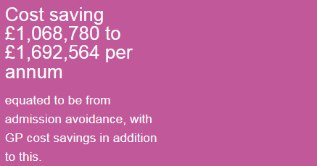
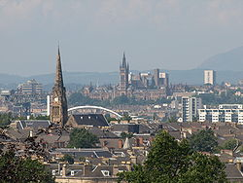
Glasgow community rehabilitation team (respiratory)
A city wide physiotherapy-led multidisciplinary team
Provide specialist input: breathlessness management
airway clearance techniques
optimisation of inhaled therapies
anxiety management
equipment provision and practice of daily tasks
home pulmonary rehabilitation, medication review
signposting to community and third sector services
Notes:
Previous initial pilot in the NW of Glasgow city demonstrated a reduction in hospital admission by 60% in small cohort of patients (60) one year post intervention Current data being collated demonstrates an ingoing reduction in COPD admissions across the city.
We estimated our cost-savings on national data; the cost of an average length of stay in hospital for COPD patients in Glasgow⁸was £3,000 and across Scotland, the cost of an inpatient spell within a speciality for someone with COPD ranges from £1,895 to £3001 depending on the severity and any co morbidities (SIMD 2013/2014⁹).
The total cost of the city wide physiotherapy lead multidisciplinary team is
£605,000 per year.
On average 12 patients per month at risk of hospital admission are referred into the Community Respiratory Team mainly through their GP and are maintained in the community. Therefore, an anticipated potential annual cost saving of between £272,880- £432,144 can therefore be predicted due to an avoidance of a hospital admissions. In addition to this figures, now that the service is established known patients to the service who have an acute exacerbation now self refer for support in the community as admission avoidance. In a given month this can approximate 35 patients which equates to £66, 325 to £105,035 per month.
In conclusion the total cost saving looking is equated to be £1,068,780 to £1, 692,564 per annum from admission avoidance, with GP cost savings in addition to this. The current cost of the MDT is £605, 000 annual savings of £463,780 to £1,087,564 per annum.

Slide 13
Physical Activity and obesity services
Activ8 Physiotherapy and Dietician led service for overweight and obese children
  Exercise and nutrition group for 10 weeks
  Data for the service showed an impressive 70 per cent of children participating had a reduction in BMI, which was maintained at six-month follow-up and in the second year of the programme.
Ashton, Wigan and Leigh Specialist Weight Management Service (Lose Weight, Feel Great)
Physiotherapy led weight management service has shown that 69.4% of people who complete 6 months are maintaining or losing weight.
In addition 96.5% improve/maintain physical activity levels, and 88.2% improve/maintain, measuring quality of life / psychological health.

Slide 14
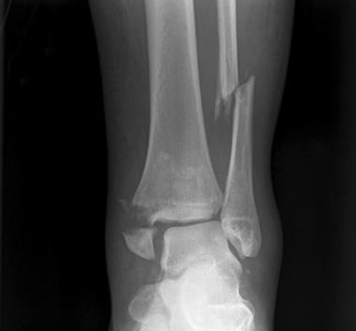
£32 per patient cost saving
Salford Royal NHS Foundation Trust treats 88,500 Accident and Emergency patients per year.
An advanced physiotherapy practitioner post was established for people attending A&E with musculoskeletal injuries.
The role includes ordering and interpreting investigations such as X-rays and blood tests and onward referral for further physiotherapy if required.
Evaluation has shown:
increased service efficiency and care quality
patients are provided with immediate access to expert physiotherapy advice and treatment, and waiting times have been lowered
reduced requirement for more expensive medical staff has resulted in cost savings of £32 per patient - a 60% reduction
patient flow through A&E has been improved and staff have reported better knowledge sharing between members of the multi-disciplinary team.

Slide 15

@CSPsouthcentral HELPING
YOU!
#physioworks

Slide 16

Evidence matters
LEAD: Leadership Exploration, Advocacy & Development
Our Digital Movement
Your service, your improvement
Notes:
Opportunity to learn and experience more about this a Physiotherapy UK 2017
World class content and CPD
The diverse UK physiotherapy community coming together
Unbeatable networking
Opportunity to network and learn about innovation and change.

Slide 17

Notes:
RECRUITING FOR LEADERSHIP PROGRAMME IN SOUTH CENTRAL REGION
Following the success of this year’s Leadership Development Programme (LDP), we are delighted to announce the recruitment of cohorts three and four, for the 2018 programme. The programme will run with two cohorts (up to 24 people in each) in the South Central and North West regions. The LDP is a 10-month modular programme, delivered using a variety of provoking, engaging and fun learning methods to allow you to learn from the programme team, yourself and your cohort colleagues.
To be eligible for a place on the programme you will need to:
wish to develop specific leadership skills and behaviours to achieve more from your current role
lead or manage people and/or services but have not had formal development in these fields
be a CSP member working in the South Central
contribute to services delivered in the community (you may be employed in an acute, private or other organisation, but patients will receive your services in non-hospital settings. This includes members working across primary, secondary and tertiary care boundaries e.g. outreaching into the community)
have the approval of your employer to undertake the programme
have the appetite and interest in spending time (some of it your own) on this important CPD
have the willingness to try new ways of thinking and operating in the workplace whether independent, NHS or private sector
For more information and details on how to apply, please visit www.csp.org.uk/LDP
Application deadline: 17:00 on Friday 13th October 2017.
Successful applicants will be invited to interview.

