Slide 1
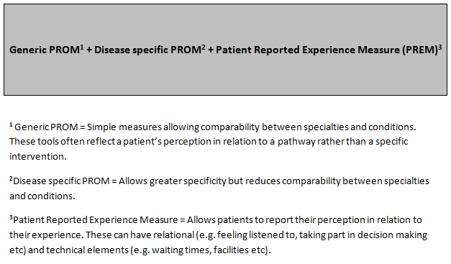
CSP recommendation for routine collection

Slide 2
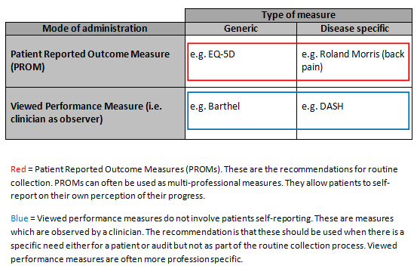
How to use the outcomes templates:

